Slide 1
Inorganic chemistry in ferrocene
N . Santhi
Dept of PG chemistry

Slide 2
The carbon atoms of the ring are Equidistant and lie on the same plane and the ligands shows aromaticity
The strong affinity of metals towards cp ligand is reflected by the formation of many other metallocenes even when the 18e rule is not obeyed
Metal Cyclopentadienyl chemically began in early 1950”s with discovery of ferrocene which was shown to have a novel SANDWICH STRUCTURE with all the carbon atoms of both the cp rings within bonding distance of metal atom
Cp- has 6πe- (4n+2) huckel aromatic very stable, resonance stabilised.

Slide 3
Thus cp as a ligand is primarily ionic and e- rich in nature it acts as lewis base
Synthesis:
From a source of cp-:
FeCl2+2Nacp → Fe(cp)2+2Nacl
Reaction of metal halides with cp in presence of base like dienylamine:
FeCl2+2C5H6+2Et2NH →Fe(C5H5)2+2Et2NH2Cl-
Reaction of cp with metals(or) its carbonyls
2C5H6+Fe → Fe(C5H5)2+H2
Fe(CO)5+C10H12 → Fe(C5H5)2(CO)2.

Slide 4
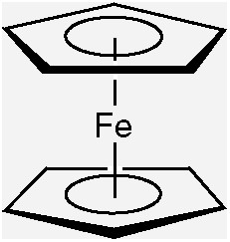
Classification:
The derivatives of cp can be classified as 3 types
i)M(CP)2-Sandwich type derivative
ii)CPMLx-Half sandwich
iii)(CP)2MLx-Bent metallocenes or Tilted sandwich
Sandwich type:

Slide 5
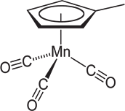
The two rings of metallocenes may be parallel
These are may be either Eclipsed or Staggard in their orientation
Staggard is more stable than the Eclipsed it is common even at low temperature but Eclipse possible only at particular cases
Half Sandwich type

Slide 6
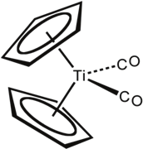
Tilted Sandwich
Structure &Bonding:
The valence bond representation of the cp anion is a resonance hybrid of 5 energetically equivalent structures

Slide 7
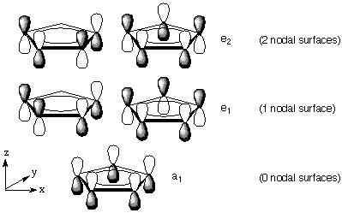
The simplest approach to illustrate the nature of bonding in ferrocene is V.B.T with the help of which one can makes prediction about the molecular geometry of metal complex in terms of number and type of metal orbitals available for bonding
Two alternative formulation of bonding in ferrocene

Slide 8
This geometry confirmed by X-ray and e- diffraction technique
On MO theory sp orbitals are available for orbital formation linear combination of which can give rise to 3bonding and 2antibonding molecular orbitals
The most strongly bonding π orbital is the one in which all 5 orbitals overlap on the side of the ring they have the same sign this is designated as A
At slightly higher energy there is a doubly degenerate set of MO(E1)each of which has one nodal Plane.
This is followed by another doubly degenerate set of MO with two nodal planes at higher energy

Slide 9
In an LCAO MO treatment of bonding in metallocenes the atomic orbitals of metal ion are grouped symmetry for ferrocene the metal orbitals are designated as
S,dz2→a1g Pz →a2u
dxz,dyz →e1g Px,Py →e1u
dxy,dx2-y2 →e2g
Ligand group orbitals can be categorised in three sets
a1g&a2u →Ψ1 filled set
e1g &e1u →Ψ2,Ψ3 filled set
e2g&e2u →Ψ4,Ψ5 unfilled set
Interaction of metal orbitals with ligand orbitals having sigma bonding through Ψ1;π bonding through Ψ2,Ψ3 and antibonding through Ψ4 andΨ5

Slide 10
The e1g of metal have been found to be interact with cp ligand group orbital of a1g,e1u,a2u three bonds are most stabilised.
The anti bonding eg on ligand orbital interact with metal e2g producing slightly bonding molecular orbital
In ferrocene all the molecular orbitals of lowest energy are occupied by electrons is the most stable metallo compounds

Slide 11
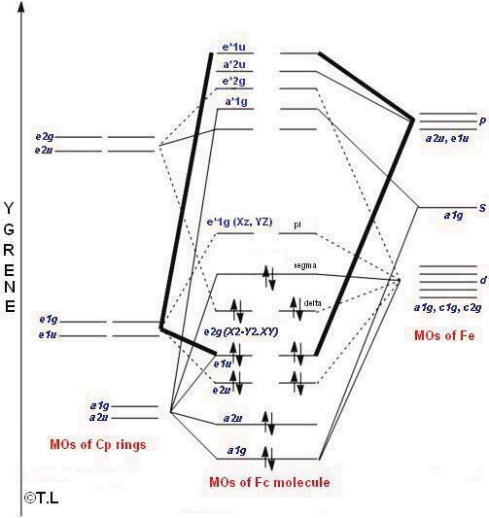

Slide 12
Thank you

