Slide 1
MOLECULAR SYMMETRY AND GROUP THEORY IN CHEMISTRY
B.V.N.K.Sri Devi

Slide 2
MOLECULAR SYMMETRY AND GROUP THEORY IN CHEMISTRY:
Molecular symmetry is a fundamental concept in chemistry that helps to understand the properties and behaviour of molecules. It involves the study of the symmetry elements and operations that describe the symmetry of a molecule. These notes provide an overview of molecular symmetry, including symmetry elements, operations, and their significance.

Slide 3
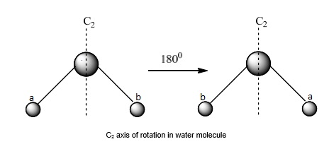
Symmetry Elements
Symmetry elements are geometric entities about which symmetry operations are performed. The main symmetry elements are:
Identity (E):
Every molecule has at least the identity element.
It represents doing nothing to the molecule.
Axis of Rotation (Cn):
A rotation about an axis by 360∘/n​ leaves the molecule unchanged.
n is the order of the axis.
Example:C2​ axis involves a 180° rotation.

Slide 4
Ammonia (NH₃)
Symmetry Elements:
Ammonia has a C3C_3C3​ axis of rotation.
Description:
The molecule can be rotated by 120° (or 240°) around an axis passing through the nitrogen atom and perpendicular to the plane of the hydrogen atoms.
After such a rotation, the molecule appears indistinguishable from its original orientation.
2. Benzene (C₆H₆)
Symmetry Elements:
Benzene has a C6 axis of rotation.
Description:
The benzene molecule can be rotated by 60° (or multiples of 60°) around an axis passing through the center of the ring and perpendicular to the plane of the ring.
After each 60° rotation, the molecule appears unchanged.

Slide 5
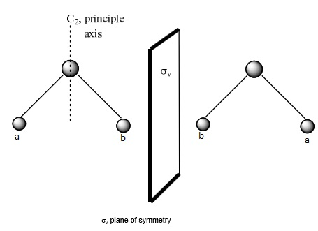
Plane of Symmetry (σ):
A reflection through a plane leaves the molecule unchanged.
Types:
σh​: Horizontal plane (perpendicular to the principal axis).
σv​: Vertical plane (contains the principal axis).
σd​: Dihedral plane (bisects the angle between two C2 axes).

Slide 6
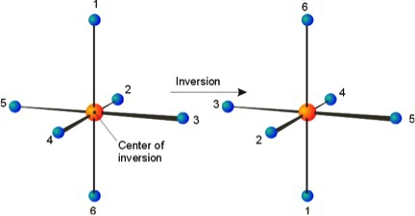
Center of Inversion (i):
Inversion through a point at the center of the molecule leaves the molecule unchanged.

Slide 7
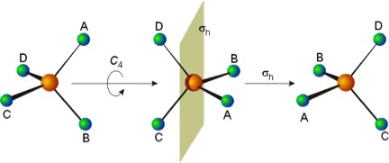
Improper Axis of Rotation (Sn):
A rotation about an axis followed by a reflection through a plane perpendicular to the axis.
Example: S4 involves a 90° rotation followed by reflection.

Slide 8
Symmetry Operations
Symmetry operations are actions that move the molecule in such a way that it appears unchanged. The main symmetry operations are:
Identity (E):
Doing nothing to the molecule.
Rotation (Cn​):
Rotation by 360∘/n about an axis.
Reflection (σ):
Reflection through a symmetry plane.
Inversion (i):
Each point of the molecule is moved through a center of inversion to an
opposite point.
Improper Rotation (Sn​):
Rotation by 360∘/n followed by reflection through a perpendicular plane

Slide 9
THANK YOU

