Slide 1
CHROMATOGRAPHY – I
T.Mounica
Dept of PG chemistry

Slide 2
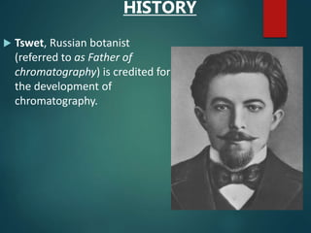

Slide 3
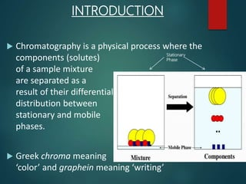

Slide 4
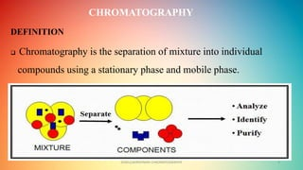

Slide 5
STATIONARY PHASE AND MOBILE PHASE
Stationary phase:-
It gives stability to the molecule or components.
Adsorption of the components takes place on the stationary phase.
Ex:- succrose, starch, alumina, silica, calcium citrate etc..
Mobile phase:-
It gives mobility to the molecule that means dissolution of the components.
Ex:- liquids and gases also acts as mobile phase. benzene, methanol, water, methanol+ water.

Slide 6
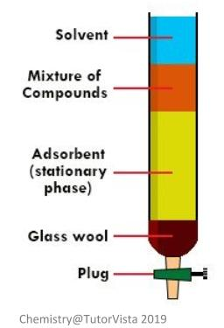

Slide 7
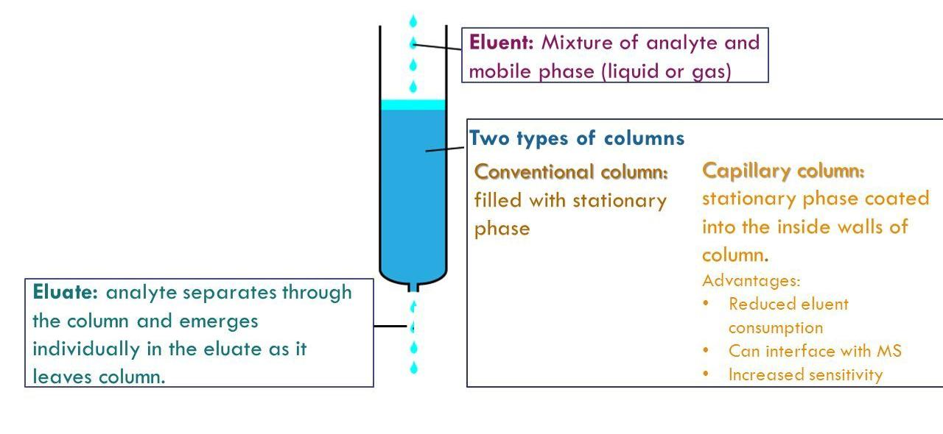
Elution pattern in chromatography techniques

Slide 8
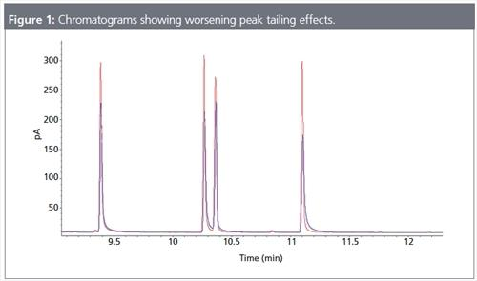

Slide 9
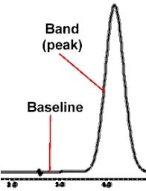
Base line:- The baseline is duration of a chromatogram during which only mobile phase is running through the detector and is the reference point for when measuring the area of any given peak

Slide 10
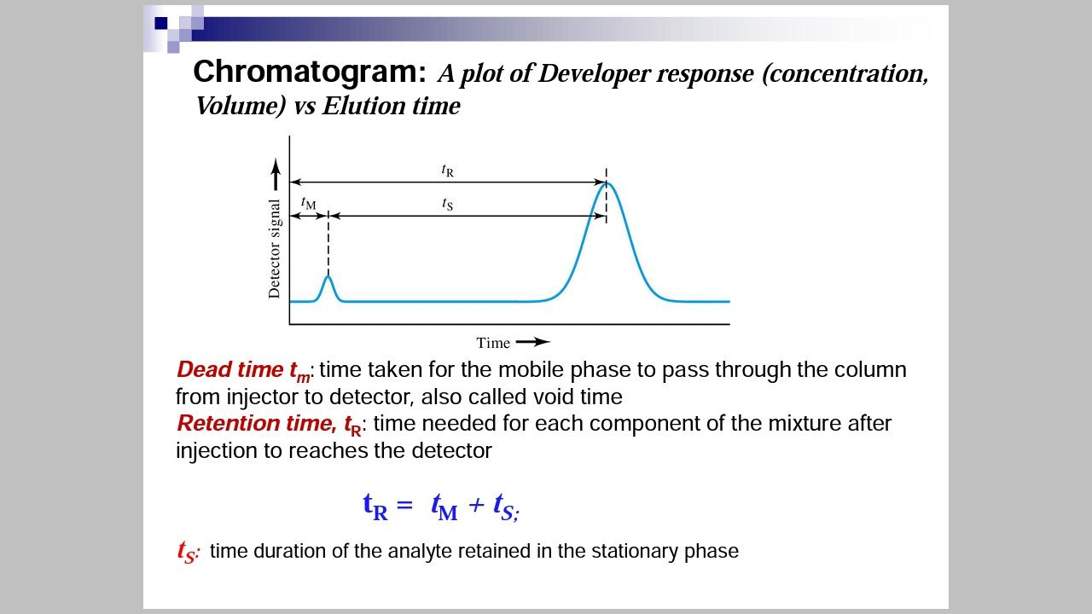

Slide 11
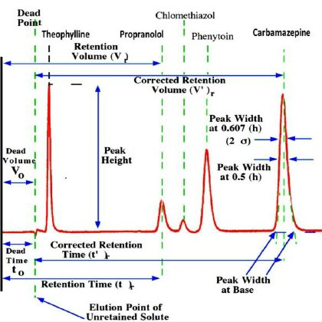

Slide 12
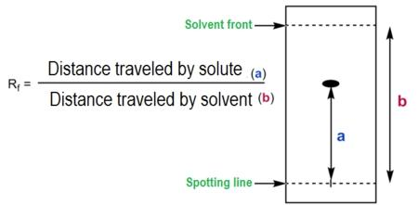
Retardation factor:-

Slide 13
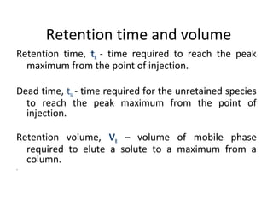

Slide 14
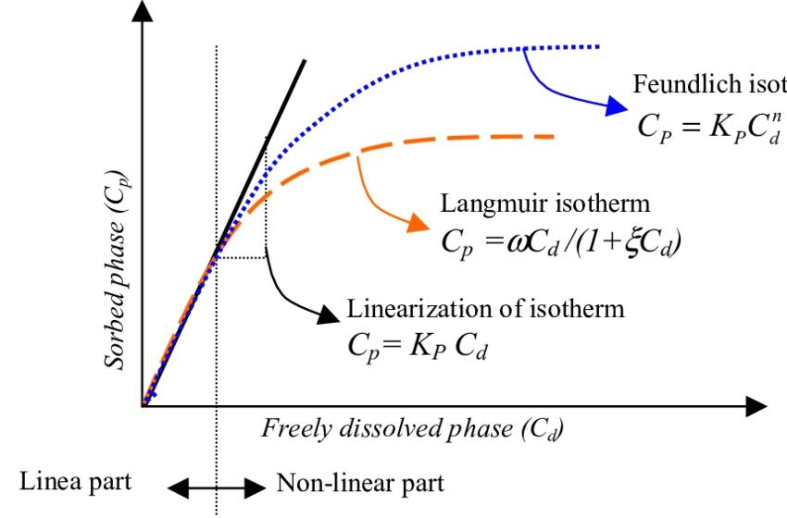
Partition isotherms:-

Slide 15
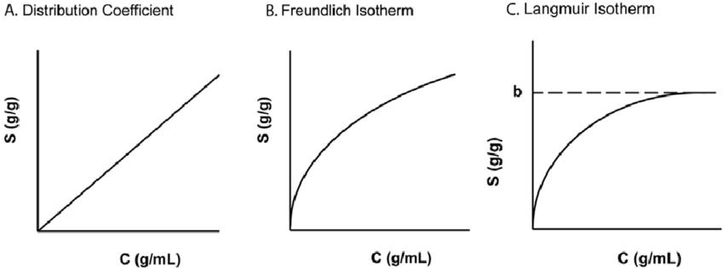

Slide 16
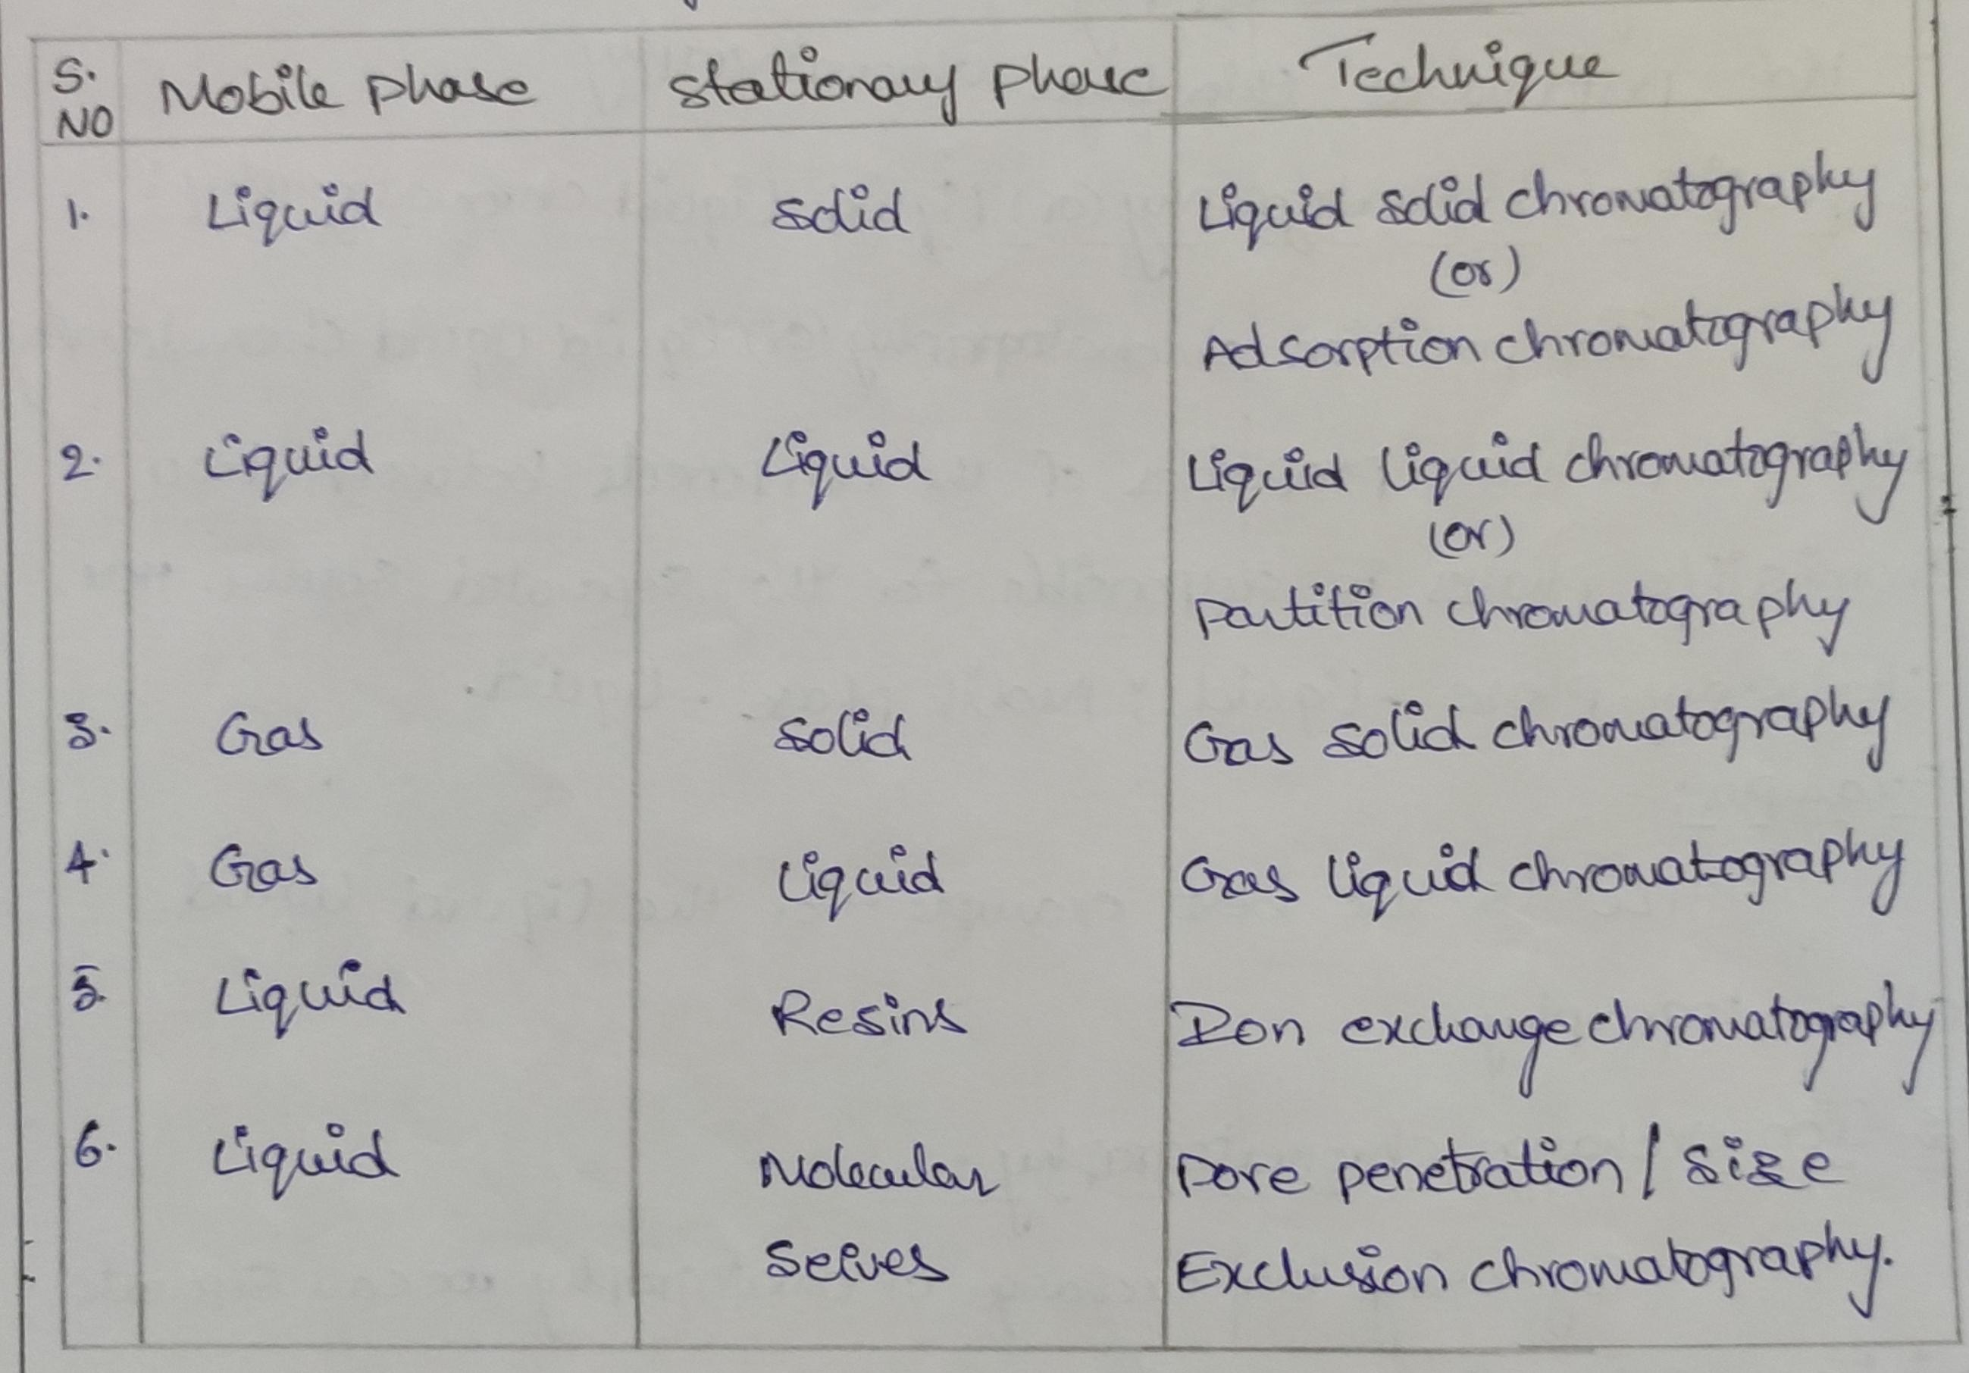
Classification of chromatography

Slide 17
Classification of different chromatographic methods:-
These are classified into four types. Their are
Adsorption chromatography
Partition chromatography
Ion exchange chromatography
Size exclusion chromatography
Adsorption chromatography:-
In adsorption chromatography physical surface attractive forces are responsible for the mixture of components separated into individual components.

Slide 18
Partition chromatography:-
In partition chromatography different partition properties of the components between two immiscible phases is responsible for the separated solutes.
Ion exchange chromatography:-
By using ion exchange chromatography we can separate mixture of ions both captions and anions into individual ions. There are two types. Cation exchange chromatography and Anion exchange chromatography.
Size exclusion chromatography:-
Separation of the components depends on the size and geometry of the molecules.

Slide 19
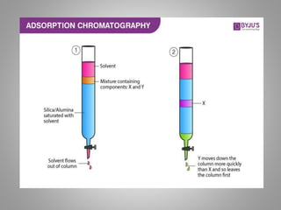

Slide 20
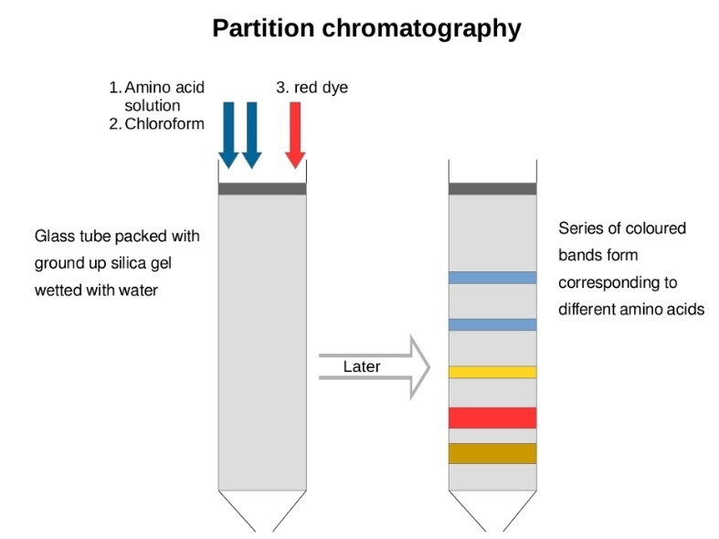

Slide 21
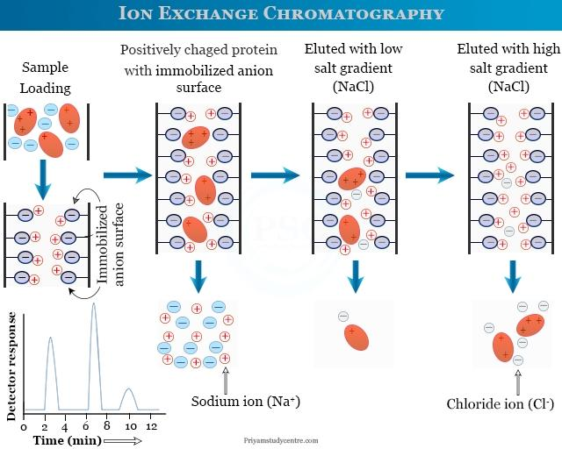

Slide 22
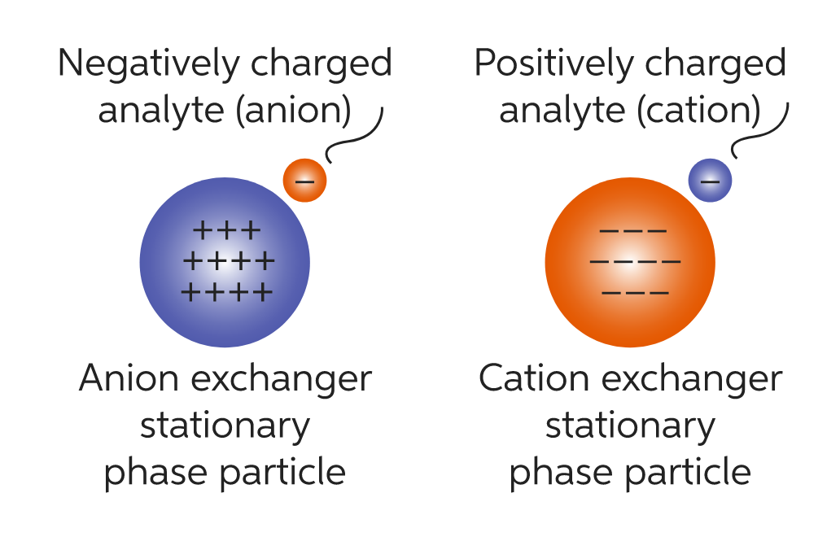

Slide 23
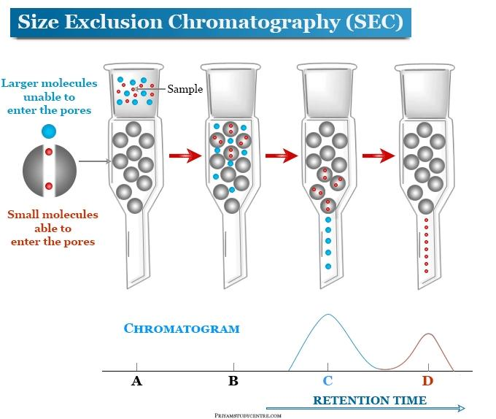

Slide 24
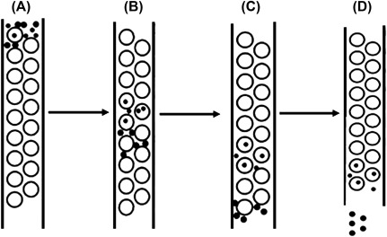
Methods of development techniques in chromatography

Slide 25
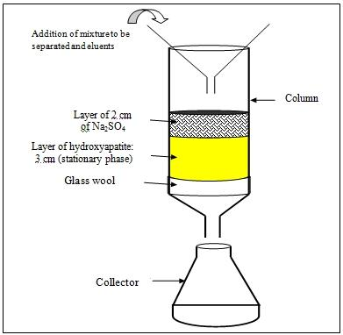

Slide 26
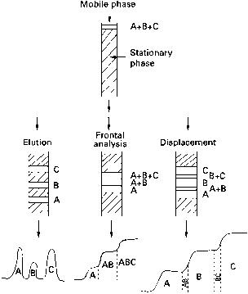

Slide 27
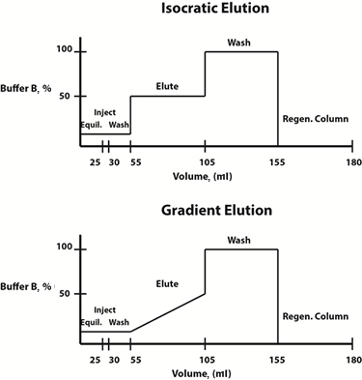

Slide 28
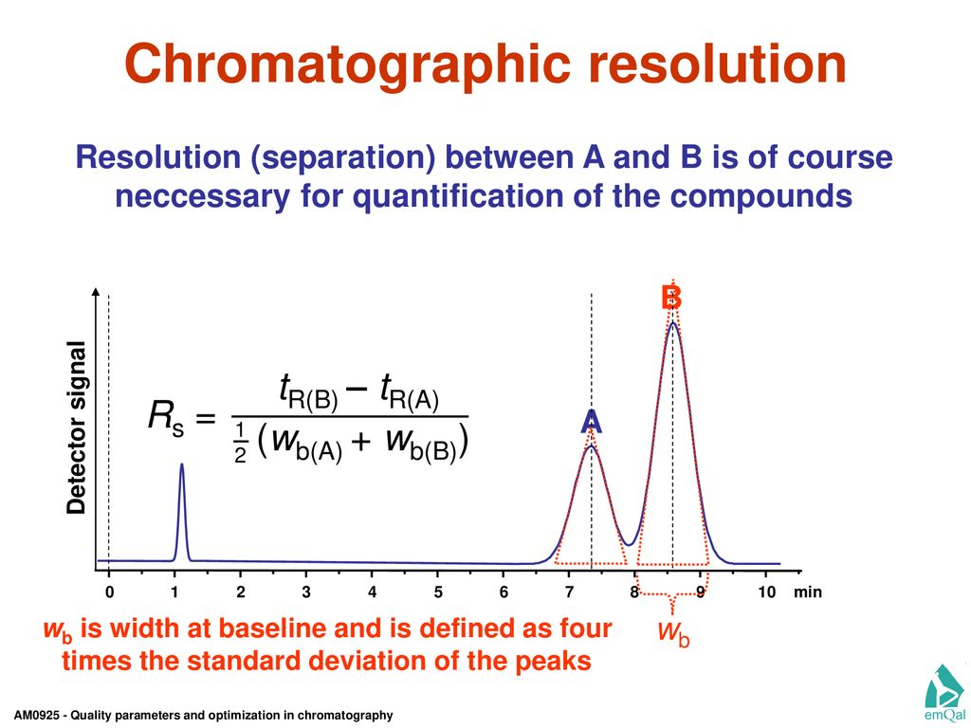
Resolution:-

Slide 29
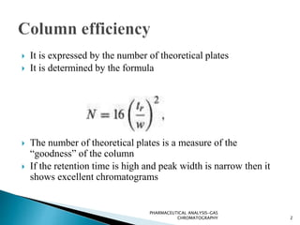

Slide 30
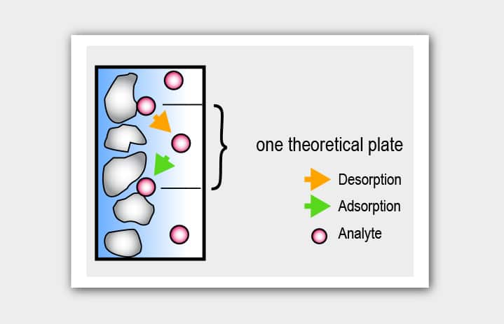

Slide 31
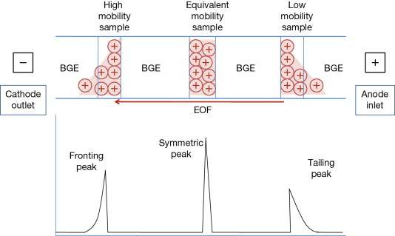

Slide 32
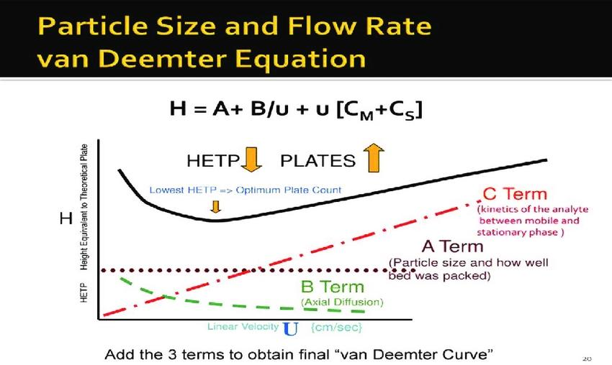

Slide 33
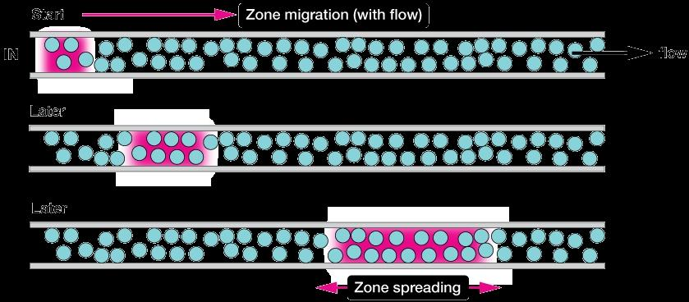

Slide 34
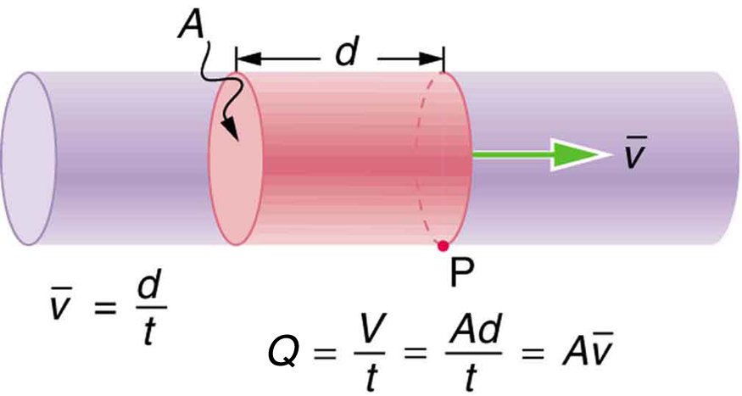
Column length and flow velocity:-

Slide 35
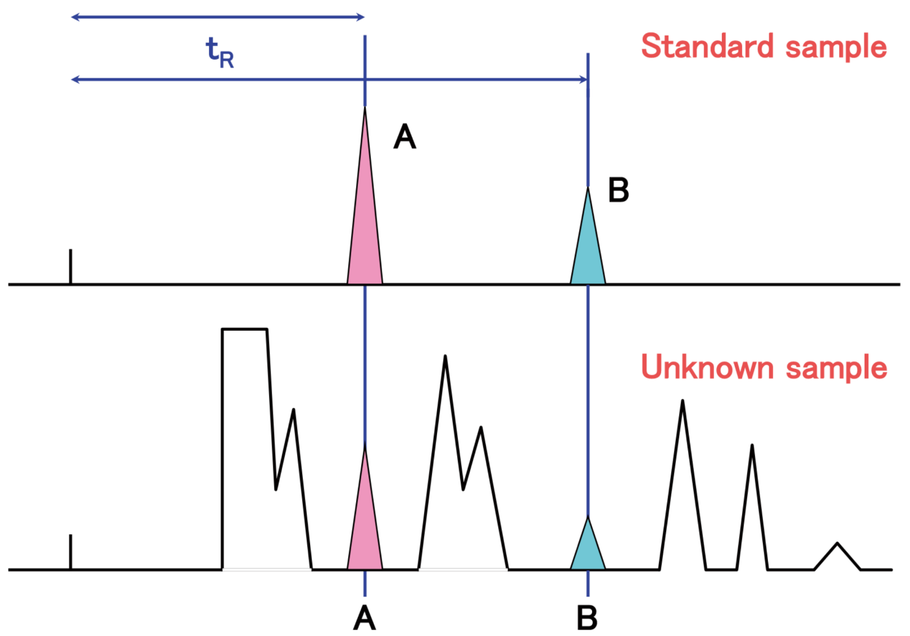
Qualitative and quantitative analysis

Slide 36
THANK YOU

