Slide 1
CHROMATOGRAPHY - II
T.Mounica
Dept of PG chemistry

Slide 2
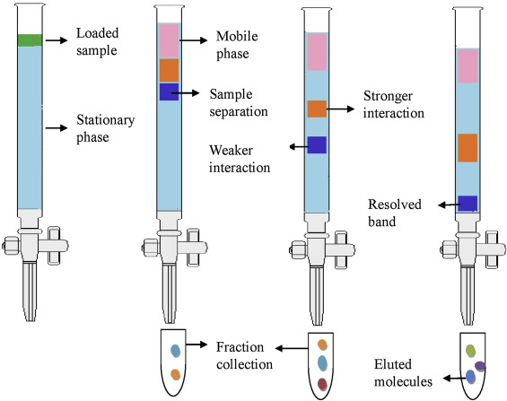
Column chromatography (Adsorption chromatography)
Mixture of components separated into individual components due to different adsorption properties of the components.

Slide 3
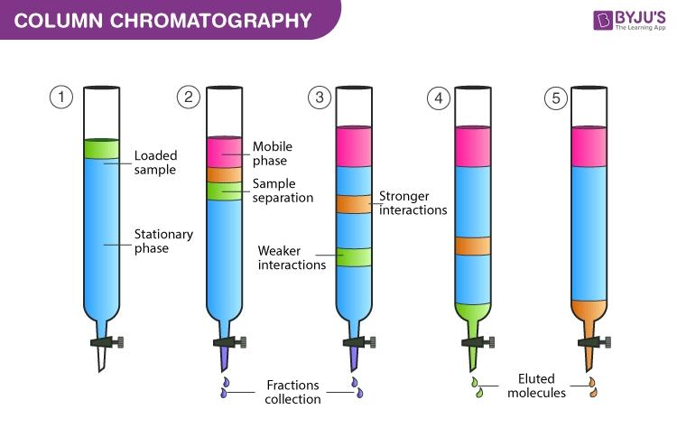

Slide 4
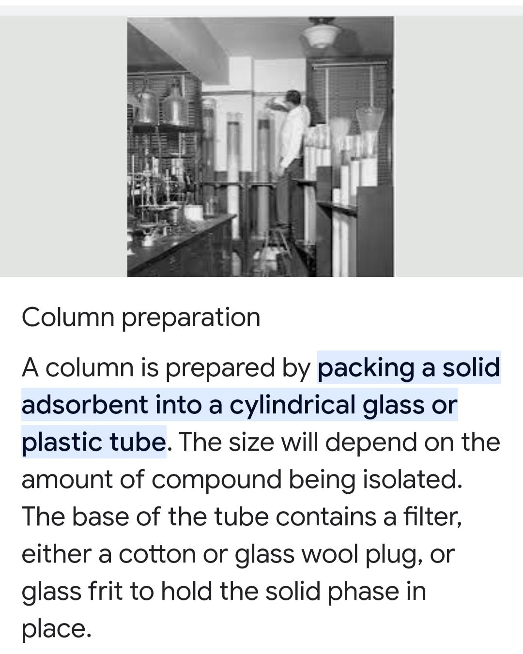

Slide 5
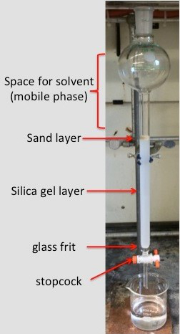

Slide 6
Adsorption isotherms:-
Adsorption isotherms is the relationship between the adsorbate in the liquid phase and the adsorbate adsorbed on the surface of the adsorbent at equilibrium at constant temperature.
An adsorption isotherm is a graph that represent the variation in the amount of adsorbate (x)adsorbed on the surface of the adsorbent with the change in pressure at a constant temperature.
The adsorption isotherms are three types,their are
Linear Adsorption isotherms
Convex Adsorption isotherms
Concave adsorption isotherms

Slide 7
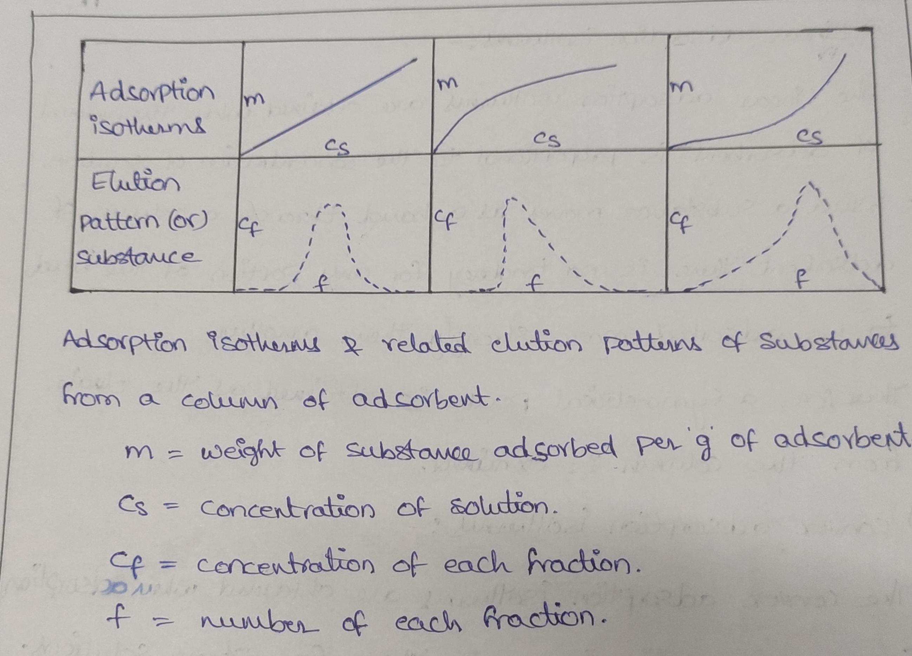

Slide 8
Stationary phase – Adsorbent is the stationary phase in adsorption chromatography. The forces involved help to remove solutes from the adsorbent so that they can move with the mobile phase. Mobile phase – Either a liquid or a gas is used as a mobile phase in adsorption chromatography
The stationary phase is a porous solid (e.g., glass, silica, or alumina) that is packed into a glass or metal tube or that constitutes the walls of an open-tube capillary.

Slide 9
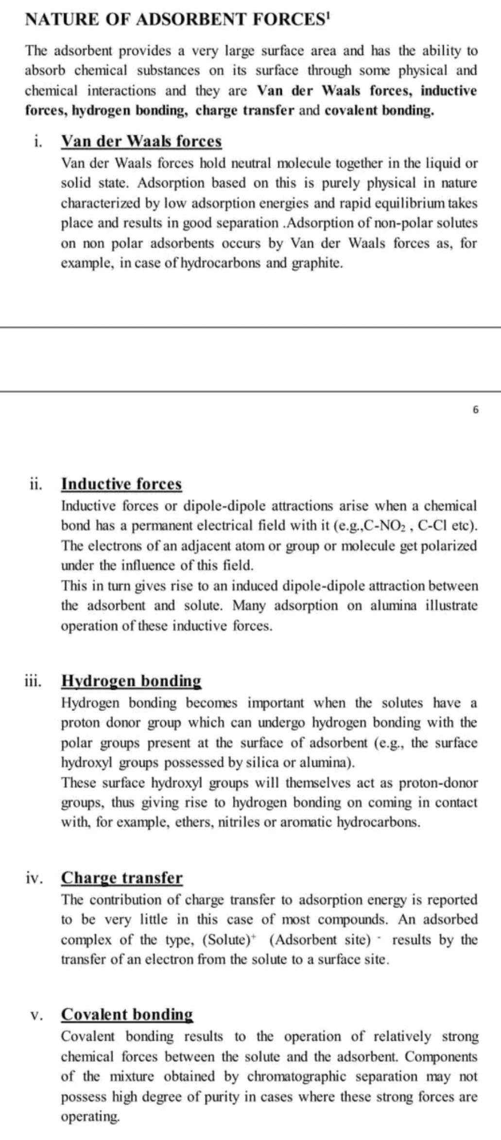

Slide 10
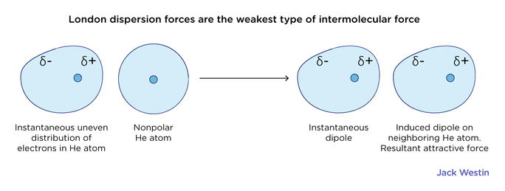

Slide 11
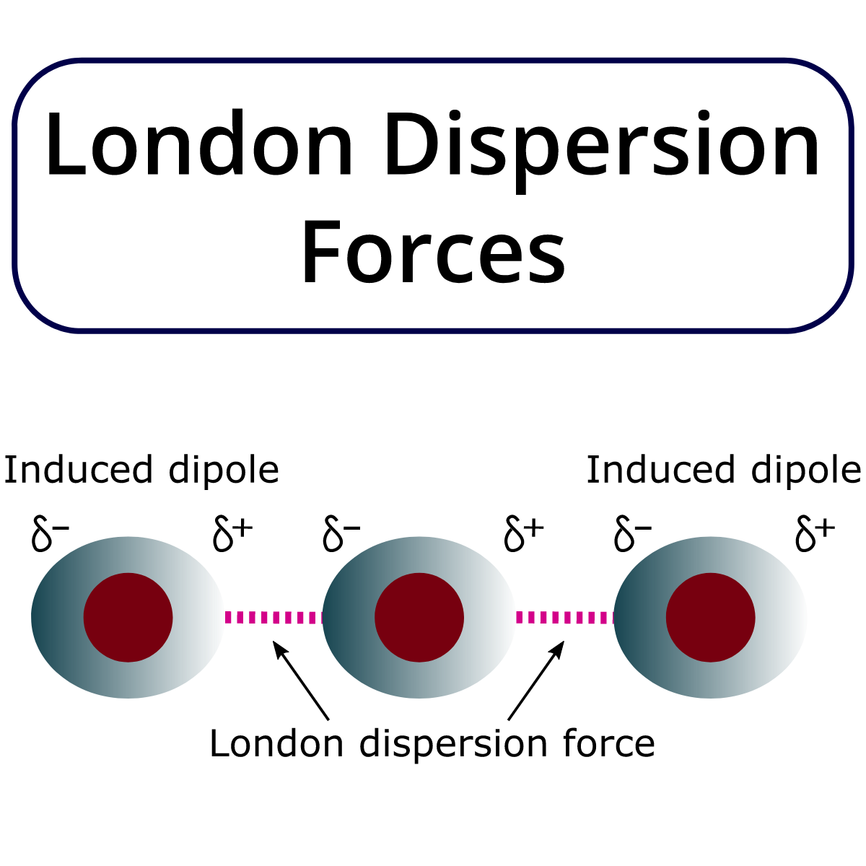

Slide 12
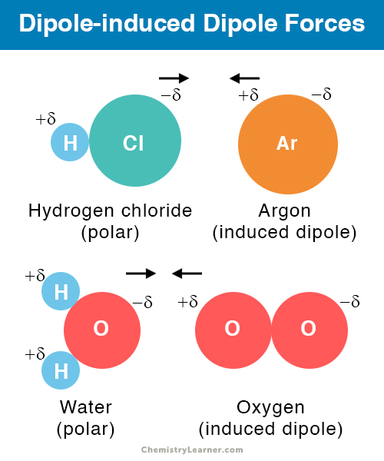

Slide 13
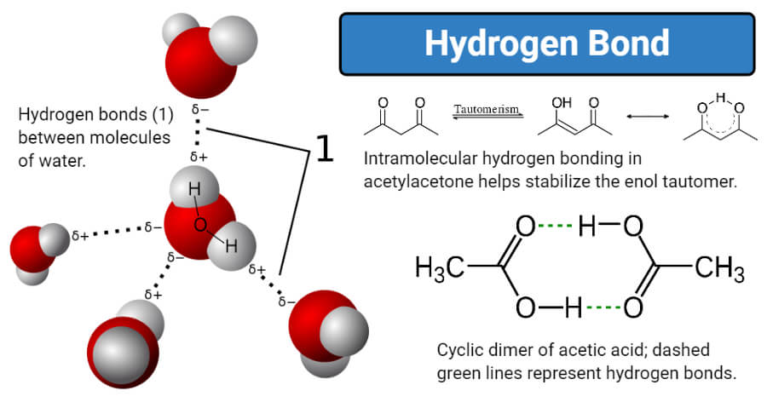

Slide 14
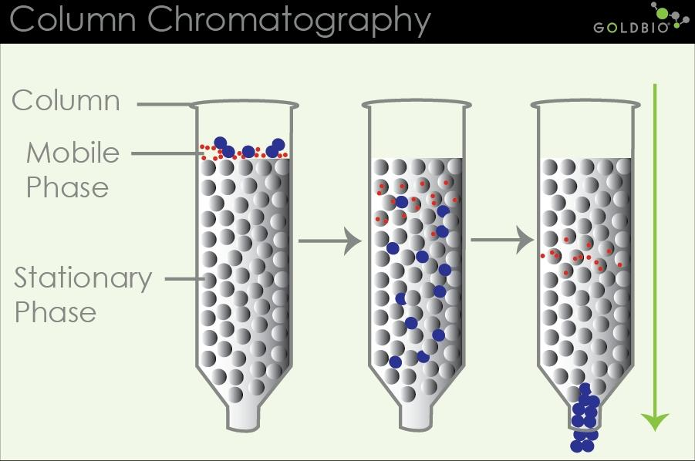
The mobile phase, called the eluent, passes through the column, and this leads to separation of the solute into its components. The outcoming solvent (eluate) from the column is collected in separate fractions, and the compositions are followed using another method. In the case of HPLC, a chromatograph is used.

Slide 15
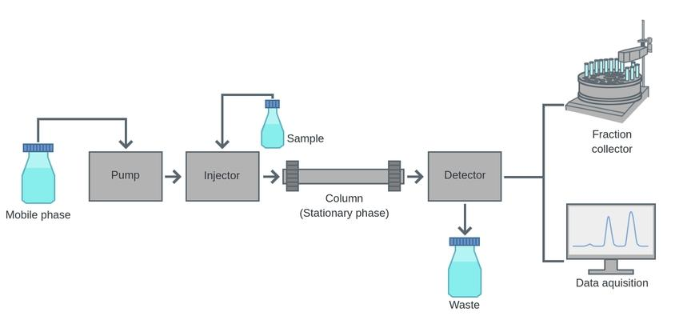
Liquid chromatography

Slide 16
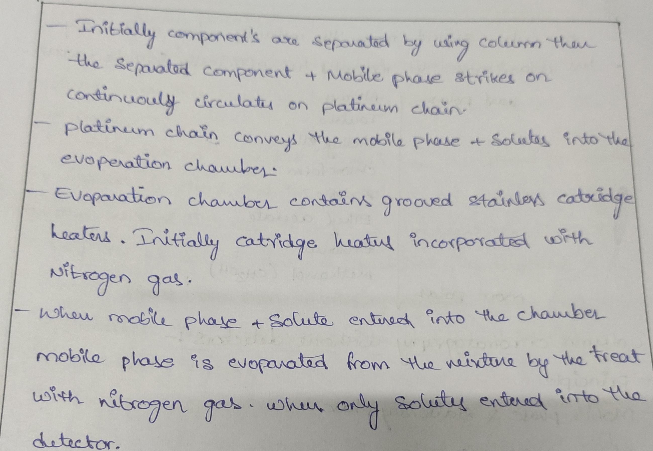

Slide 17
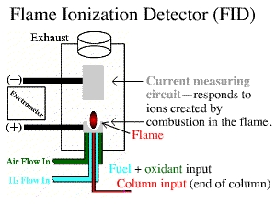

Slide 18
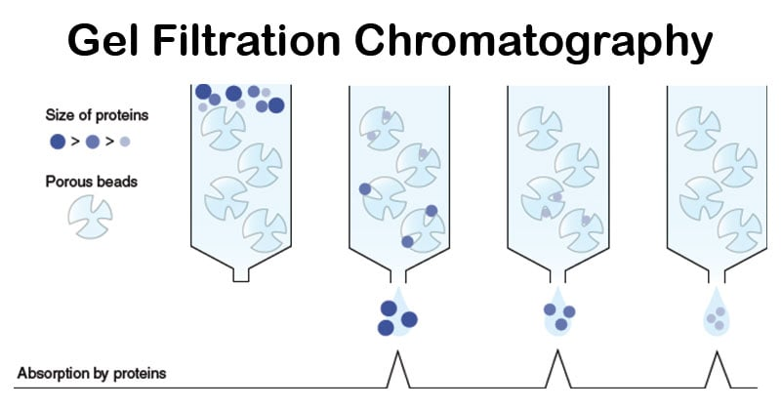

Slide 19
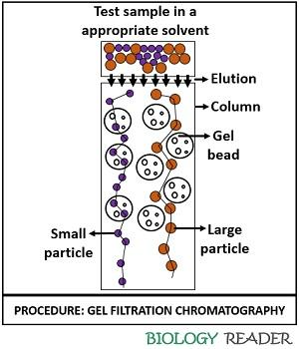

Slide 20
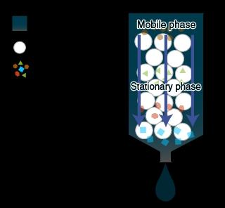
In a gel filtration chromatography column, the stationary phase is composed of a porous matrix, and the mobile phase is the buffer that flows in between the matrix beads. The beads have a defined pore size range, known as the fractionation range.

Slide 21
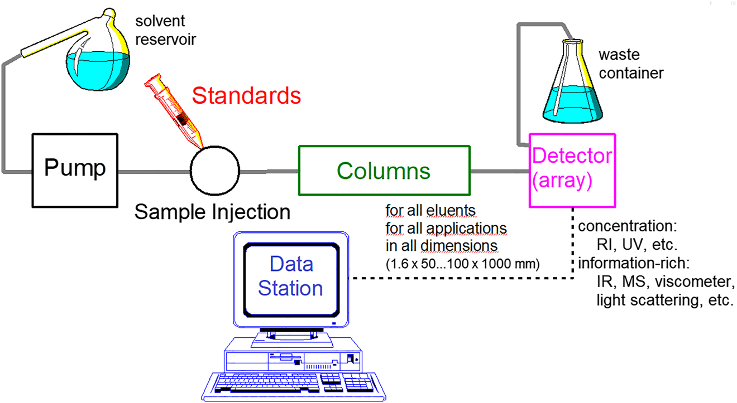
Capillary electrophoresis

Slide 22
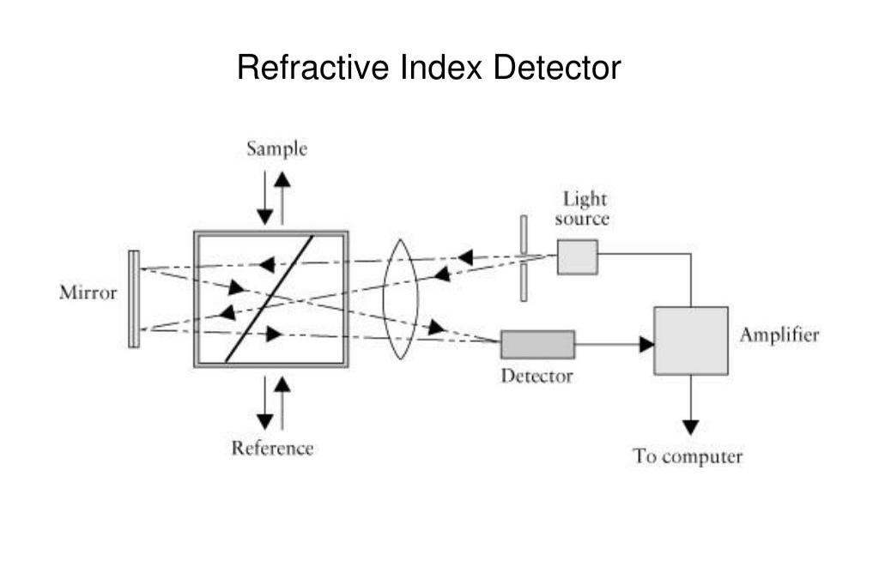

Slide 23
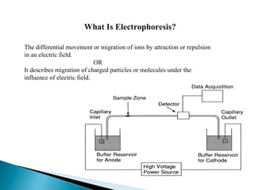

Slide 24
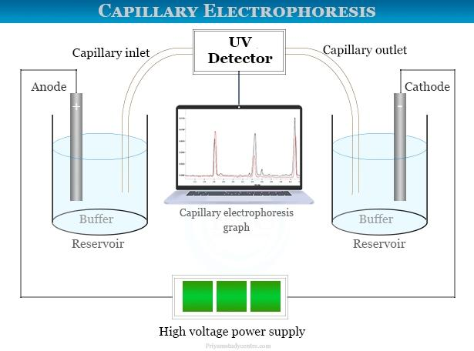

Slide 25
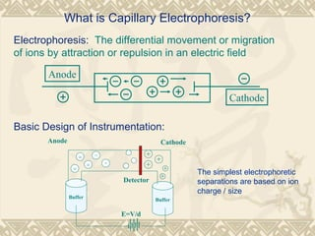

Slide 26
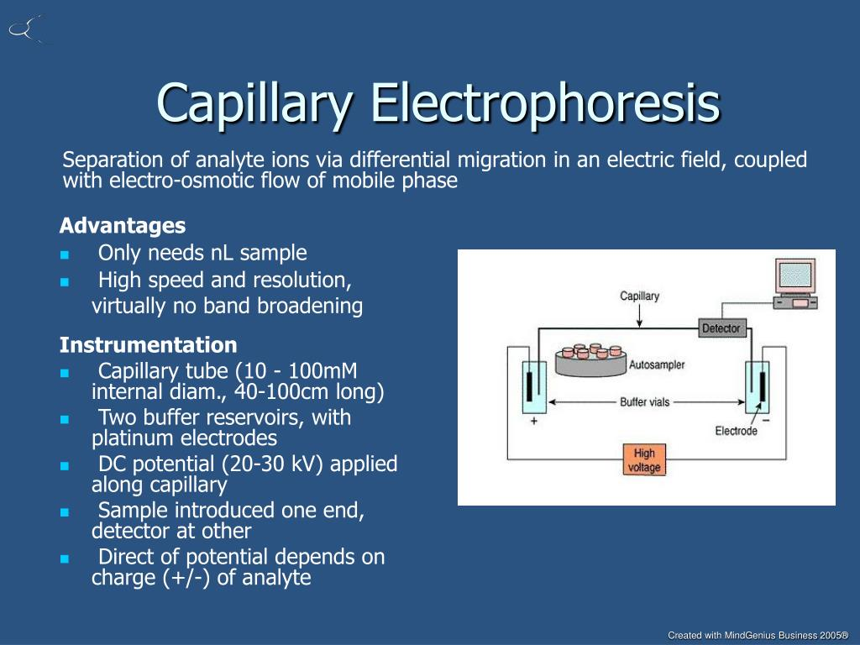

Slide 27
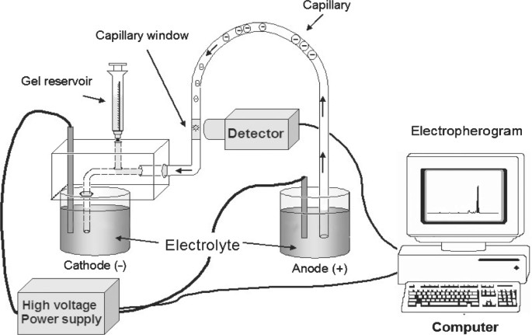
Capillary electrophoresis

Slide 28
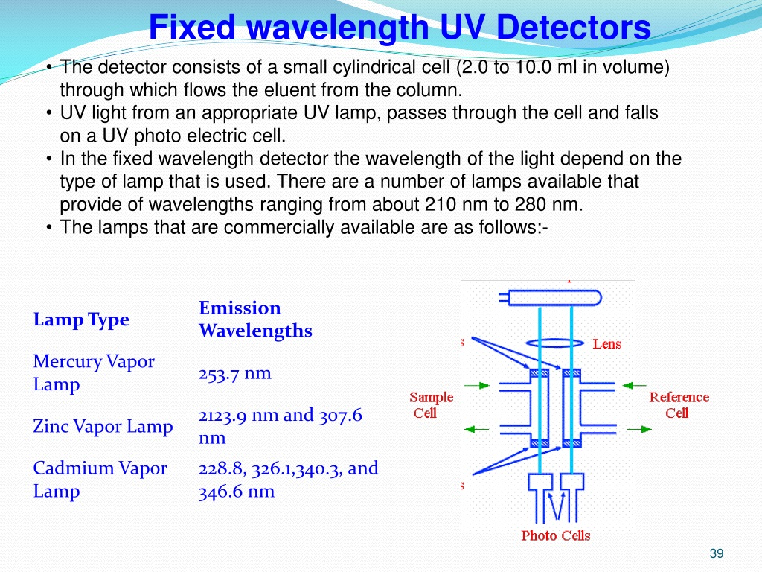

Slide 29
THANK YOU

