Slide 1
Chromatography –Iii
T.Mounica
Dept of pg chemistry

Slide 2
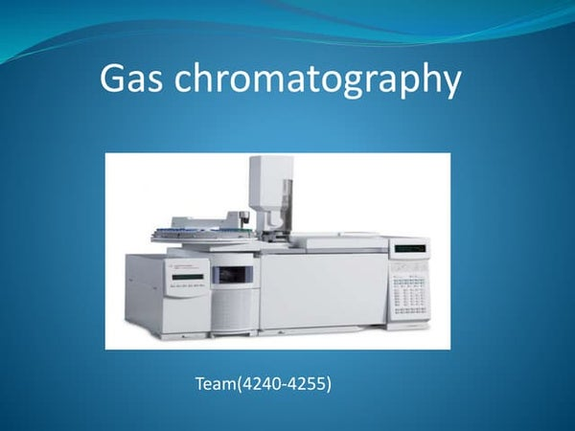

Slide 3
Gas chromatography
Principle:- Mixture of volatile components separated into individual components basing on the boiling points of the solutes. The separation of the volatile components occurs due to migration of the volatile components between stationary phase and Mobile phase ( inert gases). Temperature place main role in gas chromatography technique.
Classified into two types their are,
Gas liquid chromatography; Gas solid chromatography
Gas liquid chromatography:
Stationary phase – liquid coated on solid; Mobile phase – gas
Gas solid chromatography:
Stationary phase – solid, Mobile phase - gas

Slide 4
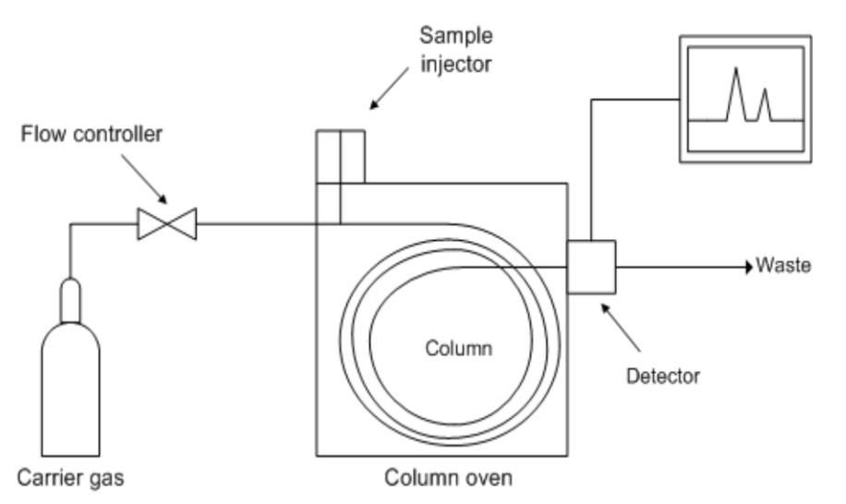
Gas liquid chromatography

Slide 5
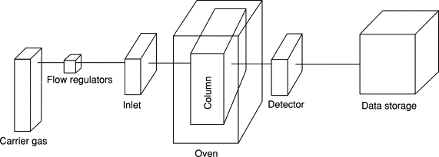
Gas solid chromatography

Slide 6
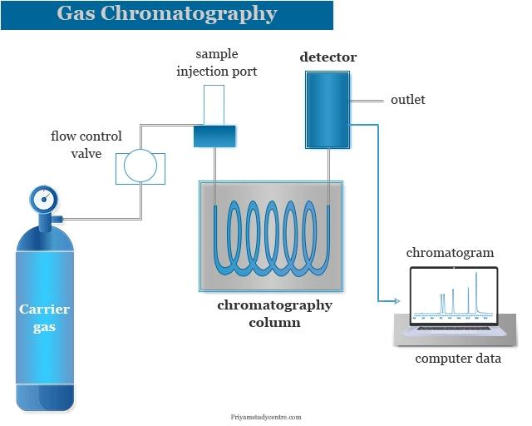
Instrumentation of gas chromatography

Slide 7
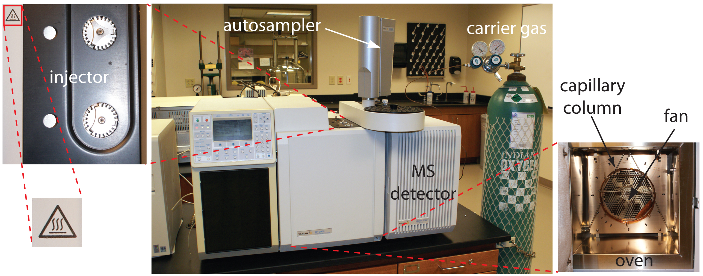

Slide 8
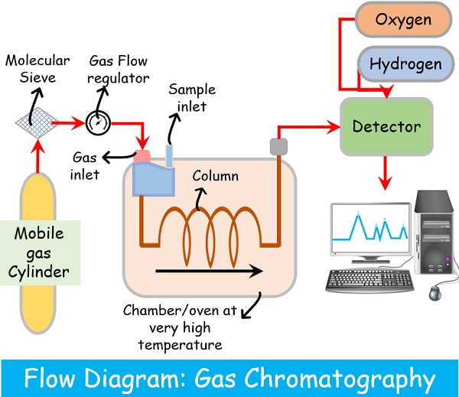

Slide 9
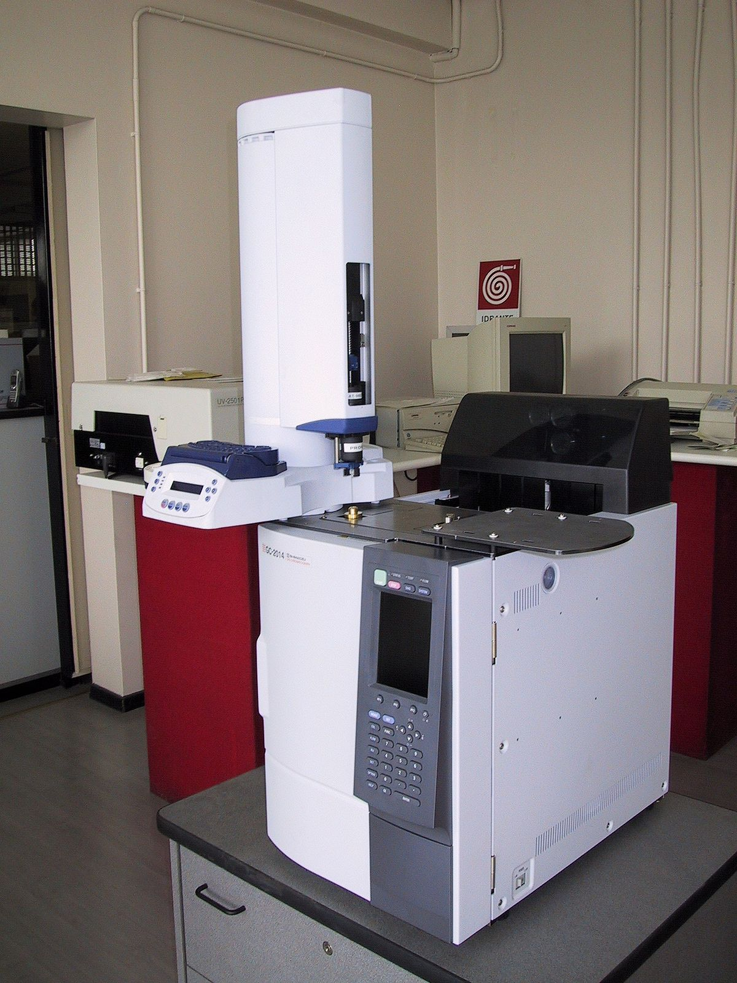

Slide 10
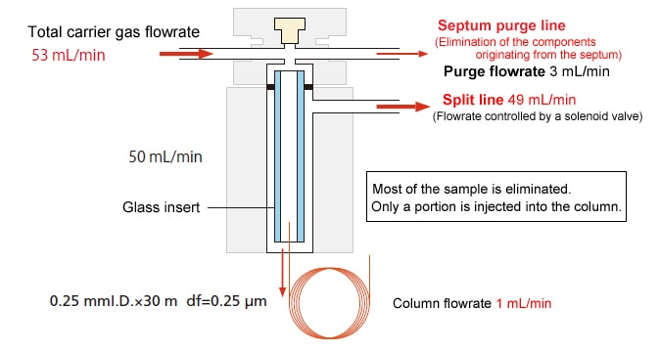
Sample injection port

Slide 11
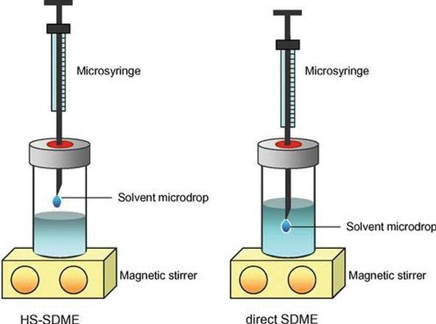

Slide 12
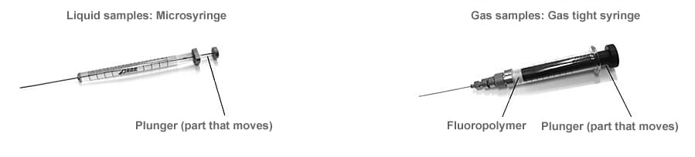

Slide 13
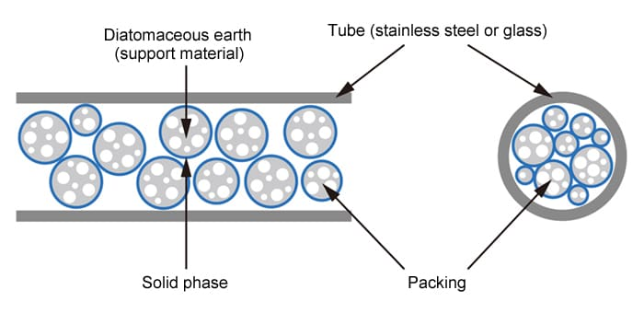
Gas chromatography
A packed column contains particles that either constitute or support the stationary phase, and the mobile phase flows through the channels of the interstitial spaces.

Slide 14
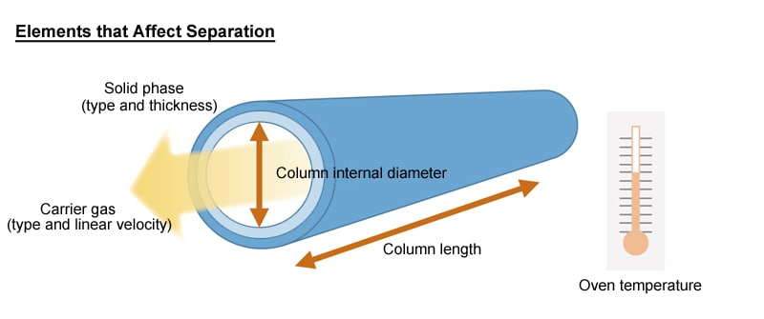
capillary column is a thin, fused silica glass tube, lined with a liquid phase or adsorbent material or having a chemical bonding layer. Thin metal tubes are also sometimes used as capillary columns. (contains immobilized porous polymer/alumina, etc.)

Slide 15
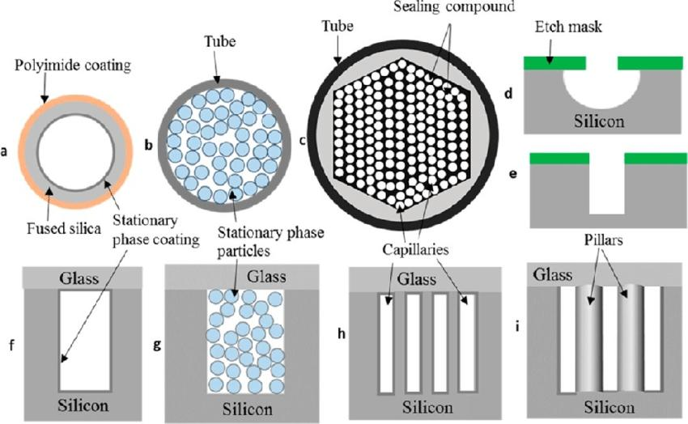
Inner view Of column

Slide 16
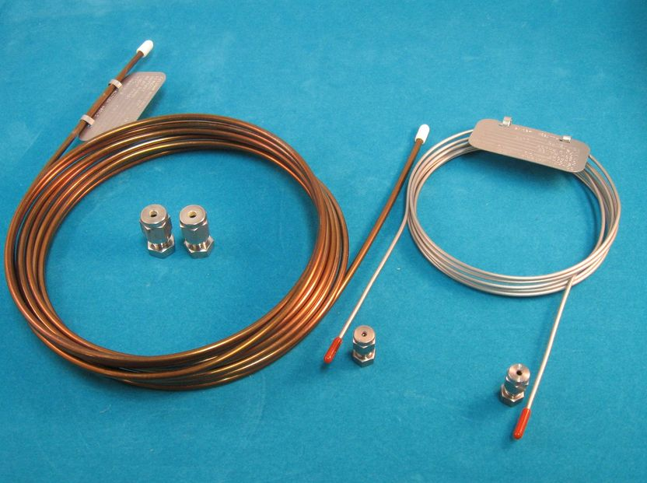
Columns

Slide 17
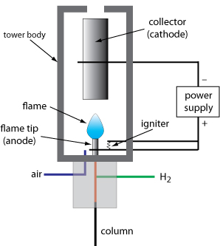
Flame ionisation detector

Slide 18
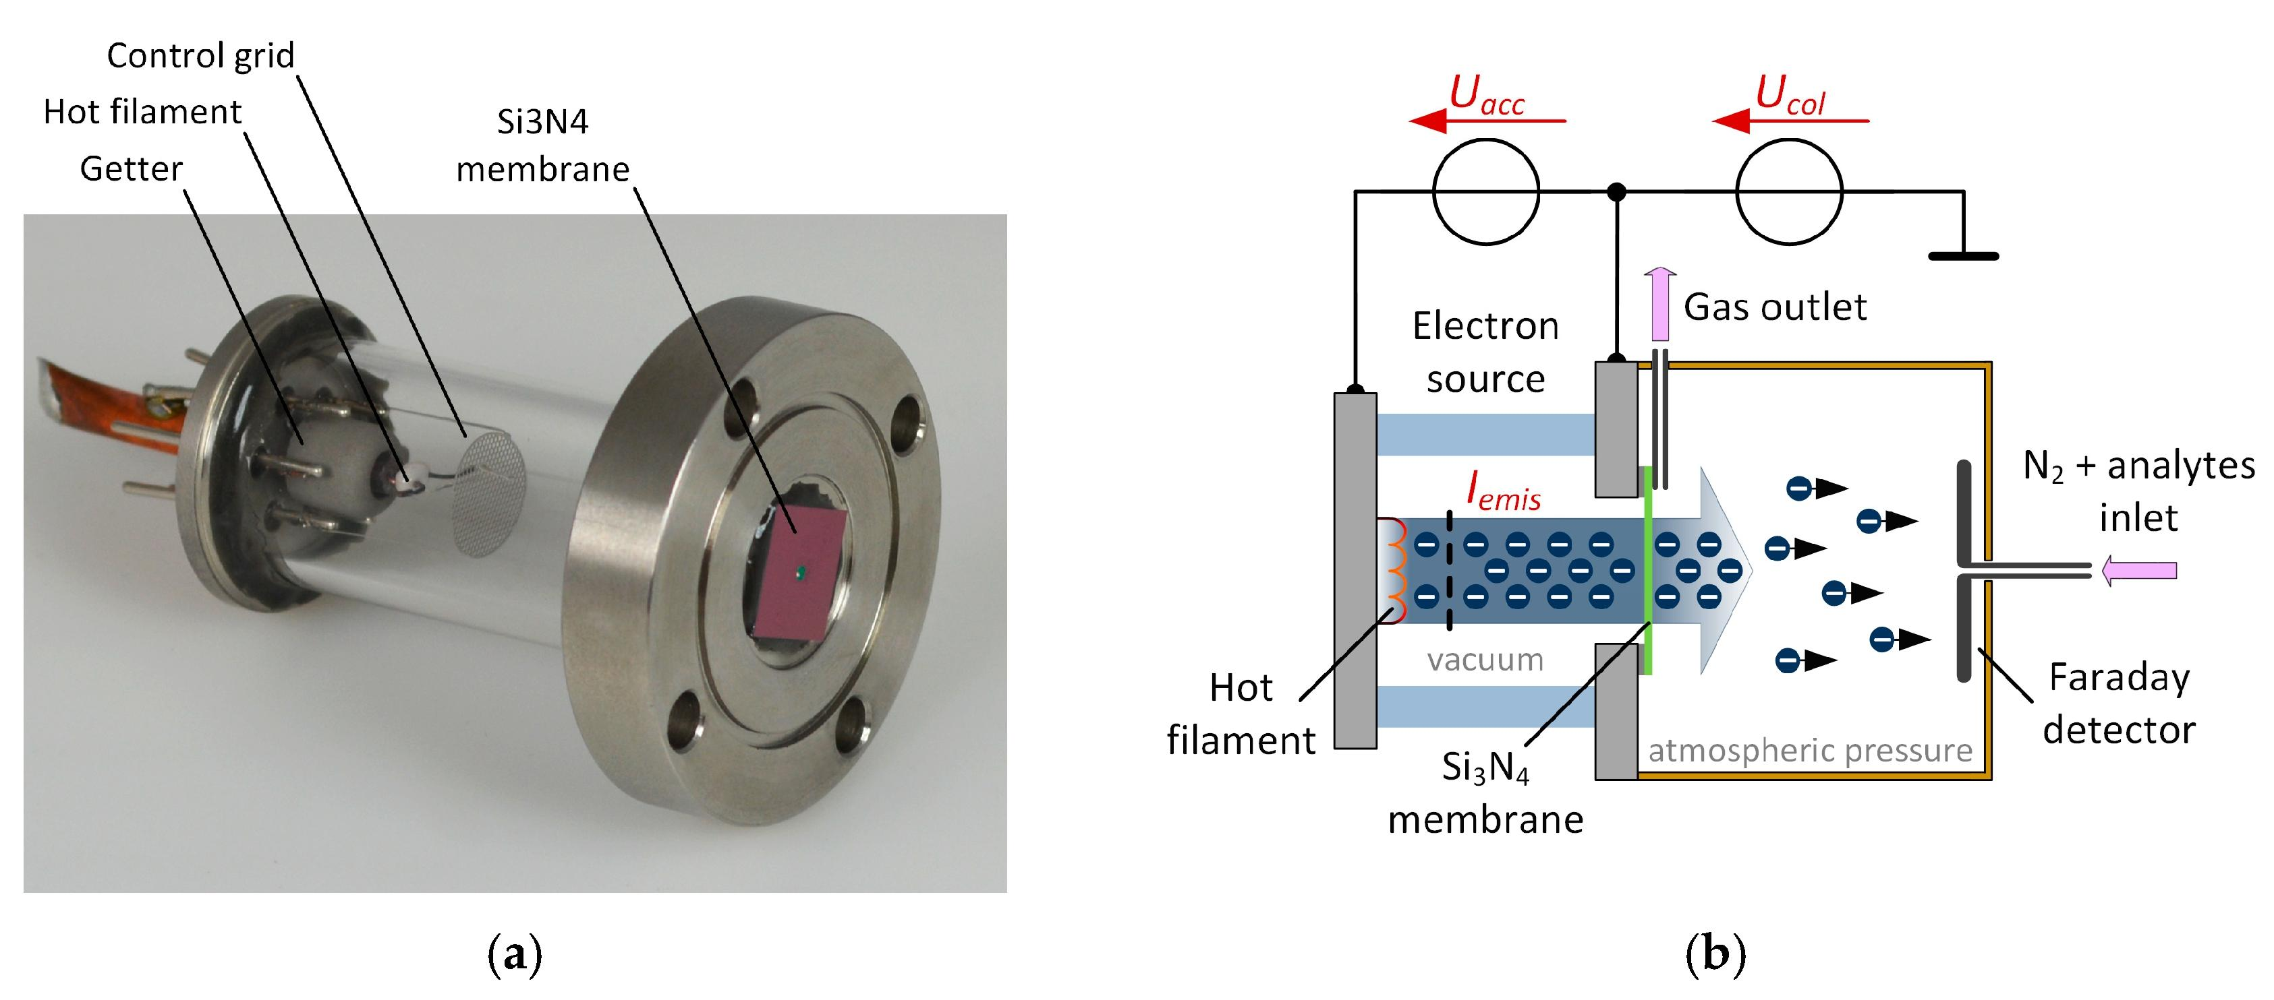
Electron capture detector

Slide 19
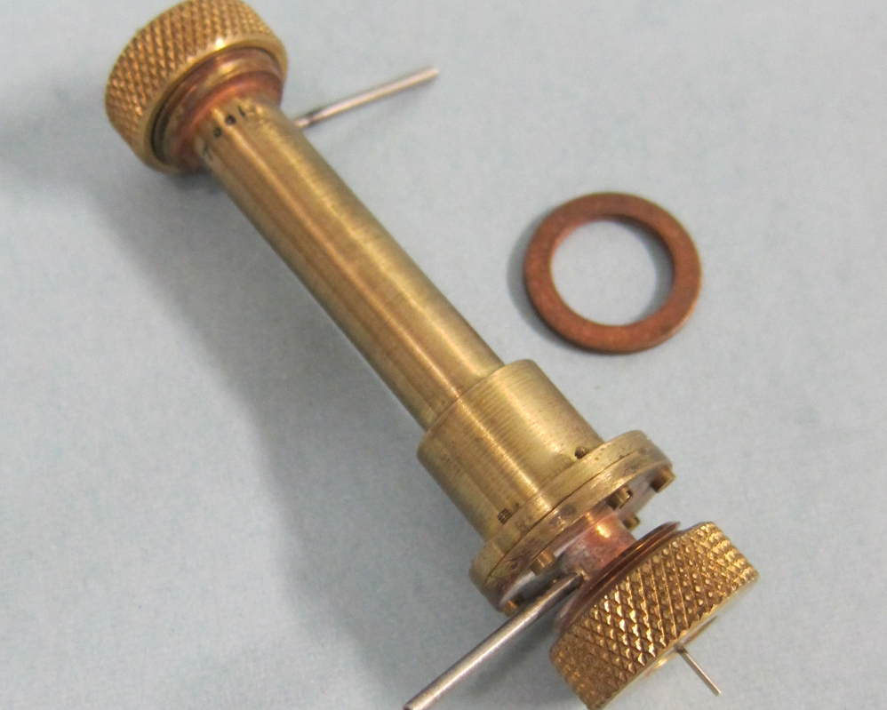

Slide 20
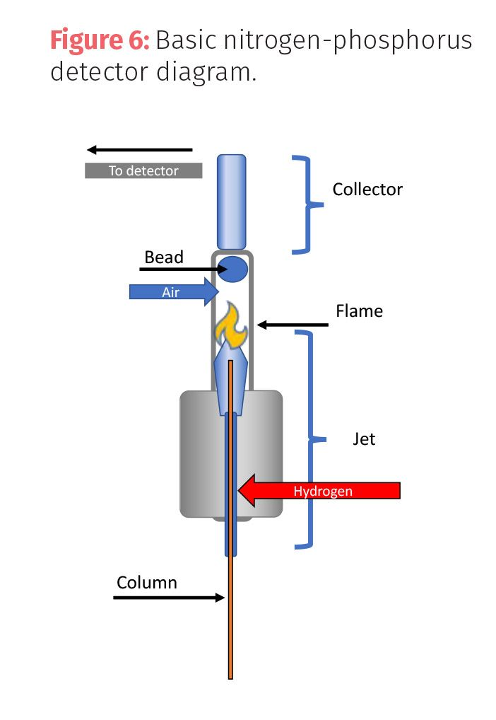
Nitrogen phosphorus detector

Slide 21
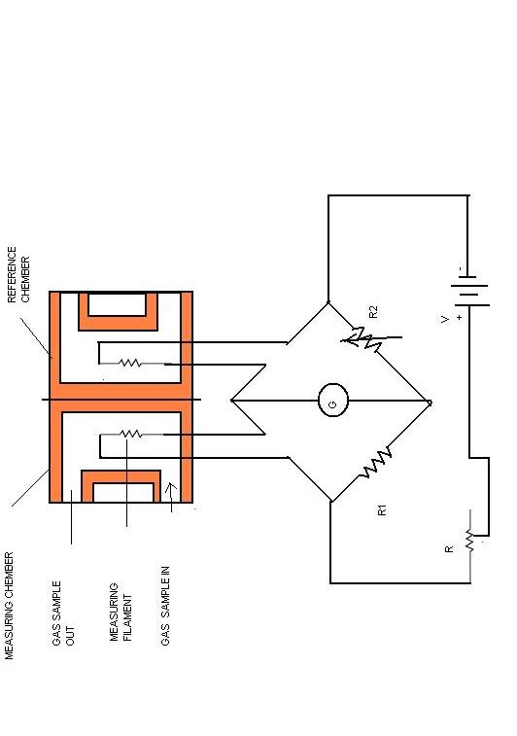
Thermal conductivity detector

Slide 22
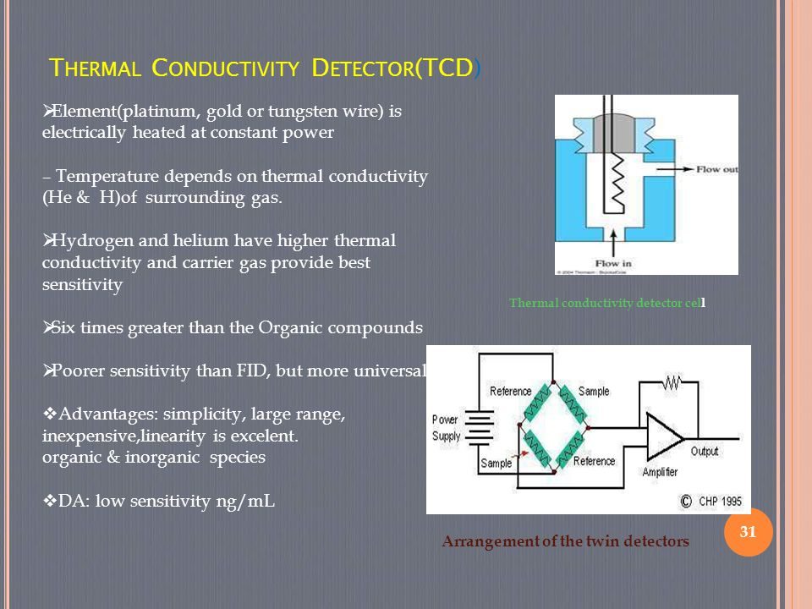

Slide 23
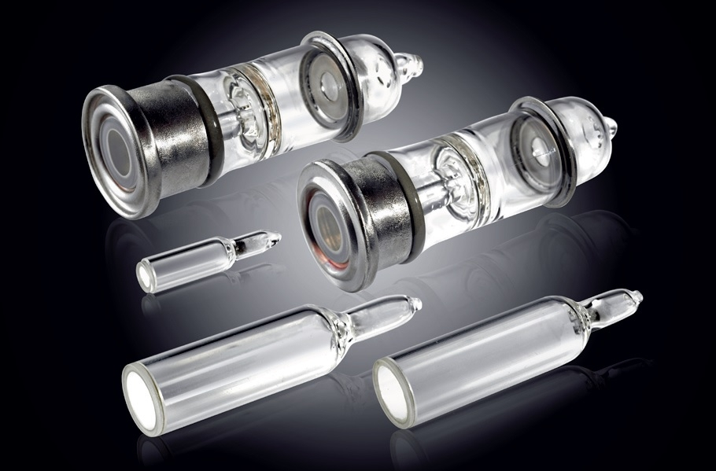

Slide 24
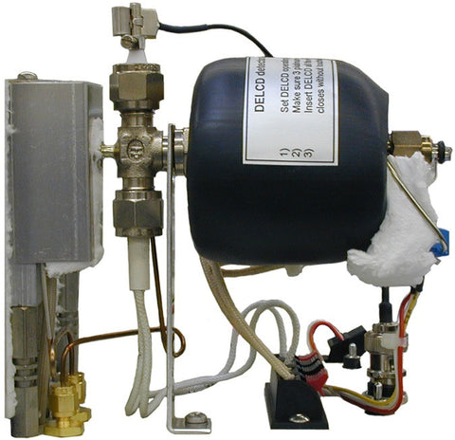
Photo ionisation detector

Slide 25
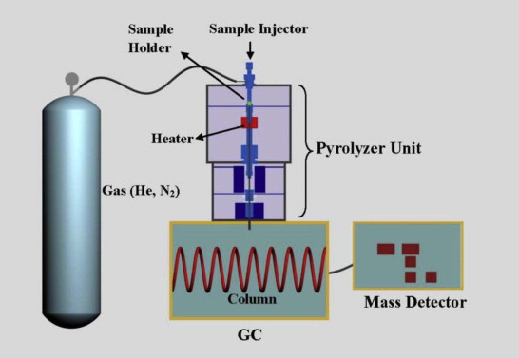
Pyrolysis gas chromatography

Slide 26
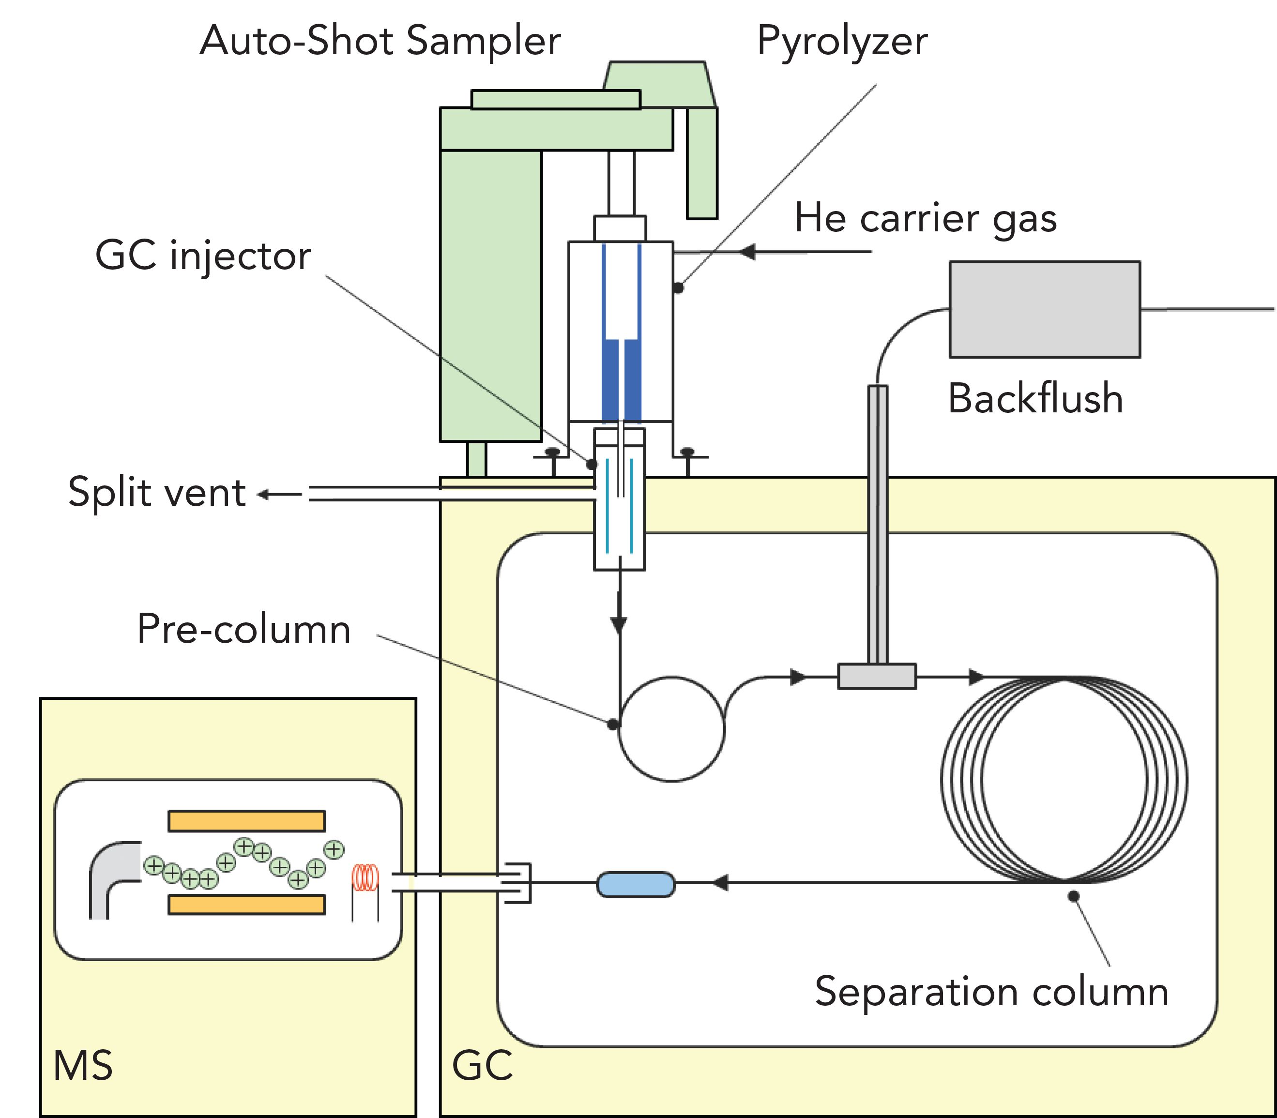

Slide 27
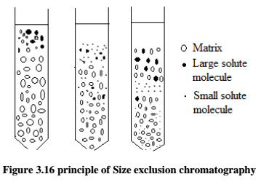
Inorganic molecular sieves

Slide 28
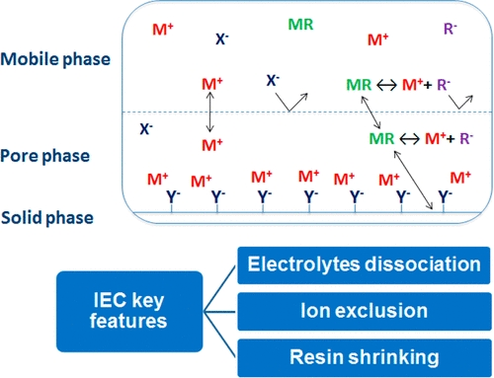
Ion exclusion chromatography

Slide 29
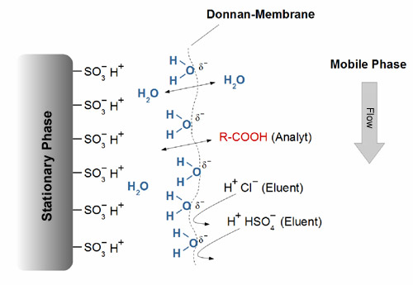

Slide 30
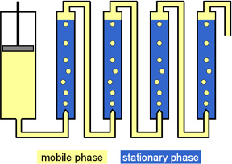
Countercurrent chromatography (CCC) is a liquid chromatography technique in which both the mobile and the stationary phase are liquids

Slide 31
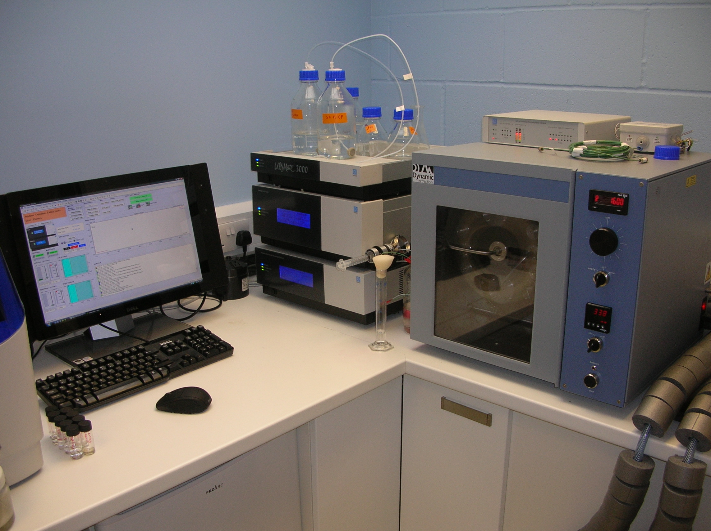
Counter current chromatography

Slide 32
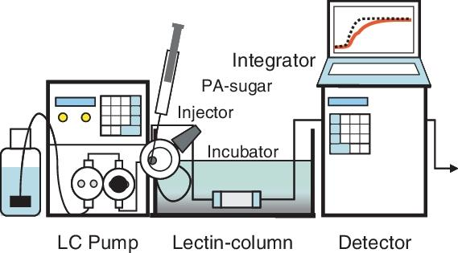
Affinity Chromatography is essentially a sample purification technique, used primarily. For biological molecules such as proteins.

Slide 33
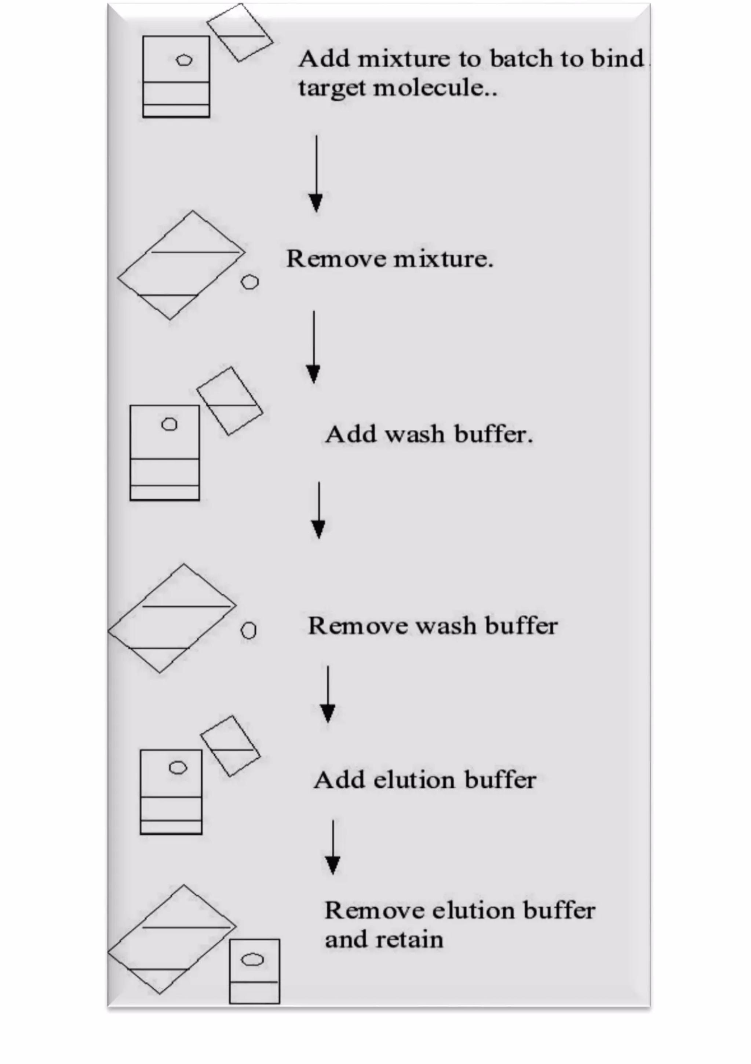

Slide 34
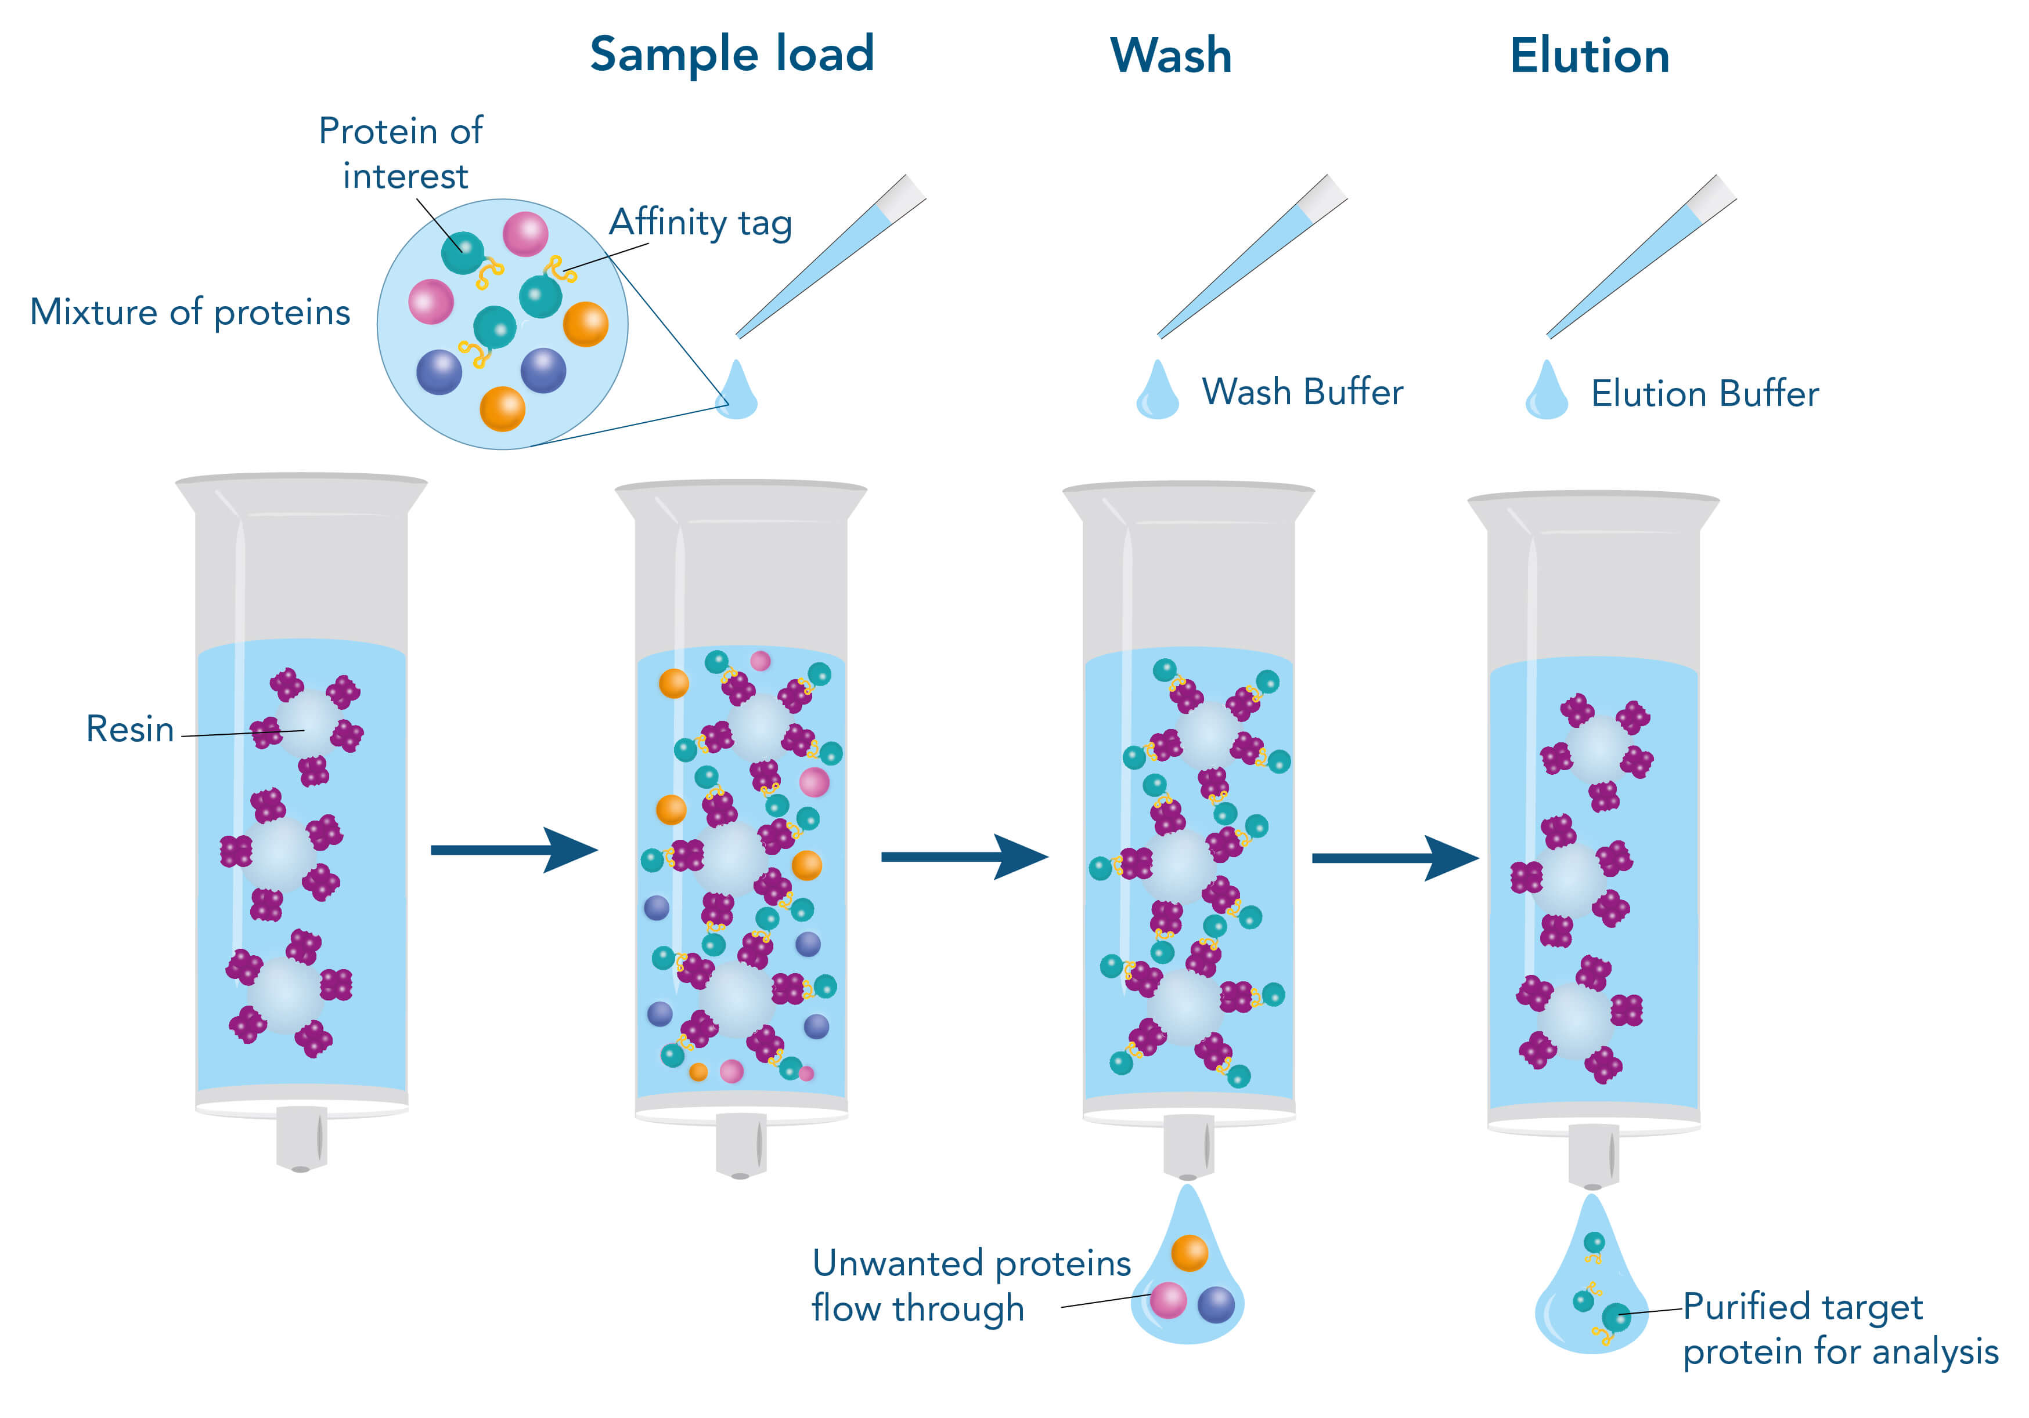

Slide 35
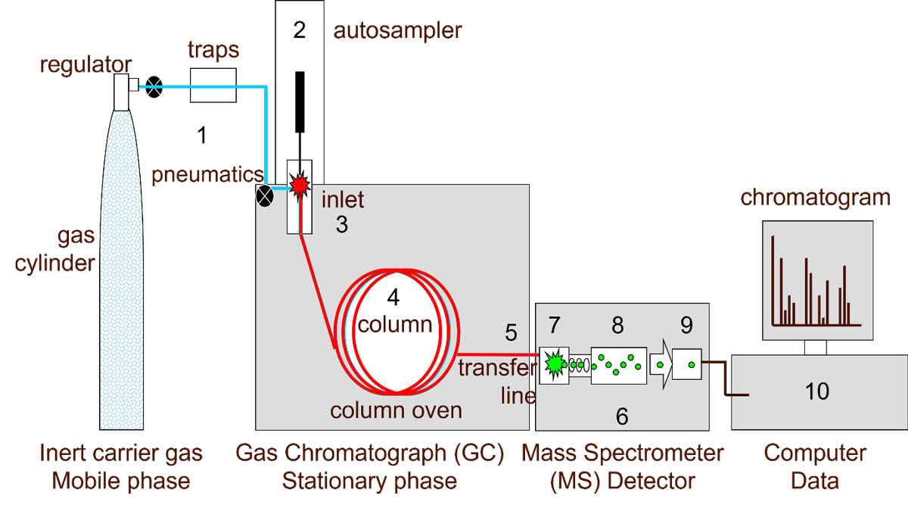
GC-ms

Slide 36
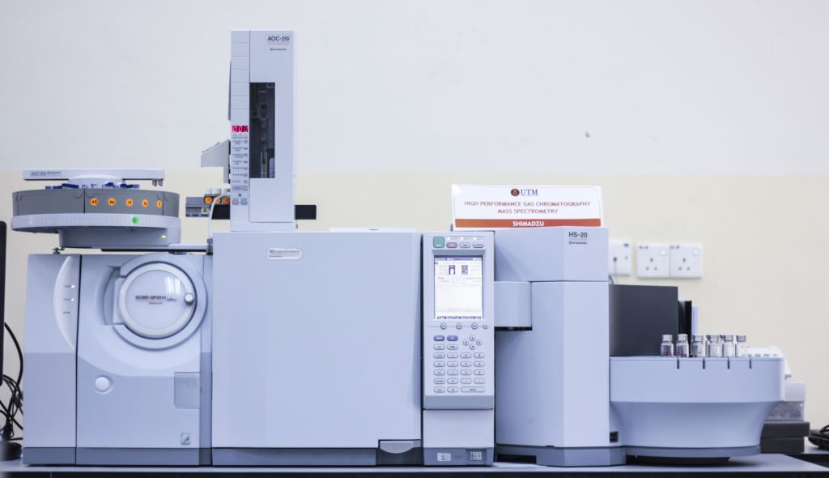

Slide 37
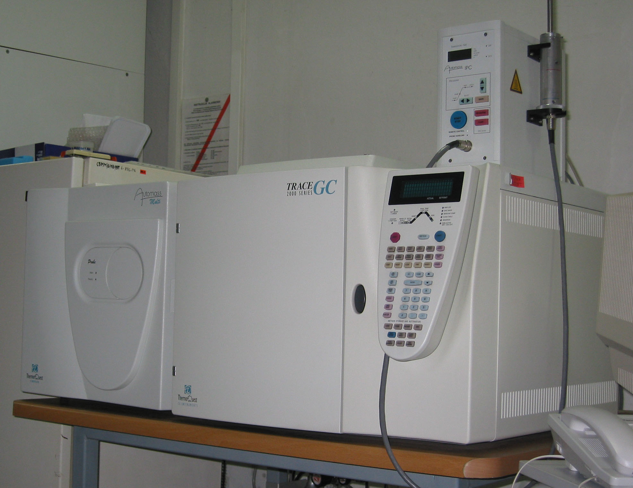

Slide 38
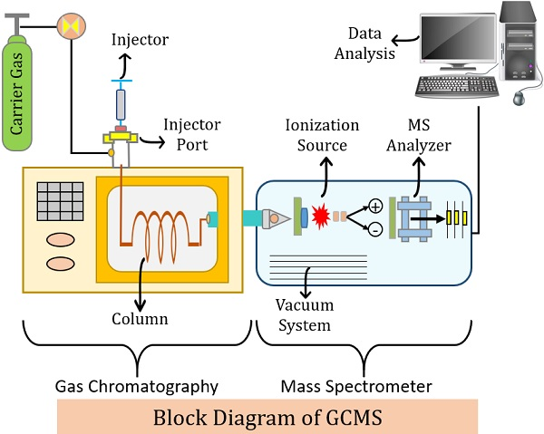

Slide 39
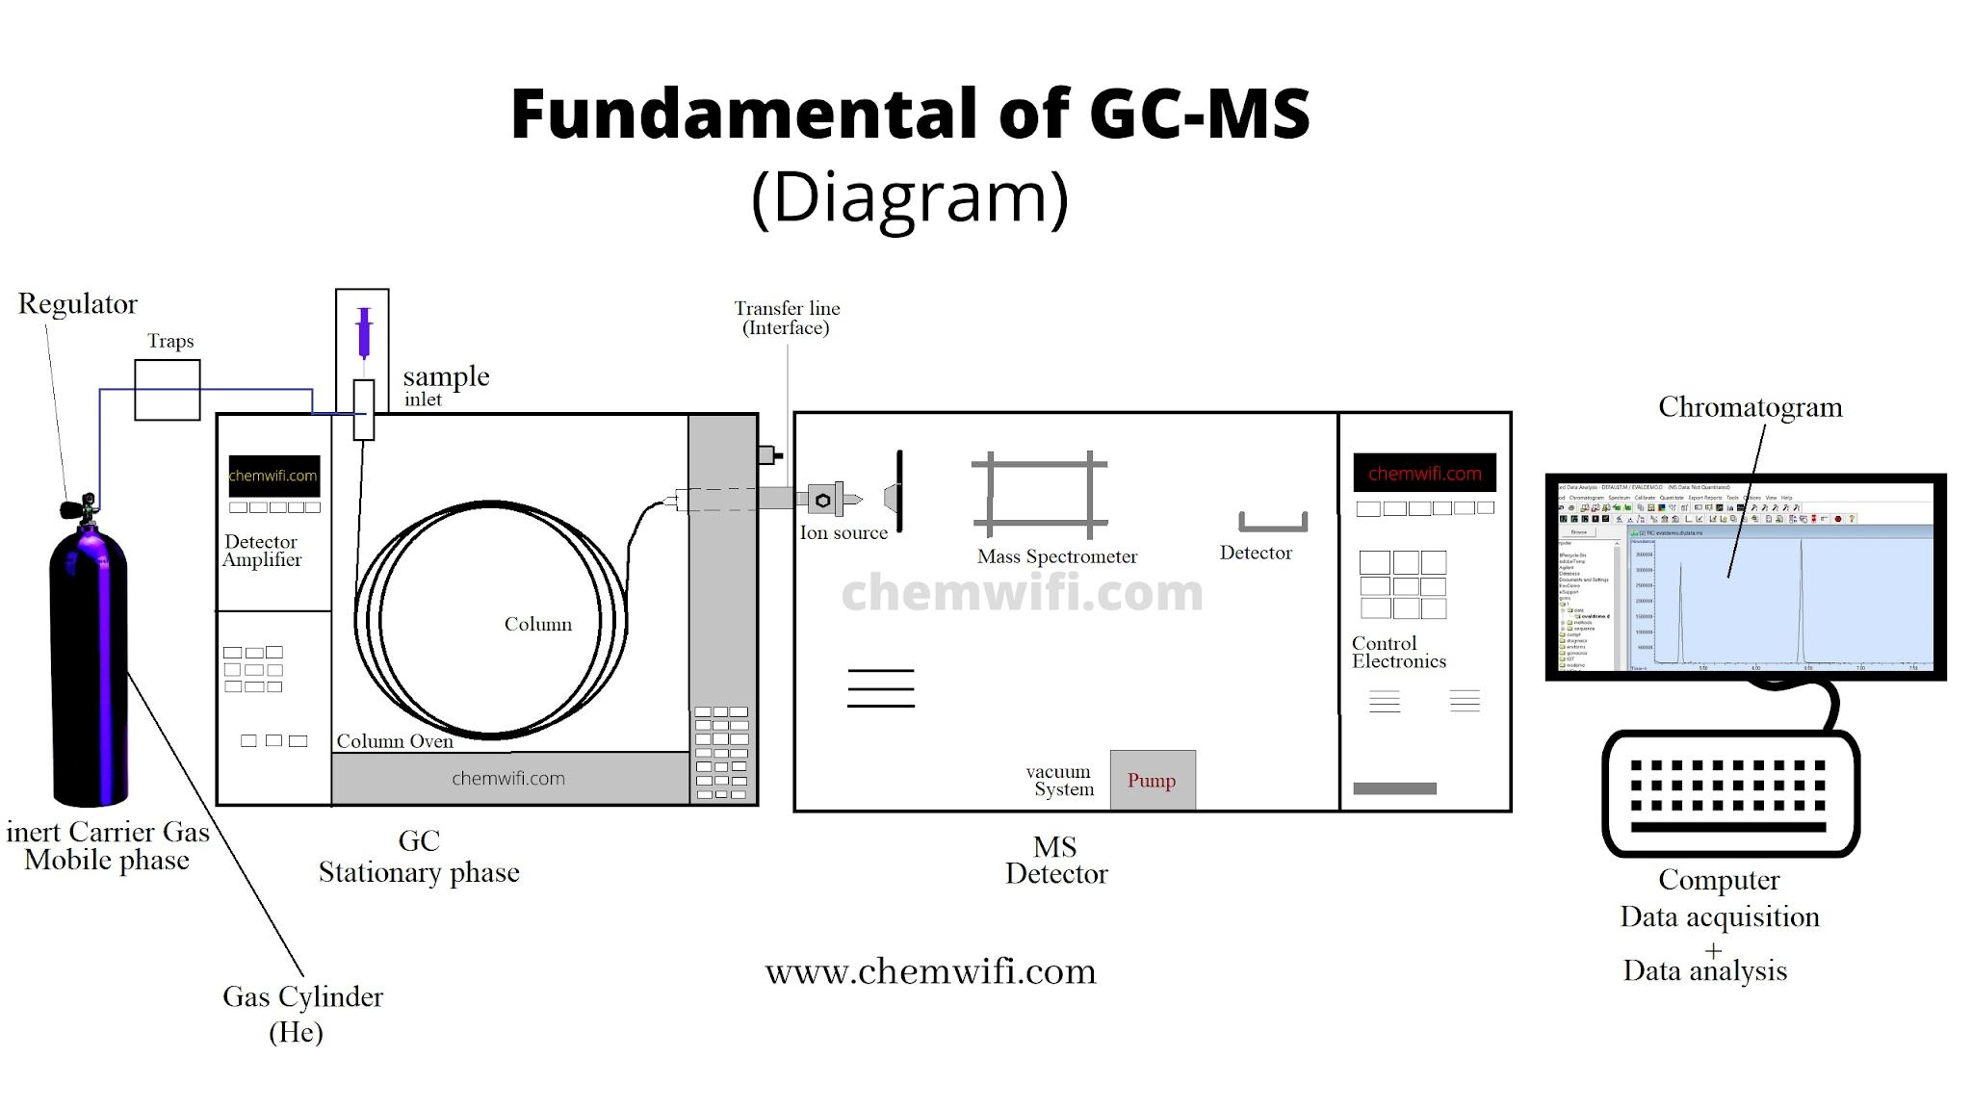
Interface system

Slide 40
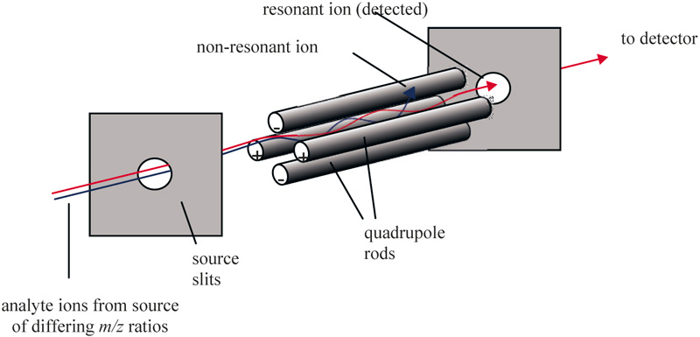
Quadrupole mass analyser

Slide 41
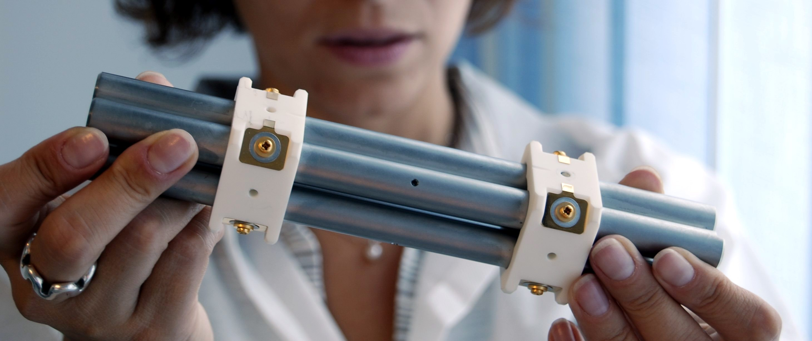

Slide 42
THANK YOU

