Slide 1
Chromatography –iv
T.Mounica
Dept of pg chemistry

Slide 2
LIQUID - LIQUID PARTITION CHROMATOGRAPHY
Principle:-
Mixture of components separated into individual components due to different partition properties of the components between two immiscible phases. In LLPC stationary phase is liquid coated on solid & mobile phase is liquid.
These are classified into two types
Normal phase
Reverse phase

Slide 3
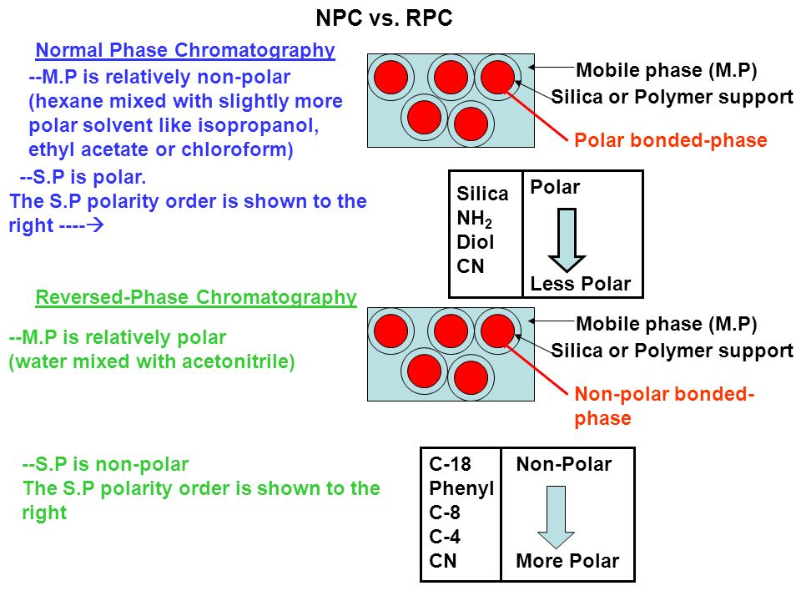

Slide 4
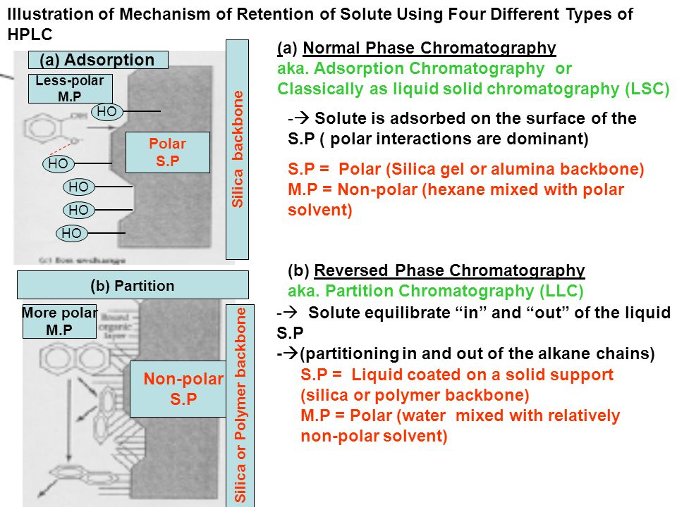

Slide 5
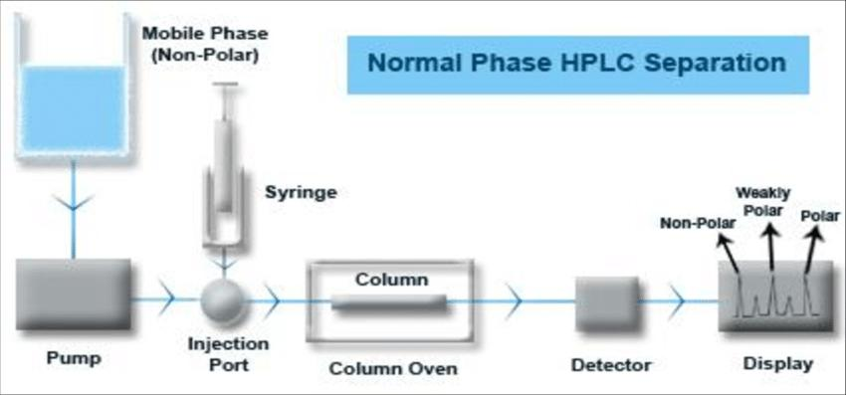

Slide 6
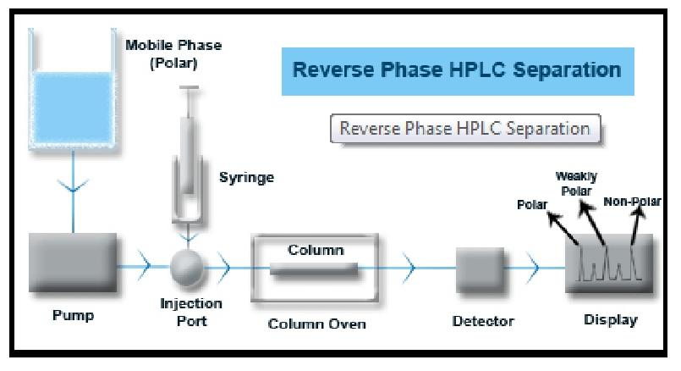

Slide 7
High performance liquid chromatography principle:- mixture of non volatile components separated into individual components basing on the different partition properties between two immiscible phases by applying high pressure to the mobile phase .
Here,
Stationary phase – liquid coated on solid mobile phase – liquid

Slide 8
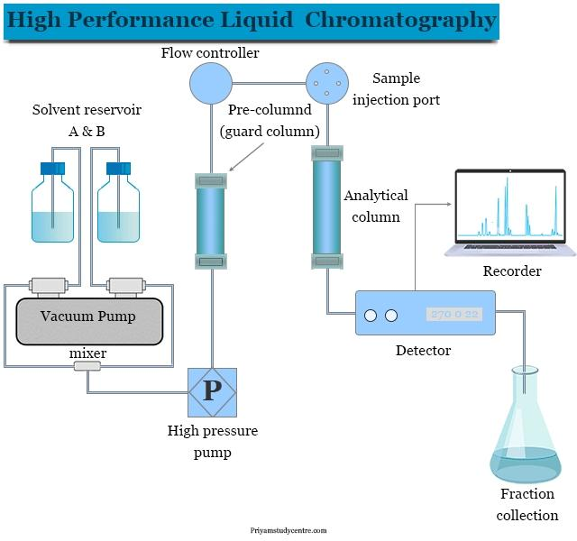

Slide 9
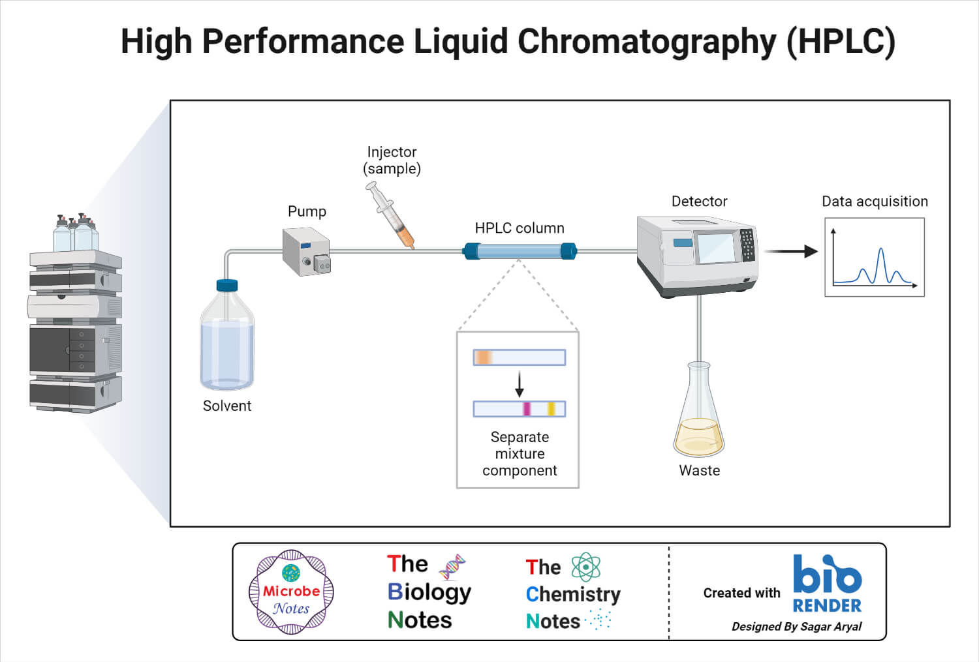

Slide 10
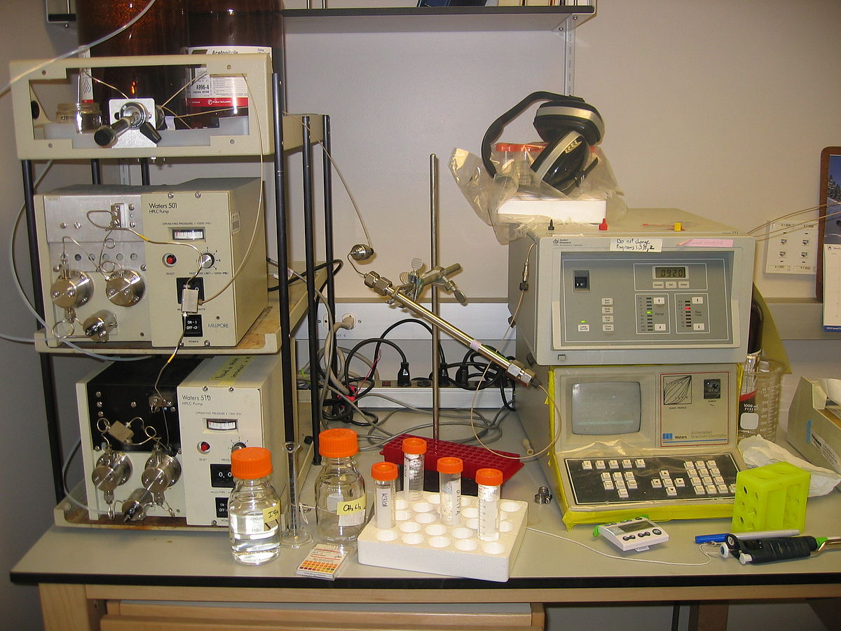

Slide 11
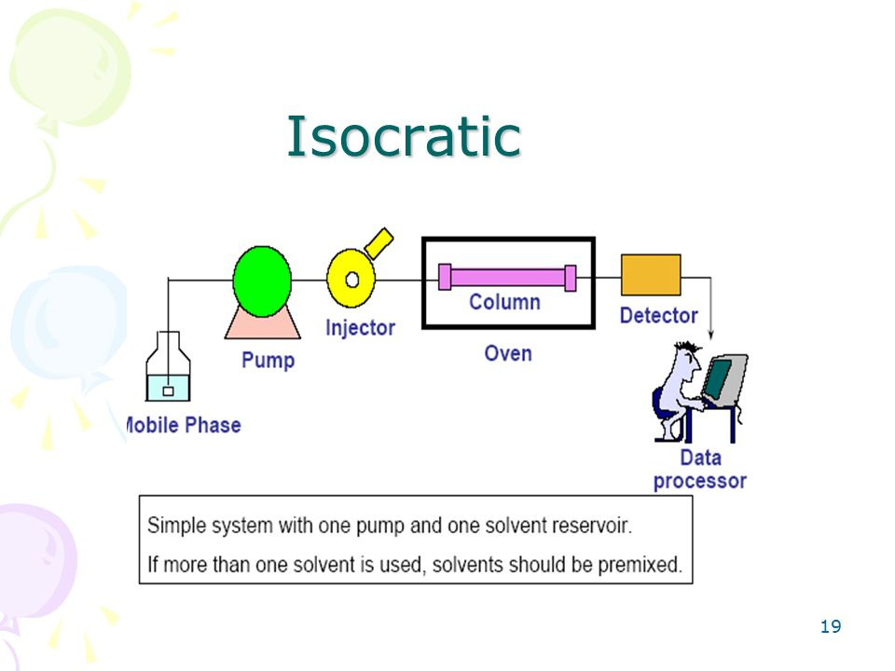

Slide 12
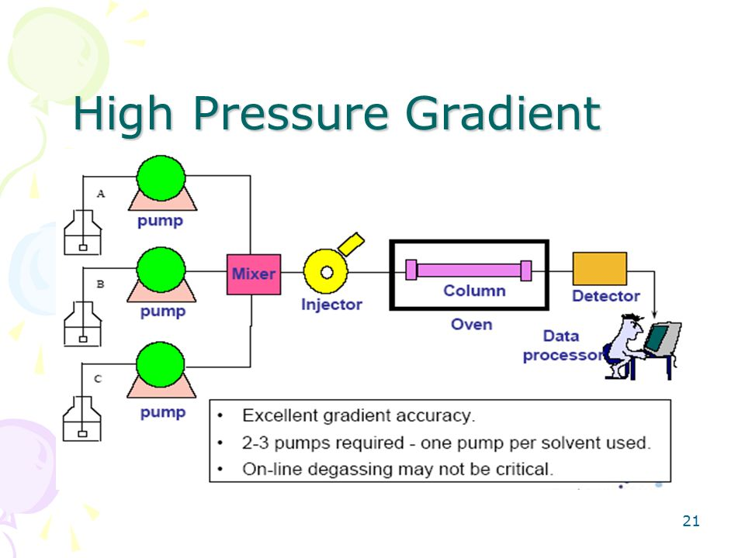

Slide 13
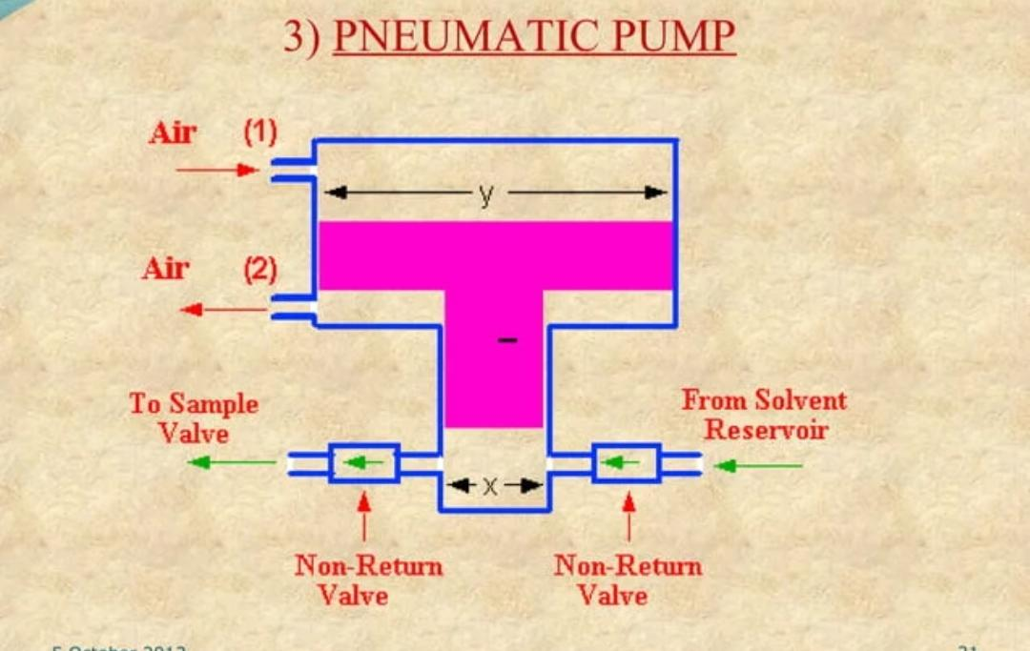

Slide 14
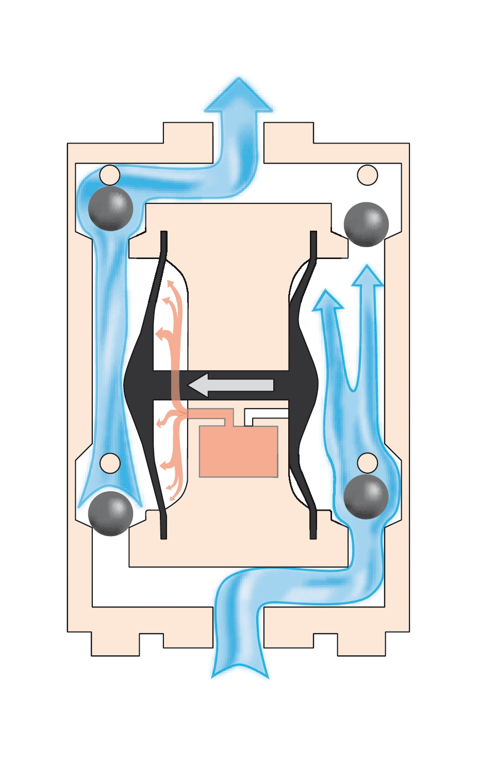

Slide 15
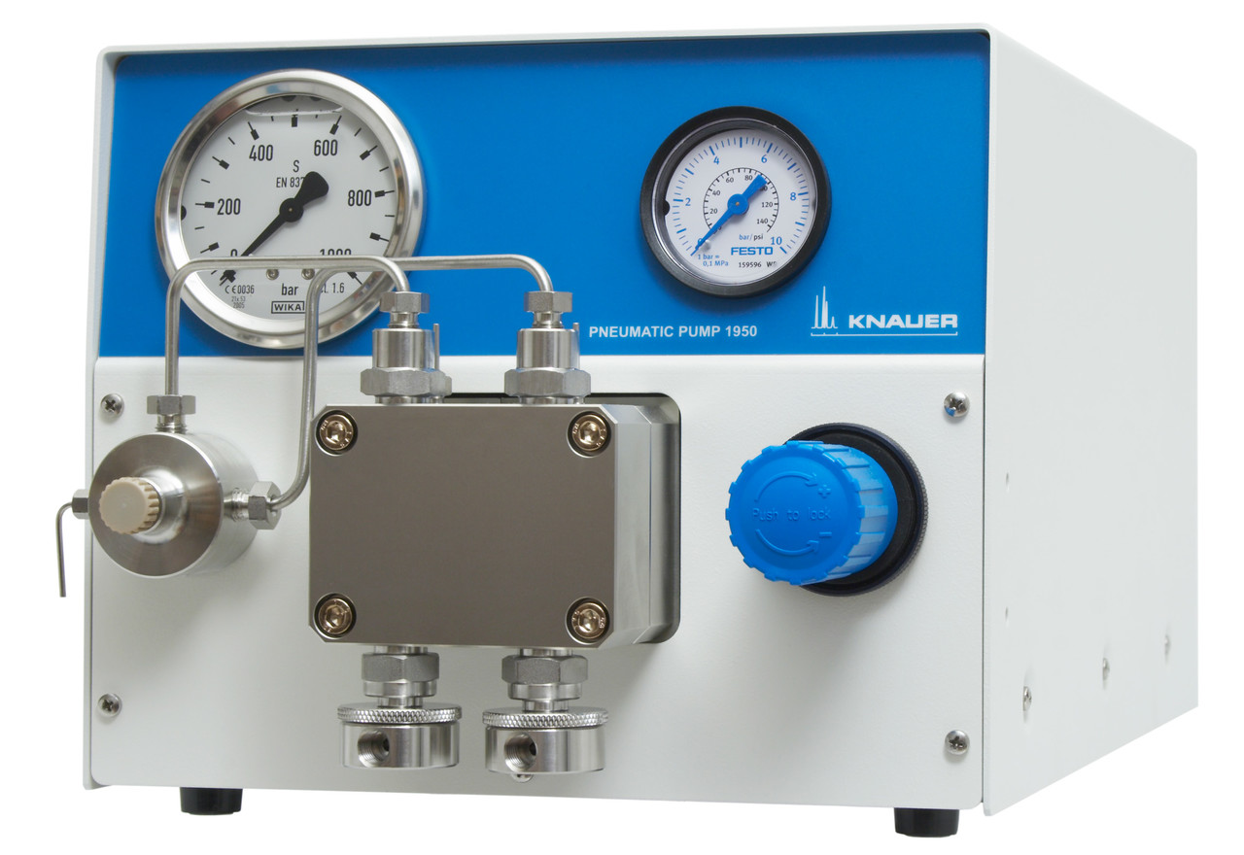

Slide 16
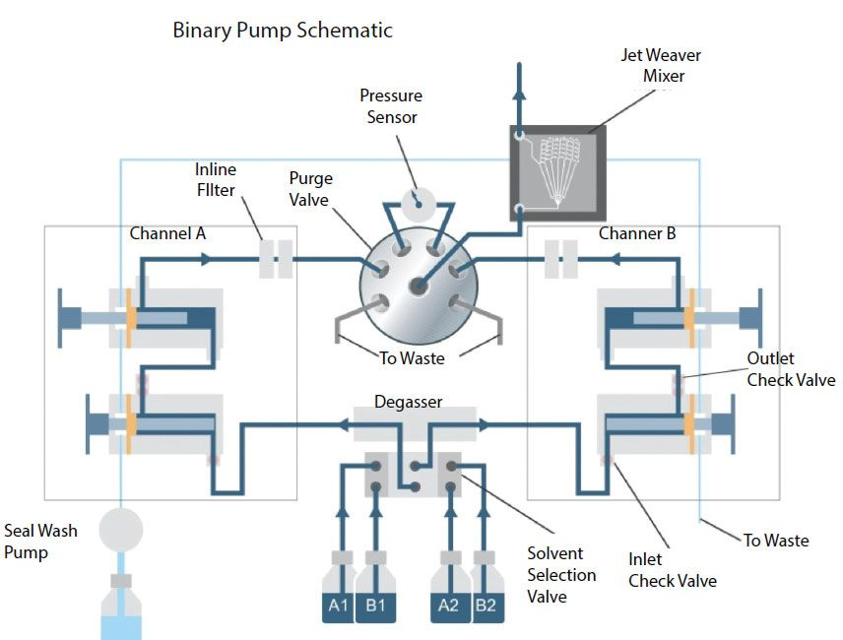

Slide 17
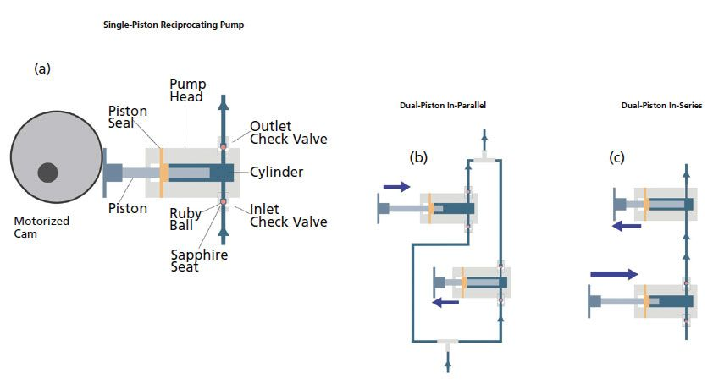

Slide 18
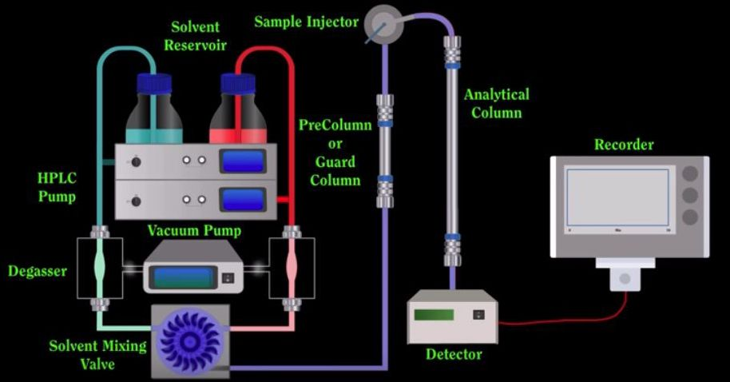

Slide 19
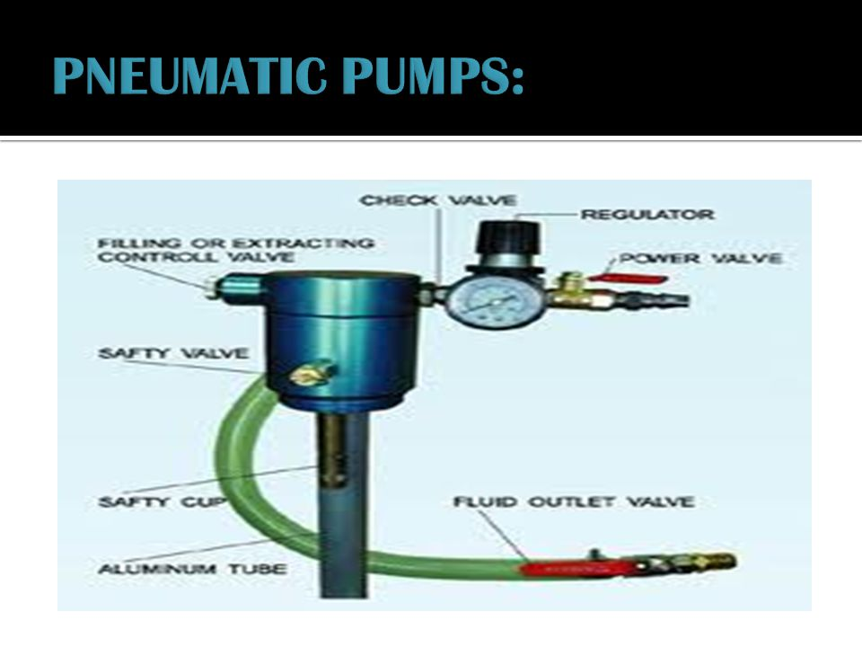

Slide 20
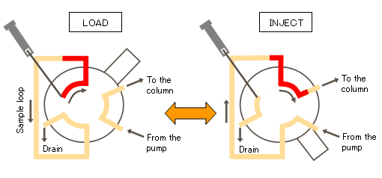
Sample injection port

Slide 21
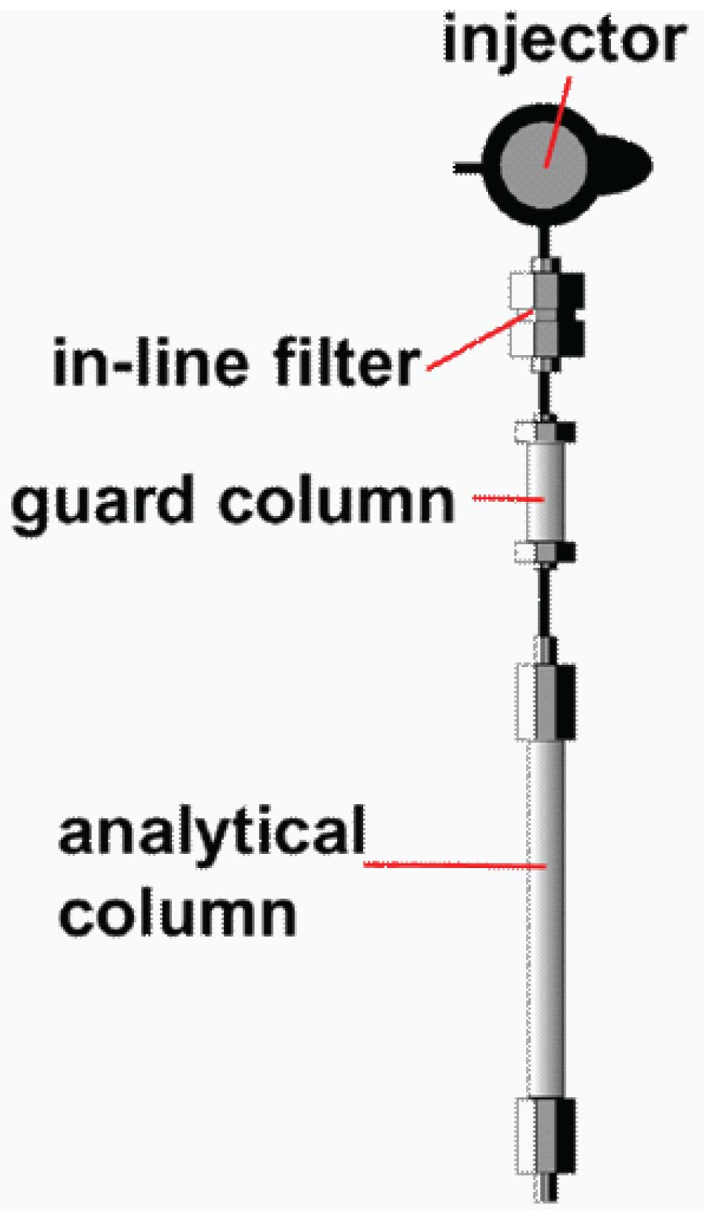
Guard columns are installed between the injector and the analytical column of a HPLC system, mainly to protect analytical columns. Guard columns are widely used as a cost effective for prolong HPLC column life. Exchangeable cartridge design and unchangeable packing design are offered.

Slide 22
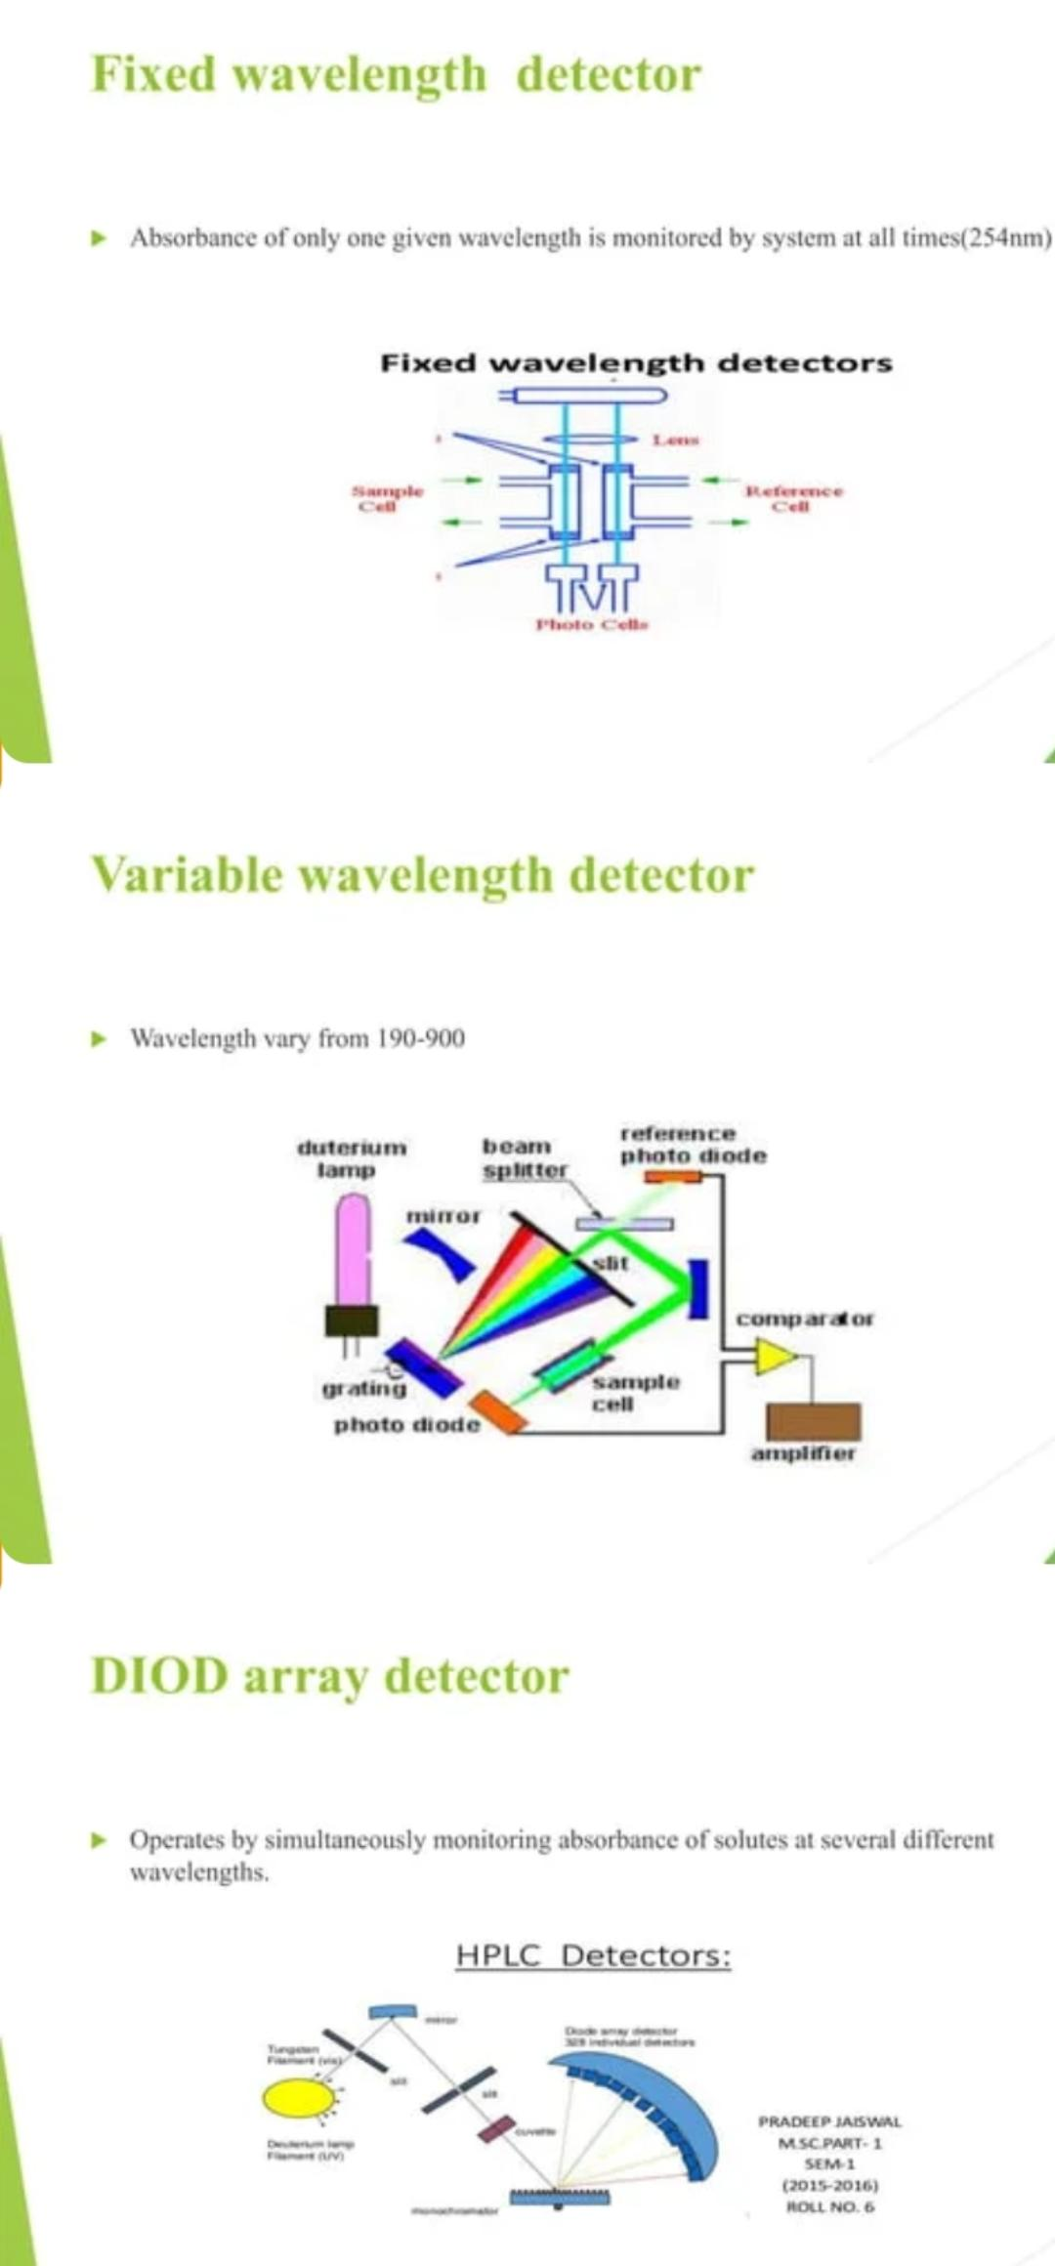

Slide 23
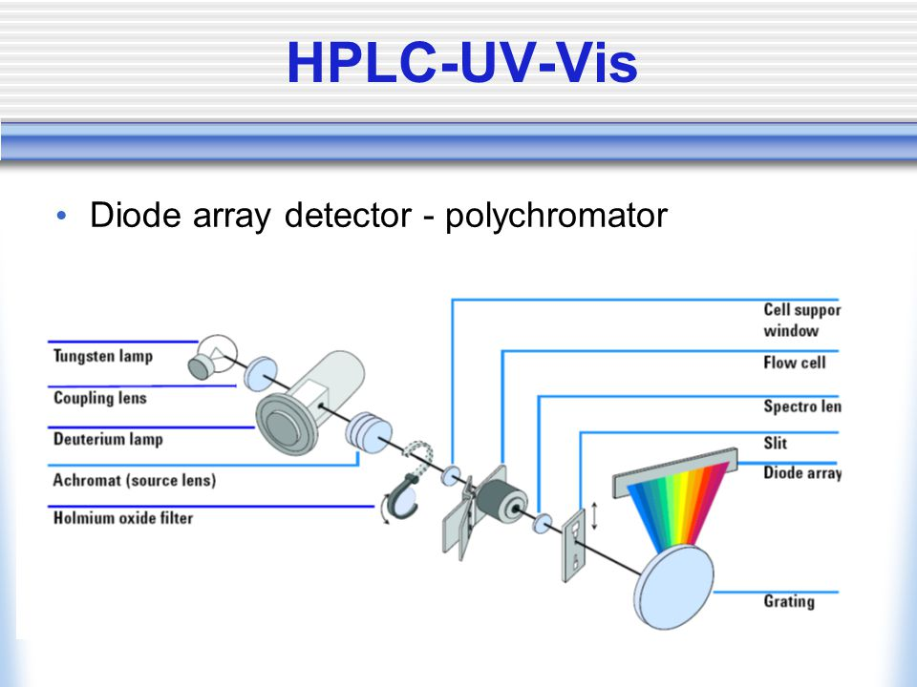

Slide 24
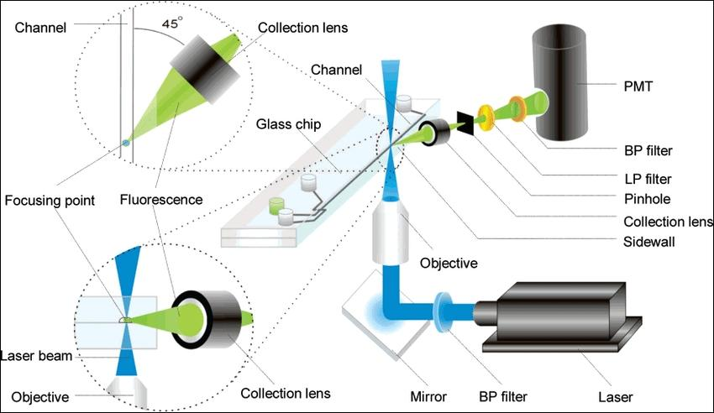
Uv fluorescence detector

Slide 25
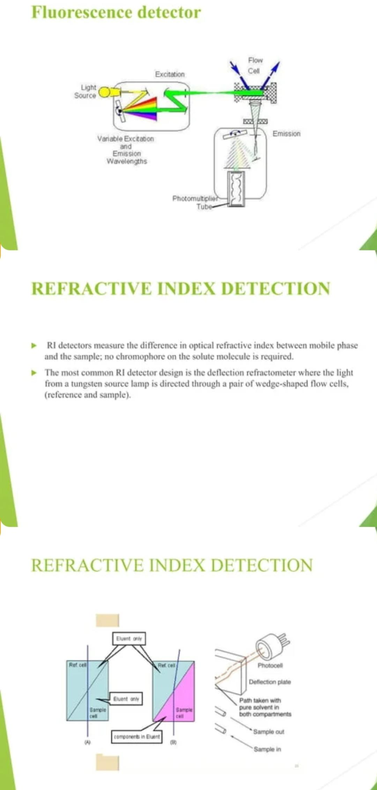

Slide 26
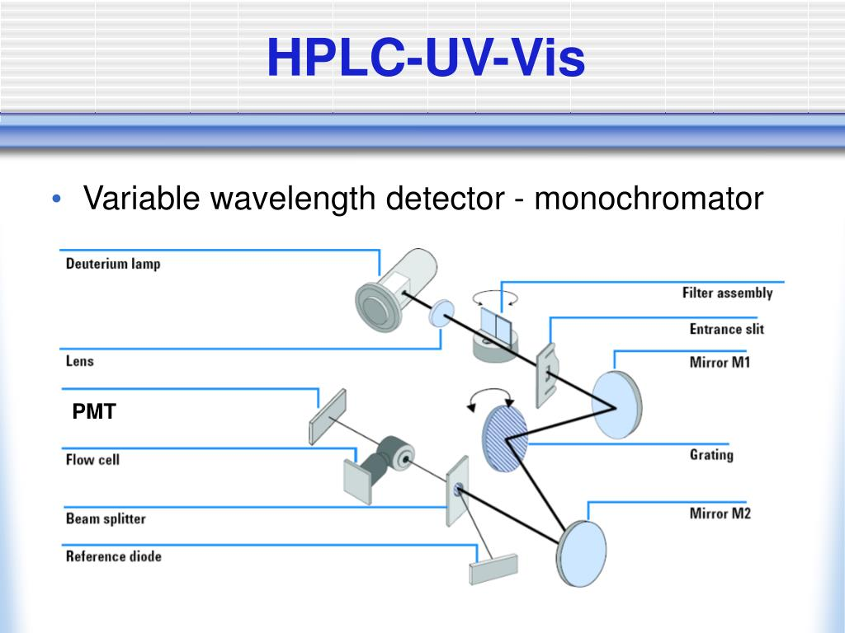

Slide 27
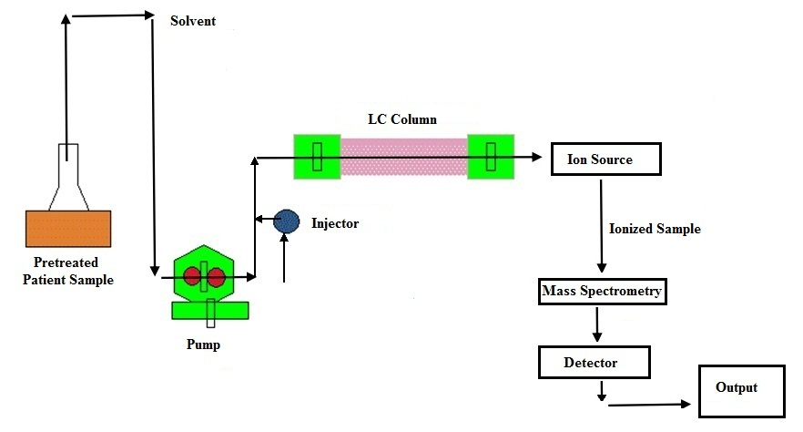
Lc-ms

Slide 28
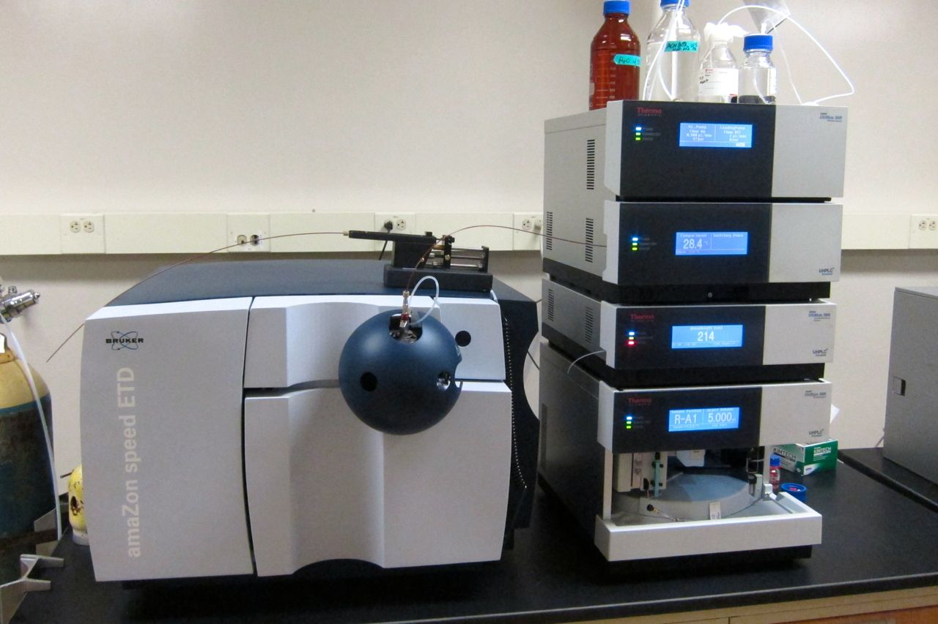

Slide 29
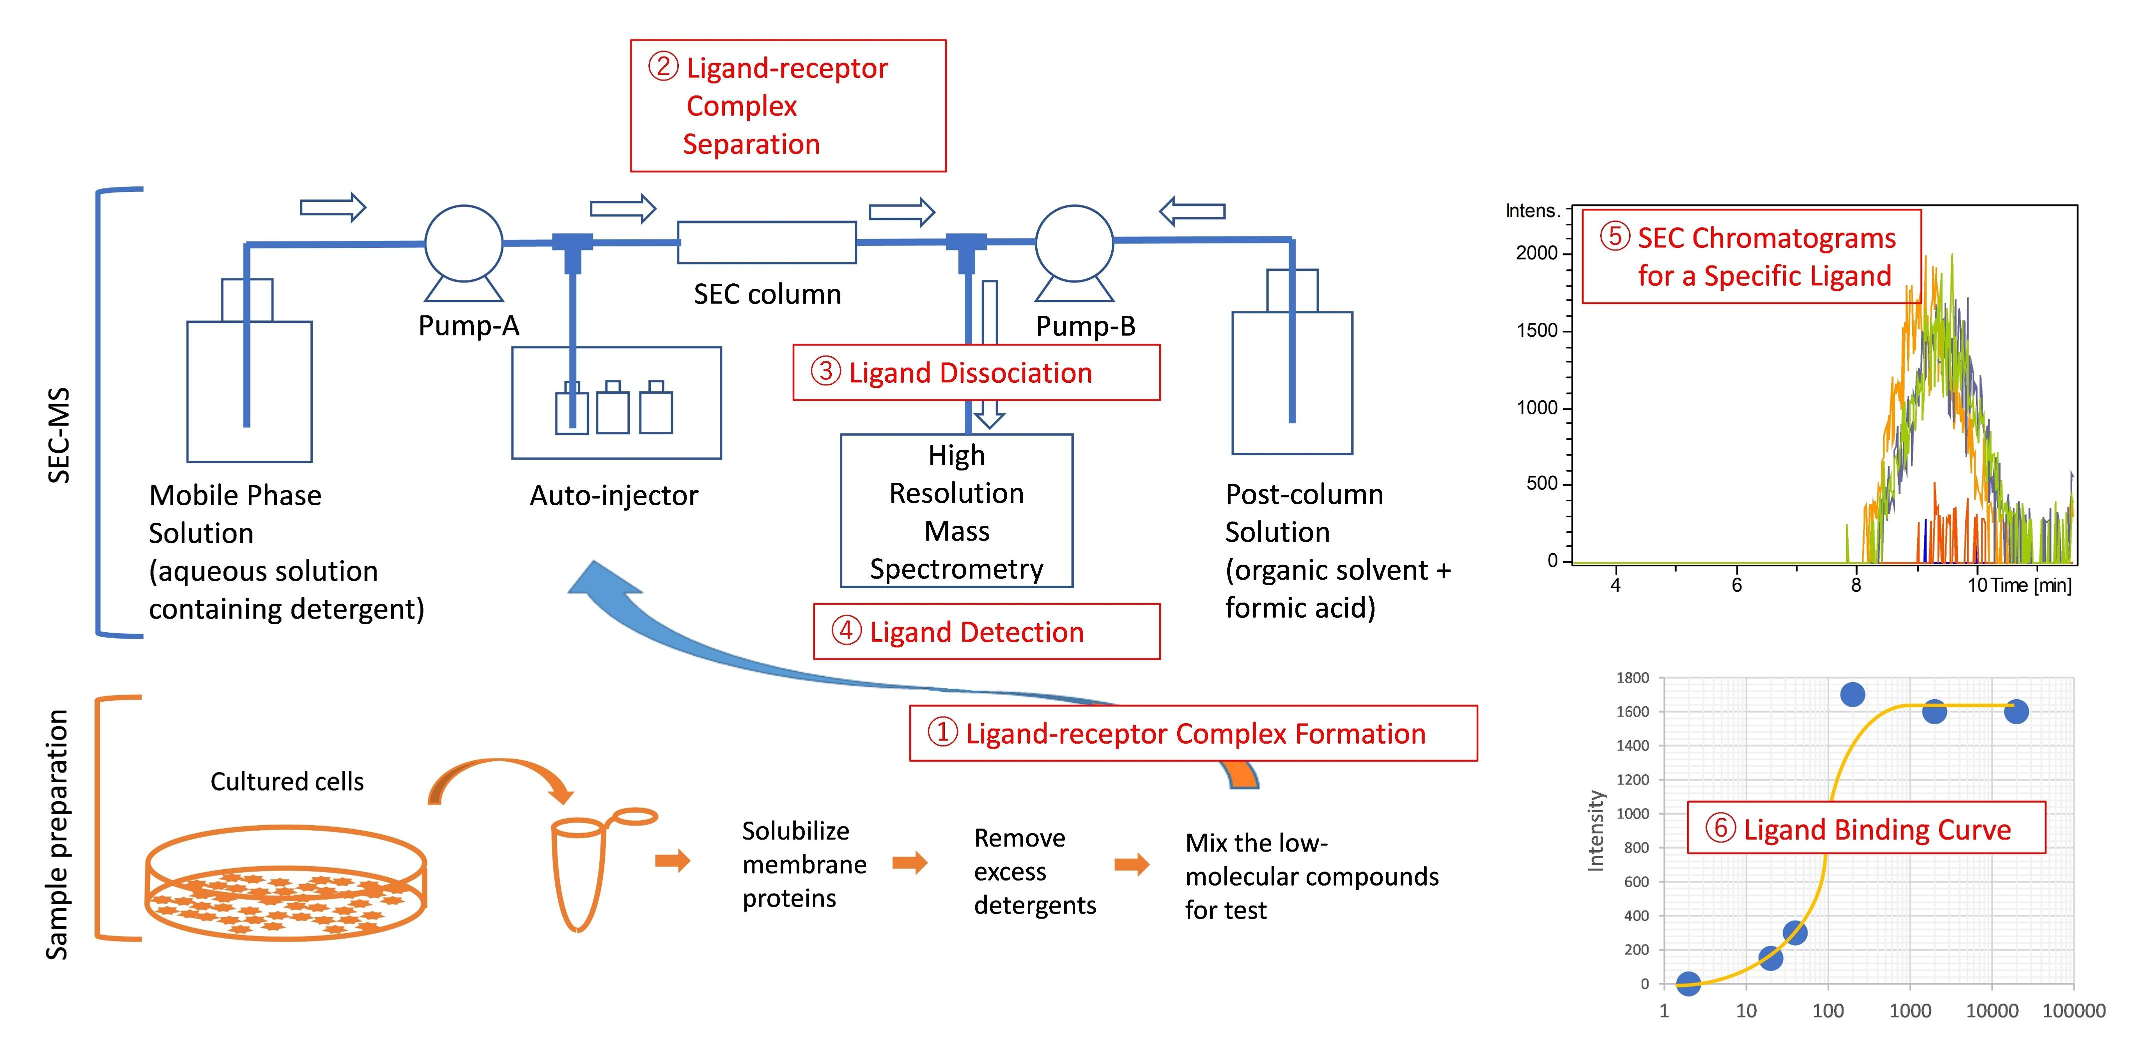

Slide 30
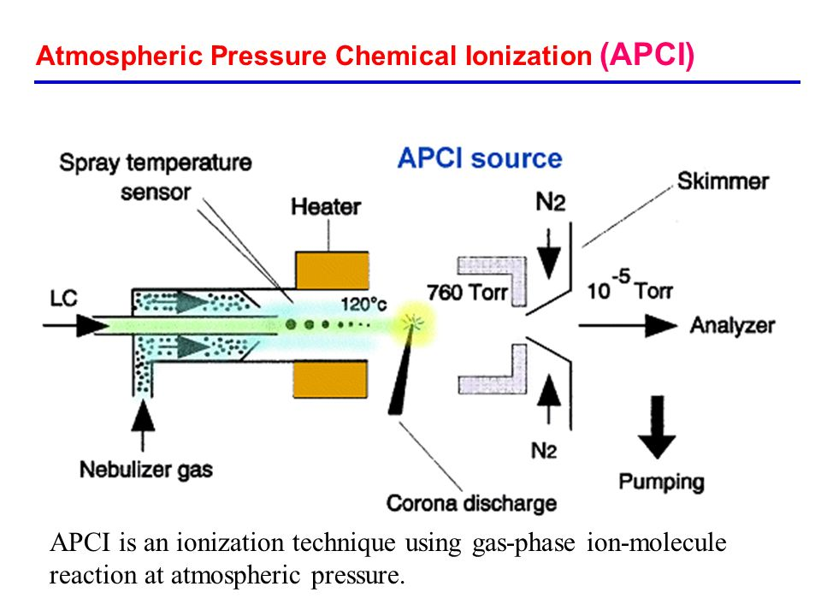

Slide 31
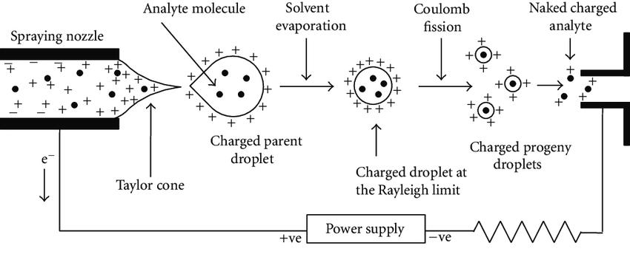
Electrical ionisation

Slide 32
THANK YOU

