Slide 1
TOXIC ELEMENTS &CARBON COMPOUNDS

Slide 2
Toxic elements present in dust & their sources:-
Heavy metals such as arsenium, lead and mercury can result in serious health risks (e.g. Lung damage, kidney diseases, nervous system failures) & can be harmful to the environment (e.g. Soil & water pollution, plants).
1. Lead (Pb⁺²):-
Sources:-
The major sources are lead in atmosphere is,
1. Combustion of leaded petrol
2. Combustion of gasoline (petrol + ethanol)
Here the hydro carbons are 50-80% in motor fuel.
They are two types of leaded petrol available they are,
Pb (CH₃)₄ →Tetra methyl lead
Pb (C₂H₅)₄ → Tetra ethyl lead & these are measured at the absorbance level 2833A^{O}

Slide 3
Natural sources:-
Natural sources are producing considerable pollutants but in the evolution most of these things are essential components of a balanced ecosystem. These sources are a raised from the naturally.
Here forest fires (69%), volcanic eruption (or) action.
Sulphur springs Marsh gases.
Man made sources:-
These are sources a raised from the man activities.
E.g.:-Motor vehicles (59.5%), Automobiles, Burning of coals, burning of fuels. Deforestation, mining, metallurgy, agricultural activities, waste treatment plant.
Power generation, industrial process (iron, steel, paper, & petroleum industries),
Mainly these are manmade sources.
The Automobiles are sources of lead particles in the atmosphere. Combustion of leaded gasoline discharged lead halides though the exhaust system.
Pb (C₂H₅)₄ + O₂ (halogenated scavengers) → PbCl₂+PbBr₂)
(A halogenated scavenger means dichloride ethane or dibromo ethane + CO₂ + H₂O +PbBrCl).
In recent years however this quality is decreasing with the use of unleaded gasoline.

Slide 4
Effects:-
Effects of organic lead:-
Most effect of tetra ethyl lead & tri methyl lead upon the nervous system. They first show as sleepless & irritation.
If the high percentage of lead liberate in atmosphere they cause effect on hallucinations, vision & hearing.
At low persistent levels they cause headache, general fatigue & sometimes depression.
Effects of inorganic acid:-
1. Inorganic lead is poising also starts with fatigue & irritability but it is often accompanied by Anemia & abdominal pain.
2. The anemia is mainly due to fact that one of the early enzymes of haemoid synthesis, D- aminolevulinic acid dehydrates inhibited by inorganic lead while RBCs shows increased fragility & have shortened life spans.
It’s also known as an erythrocyte count. The test is important because RBCs contain hemoglobin, which carries oxygen to your body’s tissues. The number of RBCs you have can affect how much oxygen your tissues receive. Your tissues need oxygen to function.
3. Inorganic lead may increase blood pressure and in children disturb the metabolism of vitamin ‘D’ which effects the growth of their long bones.
4. Inorganic lead also affects kidneys. Generally slowing of nerve is impulses occur with both inorganic & organic forms of lead. Lead is present in the body can be remove as the follows. This is removing in the form of urine.
PO₄⁻³+Pb→Pb₃ (PO₄⁻²)
Ca-Chelate +Pb→ Pb –Chelate +Ca⁺²

Slide 5
Effects of human beings:-
1. The exposure to high levels of lead may cause anemia, weakness & kidney, brain damage. Very high exposure can cause death. Lead can damage a developing baby’s nervous system.
2. Young children are particularly vulnerable to the toxic effects of lead & can suffer profound and permanent adverse health effects.
3. Particularly affecting the developing of the brain & nervous system. Lead also causes long – term harm in adults, including increased risk of high blood pressure & kidney damage.
4. Lead is a toxic metal & very strong poison. Heavy metals are toxic to human beings. Even small amounts of lead can cause serious health problems.
5. Lead serves no useful purpose in the human being. Lead effects on human beings are hormonal status, enzyme, activity, membrane structure, water potential in our body’s.

Slide 6
2. Mercury [Hg (II)]:-
Sources:-
The major sources are ‘Hg’ in chloro alkali industries. In which alkali & Cl₂ are produced by electrolysis. Intermediate sources are electrical industries in which H₂S is used. This source is agriculture industries in which pesticides containing mercury (Hg (II)).
Natural abundance of mercury is in the level of 0.1 ppb & the sources are volcanoes, due to volcanoes explosion 8.0 ppb Hg released into atmosphere. Major sources are cinnabar [HgS] & due to fossil fuel < 1, coals exhibit 100 ppb. Due to ‘Hg’ we observe psychopathological symptoms like dryness.
Natural sources:-
Natural sources are producing considerable pollutants but in the evolution most of these things are essential components of a balanced ecosystem.
These sources are a raised from the naturally.
Forest fires (69%), volcanic eruption (or) action, Sulphur springs Marsh gases.
Man made sources:-
These are sources a raised from the man activities.
E.g.:-Motor vehicles (59.5%), Automobiles, burning of coals, burning of fuels. Deforestation, mining, metallurgy, agricultural activities, waste treatment plant, power generation, industrial process (iron, steel, paper, & petroleum industries),
Mainly these are manmade sources.

Slide 7
Effects:-
Minamata disease:-
Minamata disease was first discovered in the city of Minamata in Japan in 1956. It was caused by the release of methyl mercury in the industrial wastewater from a chemical factory owned by the Chisso Corporation, which continued from 1932 to 1968. The cause of Minamata disease is the methyl mercury contaminated wastewater released from a factory in the area. Minamata disease can be contracted by eating seafood polluted by methyl mercury.
This is a disorder caused by methyl mercury poisoning that was first described in the inhabitants of Minamata Bay, Japan & resulted from their eating fish contaminated with mercury industrial waste.
Minamata disease, sometimes referred to as Chisso-Minamata disease, is a neurological disease caused by severe mercury poisoning, numbness in the hands and feet, general muscle weakness, damage to hearing and speech, neurological symptoms. Thousands of peoples lost their life’s & thousands of peoples are genetic effects are observed in the bodies. The main treatments involve the temporary relief of symptoms (symptomatic therapy), & rehabilitation (physiotherapy & occupational therapy).

Slide 8
3. Arsenic [As (III)]:-
Arsenic poisoning is a medical condition that occurs due to elevated levels of arsenic in the body. If arsenic poisoning occurs over a brief period of time, symptoms may include vomiting, abdominal pain, and watery diarrhea that contain blood. Soluble inorganic arsenic can have immediate toxic effects. Ingestion of large amounts can lead to gastrointestinal symptoms such as severe vomiting, disturbances of the blood and circulation, damage to the nervous system, and eventually death.
Arsenic compound commonly occurs in insecticides, fungicides, and herbicides these among its compounds As (III) are the most toxic. As (III) exits its toxic action by attacking ‘SH’ groups of an enzyme there is inhibiting enzyme action.

Slide 9
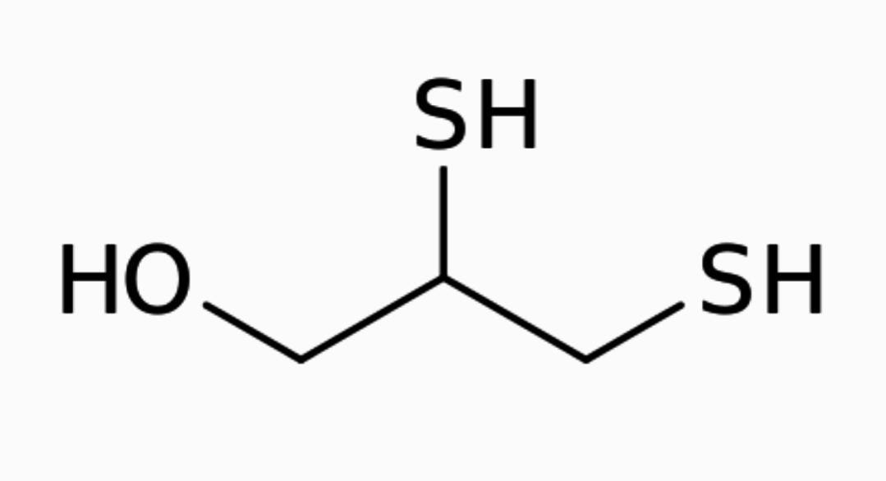
As (III) is removed by body is treating with 2, 3-dimercaptopropanol. As (III) compounds at higher concentrations coagulate proteins possible by attacking the sulphur bonds maintaining the secondary & tertiary structures of proteins.
The structure of 2, 3- dimercaptopropanol is,
a) Primary pollutants:-
i). Carbon compounds:-
1. Carbon monoxide (CO)
2. Carbon dioxide (CO₂)
1. Determination of Carbon monoxide (CO):-
Sources:-
Natural sources:-
Natural sources are producing considerable pollutants but in the evolution most of these things are essential components of a balanced ecosystem. These sources are a raised from the naturally.
Forest fires (69%), volcanic eruption (or) action, sulphur springs (gas), marsh gases.

Slide 10
1. Determination of Carbon monoxide (CO):-
Sources:-
Natural sources:-
Natural sources are producing considerable pollutants but in the evolution most of these things are essential components of a balanced ecosystem. These sources are a raised from the naturally.
Forest fires (69%), volcanic eruption (or) action, sulphur springs (gas), marsh gases.
Man made sources:-
These are sources a raised from the man activities.
E.g.:-Motor vehicles (59.5%), Automobiles, burning of coals, burning of fuels. Deforestation, mining, metallurgy, agricultural activities, waste treatment plant, power generation, industrial process (iron, steel, paper, & petroleum industries), Mainly CO is generated from the burning of coal, gasoline, motor exhaust.
Sinks of ‘CO’:-
The possible sinks of ‘CO’ are atomic oxygen, hydroxyl radicals & oxides of micro organisms, plants are sinks of ‘CO’.
Reactions of ‘CO’:-
CO+O₂→CO₂
꞉OH+CO→ CO₂+H

Slide 11
Content in the atmosphere:-
Global concentration average = 0.1ppm
Local area = 0.5ppm
Effects:-
1. Effects of ‘CO’ on human beings.
2. Effects of ‘CO’ on building material.
3. Effects of ‘CO’ on plants.
Effects of ‘CO’ on human beings:
Here dizziness and headache. It is formation of carboxy Hemoglobin in blood.
Hemoglobin reacts with carbon monoxide & produce CO-Hb [carboxy hemoglobin]
O₂Hb+CO→CO-Hb+O₂

Slide 12
CO is a color less gas, odor less gas. ‘CO’ is combine with hemoglobin to produce carboxy hemoglobin which restricts transport of oxygen from lungs to cells will the blood stream caring less oxygen, Brain function is affected & heart rate is increases in an attempt to offset the oxygen deficit.
The amount of carboxy Hemoglobin in the blood is normally expressed as the % of saturation level % of CO Hb carboxy hemoglobin is three factors.
1. The carbon monoxide concentration
2. Length of time exposed.
3. Breathing rate control the extent of carboxy hemoglobin in blood.

Slide 13
The above figure represents the relative of carboxy hemoglobin with different exposure times of ‘CO’ that within 3 to 4 hours carboxy hemoglobin reaches 50% its saturation value.
Effect of ‘CO’ on building material:-
The building materials are damaged on reacting with carbon compounds. In atmospheric air containing more carbon compounds, these are serious effects on building materials.
Effects of ‘CO’ on plants:-
In atmosphere air ‘CO’ levels increases show extreme toxicity towards plants damaging growth vegetation & leaves falling.
Control of ‘CO’ pollutants:-
The transformation sources are responsible for 74% of all ‘CO’ emissions & gasoline internal combinations are primary accountable for it. The possible solutions are controlling ‘CO’ emissions into the atmosphere are,
Modification of internal combination engines to remove the amounts of pollutants formed during fuel combustion by using catalytic convertors. E.g.:- ‘Pt’ catalyst.
The development is exhaust system reactors, which will complete the combustion process.

Slide 14
Development of pollution free power sources to replace the internal combustion engine.
E.g.: - Steam, electric & gas turbines (machine).
Development of substitute fuels for gasoline.
E.g.: - Natural gas in both compressed [CNG] & Liquid fuel gas in both compressed [LNG]
These are used as fuel. Where removing of the pollutants from the process of effluent. We are using the glass, gas cleaning equipment.
Analysis of ‘CO’:-
Sampling of gases:-
Sampling & pre concentration:-
A. Adsorption method:-
Adsorption is a surface phenomenon. This phenomenon is used for the sampling & pre concentration of gaseous substances. Active charcoal is an efficient adsorbent for volatile organic compound. After adsorption the charcoal is washed with a suitable solvent, such as ‘CS₂’ and the solution is analyzed by using the gas chromatography.

Slide 16
Beside the charcoal Al₂O₃, silicate and molecular sieves are also used as adsorbents for H₂ adsorption ‘Pd’ is used. This is adsorption process is used in purge & trap system. Purge and trap system is a form lead space analysis in which the volatile analyte is trapped on absorbent and then thermally desorbed.
B. Absorption method:-
The other technique for the sampling and pre concentration of gases is absorption phenomenon. We collection are SO_{x}, NOx, HCl, H₂S, H₂SO₄. This technique is used. Impinges are used for this technique. In this gas is absorbed in a solvent by building the gas through a liquid.
The rate of absorption depends on optimum conditions for efficient sampling are:-
Bubble size small
Temperature low
Pressure more
Concentration is absorbent.
For collection of HF is used water as absorbing solution
For basic gases are used as acid solutions
For acidic gases are used as basic solutions
For oils are used as hydro carbons are used

Slide 17
THANK YOU

