Slide 1
Ion selective electrode
(ISE)
B.Madhavi
Asst.Professor
Dept.of P.G.Chemistry
D.N.R.College
Bhimavaram

Slide 2
Introduction
Ion selective electrode (ISE) is an analytical technique used to determine the activity of ions in aqueous solution by measuring the electrical potential.
Specific ion dissolved in a solution create an electrical potential, which can be measured by a voltmeter or pH meter.
The strength of this charge is directly proportional to the concentration of the selected ion.

Slide 3
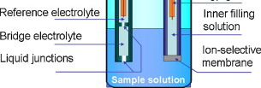

Slide 4
Principle
ISE consists of a thin membrane
Only specific ion can be diffuse.
By measuring the electric potential generated across a membrane by “selected” ions, and comparing it with reference electrode.
And net charge is determined.

Slide 5
Potentiometry
Potentiometry
Use of Electrodes to Measure Provide Chemical concentration
Voltages
that
Indicator Electrode:
Electrode that responds to analyte
Reference Electrode:
Second ½ cell at a constant potential
Cell voltage is difference between the indicator and reference electrode

Slide 6
Reference Electrode
Silver-Silver Chloride Reference Electrode

Slide 7
Types of ISE
Glass membrane
Solid state electrode
Liquid based electrode
Compound electrode

Slide 8
Glass Membrane Electrode
This method uses the electrical potential of pH-sensitive electrodes as a measurement signal.
The glass electrode is the most commonly used sensor.
Not having the disadvantages of the optical methods, it can be used almost universally.

Slide 9
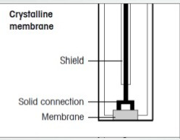
Solid State Electrode
Electrode body of Inorganic crystalline polymer.
E.g. Special Epoxide Resin with excellent mechanical properties.
High temperature stability.

Slide 10
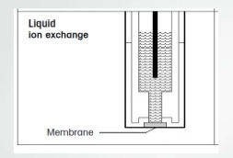
Liquid based electrode
Formed by a very thin layer of an organic liquid.
Membrane is like jelly
Impermeable to water
only to allow to pass certain ion.
Organic material
Carbon tetrachloride
Benzene
Mesitylene

Slide 11
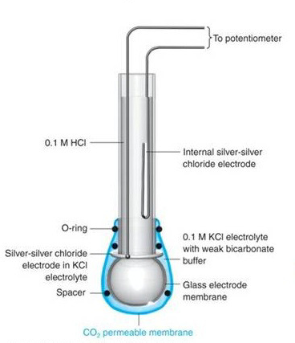
Compound electrode
Electrode have membrane of multiple type

Slide 12
Electrolytes
Type of ions
Cations – Positive charge
move toward the cathode
Na+ = Extracellular – Brain Activity
K+ = Intracellular – Heart & Muscle
Ca+ = Extracellular – Heart & Muscle
H+ = Extracellular - Acidic
Anions – Negative charge
move toward the anode
Cl – Extracellular
HCO–3 – Extracellular - Basic
12

Slide 13
Sample Collection
Serum
Collected in heparin bulb
Plain
EDTA can not be use for doing electrolyte
EDTA is chelating agent & anti-coagulant.
It chelat with all ions of blood
So interfere with concentration of ions
Urine
Collected in plain vacuette
13

Slide 14
Types of Heparin vacuette
Ammonium
Lithium = Lithium+ heparin
Sodium=Sodium+ heparin For measure the sodium
lithium heparin vacuette
ammonium heparin vacuette
Use of sodium vacuette gives false high sodium concentration.

Slide 15
Routinely measured electrolytes
Sodium
(90%)Major cation
Extracellular fluid outside cells Normal values
Serum = 135-145 mEq/L
Urine (24 hr ) = 40-220 mEq/L
Functions
Influence on regulation of body water
Osmotic activity
Central - Neuromuscular activity
15

Slide 16
Hyponatremia
Hyponatremia <135 mEq/L
Increased Na+ loss
Causes
Diabetes mellitus
Diabetic Ketoacidosis
–- Because of diuresis
Severe diarrhea & Severe Vomiting
16

Slide 17
Hypernatremia
Excess water loss
resulting in
dehydration (relative increase)
Dehydration from inadequate intake
Dehydration due severe diarrhea
Diabetes insipidus
Burns
water
17

Slide 18
Potassium (K)
(2%)major cation
Intracellular fluid inside cell Normal value
Serum- 3.5-5.3 mEq/L
Urine- 25-125 mEq/L
Function
Heart muscle contraction
Increase or Decrease K+ = Arrhythmiasis
18

Slide 19
Hypokalemia
Hypokalemia = a low level of potassium (K⁺) in the blood serum.
Diarrhea
Medications like furosemide (diuretic)
Dialysis
Diabetes insipidus
Hyperaldosteronism

Slide 20
Hyperkalemia
Increased K concentration
Causes
Acute Renal failure
Chronic Renal failure
Acidosis (Diabetes mellitus )
H+ competes with K+ to get into cells & to be excreted by kidneys
Decreased insulin promotes cellular K loss
Hyperosomolar plasma (from ↑ glucose) pulls H₂O and potassium into the plasma .
20

Slide 22
Chloride ( Cl ⁻ )
Chloride
Major cation Extracellular fluid
Normal value
Serum – 100 -110 mEq/L
24 hour urine – 110-250 mEq/L varies with intake
CSF – 120-132 mEq/L
22

Slide 23
Hypochloremia
Same as Hyponatremia
congestive heart failure
Severe diarrhea
Severe vomiting
drugs such as
Laxatives
diuretics
corticosteroids
Bicarbonates.
23

Slide 24
Hyperchloremia
Same as Hypernatremia
Increased serum Cl
dehydration
renal tubular disease
metabolic acidosis
24

Slide 25
Advantages
Good Linearity
Good precision
Less chance of damage
No consumption require
Non-contaminating.
Fast analysis.
Less interference from turbidity.
serum color &

Slide 26
Limitations
Electrodes can be block by proteins.
Interference by other ions.
Electrodes are fragile
Limited electrode life – 3 to 4 months.

Slide 27
Application of ISE
Electrolyte
Sodium
Potassium
Calcium
Lithium
Iodine
Magnesium
Chloride
Fluoride
Glucose
Urea
Arterial Blood Gas Analysis
pO2
pCO2
pH
HCO3-
27

Slide 28
THANK YOU

