Slide 1
Introduction to Java Beans
JavaBeans are reusable software components that are written in the Java programming language. JavaBeans can be used to create applications that are modular, reusable, and easy to maintain.
Presented by
K.VENKATESH
MCA DEPARTMENT

Slide 2
What are Java Beans?
1
Reusable Components
2
Platform Independent
JavaBeans are designed to be reusable, meaning they can be used in different applications without having to be rewritten.
JavaBeans are platform-independent, meaning they can run on any platform that supports the Java Virtual Machine (JVM).
3
Modular
4
Data-Driven
JavaBeans are modular, meaning they can be broken down into smaller, independent units that can be developed and tested separately.
JavaBeans are often used to represent data, such as user information, database records, or configuration settings.

Slide 3
Characteristics of Java Beans
Property
Description
Serializable
JavaBeans must be serializable, meaning they can be saved to a file and later retrieved.
Introspectable
JavaBeans must be introspectable, meaning their properties, methods, and events can be accessed and modified at runtime.
Event-Driven
JavaBeans can generate and handle events, allowing them to interact with other components.
Standard Interfaces
JavaBeans must implement standard interfaces, such as java.io.Serializable and java.beans.PropertyChangeListener.

Slide 4
Advantages of Java Beans
Code Reusability
Modular Design
Improved Maintainability
JavaBeans can be reused in different applications, reducing development time and effort.
JavaBeans promote modularity, making it easier to develop, test, and maintain applications.
JavaBeans can be updated and maintained independently, making it easier to fix bugs and add new features.

Slide 5
Java Beans Components
Properties
Data attributes of a JavaBean, representing its state.
Methods
Operations that JavaBeans can perform, such as getting or setting properties.
Events
Notifications that JavaBeans can send to other components, such as property changes.

Slide 6
Java Beans Lifecycle
Initialization
1
JavaBean is created and initialized with default values.
2
Property Setting
Properties are set by external components, configuring the JavaBean.
Event Handling
3
JavaBean listens for and responds to events, interacting with other components.
4
Destruction
JavaBean is removed from the application, releasing resources.

Slide 7
Java Beans and Enterprise JavaBeans (EJB)
EJBs as JavaBeans
EJBs for Business Logic
Enterprise JavaBeans (EJBs) are a type of JavaBean specifically designed for server-side development.
EJBs provide a framework for developing and deploying business logic in a distributed, transactional, and secure environment.
EJBs for Scalability
EJBs for Simplicity
EJBs are designed to be scalable, handling large numbers of users and requests efficiently.
EJBs abstract away complex infrastructure details, simplifying development for enterprise applications.

Slide 8
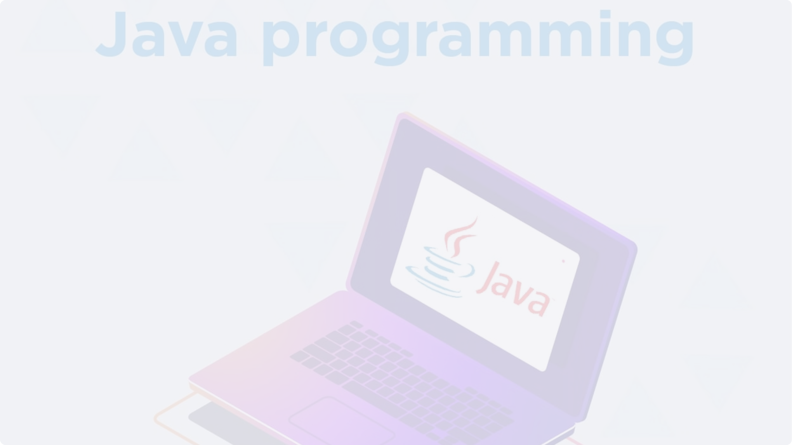
Conclusion and Summary
JavaBeans are essential components in the Java ecosystem, providing reusable, modular, and platform-independent building blocks for various applications. They facilitate code reusability, promote modular design, and simplify development while offering advantages like scalability and improved maintainability. JavaBeans, particularly Enterprise JavaBeans, empower developers to create robust, secure, and scalable enterprise applications.

