Slide 1
Introduction to JSP (JavaServer Pages)
JavaServer Pages (JSP) is a technology for creating dynamic web pages. JSP allows web developers to embed Java code within HTML pages. These pages are compiled and executed on the server, resulting in dynamic content sent to the client.
Presented by
K.VENKATESH
MCA DEPARTMENT

Slide 2
JSP Syntax and Structure
1
Directives
2
Scripting Elements
Directives are used to provide instructions to the JSP engine. They start with <%@ and end with %>. For example, <%@ page language="java" %> specifies Java as the scripting language.
Scripting elements allow you to embed Java code within JSP pages. They are enclosed within <% and %>. For instance, <% out.println("Hello, world!"); %> prints a message.
3
Expressions
4
JSP Tags
Expressions are used to insert the values of Java expressions into the HTML output. They are enclosed within <%= and %>. For example, <%= new java.util.Date() %> displays the current date.
JSP tags are special tags that provide functionality for common tasks, such as accessing data, controlling page flow, and including other files. Some standard tags include <jsp:include> and <jsp:forward>.

Slide 3
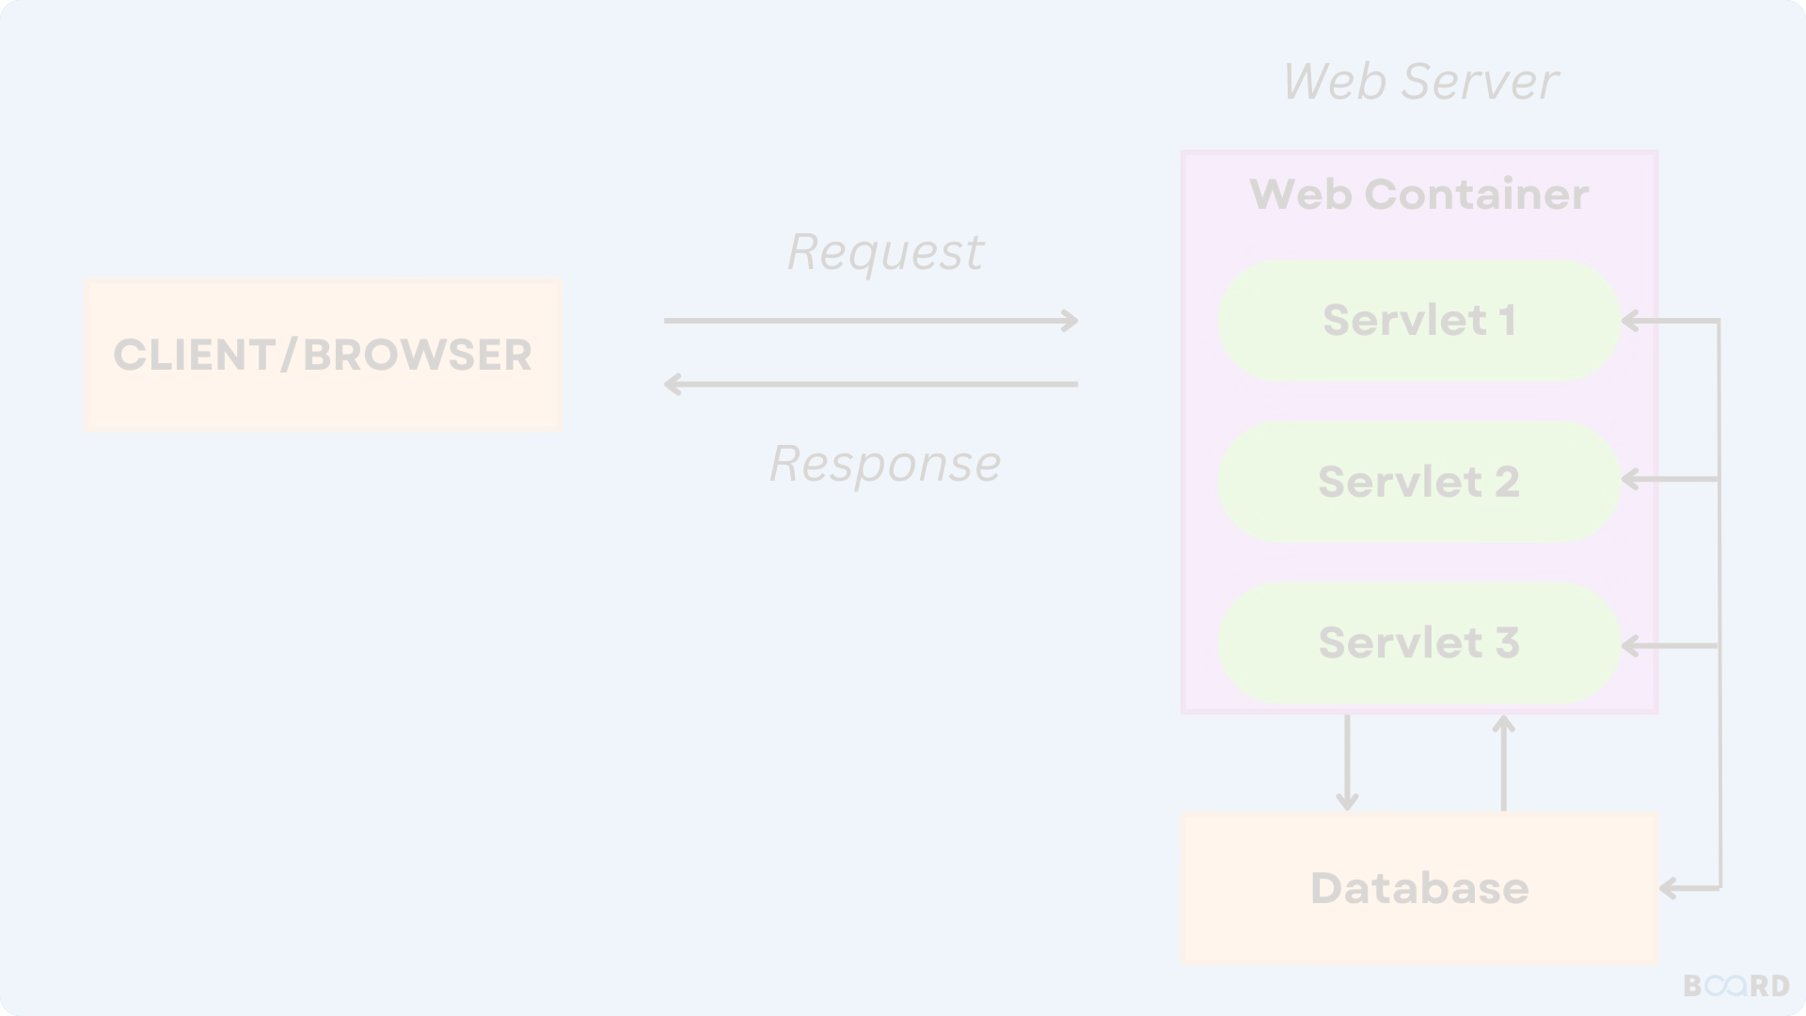
JSP Lifecycle and Processing
1
Translation
The JSP engine translates the JSP file into a servlet class. This class handles the request processing and response generation.
2
Compilation
The servlet class is compiled into bytecode. This process ensures the code is ready for execution on the server.
3
Execution
The compiled servlet class is loaded into memory and executed when a user requests the JSP page. The servlet processes the request and generates the HTML response.

Slide 4
JSP Directives and Scripting Elements
Directive
Purpose
Example
<%@ page %>
Specifies page-level attributes, such as language, import, and error page.
<%@ page language="java" import="java.util.*" %>
<%@ include %>
Includes another file at compile time.
<%@ include file="header.jsp" %>
<%@ taglib %>
Declares a custom tag library.
<%@ taglib prefix="c" uri="http://java.sun.com/jsp/jstl/core" %>

Slide 5
JSP Expression Language (EL)
EL Syntax
EL Objects
EL Functions
EL expressions are enclosed within ${ and }.
EL provides access to implicit objects, such as request, session, and application. These objects provide access to request parameters, session attributes, and application scope data.
EL supports a set of built-in functions for manipulating data, such as string manipulation, date formatting, and arithmetic operations.
Simple expressions: ${variable}
Arithmetic expressions: ${1 + 2}
${fn:toUpperCase(name)}
Relational expressions: ${age > 18}
${fn:substring(message, 0, 10)}
${requestScope.username}
${sessionScope.cart}
${applicationScope.count}

Slide 6
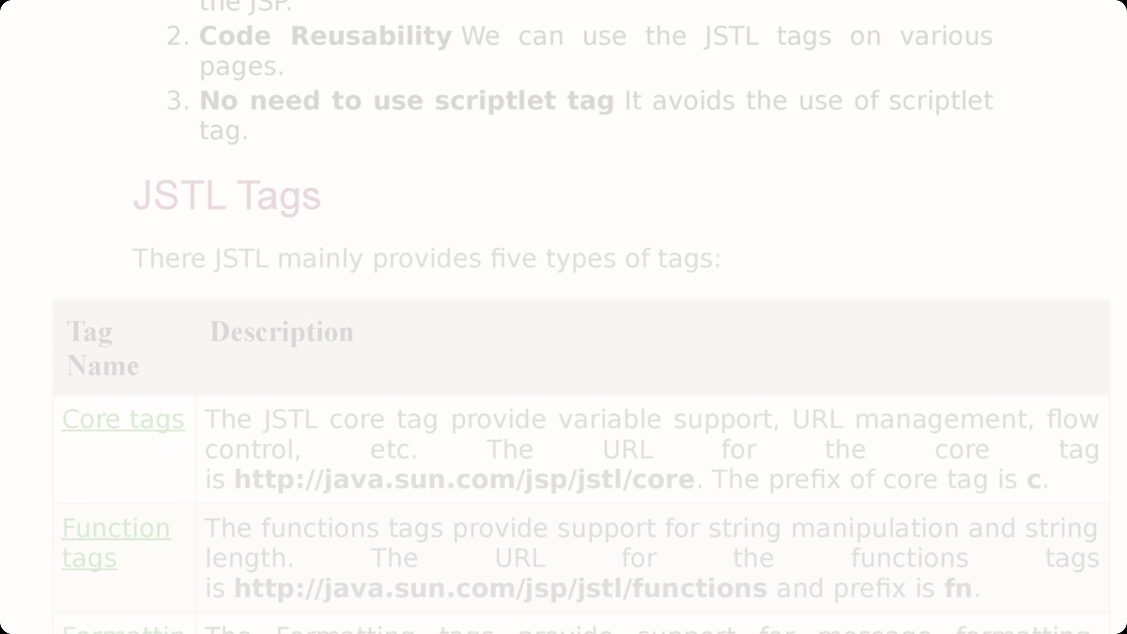
JSP Standard Tag Library (JSTL)
Core Tags
The core tag library provides basic functionalities, such as iteration, conditional logic, and URL manipulation. For example, the <c:forEach> tag iterates over a collection.
SQL Tags
The SQL tag library allows you to execute SQL queries and access database results within JSP pages.
XML Tags
The XML tag library provides tags for processing XML documents, such as parsing and transforming XML data.

Slide 7
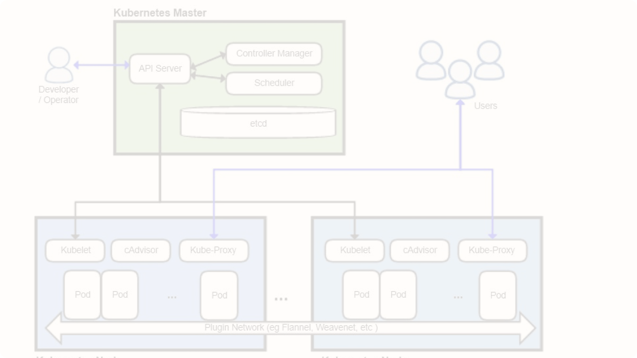
JSP Deployment and Hosting
Web Server
Application Server
Deployment Process
JSP pages are typically deployed on a web server, such as Apache Tomcat or JBoss. These servers provide a runtime environment for executing JSP applications.
Application servers, like WebSphere or GlassFish, offer additional features, such as transaction management, security, and clustering.
JSP files are packaged into a WAR file, which is deployed to the web server. The web server handles the processing and execution of JSP pages.

Slide 8
Conclusion and Best Practices
Security
Performance
Maintainability
Use JSP tags like <jsp:useBean> to access JavaBeans and maintain data integrity. Employ security measures like input validation and output encoding.
Cache frequently accessed data to reduce server load. Optimize JSP code by using EL expressions, JSTL tags, and minimizing database interactions.
Follow coding conventions, use clear and concise naming, and modularize JSP code for better organization and easier updates.

