Slide 1
DATABASE MANAGEMENT SYSTEM
Class : M..C.A II-Semester
Faculty: V.SARALA

Slide 2
Database System Introduction
DBMS
DBMS stands for Database Management System. We can break it like this DBMS = Database + Management System. Database is a collection of data and Management System is a set of programs to store and retrieve those data. Based on this we can define DBMS like this: DBMS is a collection of inter-related data and set of programs to store & access those data in an easy and effective manner.
Database systems are basically developed for large amount of data. When dealing with huge amount of data, there are two things that require optimization: Storage of data and retrieval of data.

Slide 3
Database Management System: The software which is used to manage database is called Database Management System (DBMS). For Example, MySQL, Oracle etc. are popular commercial DBMS used in different applications. DBMS allows users the following tasks:
Data Definition: It helps in creation, modification and removal of definitions that define the organization of data in database.
Data Updation: It helps in insertion, modification and deletion of the actual data in the database.
Data Retrieval: It helps in retrieval of data from the database which can be used by applications for various purposes.

Slide 4
Database Users
Database users are the one who really use and take the benefits of database. There will be different types of users depending on their need and way of accessing the database.
DBA:
DBA Stands for ​Database Administrator​.
It is a person or a team, who is responsible for managing the overall database management system. It is the leader of the database. It is like a superuser of the system. It is responsible for the administration of all the three levels of the database.
DBA is responsible for:
Deciding the instances for the database.
Defining the Schema
Liaising with Users
Define Security
Back-up and Recovery
Monitoring the performance

Slide 5
Database Designers:
Database designers design the appropriate structure for the database, where we share data.
System Analyst:
System analyst analyses the requirements of end users, especially naïve and parametric end users.
Application Programmers:
Application programmers are computer professionals, who write application programs.
Naïve Users / Parametric Users:
Naïve Users are Un-sophisticated users, which has no knowledge of the database. These users are like a layman, which has a little bit of knowledge of the database. Naive Users are just to work on developed applications and get the desired result.

Slide 6
Sophisticated Users:
Sophisticated users can be engineers, scientists, business analyst, who are familiar with the database. These users interact with the database but they do not write programs
Casual Users / Temporary Users:
These types of users communicate with the database for a little period of time.
Application user
The application user is someone who accesses an existing application program to perform daily tasks.

Slide 7
Data Models
A Database model defines the logical design and structure of a database and defines how data will be stored, accessed and updated in a database management system. While the Relational Model is the most widely used database model, there are other models too:
Hierarchical Model
Network Model
Entity-relationship Model
Relational Model

Slide 8
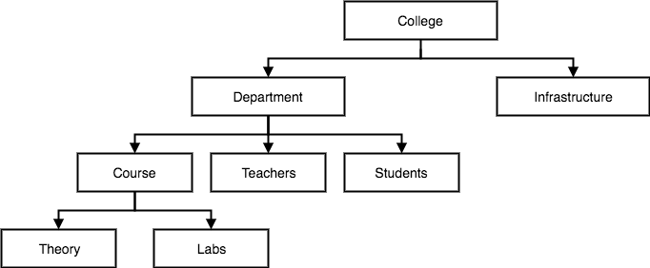
Hierarchical Model
This database model organises data into a tree-like-structure, with a single root, to which all the other data is linked. The heirarchy starts from the Root data, and expands like a tree, adding child nodes to the parent nodes.
In hierarchical model, data is organised into tree-like structure with one one-to-many relationship between two different types of data, for example, one department can have many courses, many professors and of-course many students.

Slide 9
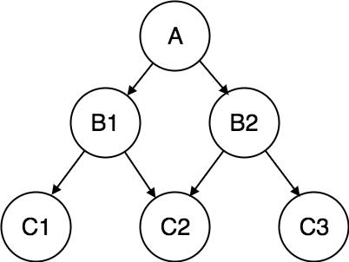
Network Model
This is an extension of the Hierarchical model. In this model data is organised more like a graph, and are allowed to have more than one parent node. In this database model data is more related as more relationships are established in this database model. Also, as the data is more related, hence accessing the data is also easier and fast. This database model was used to map many-to-many data relationships.

Slide 10
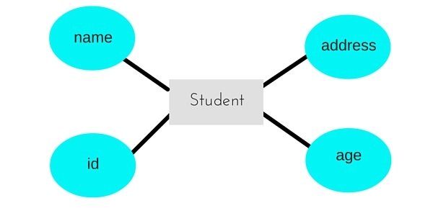
Entity-relationship Model
In this database model, relationships are created by dividing object of interest into entity and its characteristics into attributes.
Different entities are related using relationships. E-R Models are defined to represent the relationships into pictorial form to make it easier for different stakeholders to understand.

Slide 11
Relational Model
In this model, data is organised in two-dimensional tables and the relationship is maintained by storing a common field. This model was introduced by E.F Codd in 1970, and since then it has been the most widely used database model, infact, we can say the only database model used around the world. The basic structure of data in the relational model is tables. All the information related to a particular type is stored in rows of that table.
Hence, tables are also known as relations in relational model.

Slide 13
Schemas and Instances
Database Schema
A database schema is the skeleton structure that represents the logical view of the entire database. It defines how the data is organized and how the relations among them are associated. It formulates all the constraints that are to be applied on the data.
A database schema defines its entities and the relationship among them. It contains a descriptive detail of the database, which can be depicted by means of schema diagrams. It’s the database designers who design the schema to help programmers understand the database and make it useful.

Slide 14
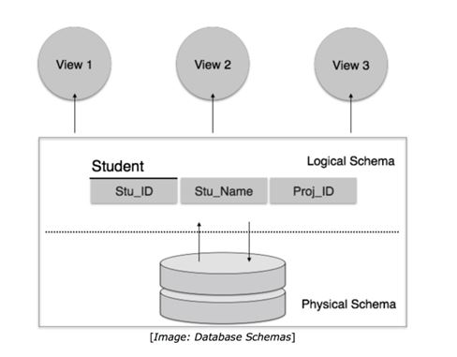

Slide 15
A database schema can be divided broadly into two categories −
Physical Database Schema − This schema pertains to the actual storage of data and its form of storage like files, indices, etc. It defines how the data will be stored in a secondary storage.
Logical Database Schema − This schema defines all the logical constraints that need to be applied on the data stored. It defines tables, views, and integrity constraints.

Slide 16
Database Instance
It is important that we distinguish these two terms individually. Database schema is the skeleton of database. It is designed when the database doesn't exist at all. Once the database is operational, it is very difficult to make any changes to it. A database schema does not contain any data or information.
A database instance is a state of operational database with data at any given time. It contains a snapshot of the database. Database instances tend to change with time. A DBMS ensures that its every instance (state) is in a valid state, by diligently following all the validations, constraints, and conditions that the database designers have imposed.

Slide 17
The conceptual level has a conceptual schema, which describes the structure of the whole database for a community of users. The conceptual schema hides the details of physical storage structures and concentrates on describing entities, data types, relationships, user operations, and constraints. Usually, a representational data model is used to describe the conceptual schema when a database system is implemented. This implementation conceptual schema is often based on a conceptual schema design in a high-level data model.
The external or view level includes a number of external schemas or user views. Each external schema describes the part of the database that a particular user group is interested in and hides the rest of the database from that user group. As in the previous level, each external schema is typically implemented using a representational data model, possibly based on an external schema design in a high-level data model.

Slide 19
DATA INDEPENDENCE
The disjointing of data descriptions from the application programs (or user-interfaces) that uses the data is called data independence. Data independence is one of the main advantages of DBMS. The three-schema architecture provides the concept of data independence, which means that upper-levels are unaffected by changes to lower-levels. The three schemas architecture makes it easier to achieve true data independence. There are two kinds of data independence.

Slide 20
Three-Schema Architecture and Data Independence
The Three-Schema Architecture
The goal of the three-schema architecture, illustrated in Figure, is to separate the user applications from the physical database. In this architecture, schemas can be defined at the following three levels:
The internal level has an internal schema, which describes the physical stor-age structure of the database. The internal schema uses a physical data model and describes the complete details of data storage and access paths for the database.

Slide 21
Physical data independence
* The ability to modify the physical scheme without causing application programs to be rewritten.
* Modifications at this level are usually to improve performance.
Logical data independence
* The ability to modify the conceptual scheme without causing application programs to be rewritten.
* Usually done when logical structure of database is altered.
Logical data independence is harder to achieve as the application programs are usually heavily dependent on the logical structure of the data. An analogy is made to abstract data types in programming languages.

Slide 22
The Database System Environment
A database environment is a collective system of components that comprise and regulates the group of data, management, and use of data, which consist of software, hardware, people, techniques of handling database, and the data also.
The term database system refers to an organization of components that define and regulate the collection, storage, management, and use of data within a database
environment. These are:
• Hardware
• Software
• People
• Procedures
• Data

Slide 24
Hardware: It identifies all the system’s physical devices. The database system’s main and most easily identified hardware component is the computer, which might be a microprocessor, a minicomputer, or a mainframe computer. It also include peripherals like keyboard, mice,
modems, printers, etc.
Software: Software refers to the collection of programs used by the computers within the database system.
Operating system Software
DBMS Software
Application Programs & Utilities Software

Slide 25
People:
System Administrator: oversee the database system’s general operations.
Database Administrator: manage the DBMS’s use and ensure that the database is functioning properly.
Database Designers: design the database structure. They are in effect the database architects. If the database design is poor, even the best application programmers and the most dedicated DBAs will fail to produce a useful database environment.
System Analysts and Programmers: design and implement the application programs.
End Users: are the people who use the application programs to run the organization’s daily operations.

Slide 26
Procedures: Procedures are the instructions and rules that govern the design and use of the database system. Procedure are a critical, although occasionally forgotten, component of the system. Procedures play a very important role in a company, because they enforce the standards by which business is conducted within the organization and with customers. These also are used to ensure that there is an organized way to monitor and audit both the data and information.
Data: The word “data” covers the collection of facts stored in the database. Because data are the raw material from which information is generated, the determination of which data are
to be entered into the database and how such data are to be organized is a vital part of the database designer’s job.

Slide 27
Centralized and Client/Server Architectures
Centralized DBMSs Architecture:
Architectures for DBMSs have followed trends similar to those for general computer system architectures. Earlier architectures used mainframe computers to provide the main processing for all system functions, including user application programs and user interface programs, as well as all the DBMS functionality. The reason was that most users accessed such systems via computer terminals that did not have processing power and only provided display capabilities.
A centralized DBMS in which all the DBMS functionality, application program execution, and user inter-face processing were carried out on one machine. Figure 2.4 illustrates the physical components in a centralized architecture. Gradually, DBMS systems started to exploit the available processing power at the user side, which led to client/server DBMS architectures.

Slide 29
Basic Client/Server Architectures:
First, we discuss client/server architecture in general, then we see how it is applied to DBMSs. The client/server architecture was developed to deal with computing environments in which a large number of PCs, workstations, file servers, printers, database servers, Web servers, e-mail servers, and other software and equipment are connected via a network. The idea is to define specialized servers with specific functionalities. For example, it is possible to connect a number of PCs or small workstations as clients to a file server that maintains the files of the client machines. Another machine can be designated as a printer server by being connected to various printers; all print requests by the clients are forwarded to this machine. Web servers or e-mail servers also fall into the specialized server category. The resources provided by specialized servers can be accessed by many client machines. The client machines provide the user with the appropriate interfaces to utilize these servers, as well as with local processing power to run local applications.

Slide 30
Figure 2.5 illustrates client/server architecture at the logical level;

Slide 31
Figure 2.6 is a simplified diagram that shows the physical architecture. Some machines would be client sites only.

Slide 32
Data Modeling Using the Entity-Relationship Model
Using High-Level Conceptual Data Models for Database Design
Figure 7.1 shows a simplified overview of the database design process. The first step shown is requirements collection and analysis. During this step, the database designers interview prospective database users to understand and document their data requirements. The result of this step is a concisely written set of users’ requirements. These requirements should be specified in as detailed and complete a form as possible. In parallel with specifying the data requirements, it is useful to specify the known functional requirements of the application.

Slide 33
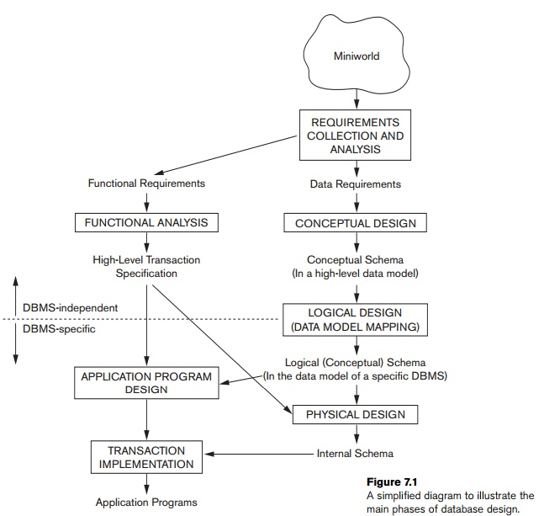

Slide 34
Conceptual Design: Conceptual schema for the database, using a high-level conceptual data model. This step is called conceptual design. The conceptual schema is a concise description of the data requirements of the users and includes detailed descriptions of the entity types, relationships, and constraints; these are expressed using the concepts provided by the high-level data model. Because these concepts do not include implementation details, they are usually easier to understand and can be used to communicate with nontechnical users. The high-level conceptual schema can also be used as a reference to ensure that all users’ data requirements are met and that the requirements do not conflict. This approach enables database designers to concentrate on specifying the properties of the data, without being concerned with storage and implementation details. This makes it is easier to create a good conceptual data-base design.

Slide 35
Logical Design: The next step in database design is the actual implementation of the database, using a commercial DBMS. Most current commercial DBMSs use an implementation data model—such as the relational or the object-relational database model—so the conceptual schema is transformed from the high-level data model into the implementation data model. This step is called logical design or data model mapping; its result is a database schema in the implementation data model of the DBMS. Data model mapping is often automated or semiautomated within the database design tools.
Physical Design: The last step is the physical design phase, during which the internal storage structures, file organizations, indexes, access paths, and physical design parameters for the database files are specified. In parallel with these activities, application programs are designed and implemented as database transactions corresponding to the high-level transaction specifications.

Slide 36
Entity Types, Entity Sets
Entity
An entity is a real-world thing which can be distinctly identified like a person, place or a concept. It is an object which is distinguishable from others. If we cannot distinguish it from others then it is an object but not an entity. An entity can be of two types:
Tangible Entity: Tangible Entities are those entities which exist in the real world physically. Example: Person, car, etc.
Intangible Entity: Intangible Entities are those entities which exist only logically and have no physical existence. Example: Bank Account, etc.

Slide 37
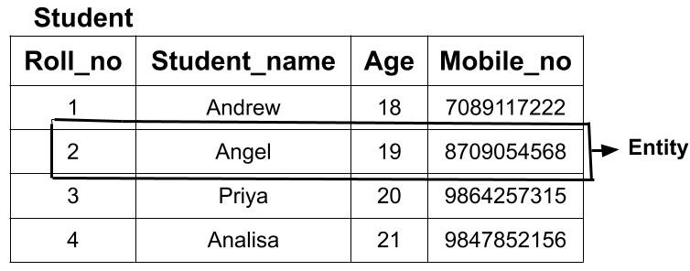
Example: If we have a table of a Student (Roll_no, Student_name, Age, Mobile_no) then each student in that table is an entity and can be uniquely identified by their Roll Number i.e Roll_no.

Slide 38
Entity Type
The entity type is a collection of the entity having similar attributes. In the above Student table example, we have each row as an entity and they are having common attributes i.e each row has its own value for attributes Roll_no, Age, Student_name and Mobile_no. So, we can define the above STUDENT table as an entity type because it is a collection of entities having the same attributes. So, an entity type in an ER diagram is defined by a name(here, STUDENT) and a set of attributes(here, Roll_no, Student_name, Age, Mobile_no). The table below shows how the data of different entities( different students) are stored.

Slide 39
The E-R representation of the above Student Entity Type is done below.

Slide 40
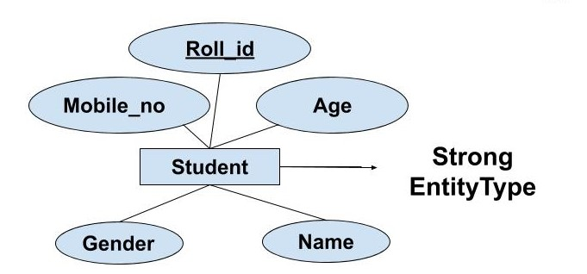
Types of Entity type
Strong Entity Type
Weak Entity Type
Strong Entity Type: Strong entity are those entity types which has a key attribute. The primary key helps in identifying each entity uniquely. It is represented by a rectangle. In the above example, Roll_no identifies each element of the table uniquely and hence, we can say that STUDENT is a strong entity type.

Slide 41
Weak Entity Type: Weak entity type doesn't have a key attribute. Weak entity type can't be identified on its own. It depends upon some other strong entity for its distinct identity. This can be understood with a real-life example. There can be children only if the parent exits. There can be no independent existence of children. There can be a room only if building exits. There can be no independent existence of a room. A weak entity is represented by a double outlined rectangle. The relationship between a weak entity type and strong entity type is called an identifying relationship and shown with a double outlined diamond instead of a single outlined diamond. This representation can be seen in the diagram below.

Slide 42
Example: If we have two tables of Customer(Customer_id, Name, Mobile_no, Age, Gender) and Address(Locality, Town, State, Customer_id). Here we cannot identify the address uniquely as there can be many customers from the same locality. So, for this, we need an attribute of Strong Entity Type i.e ‘Customer’ here to uniquely identify entities of 'Address' Entity Type.

Slide 43
Entity Set
An Entity set is a group of entities that posses the same set of attributes. Each entity in an entity set has its own set of values for the attributes which make it distinct from other entities in a table. No two entities in an entity set will have the same values for the attributes. (or)
Entity Set is a collection of entities of the same entity type. In the above example of STUDENT entity type, a collection of entities from the Student entity type would form an entity set. We can say that entity type is a superset of the entity set as all the entities are included in the entity type. Let's try to understand this with the help of an example.

Slide 44
Example: In the below example, two entities E1 (2, Angel, 19, 8709054568) and E2(4, Analisa, 21, 9847852156) form an entity set.

Slide 45
Types of Entity Set
Entity set can be classified into two categories as shown below:
Strong Entity Set
Weak Entity Set
Strong Entity Set
An entity set that has a primary key using which, entities in the table can be uniquely identified. This kind of entity set is termed as a strong entity set. Strong entity set is also known as a regular entity set.
In an ER diagram, the strong entity set is represented by the rectangle. Here, the primary key is underlined with the solid line.

Slide 46
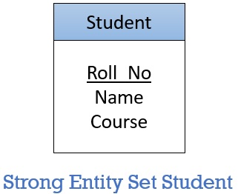
An in ER diagram it would be represented as below.
Weak Entity Sets
A weak entity set doesn’t have any primary key which can identify each entity in a set distinctly. But, for discriminating the entities in a set, the weak entity set is dependent on a particular strong entity set.

Slide 47
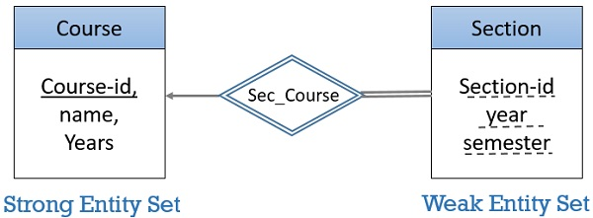
The weak entity is shown by a rectangle in an ER diagram. But, the attributes of weak entity set are underlined with the dashed line. The relationship of a weak entity set and strong entity set is shown with the double diamond as shown in the figure below

Slide 48
Attributes and Keys
Attributes: Attributes are the set of features that describe an entity. For example, suppose we an entity Student. To describe its characteristics or properties we need attributes like Roll Number, First Name, Middle Name, Last Name, Date of Birth, Age, Phone No., Address etc. Attributes are basically used to differentiate one entity from another. When we chose an attribute or set of attributes to distinctly identify entities in entity sets, they are called keys. Attributes and Keys in ER Diagrams define characteristics of entities.

Slide 49
Attributes and Keys in ER Diagrams are represented by ellipse or oval along with the underlined entity names.

Slide 50
Types of Attributes
On the Basis of Composition
1. Simple Attributes
Attributes that have only atomic values are called simple attributes. These cannot be divided further. Student Roll Number is a simple entity. Each student entity will have a Roll Number that may store a single numeric or alphanumeric value. Simple attributes are represented by oval with single outline in an ER diagrams.
2. Composite Attributes
Attributes that can be further divided and represented into simple attributes are called composite attributes. For example Name attribute can be divided into First Name, Middle Name and Last Name. Address attribute is usually divided into House Number, Street, City, State and Zip Code. Composite attributes are represented by an oval connected with other attribute ovals in an ER diagram.

Slide 51
On the Basis of Count of Values that can be Stored
1. Single Valued Attributes
Single valued attributes can have only one value at a given instance of time. For example Date of Birth, Roll Number, Father’s Name attributes can have single value. These are represented by single outline ovals in ER diagram.
2. Multi Valued Attributes
Multi valued attributes can have more than one value at a given instance of time. For example a person can have multiple Phone Numbers, E-mail Ids, Addresses, Qualifications, Job Experiences. Multi valued attributes are represented with double outlined ovals in ER diagrams. In relational database a separate table is created for multi valued attributes. These are not simply included as a column in an entity relation.

Slide 52
On the Basis of How the Attribute Value can be Stored
1. Stored Attributes
The attributes whose values are stored in database and which does not change over a period of time are called Stored Attributes. The values in Stored Attributes can be used to derive values for other attribute. Date of Birth and Basic Pay are examples of Stored Attribute. These are represented as ovals with single outline in ER diagram.
2. Derived Attribute
The attributes whose values can change over time and can be derived from the stored attributes are called Derived Attributes. For example age attribute of a person changes from time to time. So we can keep this attribute in database as derived attribute. It can be derived from Date of Birth attribute and current date. You may have seen many times while filling an online form that on filling Date of Birth, Age is automatically calculated. Derived attribute is represented by dashed or dotted outline ovals in the ER diagram.

Slide 53
Types of Keys used in ER Diagrams
Primary Key
It is the attribute or set of attributes that can uniquely identify each entity in an entity set. In the previous ER diagram Roll Number is chosen as the primary key. It is represented by underlining the attribute name.
There are certain properties for a primary key to follow. These are:
Unique values must not be null i.e. primary key attribute must never contain null values for any entity.
All values of the primary key attribute must be unique.
When choosing a primary key from the pool of candidate key always choose a single simple key over a composite key. For example here in the above example, {Roll Number}, {Registration Number}, {DOB, Name} are possible candidate keys. So instead of taking {DOB, name} as the primary key we have chosen {Roll Number} as the primary key for Student Entity Set.

Slide 54
Foreign key
It is an attribute or set of attributes that must have values from Primary Key of the strong Entity on which a weak Entity depends on. It is represented by underlining the attribute name with a dotted line.
Whenever there is some relationship between two entities there must be some common attributes between them. An attribute to become a foreign key must satisfy some conditions:
Values of foreign key attribute must have the same domain as defined for the primary key of the Strong Entity Set.
The foreign key values for any entity of an entity set are either null or must match the primary key data values of some entity of the primary key entity set.

Slide 55
Relationships Types
Any association between two entity types is called a relationship. Entities take part in the relationship. It is represented by a diamond shape.
For example, A teacher teaches students. Here, "teaches" is a relationship and this is the relationship between a Teacher entity and a Student entity.
There are three types of relationships that can exist between two entities.
One-to-One Relationship
One-to-Many or Many-to-One Relationship
Many-to-Many Relationship

Slide 56
One-to-One Relationship
Such a relationship exists when each record of one table is related to only one record of the other table.
For example, If there are two entities ‘Person’ (Id, Name, Age, Address)and ‘Passport’(Passport_id, Passport_no). So, each person can have only one passport and each passport belongs to only one person.

Slide 57
One-to-Many or Many-to-One Relationship
Such a relationship exists when each record of one table can be related to one or more than one record of the other table. This relationship is the most common relationship found. A one-to-many relationship can also be said as a many-to-one relationship depending upon the way we view it.
For example, If there are two entity type ‘Customer’ and ‘Account’ then each ‘Customer’ can have more than one ‘Account’ but each ‘Account’ is held by only one ‘Customer’. In this example, we can say that each Customer is associated with many Account. So, it is a one-to-many relationship. But, if we see it the other way i.e many Account is associated with one Customer then we can say that it is a many-to-one relationship.

Slide 58
Many-to-Many Relationship
Such a relationship exists when each record of the first table can be related to one or more than one record of the second table and a single record of the second table can be related to one or more than one record of the first table. A many-to-many relationship can be seen as a two one-to-many relationship which is linked by a 'linking table' or 'associate table'. The linking table links two tables by having fields which are the primary key of the other two tables. We can understand this with the following example.
Example: If there are two entity type ‘Customer’ and ‘Product’ then each customer can buy more than one product and a product can be bought by many different customers.

Slide 59
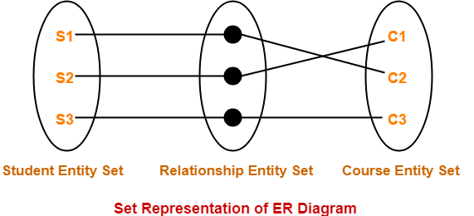
Relationships Sets
Relationship Set
A relationship set is a set of relationships of same type.
Example- ‘Enrolled in’ is a relationship that exists between entities Student and Course.
Example- Set representation of above ER diagram is-

Slide 60
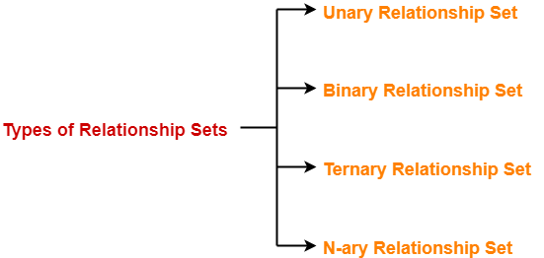
Degree of a Relationship Set
The number of entity sets that participate in a relationship set is termed as the degree of that relationship set.
Types of Relationship Sets
On the basis of degree of a relationship set, a relationship set can be classified into the following types-

Slide 61
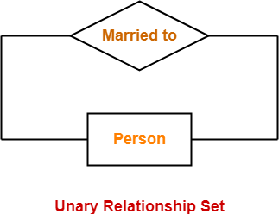
Unary relationship set
Binary relationship set
Ternary relationship set
N-ary relationship set
1. Unary Relationship Set
Unary relationship set is a relationship set where only one entity set participates in a relationship set.
Example-

Slide 62
2. Binary Relationship Set
Binary relationship set is a relationship set where two entity sets participate in a relationship set.
Example-

Slide 63
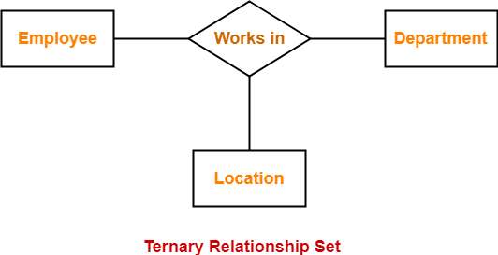
3. Ternary Relationship Set
Ternary relationship set is a relationship set where three entity sets participate in a relationship set.
Example-
4. N-ary Relationship Set
N-ary relationship set is a relationship set where ‘n’ entity sets participate in a relationship set.

Slide 64
Weak Entity Types
A weak entity is an entity set that does not have sufficient attributes for Unique Identification of its records
Simply a weak entity is nothing but an entity which does not have a primary key attribute
It contains a partial key called as discriminator which helps in identifying a group of entities from the entity set
Discriminator is represented by underlining with a dashed line
Representation
A double rectangle is used for representing a weak entity set
The double diamond symbol is used for representing the relationship between a strong entity and weak entity which is known as identifying relationship
Double lines are used for presenting the connection with a weak entity set with relationship

Slide 65
Weak Entity Set

Slide 66
There are two types of weak entities: associative entities and subtype entities. The latter represents a crucial type of normalization, where the super-type entity inherits its attributes to subtype entities based on the value of the discriminator.
A government standard for capturing requirements, possible sub-type relationships are:
Complete subtype relationship, when all categories are known.
Incomplete subtype relationship, when all categories may not be known.

Slide 67
ER Diagrams
An ER diagram shows the relationship among entity sets. An entity set is a group of similar entities and these entities can have attributes. In terms of DBMS, an entity is a table or attribute of a table in database, so by showing relationship among tables and their attributes, ER diagram shows the complete logical structure of a database. Lets have a look at a simple ER diagram to understand this concept.
A simple ER Diagram:
In the following diagram we have two entities Student and College and their relationship. The relationship between Student and College is many to one as a college can have many students however a student cannot study in multiple colleges at the same time. Student entity has attributes such as Stu_Id, Stu_Name & Stu_Addr and College entity has attributes such as Col_ID & Col_Name.

Slide 68
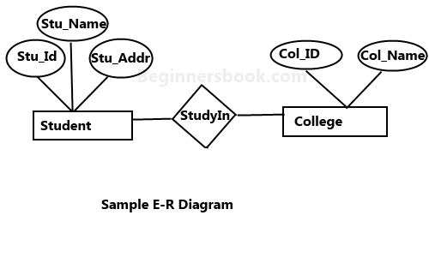
Rectangle: Represents Entity sets.
Ellipses: Attributes
Diamonds: Relationship Set
Lines: They link attributes to Entity Sets and Entity sets to Relationship Set
Double Ellipses: Multivalued Attributes
Dashed Ellipses: Derived Attributes
Double Rectangles: Weak Entity Sets
Double Lines: Total participation of an entity in a relationship set

Slide 69
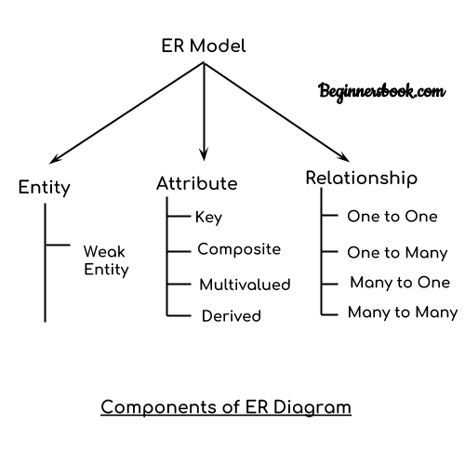
Components of a ER Diagram

Slide 70
an ER diagram has three main components:
1. Entity
2. Attribute
3. Relationship
1. Entity
An entity is an object or component of data. An entity is represented as rectangle in an ER diagram.
For example: In the following ER diagram we have two entities Student and College and these two entities have many to one relationship as many students study in a single college. We will read more about relationships later, for now focus on entities.

Slide 71
2. Attribute
An attribute describes the property of an entity. An attribute is represented as Oval in an ER diagram. There are four types of attributes:
1. Key attribute
2. Composite attribute
3. Multivalued attribute
4. Derived attribute
1. Key attribute:
A key attribute can uniquely identify an entity from an entity set. For example, student roll number can uniquely identify a student from a set of students. Key attribute is represented by oval same as other attributes however the text of key attribute is underlined.

Slide 72
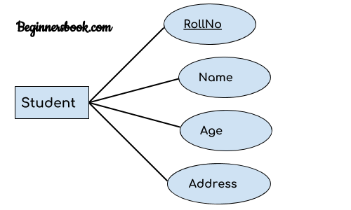
2. Composite attribute:
An attribute that is a combination of other attributes is known as composite attribute. For example, In student entity, the student address is a composite attribute as an address is composed of other attributes such as pin code, state, country.

Slide 73
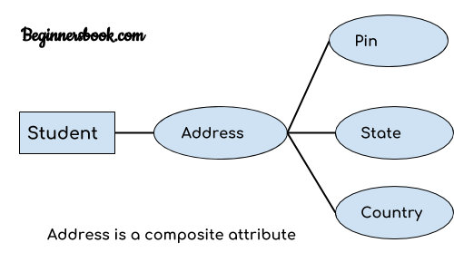
3. Multivalued attribute:
An attribute that can hold multiple values is known as multivalued attribute. It is represented with double ovals in an ER Diagram. For example – A person can have more than one phone numbers so the phone number attribute is multivalued.

Slide 74
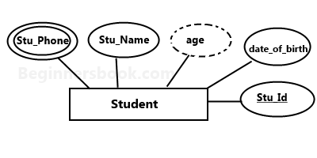
4. Derived attribute:
A derived attribute is one whose value is dynamic and derived from another attribute. It is represented by dashed oval in an ER Diagram. For example – Person age is a derived attribute as it changes over time and can be derived from another attribute (Date of birth).
E-R diagram with multivalued and derived attributes:

Slide 75
3. Relationship
A relationship is represented by diamond shape in ER diagram, it shows the relationship among entities. There are four types of relationships:
1. One to One
2. One to Many
3. Many to One
4. Many to Many

Slide 76
Relational Data Model and Relational Database Constraints
Relational Model Concepts
RELATIONAL MODEL (RM) represents the database as a collection of relations. A relation is nothing but a table of values. Every row in the table represents a collection of related data values. These rows in the table denote a real-world entity or relationship.
Some popular Relational Database management systems are:
DB2 and Informix Dynamic Server - IBM
Oracle and RDB – Oracle
SQL Server and Access - Microsoft

Slide 77
Relational Model Concepts
Attribute: Each column in a Table. Attributes are the properties which define a relation. e.g., Student_Rollno, NAME,etc.
Tables – In the Relational model the, relations are saved in the table format. It is stored along with its entities. A table has two properties rows and columns. Rows represent records and columns represent attributes.
Tuple – It is nothing but a single row of a table, which contains a single record.
Relation Schema: A relation schema represents the name of the relation with its attributes.
Degree: The total number of attributes which in the relation is called the degree of the relation.

Slide 78
6. Cardinality: Total number of rows present in the Table.
Column: The column represents the set of values for a
specific attribute.
Relation instance – Relation instance is a finite set of tuples in the RDBMS system. Relation instances never have duplicate tuples.
Relation key - Every row has one, two or multiple attributes,
which is called relation key.
Attribute domain – Every attribute has some pre-defined
value and scope which is known as attribute domain

Slide 80
Constraints and Relational Schemas
Relational Integrity constraints
Relational Integrity constraints is referred to conditions which must be present for a valid relation. These integrity constraints are derived from the rules in the mini-world that the database represents.
There are many types of integrity constraints. Constraints on the Relational database management system is mostly divided into three main categories are:
Domain constraints
Key constraints
Referential integrity constraints

Slide 81
Domain Constraints
Domain constraints can be violated if an attribute value is not appearing in the corresponding domain or it is not of the appropriate data type.
Domain constraints specify that within each tuple, and the value of each attribute must be unique. This is specified as data types which include standard data types integers, real numbers, characters, Booleans, variable length strings, etc.
Example:
Create DOMAIN CustomerName
CHECK (value not NULL)

Slide 82
Key constraints
An attribute that can uniquely identify a tuple in a relation is called the key of the table. The value of the attribute for different tuples in the relation has to be unique.
Example:
In the given table, CustomerID is a key attribute of Customer Table. It is most likely to have a single key for one customer, CustomerID =1 is only for the CustomerName =" Google".
CustomerID CustomerName Status
1 Google Active
2 Amazon Active
3 Apple Inactive

Slide 83
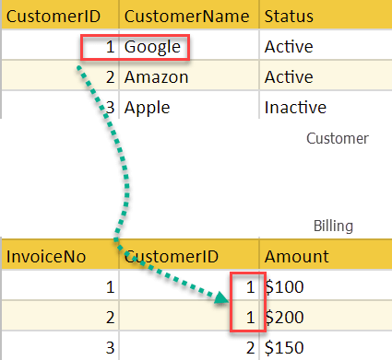
Referential integrity constraints
Referential integrity constraints is base on the concept of Foreign Keys. A foreign key is an important attribute of a relation which should be referred to in other relationships. Referential integrity constraint state happens where relation refers to a key attribute of a different or same relation. However, that key element must exist in the table.
Example:

Slide 84
Relational Schema
A relational database schema S is a set of relation schemas S = {R1, R2, ..., Rm} and a set of integrity constraints IC. A relational database state DB of S is a set of relation states DB = {r1, r2, ..., rm} such that each ri is a state of Ri and such that the ri relation states satisfy the integrity constraints specified in IC. Figure 3.5 shows a relational database schema that we call COMPANY = {EMPLOYEE, DEPARTMENT, DEPT_LOCATIONS, PROJECT, WORKS_ON, DEPENDENT}. The underlined attributes represent primary keys. Figure 3.6 shows a relational database state corresponding to the COMPANY schema.
When we refer to a relational database, we implicitly include both its schema and its current state. A database state that does not obey all the integrity constraints is called an invalid state, and a state that satisfies all the constraints in the defined set of integrity constraints IC is called a valid state.

Slide 85
Figure: 3.5 Schema diagram for the COMPANY relational database schema

Slide 86
Update Operations and Dealing with Constraint Violations
We concentrate on the database modification or update operations. There are three basic operations that can change the states of relations in the data-base: Insert, Delete, and Update (or Modify). They insert new data, delete old data, or modify existing data records. Insert is used to insert one or more new tuples in a relation, Delete is used to delete tuples, and Update (or Modify) is used to change the values of some attributes in existing tuples. Whenever these operations are applied, the integrity constraints specified on the relational database schema should not be violated.

Slide 87
1. The Insert Operation
The Insert operation provides a list of attribute values for a new
tuple t that is to be inserted into a relation R.
Operation:
Insert <‘Cecilia’, ‘F’, ‘Kolonsky’, NULL, ‘1960-04-05’, ‘6357 Windy Lane, Katy, TX’, F, 28000, NULL, 4> into EMPLOYEE.
2. The Delete Operation
The Delete operation can violate only referential integrity. This occurs if the tuple being deleted is referenced by foreign keys from other tuples in the database. To specify deletion, a condition on the attributes of the relation selects the tuple (or tuples) to be deleted. Here are some examples.
Operation:
Delete the WORKS_ON tuple with Essn = ‘999887777’ and Pno = 10. Result: This deletion is acceptable and deletes exactly one tuple.

Slide 88
3. The Update Operation
The Update (or Modify) operation is used to change the values of one or more attributes in a tuple (or tuples) of some relation R. It is necessary to specify a condition on the attributes of the relation to select the tuple (or tuples) to be modified. Here are some examples.
Operation:
Update the Dno of the EMPLOYEE tuple with Ssn = ‘999887777’ to 7. Result: Unacceptable, because it violates referential integrity.

Slide 89
Relational Database Design Using ER to Relational Mapping
ER Model, when conceptualized into diagrams, gives a good overview of entity-relationship, which is easier to understand. ER diagrams can be mapped to relational schema, that is, it is possible to create relational schema using ER diagram.
There are several processes and algorithms available to convert ER Diagrams into Relational Schema. Some of them are automated and some of them are manual. We may focus here on the mapping diagram contents to relational basics.
ER diagrams mainly comprise of −
Entity and its attributes
Relationship, which is association among entities.

Slide 90
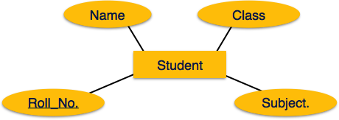
Mapping Entity
An entity is a real-world object with some attributes.
Mapping Process (Algorithm)
Create table for each entity.
Entity's attributes should become fields of tables with their respective data types.
Declare primary key.

Slide 91
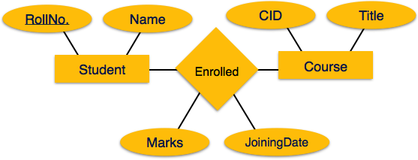
Mapping Relationship
A relationship is an association among entities.
Mapping Process
Create table for a relationship.
Add the primary keys of all participating Entities as fields of table with their respective data types.
If relationship has any attribute, add each attribute as field of table.
Declare a primary key composing all the primary keys of participating entities.
Declare all foreign key constraints.

Slide 92
Mapping Weak Entity Sets
A weak entity set is one which does not have any primary key associated with it.
Mapping Process
Create table for weak entity set.
Add all its attributes to table as field.
Add the primary key of identifying entity set.
Declare all foreign key constraints.

Slide 93
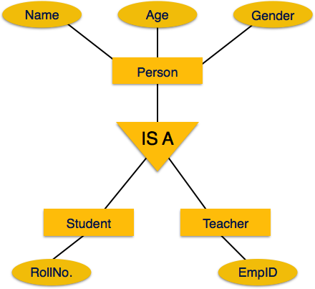
Mapping Hierarchical Entities
ER specialization or generalization comes in the form of hierarchical entity sets.

Slide 94
Mapping Process
Create tables for all higher-level entities.
Create tables for lower-level entities.
Add primary keys of higher-level entities in the table of lower-level entities.
In lower-level tables, add all other attributes of lower-level entities.
Declare primary key of higher-level table and the primary key for lower-level table.
Declare foreign key constraints.

Slide 95
UNIT-II

Slide 96
Relational Database Design
Design Guidelines for Relation Schema
1.Semantics of the Attributes
2.Reducing the Redundant Value in Tuples.
3.Reducing Null values in Tuples.
4.Dissallowing spurious Tuples.
1. Semantics of the Attributes
Whenever we are going to form relational schema there should be some meaning among the attributes.This meaning is called semantics.This semantics relates one attribute to another with some relation.

Slide 97
Eg:
2. Reducing the Redundant Value in Tuples
Mixing attributes of multiple entities may cause problems
Information is stored redundantly wasting storage
Problems with update anomalies
Insertion anomalies
Deletion anomalies
Modification anomalies
Eg:
If we integrate these two and is used as a single table i.e Student Table
USN No | Student name | Sem
Dept No | Dept Name
USN No | Student Name | Sem | Dept No | Dept Name

Slide 98
3. Reducing Null values in Tuples.
Note: Relations should be designed such that their tuples will have as few NULL values as possible
Attributes that are NULL frequently could be placed in separate relations (with the primary key)
Reasons for nulls:
attribute not applicable or invalid
attribute value unknown (may exist)
value known to exist, but unavailable
4. Disallowing spurious Tuples
Bad designs for a relational database may result in erroneous results for certain JOIN operations
The "lossless join" property is used to guarantee meaningful results for join operations

Slide 99
Functional Dependencies
Functional dependency in DBMS, as the name suggests is a relationship between attributes of a table dependent on each other. Introduced by E. F. Codd, it helps in preventing data redundancy and gets to know about bad designs.
To understand the concept thoroughly, let us consider P is a relation with attributes A and B. Functional Dependency is represented by -> (arrow sign)
Then the following will represent the functional dependency between attributes with an arrow sign −
A -> B

Slide 100
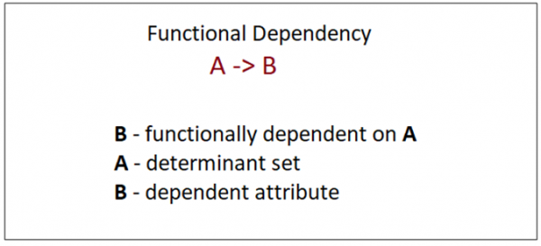
Above suggests the following:
Example
The following is an example that would make it easier to understand functional dependency −
We have a <Department> table with two attributes − DeptId and DeptName.
DeptId = Department ID
DeptName = Department Name

Slide 101
The DeptId is our primary key. Here, DeptId uniquely identifies the DeptName attribute. This is because if you want to know the department name, then at first you need to have the DeptId.
DeptId DeptName
001 Finance
002 Marketing
003 HR
Therefore, the above functional dependency between DeptId and DeptName can be determined as DeptId is functionally dependent on DeptName −
DeptId -> DeptName

Slide 102
Types of Functional Dependency
Functional Dependency has three forms −
Trivial Functional Dependency
Non-Trivial Functional Dependency
Completely Non-Trivial Functional Dependency
Trivial Functional Dependency
It occurs when B is a subset of A in −
A ->B
Example
We are considering the same <Department> table with two attributes to understand the concept of trivial dependency.
The following is a trivial functional dependency since DeptId is a subset of DeptId and DeptName
{ DeptId, DeptName } -> Dept Id

Slide 103
Non –Trivial Functional Dependency
It occurs when B is not a subset of A in −
A ->B
Example
DeptId -> DeptName
The above is a non-trivial functional dependency since DeptName is a not a subset of DeptId.
Completely Non - Trivial Functional Dependency
It occurs when A intersection B is null in −
A ->B

Slide 104
Normal Forms based on Primary keys
Primary Keys
Primary keys are a database constraint allowing us to implement the first and second normal forms. The first rule to follow to reach first normal form says “There are no duplicated rows in the table”.
A primary key ensures two things:
The attributes that are part of the primary key constraint definition are not allowed to be null.
The attributes that are part of the primary key are unique in the table’s content.

Slide 105
Normal Forms
There are several levels of normalization and the web site dbnormalization.com offers a practical guide to them. In this quick introduction to database normalization, we include the definition of the normal forms:
1st Normal Form (1NF)
A table (relation) is in 1NF if:
There are no duplicated rows in the table.
Each cell is single-valued (no repeating groups or arrays).
Entries in a column (field) are of the same kind.

Slide 106
Normalization
Normalization is the process of organizing the data in the database.
Normalization is used to minimize the redundancy from a relation or set of relations. It is also used to eliminate the undesirable characteristics like Insertion, Update and Deletion Anomalies.
Normalization divides the larger table into the smaller table and links them using relationship.
The normal form is used to reduce redundancy from the database table.

Slide 107
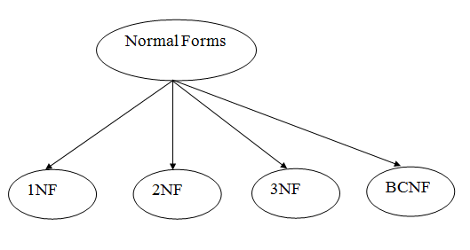
Types of Normal Forms
There are the four types of normal forms:

Slide 108
First Normal Form (1NF)
A relation will be 1NF if it contains an atomic value.
It states that an attribute of a table cannot hold multiple values. It must hold only single-valued attribute.
First normal form disallows the multi-valued attribute, composite attribute, and their combinations.
Example: Relation EMPLOYEE is not in 1NF because of multi-valued attribute EMP_PHONE.

Slide 109
THANK YOU

