Slide 1
DNR COLLEGE, PG COURSES BHIMAVARAM INFORMATION SECURITY AND CRYPTOGRAPHY
Class : M.Sc(Computer Science) III-Semester
Faculty: V.SARALA

Slide 2
UNIT-III

Slide 3
User Authentication Mechanisms
Introduction
Authentication
Authentication is the process of determining whether someone or something is, in fact, who or what it declares itself to be. Authentication technology provides access control for systems by checking to see if a user's credentials match the credentials in a database of authorized users or in a data authentication server.
Users are usually identified with a user ID, and authentication is accomplished when the user provides a credential, for example a password, that matches with that user ID. Most users are most familiar with using a password, which, as a piece of information that should be known only to the user, is called a knowledge authentication factor. Other authentication factors, and how they are used for two-factor or multifactor authentication (MFA).

Slide 4
Passwords authentication
Simple password authentication offers an easy way of authenticating users. In password authentication, the user must supply a password for each server, and the administrator must keep track of the name and password for each user, typically on separate servers.
Steps in Password-Based Authentication
Figure shows the steps involved in authenticating a client by using a name and password. The figure assumes the following points.
The user has already decided to trust the system, either without authentication, or on the basis of server authentication via SSL.
The user has requested a resource controlled by the server.
The server requires client authentication before permitting access to the requested resource.

Slide 5
Figure: Password-Based Authentication

Slide 6
In Figure, password authentication is performed in the following steps.
The user enters a name and password.
For the LDAP bind to Directory Server, the client application must bind with a Distinguished Name. Therefore the client application may use the name entered by the user to retrieve the DN.
2. The client sends the DN and password across the network.
3. The server determines whether the password sent from the client matches the password stored for the entry with the DN sent from the client.
If so, the server accepts the credentials as evidence authenticating the user identity.
4. The server determines whether the identified user is permitted to access the requested resource.
If so, the server allows the client to access the resource.

Slide 7
Tokens
Token: A token is a piece of data that has no meaning or use on its own, but combined with the correct tokenization system, becomes a vital player in securing your application. Token based authentication works by ensuring that each request to a server is accompanied by a signed token which the server verifies for authenticity and only then responds to the request.
Basically, the digital token proves you’ve already been allowed in. It also allows the website to add more layers of security without forcing you to continually prove you are who you say you are.

Slide 8
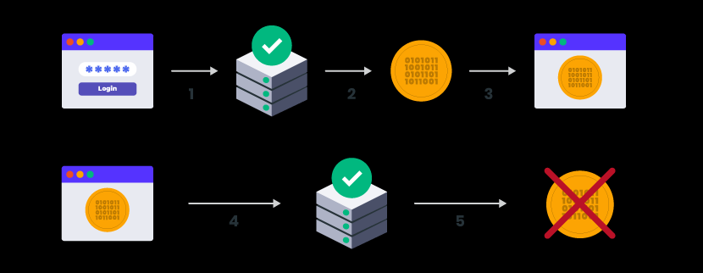
Here’s how the process works:

Slide 9
The user enters their username and password.
The server verifies that the login information is correct and generates a secure, signed token for that user at that particular time.
The token is sent back to the user’s browser and stored there.
When the user needs to access something new on the server, the system decodes and verifies the attached token. A match allows the user to proceed.
Once the user logs out of the server, the token is destroyed.
USEs of TOKENS
1. Tokens are stateless.
2. Tokens can be generated from anywhere.
3. Fine-grained access control.

Slide 10
Certificate based authentication
Certificate-based authentication is the use of a Digital Certificate to identify a user, machine, or device before granting access to a resource, network, application, etc. In the case of user authentication, it is often deployed in coordination with traditional methods such as username and password.
Most certificate-based solutions today come with a cloud-based management platform that makes it easy for administrators to issue certificates to new employees, renew certificates and revoke certificates when an employee leaves the organization. Solutions that integrate with Active Directory can make the enrollment and issuance process even easier, by enabling auto enrollment and silent installations.

Slide 11
How Is Certificate-Based Authentication Used?
Certificate-based authentication is quite flexible and can be used in a number of ways, but here are some of the most common use cases we hear from our customers. You’ll notice the common theme with all of these and certificate-based authentication in general, is to allow access only to approved users and machines and prevent unauthorized users or rogue machines.
User authentication
Machine and device authentication

Slide 12
Biometric Authentication
Biometric authentication is simply the process of verifying your identity using your measurements or other unique characteristics of your body, then logging you in a service, an app, a device and so on. What’s complicated is the technology behind it, so let’s see how it works.

Slide 13
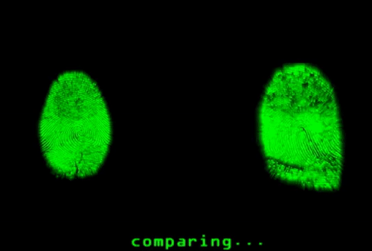
Biometric authentication works by comparing two sets of data: the first one is preset by the owner of the device, while the second one belongs to a device visitor. If the two data are nearly identical, the device knows that “visitor” and “owner” are one and the same, and gives access to the person.
The important thing to note is that the match between the two data sets has to be nearly identical but not exactly identical. This is because it’s close to impossible for 2 biometric data to match 100%. For instance, you might have a slightly sweaty finger or a tiny, tiny scar that changes the print pattern.

Slide 14
Popular biometric authentication methods
Fingerprint Scanners
Eye scanners
Speaker recognition
Facial recognition systems
Advantage:
Ease of use
The malicious hacker has to be near you
Disadvantages:
You cannot revoke the fingerprint/iris/voice print remotely
“Master fingerprints” can trick many phones and scanners
Biometrics last a lifetime
Vulnerabilities in biometric authentication software

Slide 15
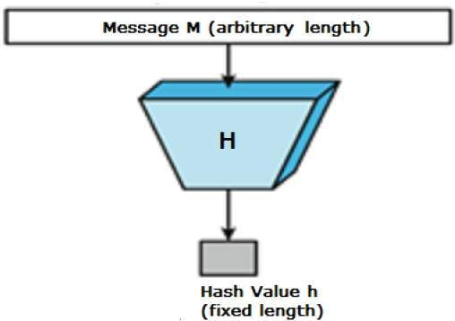
Hash Functions
A hash function is a mathematical function that converts a numerical input value into another compressed numerical value. The input to the hash function is of arbitrary length but output is always of fixed length.
Values returned by a hash function are called message digest or simply hash values. The following picture illustrated hash function −

Slide 16
Features of Hash Functions
Fixed Length Output (Hash Value)
Hash function coverts data of arbitrary length to a fixed length.
In general, the hash is much smaller than the input data, hence hash functions are sometimes called compression functions.
Since a hash is a smaller representation of a larger data, it is also referred to as a digest.
Hash function with n bit output is referred to as an n-bit hash function. Popular hash functions generate values between 160 and 512 bits.
2. Efficiency of Operation
Generally for any hash function h with input x, computation of h(x) is a fast operation.
Computationally hash functions are much faster than a symmetric encryption.

Slide 17
Popular Hash Functions
Message Digest (MD)
Secure Hash Function (SHA)
RIPEMD (RACE Integrity Primitives Evaluation Message Digest)
Applications of Hash Functions
There are two direct applications of hash function based on its cryptographic properties.
Password Storage
Data Integrity Check

Slide 18
SHA-1
The Secure Hash Algorithm 1 (SHA-1) is a cryptographic computer security algorithm. It was created by the US National Security Agency in 1995, after the SHA-0 algorithm in 1993, and it is part of the Digital Signature Algorithm or the Digital Signature Standard (DSS).
SHA-1 produces a 160-bit hash value or message digests from the inputted data. It uses 80 rounds of cryptographic operations to encrypt and secure a data object. Some of the protocols that use SHA-1 include:
Transport Layer Security (TLS)
Secure Sockets Layer (SSL)
Pretty Good Privacy (PGP)
Secure Shell (SSH)
Secure/Multipurpose Internet Mail Extensions (S/MIME)
Internet Protocol Security (IPSec)

Slide 23
System Security
Intruders and Types of Intruders
One of the two most publicized threats to security is the intruder (the other is viruses), often referred to as a hacker or cracker. In an important early study of intrusion, Anderson [ANDE80] identified three classes of intruders:
• Masquerader: An individual who is not authorized to use the computer and who penetrates a system’s access controls to exploit a legitimate user’s account
• Misfeasor: A legitimate user who accesses data, programs, or resources for which such access is not authorized, or who is authorized for such access but misuses his or her privileges
• Clandestine user: An individual who seizes supervisory control of the system and uses this control to evade auditing and access controls or to suppress audit collection

Slide 24
Mechanisms Used:
Prevention: isolate from network, strict authentication measures, encryption
Preemption: “do unto others before they do unto you”
Deterrence: dire warnings, ◦“we have a bomb too.”
Deflection: diversionary techniques to lure away
Detection
Counter attacks
The two principal counter-measures
Detection : is concerned with learning of an attack, either before or after its success.
Prevention : s a challenging security goal.

Slide 25
Viruses and virus Types
A virus is a fragment of code embedded in a legitimate program. Virus are self-replicating and are designed to infect other programs. They can wreak havoc in a system by modifying or destroying files causing system crashes and program malfunctions.
.Different Virus Expressions
Virus
A computer virus is a piece of software that can 'infect' a computer, install itself and copy itself to other computers, without the users knowledge or permission. It usually attaches itself to other computer programs, data files, or the boot sector of a Hard drive.
Malware
Malware is short for malicious software. Malware is the name that is given to any type of software that could harm a computer system, interfere with and gather a user's data, or make the computer perform actions without the owner's knowledge or permission.

Slide 26
Trojan horse
A type of malware that uses malicious code to install software that seems ok, but is hidden to create back doors into a system. This typically causes loss or theft of data from an external source.
Worm
Unlike a virus, a worm, is a standalone piece of malicious software that replicates itself in order to spread to other computers. It often uses a computer network to spread itself, relying on security flaws on the target system to allow access.
Spyware
Spyware is software that aids in gathering information about a person or organization without their knowledge. Spyware can monitor and log the activity that is performed on a target system, like log key strokes, or gather credit card and other information.

Slide 27
Related Threats
Threats to Information Security. In Information Security threats can be many like Software attacks, theft of intellectual property, identity theft, theft of equipment or information, sabotage, and information extortion.
Threat can be anything that can take advantage of a vulnerability to breach security and negatively alter, erase, harm object or objects of interest.
Software attacks means attack by Viruses, Worms, Trojan Horses etc. Many users believe that malware, virus, worms, bots are all same things. But they are not same, only similarity is that they all are malicious software that behave differently.

Slide 28
Malware is a combination of 2 terms- Malicious and Software. So Malware basically means malicious software that can be an intrusive program code or a anything that is designed to perform malicious operations on system. Malware can be divided in 2 categories:
Infection Methods
Malware Actions
Malware on the basis of Infection Method are following:
Virus, Worms, Trojan, Bots.
Malware on the basis of Actions:
Adware, Spyware, Ransomware, Scareware, Zombies,
Rootkits .

Slide 29
Introduction to Trusted Systems
A trusted system is a system that is relied upon to a specified extent to enforce a specified security policy. This is equivalent to saying that a trusted system is one whose failure would break a security policy.
Trusted system can also be seen as level base security system where protection is provided and handled according to different levels. This is commonly found in military, where information is categorized as unclassified(U), confidential(C), Secret(S), Top secret(TS) and beyond. These also enforces the policies of No-read up and No-write down.

Slide 30
1. Data access control
A general model of access control as exercised by an file or database management system is that of an access matrix. The basic elements of the model are as follows:
Subject: An entity capable of accessing objects. Generally, the concept of subject equates with that of process.
Object: Anything to which access is controlled. Examples include files, portion of files, programs, and segments of memory.
Access right: The way in which the object is accessed by a subject. Examples are read, write and execute.

Slide 31
2. The concept of Trusted Systems
For implementation purposes, this requirement is in two parts and is simply stated. A multilevel secure system must enforce:
No read up: A subject can only read an object of less or equal security level. This is referred to as simple security property.
No write down: A subject can only write into an object of greater or equal security level.
3. Reference Monitor concept
The reference monitor is a controlling element in the hardware and operating system of a computer.
The reference monitor enforces the security rules and has the following properties:
Complete mediation: The security rules are enforced on every access, not just, for example, when a file is opened.
Isolation: The reference monitor and database are protected from unauthorised modification.

Slide 32
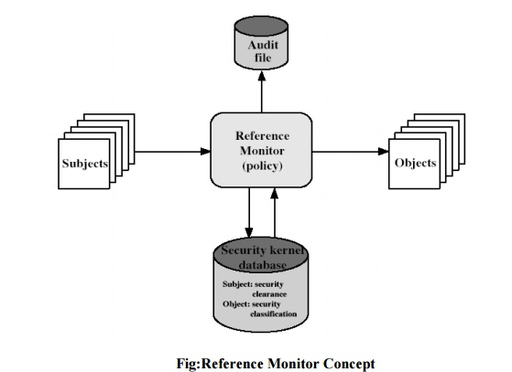
Verifiability: The reference monitor’s correctness must be provable.

Slide 33
End of UNIT-III Thank You

