Slide 1
DNR COLLEGE, PG COURSES BHIMAVARAM INFORMATION SECURITY AND CRYPTOGRAPHY
Class : M.Sc(Computer Science) III-Semester
Faculty: V.SARALA

Slide 2
UNIT-II

Slide 3
Symmetric Key Cryptographic Algorithms
Symmetric-key algorithms are algorithms for cryptography that use the same cryptographic keys for both encryption of plaintext and decryption of ciphertext. The keys may be identical or there may be a simple transformation to go between the two keys. The keys, in practice, represent a shared secret between two or more parties that can be used to maintain a private information link.
Some examples of symmetric encryption algorithms include:
AES (Advanced Encryption Standard)
DES (Data Encryption Standard)
IDEA (International Data Encryption Algorithm)
Blowfish (Drop-in replacement for DES or IDEA)
RC4 (Rivest Cipher 4)
RC5 (Rivest Cipher 5)
RC6 (Rivest Cipher 6)
AES, DES, IDEA, Blowfish, RC5 and RC6 are block ciphers. RC4 is stream cipher.

Slide 5
Symmetric Algorithms Modes or Block Cipher Modes of Operations
The modes of operation of a block cipher. These are procedural rules for a generic block cipher. Interestingly, the different modes result in different properties being achieved which add to the security of the underlying block cipher.
A block cipher processes the data blocks of fixed size. Usually, the size of a message is larger than the block size. Hence, the long message is divided into a series of sequential message blocks, and the cipher operates on these blocks one at a time.
Electronic Code Book (ECB) Mode
Cipher Block Chaining (CBC) Mode
Cipher Feedback (CFB) Mode
Output Feedback (OFB) Mode
Counter (CTR) Mode

Slide 6
Electronic Code Book (ECB) Mode
This mode is a most straightforward way of processing a series of sequentially listed message blocks.
Operation
The user takes the first block of plaintext and encrypts it with the key to produce the first block of ciphertext.
He then takes the second block of plaintext and follows the same process with same key and so on so forth.
The ECB mode is deterministic, that is, if plaintext block P1, P2,…, Pm are encrypted twice under the same key, the output ciphertext blocks will be the same.

Slide 7
In fact, for a given key technically we can create a codebook of ciphertexts for all possible plaintext blocks. Encryption would then entail only looking up for required plaintext and select the corresponding ciphertext. Thus, the operation is analogous to the assignment of code words in a codebook, and hence gets an official name − Electronic Codebook mode of operation (ECB). It is illustrated as follows –

Slide 8
Cipher Block Chaining (CBC) Mode
CBC mode of operation provides message dependence for generating ciphertext and makes the system non-deterministic.
Operation
The operation of CBC mode is depicted in the following illustration. The steps are as follows −
Load the n-bit Initialization Vector (IV) in the top register.
XOR the n-bit plaintext block with data value in top register.
Encrypt the result of XOR operation with underlying block cipher with key K.
Feed ciphertext block into top register and continue the operation till all plaintext blocks are processed.
For decryption, IV data is XORed with first ciphertext block decrypted. The first ciphertext block is also fed into to register replacing IV for decrypting next ciphertext block.

Slide 9
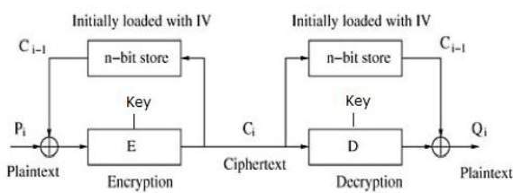

Slide 10
Cipher Feedback (CFB) Mode
In this mode, each ciphertext block gets ‘fed back’ into the encryption process in order to encrypt the next plaintext block.
Operation
The operation of CFB mode is depicted in the following illustration. For example, in the present system, a message block has a size ‘s’ bits where 1 < s < n. The CFB mode requires an initialization vector (IV) as the initial random n-bit input block. The IV need not be secret. Steps of operation are−
Load the IV in the top register.
Encrypt the data value in top register with underlying block cipher with key K.
Take only ‘s’ number of most significant bits (left bits) of output of encryption process and XOR them with ‘s’ bit plaintext message block to generate ciphertext block.

Slide 11
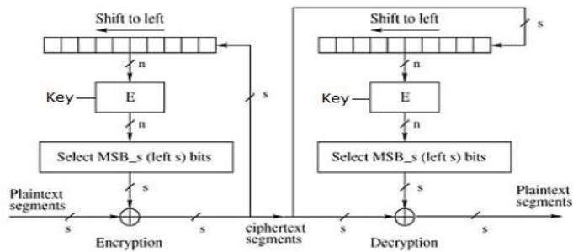
Feed ciphertext block into top register by shifting already present data to the left and continue the operation till all plaintext blocks are processed.
Essentially, the previous ciphertext block is encrypted with the key, and then the result is XORed to the current plaintext block.
Similar steps are followed for decryption. Pre-decided IV is initially loaded at the start of decryption.

Slide 12
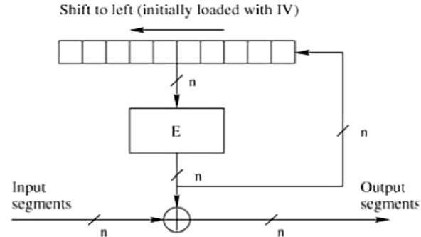
Output Feedback (OFB) Mode
It involves feeding the successive output blocks from the underlying block cipher back to it. These feedback blocks provide string of bits to feed the encryption algorithm which act as the key-stream generator as in case of CFB mode.
The key stream generated is XOR-ed with the plaintext blocks. The OFB mode requires an IV as the initial random n-bit input block. The IV need not be secret.
The operation is depicted in the following illustration −

Slide 13
Counter (CTR) Mode
It can be considered as a counter-based version of CFB mode without the feedback. In this mode, both the sender and receiver need to access to a reliable counter, which computes a new shared value each time a ciphertext block is exchanged. This shared counter is not necessarily a secret value, but challenge is that both sides must keep the counter synchronized.
Operation
Both encryption and decryption in CTR mode are depicted in the following illustration. Steps in operation are −
Load the initial counter value in the top register is the same for both the sender and the receiver. It plays the same role as the IV in CFB (and CBC) mode.

Slide 14
Encrypt the contents of the counter with the key and place the result in the bottom register.
Take the first plaintext block P1 and XOR this to the contents of the bottom register. The result of this is C1. Send C1 to the receiver and update the counter. The counter update replaces the ciphertext feedback in CFB mode.
Continue in this manner until the last plaintext block has been encrypted.
The decryption is the reverse process. The ciphertext block is XORed with the output of encrypted contents of counter value. After decryption of each ciphertext block counter is updated as in case of encryption.

Slide 15
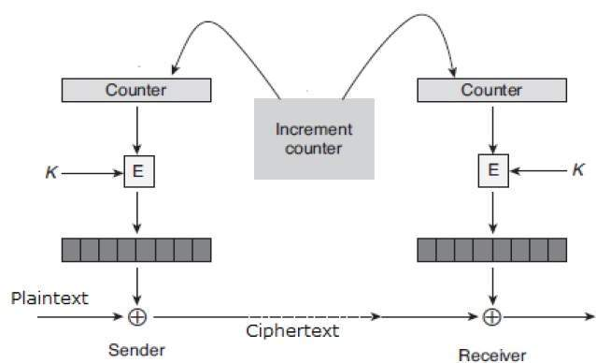

Slide 16
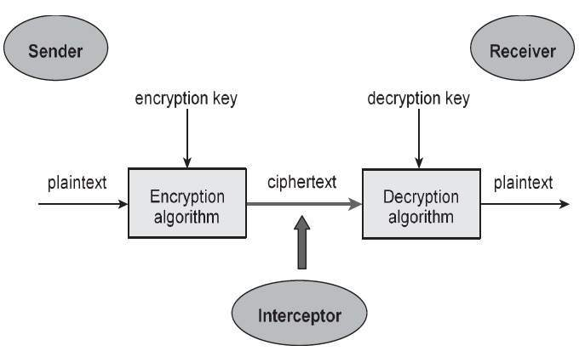
Overview of Symmetric Key Cryptography
A cryptosystem is an implementation of cryptographic techniques and their accompanying infrastructure to provide information security services. A cryptosystem is also referred to as a cipher system.
A simple model of a cryptosystem that provides confidentiality to the information being transmitted. This basic model is depicted in the illustration below

Slide 17
Components of a Cryptosystem
The various components of a basic cryptosystem are as follows −
Plaintext. It is the data to be protected during transmission.
Encryption Algorithm. It is a mathematical process that produces a ciphertext for any given plaintext and encryption key. It is a cryptographic algorithm that takes plaintext and an encryption key as input and produces a ciphertext.
Ciphertext. It is the scrambled version of the plaintext produced by the encryption algorithm using a specific the encryption key. The ciphertext is not guarded. It flows on public channel.
Decryption Algorithm, It is a mathematical process, that produces a unique plaintext for any given ciphertext and decryption key. It is a cryptographic algorithm that takes a ciphertext and a decryption key as input, and outputs a plaintext. The decryption algorithm essentially reverses the encryption algorithm and is thus closely related to it.

Slide 18
Encryption Key. It is a value that is known to the sender. The sender inputs the encryption key into the encryption algorithm along with the plaintext in order to compute the ciphertext.
Decryption Key. It is a value that is known to the receiver. The decryption key is related to the encryption key, but is not always identical to it. The receiver inputs the decryption key into the decryption algorithm along with the ciphertext in order to compute the plaintext.
Symmetric Key Cryptography is a type of encryption where only one key (a secret key) is used to both encrypt and decrypt electronic information. The entities communicating via symmetric encryption must exchange the key so that it can be used in the decryption process. This encryption method differs from asymmetric encryption where a pair of keys, one public and one private, is used to encrypt and decrypt messages.

Slide 19
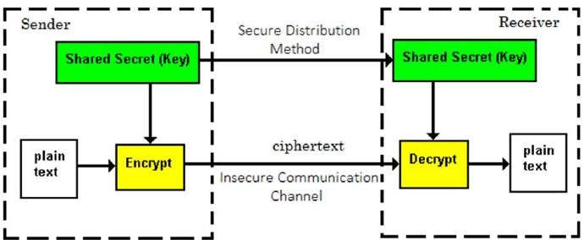
Fig: Symmetric key Cryptography

Slide 20
DES Algorithm
Data Encryption Standard (DES) is a block cipher algorithm that takes plain text in blocks of 64 bits and converts them to cipher text using keys of 48 bits. It is a symmetric key algorithm, which means that the same key is used for encrypting and decrypting ​data.
DES is an implementation of a Feistel Cipher. It uses 16 round Feistel structure. The block size is 64-bit. Though, key length is 64-bit, DES has an effective key length of 56 bits, since 8 of the 64 bits of the key are not used by the encryption algorithm (function as check bits only). General Structure of DES is depicted in the following illustration

Slide 21
General Depiction if DES Encryption Algorithm

Slide 22
The initial plain text is 64-bits, it is written in the form of
8 x 8 matrix. It is given to the IP function. Let our message
X (plain text) is
M₁ M₂ M₃ M₄ M₅ M₆ M₇ M₈
M₉ M₁₀ M₁₁ M₁₂ M₁₃ M₁₄ M₁₅ M₁₆
M₁₇ M₁₈ M₁₉ M₂₀ M₂₁ M₂₂ M₂₃ M₂₄
M₂₅ M₂₆ M₂₇ M₂₈ M₂₉ M₃₀ M₃₁ M₃₂
M₃₃ M₃₄ M₃₅ M₃₆ M₃₇ M₃₈ M₃₉ M₄₀
M₄₁ M₄₂ M₄₃ M₄₄ M₄₅ M₄₆ M₄₇ M₄₈
M₄₉ M₅₀ M₅₁ M₅₂ M₅₃ M₅₄ M₅₅ M₅₆
M₅₇ M₅₈ M₅₉ M₆₀ M₆₁ M₆₂ M₆₃ M₆₄
where M_{i} is a binary digit. Then the permutation X = IP(M)

Slide 23
Initial and Final Permutation
The initial and final permutations are straight Permutation boxes (P-boxes) that are inverses of each other. They have no cryptography significance in DES. The initial and final permutations are shown as follows −
Initial Permutation(IP): Final Permutation(IP⁻¹):
50 42 34 26 18 10 2 40 8 48 16 56 24 64 32
52 44 36 28 20 12 4 39 7 47 15 55 23 63 31
54 46 38 30 22 14 6 38 6 46 14 54 22 62 30
56 48 40 32 24 16 8 37 5 45 13 53 21 61 29
49 41 33 25 17 9 1 36 4 44 12 52 20 60 28
51 43 35 27 19 11 3 35 3 43 11 51 19 59 27
53 45 37 29 21 13 5 34 2 42 10 50 18 58 26
63 55 47 39 31 23 15 7 33 1 41 9 49 17 57 25

Slide 24
Generation of Sub keys:
A total of 16 sub keys. Each of 48-bits are used in 16 rounds
of DES algorithm. These are generated from 56-bit key.
The actual key of DES algorithm looks like 64-bit long. But
each and every 8th bit is called the odd parity. So, we exclude
these bits i.e., we exclude 8,16,24,32,40,48,56,64. From
remaining 56-bits generate the 16 sub keys.
Initially the 56-bits are permutated and divided into two
halves (C₀, D₀). These are as given below:

Slide 25
Let us consider the 56-bit key.
1 2 3 4 5 6 7
9 10 11 12 13 14 15
17 18 19 20 21 22 23
25 26 27 28 29 30 31
33 34 35 36 37 38 39
41 42 43 44 45 46 47
49 50 51 52 53 54 55
57 58 59 60 61 62 63
57 49 41 33 25 17 9 63 55 47 39 31 23 15
C₀ = 1 58 50 42 34 26 18 D₀ = 7 62 54 46 38 30 22
10 2 59 51 43 35 27 14 6 61 53 45 37 29
19 11 3 60 52 44 36 21 13 5 28 20 12 4

Slide 26
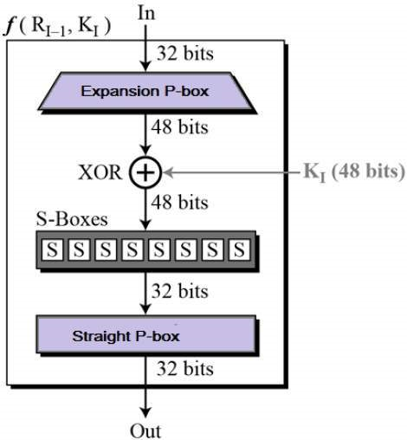
Round Function
Each round in DES algorithm takes a 64-bit input and a 48-bit sub key to produce 64-bit output. The 64-bit input is divided into two 32-bit halves. The DES function applies a 48-bit key to the rightmost 32 bits to produce a 32-bit output.

Slide 27
AES Algorithm
Advanced Encryption Standard
The features of AES are as follows −
Symmetric key symmetric block cipher
128-bit data, 128/192/256-bit keys
Stronger and faster than Triple-DES
Provide full specification and design details
Software implementable in C and Java
Operation of AES
AES is an iterative rather than Feistel cipher. It is based on ‘substitution–permutation network’. It comprises of a series of linked operations, some of which involve replacing inputs by specific outputs (substitutions) and others involve shuffling bits around (permutations).

Slide 28
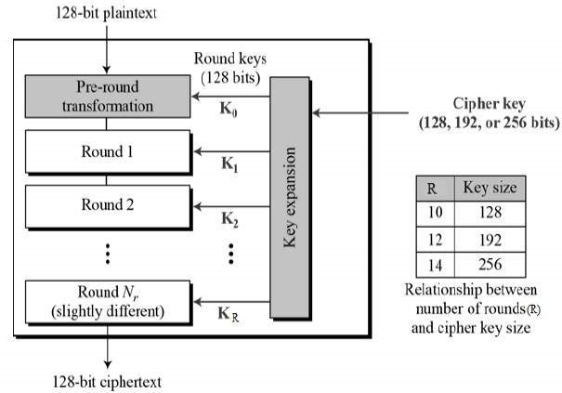
Unlike DES, the number of rounds in AES is variable and depends on the length of the key. AES uses 10 rounds for 128-bit keys, 12 rounds for 192-bit keys and 14 rounds for 256-bit keys. Each of these rounds uses a different 128-bit round key, which is calculated from the original AES key.

Slide 29
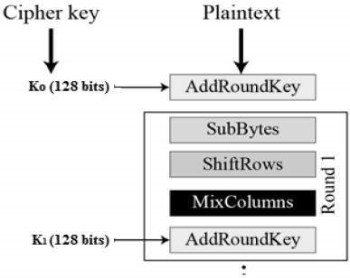
Encryption Process
Here, we restrict to description of a typical round of AES encryption. Each round comprise of four sub-processes. The first round process is depicted below −

Slide 30
Decryption Process
The process of decryption of an AES ciphertext is similar to the encryption process in the reverse order. Each round consists of the four processes conducted in the reverse order −
Add round key
Mix columns
Shift rows
Byte substitution
Since sub-processes in each round are in reverse manner, unlike for a Feistel Cipher, the encryption and decryption algorithms needs to be separately implemented, although they are very closely related.

Slide 31
Asymmetric Key Cryptographic Algorithms
Overview of Asymmetric key Cryptography
The encryption process where different keys are used for encrypting and decrypting the information is known as Asymmetric Key Encryption. This is also called Public Key Cryptography. In this two key are used, Public Key and Private Key. Though the keys are different, they are mathematically related and hence, retrieving the plaintext by decrypting ciphertext is feasible.
Asymmetric key algorithms are not quite as fast as symmetric key algorithms. This is partially due to the fact that asymmetric key algorithms are generally more complex, using a more sophisticated set of functions.
Asymmetric Key Algorithms
Asymmetric key algorithms aren't as widely used as their symmetric counterparts. So we'll just go over two of the big ones: Diffie-Hellman and RSA.

Slide 32
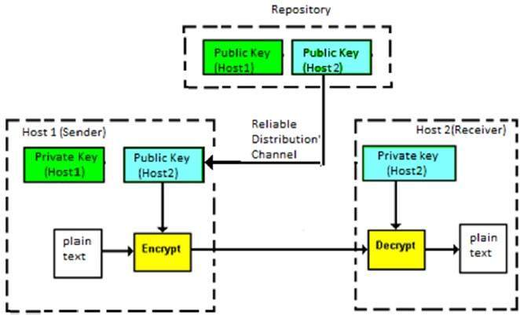
Fig: Asymmetric key Cryptography

Slide 33
RSA Algorithm
RSA (Rivest–Shamir–Adleman) is an algorithm used by modern computers to encrypt and decrypt messages. It is an asymmetric cryptographic algorithm. Asymmetric means that there are two different keys. This is also called public key cryptography, because one of the keys can be given to anyone.
The public and private key generation algorithm is the most complex part of RSA cryptography. Two large prime numbers, p and q, are generated using the Rabin-Miller primality test algorithm. A modulus, n, is calculated by multiplying p and q. This number is used by both the public and private keys and provides the link between them. Its length, usually expressed in bits, is called the key length.

Slide 34
RSA Algorithm

Slide 35
Symmetric and asymmetric key cryptography together
Symmetric-key cryptography and asymmetric-key cryptography are combined to have a very efficient security solution. The way it works is as follows, assuming that A is the sender of message and B is its receiver.
1. A’s computer encrypts the original plain-text message (PT) with the help of a standard symmetric key cryptography algorithm, such DES, IDEA or RC5, etc. this produces a cipher-text message (CT) as shown in Fig. below. The key used in this operation (K1) is called one-time symmetric key, as it is used once and then discarded.

Slide 36
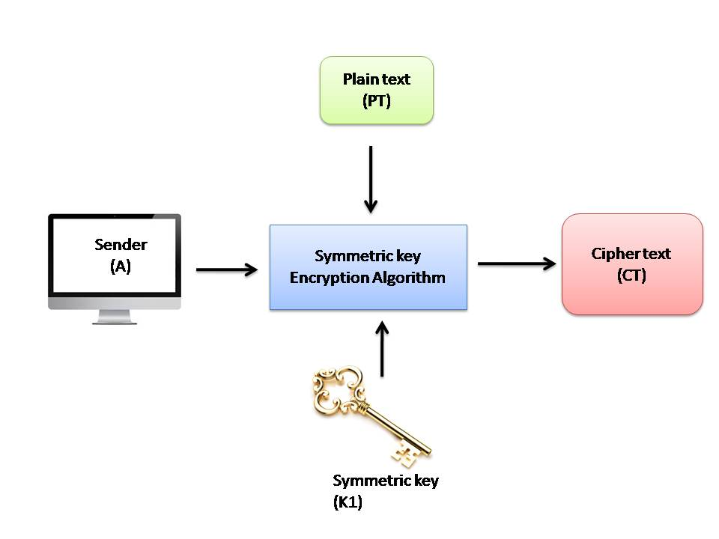

Slide 37
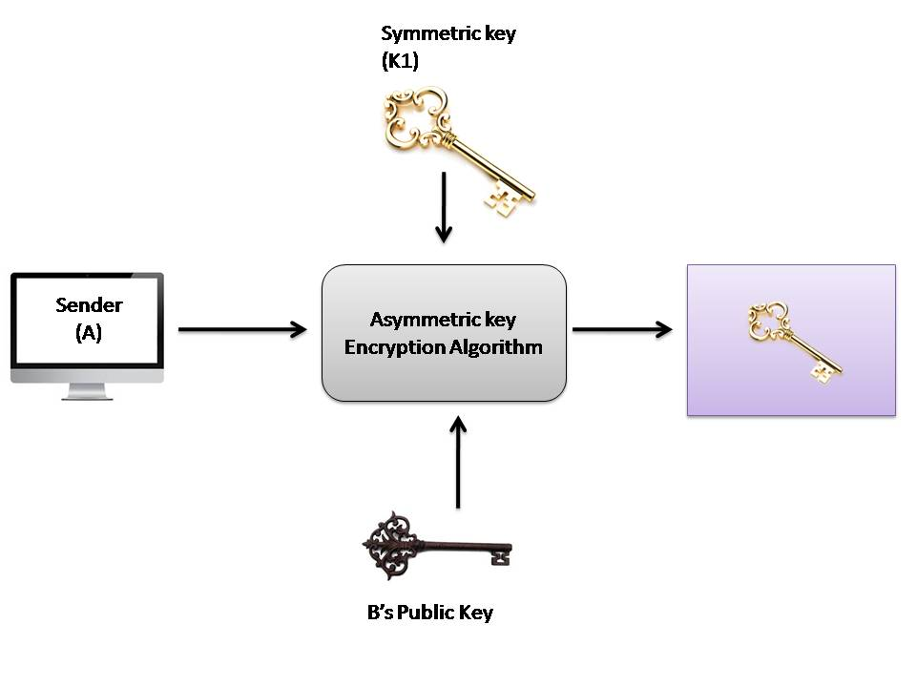
2. We would now think, we are back to square one! We have encrypted the plain text (PT) with a symmetric-key operation. We must now transport this one-time symmetric key (K1) to the server so that the server can decrypt the cipher text (CT) to get back the original plain-text message (PT). Does this not again lead us to the key-exchange problem? Well, a novel concept is used now. A now takes the one-time symmetric key of step 1 (i.e. K1), and encrypts K1 with B’s public key (K2). This process is called key wrapping of the symmetric key, and is shown in fig. below. We have shown that the symmetric key K1 goes inside a logical box, which is sealed by B’s public key (i.e. K2).

Slide 38
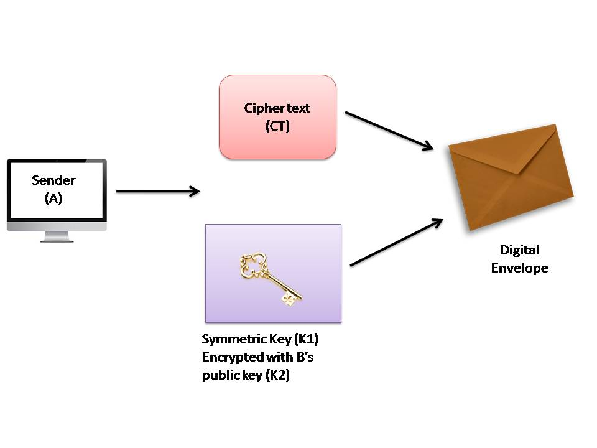
3. Now, A puts the cipher text CT1 and the encrypted symmetric key together inside a digital envelope. This is shown in fig. below

Slide 39
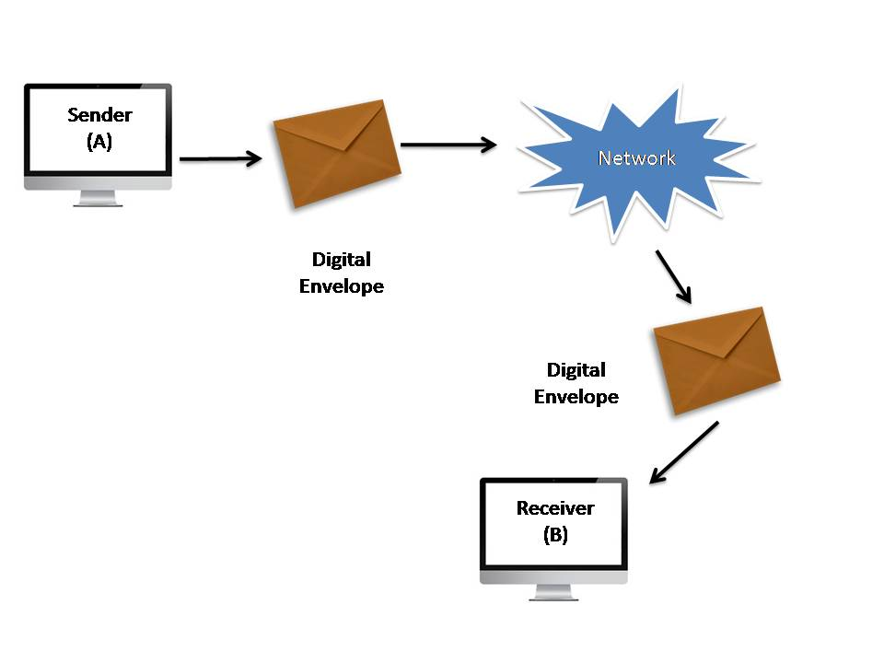
4. The sender (A) now sends the digital envelope [which contains the cipher text (CT) and the onetime symmetric key (K1) encrypted with B’s public key, (K2)] to B using the underlying transport mechanism (network). This is shown in fig .we do not show the contents of the envelope, and assume that the envelope contains the two entities, as discussed.

Slide 40
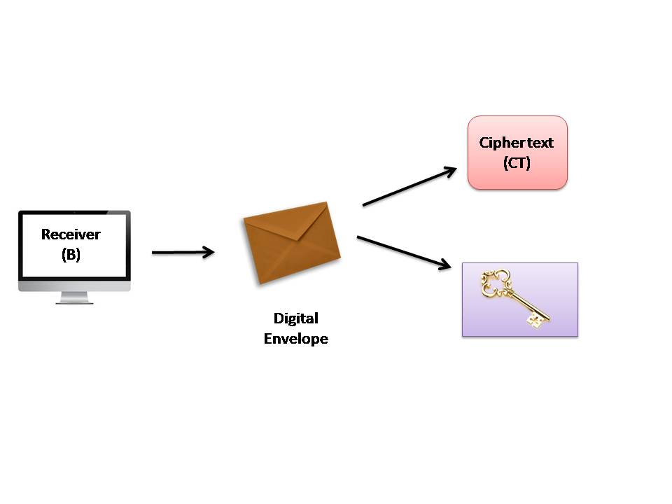
5. B receives digital envelope and opens it . After B opens this digital envelope, he gets 2 things first is cipher text (CT) and another one is the one-time session key (K1) which is encrypted using B’s public key (K2). This is shown in fig. below.

Slide 41
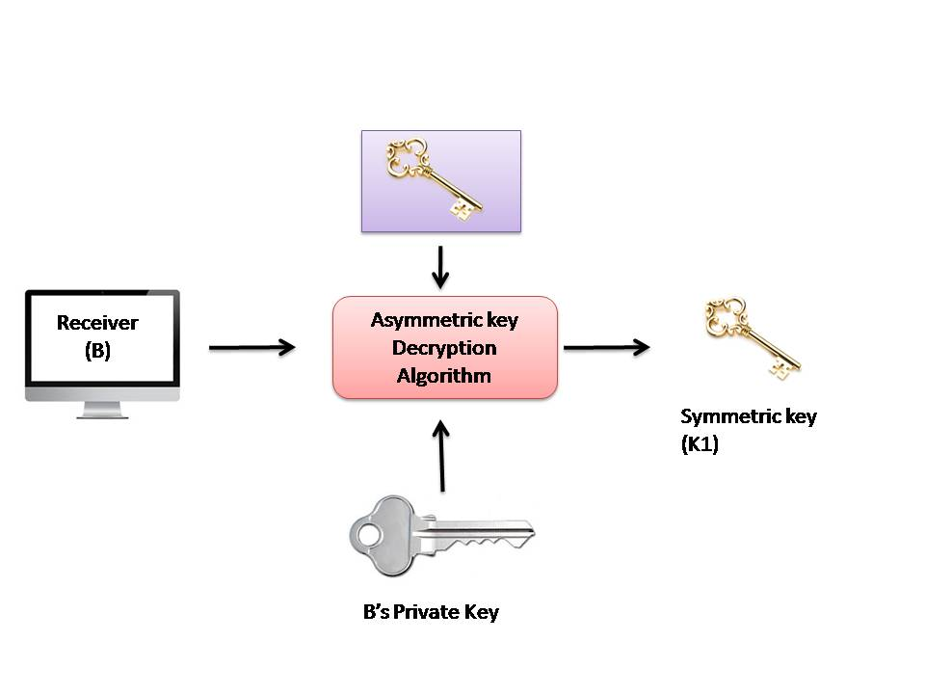
6. B now uses the same asymmetric-key algorithm as was used by A and her private key (K3) to decrypt (i.e. open up) the logical box that contains the symmetric key (K1), which was encrypted with B’s public key (K2). This is shown in fig. below. This the output of the process is the one-time symmetric key K1.

Slide 42
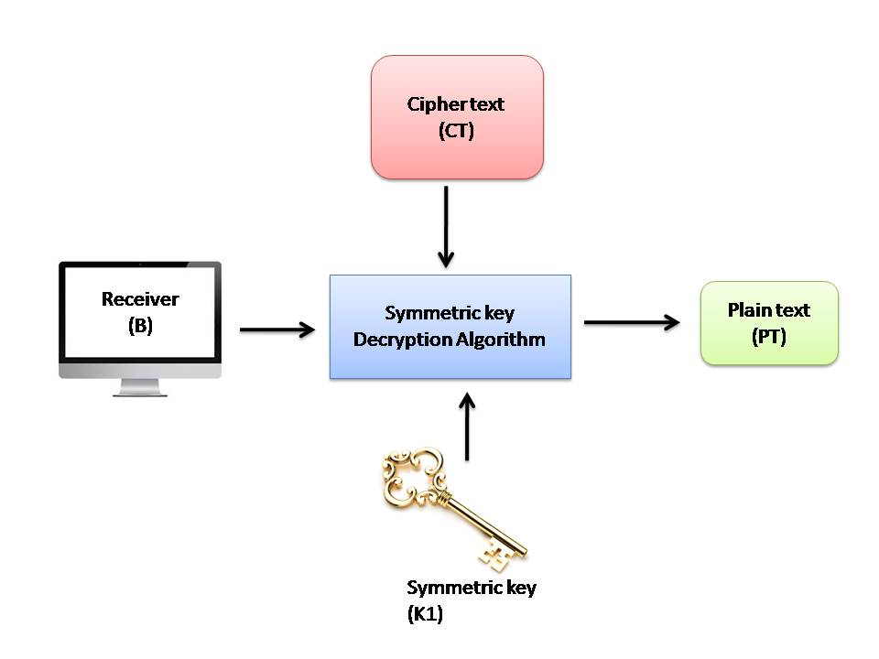
7. Finally, B applies the same symmetric-key algorithm as was used by A, and the symmetric key K1 to decrypt the cipher text (C1). This process yields the original plain text (PT), as shown in fig. below.

Slide 43
Introduction to Digital Signatures
Digital Signature
A digital signature is proof of the authenticity of digital messages, files, executables, and documents etc. in modern communication - by employing strong cryptographic techniques such as encryption and hashing. A unique digital ID (and a signing key) is required to create a digital signature. Digital IDs or certificates are based on asymmetric (or public key) cryptography which use key pairs (combination of public and private keys). Public keys are openly distributed among the communicating entities and the private (signing) keys are kept secret. The most common public key algorithm used is RSA.

Slide 44
Digital Certificate
A digital certificate is an electronic document used to prove ownership of a public key. The certificate includes the public key, information about its owner's identity and associated permissions. Certificates provide the foundation for a PKI (Public Key Infrastructure). Certificates are electronic representations of users, computers, network devices, or services, issued by a CA (Certificate Authority), that are associated with a public and private key pair. The current standard being used for digital certificates is X.509 defined in RFC 5280. Some main parameters that exist in a certificate are:
Certificate serial number
Name of the certificate issuer
Certificate issuer’s signature algorithm identifier
Validity period
Public key

Slide 45
Services provided by Digital Signature
Sender/Source Authentication
Message Integrity
Non-Repudiation
Process of Digital Signing and Verification
Key Generation: A key pair (private and public key) is generated by employing a public key algorithm such as RSA.
Digital Signature Generation: Compute the cryptographic hash of the input file or message by using a secure hashing algorithm such as SHA-256, SHA-384, SHA-512 or Whirlpool etc. The computed hash is encrypted by the private key of sender resulting in the digital signature. The digital signature is sent along with the original file for its verification by the receiver.

Slide 46
Digital Signature Verification: Sender computes the cryptographic hash of the received file or message by using the same hashing algorithm. Sender decrypts the digital signature by using the public key of the sender to get the hash sent by the sender. If the decrypted hash is exactly same as the computed hash of the received file, it means that digital signature is verified and data was not tampered with during transit.

Slide 47
THANK YOU

