Slide 1
DNR COLLEGE, PG COURSES BHIMAVARAM INFORMATION SECURITY AND CRYPTOGRAPHY
Class : M.Sc(Computer Science) III-Semester
Faculty: V.SARALA

Slide 2
UNIT-IV

Slide 3
Internet Security Protocols
Basic Concepts
Internet security refers to securing communication over the internet. It includes specific security protocols such as:
Internet Security Protocol (IPSec)
Secure Socket Layer (SSL)
Internet Security Protocol (IPSec)
It consists of a set of protocols designed by Internet Engineering Task Force (IETF). It provides security at network level and helps to create authenticated and confidential packets for IP layer.
Secure Socket Layer (SSL)
It is a security protocol developed by Netscape Communications Corporation. It provides security at transport layer. It addresses the following security issues: Privacy, Integrity, Authentication

Slide 4
SSL
Secure Sockets Layer (SSL) was the most widely deployed cryptographic protocol to provide security over internet communications before it was preceded by TLS (Transport Layer Security) in 1999. ... SSL provides a secure channel between two machines or devices operating over the internet or an internal network.
SSL provide security to the data that is transferred between web browser and server. SSL encrypt the link between a web server and a browser which ensures that all data passed between them remain private and free from attack.
Secure Socket Layer Protocols:
1. SSL record protocol
2. Handshake protocol
3. Change-cipher spec protocol
4. Alert protocol

Slide 5
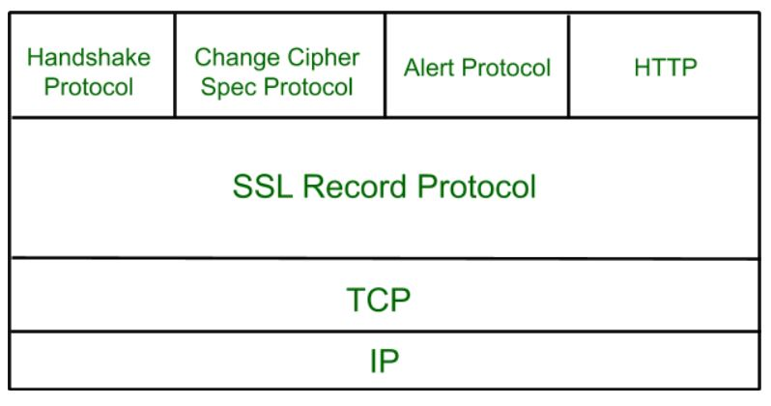
SSL Protocol Stack:

Slide 6
SSL Record Protocol:
SSL Record provide two services to SSL connection.
Confidentiality
Message Integerity
In SSL Record Protocol application data is divided into fragments. The fragment is compressed and then encrypted MAC (Message Authentication Code) generated by algorithms like SHA (Secure Hash Protocol) and MD5 (Message Digest) is appended. After that encryption of the data is done and in last SSL header is appended to the data.

Slide 8
Handshake Protocol:
Handshake Protocol is used to establish sessions. This protocol allow client and server to authenticate each other by sending a series of messages to each other. Handshake protocol uses four phases to complete its cycle.
Phase-1: In Phase-1 both Client and Server send hello-packets to each other. In this IP session, cipher suite and protocol version are exchanged for security purpose.
Phase-2: Server send his certificate and Server-key-exchange. Server end the phase-2 by sending Server-hello-end packet.
Phase-3: In this phase Client reply to the server by sending his certificate and Client-exchange-key.
Phase-4: In Phase-4 Change-cipher suite occurred and after this Handshake Protocol ends.

Slide 9
Change-cipher Protocol:
This protocol uses SSL record protocol. Unless Handshake Protocol is completed, the SSL record Output will be in pending state. After handshake protocol the Pending state is converted into Current state.
Change-cipher protocol consists of single message which is 1 byte in length and can have only one value. This protocol purpose is to cause the pending state to be copied into current state.

Slide 10
Alert Protocol:
This protocol is used to convey SSL-related alerts to the peer entity. Each message in this protocol contain 2 bytes.
Level is further classified into two parts:
Warning:
This Alert have no impact on the connection between
sender and receiver.
Fatal Error:
This Alert breaks the connection between sender and
receiver.

Slide 11
Features of Secure Socket Layer:
Advantage of this approach is that the service can be tailored to the specific needs of the given application.
Secure Socket Layer was originated by Netscape.
SSL is designed to make use of TCP to provide reliable end-to-end secure service.
This is two-layered protocol.

Slide 12
SHTTP
Secure Hypertext Transfer Protocol (S-HTTP) is an obsolete alternative to the HTTPS protocol for encrypting web communications carried over HTTP. It was developed by Eric Rescorla and Allan M. Schiffman, and published in 1999 as RFC 2660.
WebBrowser typically use HTTP to communicate with web servers, sending and receiving information without encrypting it. For sensitive transactions, such as Internet e-commerce or online access to financial accounts, the browser and server must encrypt this information. HTTPS and S-HTTP were both defined in the mid-1990s to address this need. S-HTTP was used by Spyglass's web server, while Netscape and Microsoft supported HTTPS rather than S-HTTP, leading to HTTPS becoming the de facto standard mechanism for securing web communications.

Slide 13
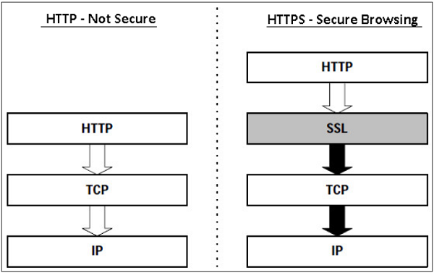
HTTPS Defined
Hyper Text Transfer Protocol (HTTP) protocol is used for web browsing. The function of HTTPS is similar to HTTP. The only difference is that HTTPS provides “secure” web browsing. HTTPS stands for HTTP over SSL. This protocol is used to provide the encrypted and authenticated connection between the client web browser and the website server.

Slide 14
TSP
The Tunnel Setup Protocol (TSP) is a networking control protocol used to negotiate IP tunnel setup parameters between a tunnel client host and a tunnel broker server, the tunnel end-points. The protocol is defined in RFC 5572. A major use of TSP is in IPv6 transition mechanisms.

Slide 15
Parameter negotiation
The TSP protocol performs negotiation of the following parameters:
User authentication using the Simple Authentication and Security Layer (SASL) protocol (RFC 4422).
Tunnel encapsulation for a variety of tunneling scenarios:
IPv6 over IPv4 tunnels (RFC 4213)
IPv4 over IPv6 tunnels (RFC 2473)
IPv6 over UDP/IPv4 tunnels for built-in traversal of
network address translators (NAT)
IP address assignment for both tunnel endpoints
Domain Name System (DNS) registration of end point addresses
Tunnel keep-alive mechanism as needed
IPv6 address prefix assignment for routers
Routing protocols

Slide 16
Application of TSP
TSP can be used in many security related application areas
General WWW Security Mechanism
1. IP Adress Authentication
2. Basic Authentication
3. install NCSA Server
4. install CERN Server
5. Message Digest Authentication
PGP / PEM mail
S-HTTP (Secure-HTTP)
SSL / SSLeay: Transport Layer Security
1. secure channel
2.any TCP-based protocol: HTTP, NNTP, telnet, ftp, etc
3.optional public key server / client authentication ( by using
RSA, DSS, X509 )
4.hash: combined MD5 & SHA

Slide 17
SET
Secure Electronic Transaction or SET is a system which ensures security and integrity of electronic transactions done using credit cards in a scenario. SET is not some system that enables payment but it is a security protocol applied on those payments. It uses different encryption and hashing techniques to secure payments over internet done through credit cards. SET protocol was supported in development by major organizations like Visa, Mastercard, Microsoft which provided its Secure Transaction Technology (STT) and NetScape which provided technology of Secure Socket Layer (SSL).
Before discussing SET further, let’s see a general scenario of electronic transaction, which includes client, payment gateway, client financial institution, merchant and merchant financial institution.

Slide 19
Requirements in SET :
SET protocol has some requirements to meet, some of the important requirements are :
It has to provide mutual authentication i.e., customer (or cardholder) authentication by confirming if the customer is intended user or not and merchant authentication.
It has to keep the PI (Payment Information) and OI (Order Information) confidential by appropriate encryptions.
It has to be resistive against message modifications i.e., no changes should be allowed in the content being transmitted.
SET also needs to provide interoperability and make use of best security mechanisms.

Slide 20
Participants in SET :
In the general scenario of online transaction, SET includes similar participants:
Cardholder – customer
Issuer – customer financial institution
Merchant
Acquirer – Merchant financial
Certificate authority – Authority which follows certain standards and issues certificates(like X.509V3) to all other participants.

Slide 21
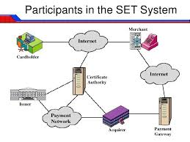

Slide 22
SET functionalities :
Provide Authentication
1. Merchant Authentication – To prevent theft, SET allows customers to check previous relationships between merchant and financial institution. Standard X.509V3 certificates are used for this verification.
2. Customer / Cardholder Authentication – SET checks if use of credit card is done by an authorized user or not using X.509V3 certificates.
Provide Message Confidentiality : Confidentiality refers to preventing unintended people from reading the message being transferred. SET implements confidentiality by using encryption techniques. Traditionally DES is used for encryption purpose.
Provide Message Integrity : SET doesn’t allow message modification with the help of signatures. Messages are protected against unauthorized modification using RSA digital signatures with SHA-1 and some using HMAC with SHA-1,

Slide 23
Dual Signature :
The dual signature is a concept introduced with SET, which aims at connecting two information pieces meant for two different receivers :
Order Information (OI) for merchant
Payment Information (PI) for bank
You might think sending them separately is an easy and more secure way, but sending them in a connected form resolves any future dispute possible. Here is the generation of dual signature:

Slide 24
SSL versus SET

Slide 27
3D Secure Protocol
3-D Secure is an XML-based protocol designed to be an additional security layer for online credit and debit card transactions. It was originally developed by Arcot Systems (now CA Technologies) and first deployed by Visa with the intention of improving the security of Internet payments, and is offered to customers under the Verified by Visa/Visa Secure brands. Services based on the protocol have also been adopted by Mastercard as SecureCode, Discover as ProtectBuy and by JCB International as J/Secure. American Express added 3-D Secure in selected markets on November 8, 2010 as American Express SafeKey, and continues to launch additional markets.

Slide 28
The basic concept of the protocol is to tie the financial authorization process with online authentication. This additional security authentication is based on a three-domain model (hence the 3-D in the name itself). The three domains are:
Acquirer domain (the bank and the merchant to which the money is being paid).
Issuer domain (the bank which issued the card being used).
Interoperability domain (the infrastructure provided by the card scheme, credit, debit, prepaid or other types of a payment card, to support the 3-D Secure protocol). It includes the Internet, merchant plug-in, access control server, and other software providers
The protocol uses XML messages sent over SSL connections with client authentication[6] (this ensures the authenticity of both peers, the server and the client, using digital certificates).

Slide 29
ACS providers
In the 3-D Secure protocol, the ACS (access control server) is on the issuer side (banks). Currently, most banks outsource ACS to a third party. Commonly, the buyer's web browser shows the domain name of the ACS provider, rather than the bank's domain name; however, this is not required by the protocol. Dependent on the ACS provider, it is possible to specify a bank-owned domain name for use by the ACS.
MPI providers
Each 3-D Secure version 1 transaction involves two Internet request/response pairs: VEReq/VERes and PAReq/PARes.[7] Visa and Mastercard do not permit merchants to send requests directly to their servers. Merchants must instead use MPI (merchant plug-in) providers.

Slide 30
Electronic money
Electronic money is referred to as the form of currency that is electronically stored in devices, such as the banking computer systems. Unlike the decentralised cryptocurrency, electronic money is backed by a fiat currency; meaning they are regulated by a central authority.
Electronic money a.k.a e-money can be transferred through smart cards (credit or debit cards), smartphones, and computer systems, among others.
In order to facilitate transactions from bank accounts, financial firms and banks sign deals with e-money networking processors to give customers access to smart cards with which electronic transactions will be possible.

Slide 31
Types of electronic money
E-money is usually issued by an institution upon receipt of funds and is given a value in a national currency like Rupee. Basically, money is of three types with the first two being the most important. The first category is stored value cards that contain prepaid money. Smart cards, prepaid cards and cards used in bus like Mybus card, are examples of this prepaid payment cards. Second is the software based electronic money where money is kept online in servers. Here, account balances are kept at online service providers such as Paytm.
Another type of e-money is virtual currencies without an issuer and that not denominated in national currencies. But there are several conditions that makes virtual currencies to be counted as electronic money. The ECB itself gives three areas of electronic money.
Empirically, the stored value cards like smart cards are used for standard retail payment transactions. On the other hand, the software based online payments supported by software based mobile wallets and digital wallets.

Slide 32
Email Security
PGP
PGP (Pretty Good Privacy), is a popular program that is used to provide confidentiality and authentication services for electronic mail and file storage. It was designed by Phil Zimmermann way back in 1991. He designed it in such a way, that the best cryptographic algorithms such as RSA, Diffie-Hellman key exchange, DSS are used for the public-key encryption (or) asymmetric encryption; CAST-128, 3DES, IDEA are used for symmetric encryption and SHA-1 is used for hashing purposes. PGP software is an open source one and is not dependent on either of the OS (Operating System) or the processor. The application is based on a few commands which are very easy to use.

Slide 33
The following are the services offered by PGP:
1. Authentication
2. Confidentiality
3. Compression
4. Email Compatibility
5. Segmentation
1. Authentication:
Authentication basically means something that is used to validate something as true or real. To login into some sites sometimes we give our account name and password, that is an authentication verification procedure.

Slide 34
2. Confidentiality:
Sometimes we see some packages labelled as ‘Confidential’, which means that those packages are not meant for all the people and only selected persons can see them. The same applies to the email confidentiality as well. Here, in the email service, only the sender and the receiver should be able to read the message, that means the contents have to be kept secret from every other person, except for those two.
PGP provides that Confidentiality service in the following manner:

Slide 35
The message is first compressed and a 128 bit session key (Ks), generated by the PGP, is used to encrypt the message through symmetric encryption. Then, the session key (Ks) itself gets encrypted through public key encryption (EP) using receiver’s public key(KUb) . Both the encrypted entities are now concatenated and sent to the receiver.
Practically, both the Authentication and Confidentiality services are provided in parallel as follows :

Slide 36
Note:
M – Message
H – Hash Function
Ks – A random Session Key created for Symmetric Encryption purpose
DP – Public-Key Decryption Algorithm
EP – Public-Key Encryption Algorithm
DC – Asymmetric Encryption Algorithm
EC – Symmetric Encryption Algorithm
KPb – A private key of user B used in Public-key encryption process
KPa – A private key of user A used in Public-key encryption process
PUa – A private key of user A used in Public-key encryption process
KUb – A private key of user B used in Public-key encryption process
|| – Concatenation
Z – Compression Function
Z-1 – Decompression Function

Slide 37
3. Compression
As a default, PGP compresses the message after applying the signature but before encryption. This has the benefit of saving space both for e-mail transmission and for file storage.
The placement of the compression algorithm, indicated by Z for compression and Z−1 for decompression.
4. E-mail compatibility
Many electronic mail systems only permit the use of blocks consisting of ASCII text. When PGP is used, at least part of the block to be transmitted is encrypted. This basically produces a sequence of arbitrary binary words which some mail systems won’t accept. To accommodate this restriction PGP uses and algorithm known as radix64 which maps 6 bits of a binary data into and 8 bit ASCII character.

Slide 38
5. Segmentation
E-mail facilities are often restricted to a maximum message length. For example, many of the facilities accessible throughout the Internet impose a maximum length of 50,000 octets. Any message longer than that must be broken up into smaller segments, each of which is mailed separately.
Cryptographic Keys and Key Rings
PGP makes use of four types of keys:
1. One-time session symmetric keys
2. Public keys
3. Private keys
4. Passphrase based symmetric keys

Slide 39
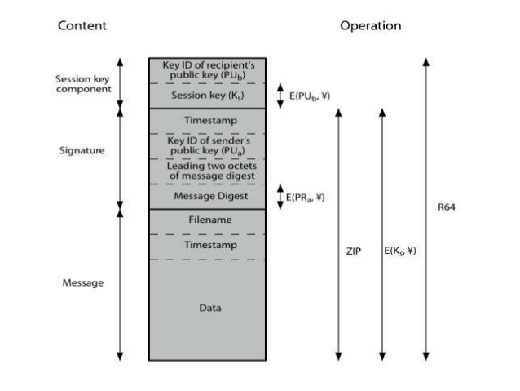
Figure: General format of PGP message (from A to B).

Slide 40
S/MIME
S/MIME (Secure/Multipurpose Internet Mail Extensions) is a standard for public key encryption and signing of MIME data. S/MIME is on an IETF standards track and defined in a number of documents, most importantly RFC 3369, 3370, 3850 and 3851. It was originally developed by RSA Data Security and the original specification used the IETF MIME specification with the de facto industry standard PKCS#7 secure message format.
S/MIME provides the following cryptographic security services for electronic messaging applications:
Authentication
Message integrity
Non-repudiation of origin (using digital signatures)
Privacy
Data security (using encryption)

Slide 41
S/MIME Functionality
In terms of general functionality, S/MIME is very similar to PGP. Both offer the ability to sign and/or encrypt messages. In this subsection, we briefly summarize S/MIME capability. We then look in more detail at this capability by examining message formats and message preparation.
Functions
S/MIME provides the following functions:
1. Enveloped data: This consists of encrypted content of any type and encrypted-content encryption keys for one or more recipients.
· 2. Signed data: A digital signature is formed by taking the message digest of the content to be signed and then encrypting that with the private key of the signer. The content plus signature are then encoded using base64 encoding. A signed data message can only be
· 3. viewed by a recipient with S/MIME capability.
4. Clear-signed data: As with signed data, a digital signature of the content is formed. However, in this case, only the digital signature is encoded using base64. As a result, recipients without S/MIME capability can view the message content, although they cannot verify the signature.
· 5. Signed and enveloped data: Signed-only and encrypted-only entities may be nested, so that encrypted data may be signed and signed data or clear-signed data may be encrypted.

Slide 42
Cryptographic Algorithms
hash functions: SHA-1 & MD5
digital signatures: DSS & RSA
session key encryption: ElGamal & RSA
message encryption: Triple-DES, RC2/40 and others
have a procedure to decide which algorithms to use.
S/MIME uses the following terminology, taken from RFC 2119 to specify the requirement level:
Must: The definition is an absolute requirement of the specification. An implementation must include this feature or function to be in conformance with the specification.
Should: There may exist valid reasons in particular circumstances to ignore this feature or function, but it is recommended that an implementation include the feature or function.

Slide 44
Network Security
Firewalls: Firewalls Characteristics and Types of Fire walls
Firewall is a network security system that monitors and controls incoming and outgoing network traffic based on predetermined security rules. A firewall typically establishes a barrier between a trusted internal network and untrusted external network, such as the Internet.
Firewalls are often categorized as either network firewalls or host-based firewalls. Network firewalls filter traffic between two or more networks and run on network hardware. Host-based firewalls run on host computers and control network traffic in and out of those machines.

Slide 46
The main characteristics of the firewall protection include the following:
Different protection levels based on the location of the computer
When your PC connects to a network, the firewall applies a security level in accordance with the type of network. If you want to change the security level assigned initially, you can do this at any time through the firewall settings.
Protection of wireless networks (Wi-Fi)
This blocks intrusion attempts launched through wireless networks (Wi-Fi). When an intruder attempts to access, a pop-up warning is displayed that allows you to immediately block the attack.
Access to the network and the Internet
It specifies which programs installed on your computer can access the network or the Internet.

Slide 47
Protection against intruders
It prevents hacker attacks that try to access your computer to carry out certain actions.
Blocks
The firewall can block the access of the programs that you specify should not be able to access the local network or the Internet. It also blocks access from other computers that try to connect to programs installed on your computer.
Definition of rules
This defines rules that you can use to specify which connections you want to allow and the ports and zones through which the connection can be established.

Slide 48
Types of Firewalls
The five types of firewall are:
Packet filtering firewall
Circuit-level gateway
Stateful inspection firewall
Application-level gateway (aka proxy firewall)
Next-generation firewall (NGFW)
Packet filtering firewall
Packet filtering firewalls operate inline at junction points where devices such as routers and switches do their work. However, these firewalls don't route packets, but rather they compare each packet received to a set of established criteria -- such as the allowed IP addresses, packet type, port number and other aspects of the packet protocol headers.

Slide 49
Circuit-level gateway
Using another relatively quick way to identify malicious content, circuit-level gateways monitor TCP handshakes and other network protocol session initiation messages across the network as they are established between the local and remote hosts to determine whether the session being initiated is legitimate -- whether the remote system is considered trusted. They don't inspect the packets themselves, however.
Stateful inspection firewall
State-aware devices, on the other hand, not only examine each packet, but also keep track of whether or not that packet is part of an established TCP or other network session. This offers more security than either packet filtering or circuit monitoring alone but exacts a greater toll on network performance.

Slide 50
Application-level gateway
This kind of device -- technically a proxy and sometimes referred to as a proxy firewall -- combines some of the attributes of packet filtering firewalls with those of circuit-level gateways. They filter packets not only according to the service for which they are intended -- as specified by the destination port -- but also by certain other characteristics, such as the HTTP request string.
Next-generation firewall
A typical NGFW combines packet inspection with stateful inspection and also includes some variety of deep packet inspection, as well as other network security systems, such as intrusion detection/prevention, malware filtering and antivirus.

Slide 51
IP Security
IPsec provides security mechanisms that include secure datagram authentication and encryption mechanisms within IP. When you invoke IPsec, IPsec applies the security mechanisms to IP datagrams that you have enabled in the IPsec global policy file.
IPSec Architecture
IPSec (IP Security) architecture uses two protocols to secure the traffic or data flow. These protocols are ESP (Encapsulation Security Payload) and AH (Authentication Header). IPSec Architecture include protocols, algorithms, DOI, and Key Management. All these components are very important in order to provide the three main services:
Confidentiality
Authentication
Integirity

Slide 52
IP Security Architecture:

Slide 53
1. Architecture:
Architecture or IP Security Architecture covers the general concepts, definitions, protocols, algorithms and security requirements of IP Security technology.
2. ESP Protocol:
ESP(Encapsulation Security Payload) provide the confidentiality service. Encapsulation Security Payload is implemented in either two ways:
ESP with optional Authentication.
ESP with Authentication.
3. Encryption algorithm:
Encryption algorithm is the document that describes various encryption algorithm used for Encapsulation Security Payload.

Slide 54
4. AH Protocol:
AH (Authentication Header) Protocol provides both Authentication and Integrity service. Authentication Header is implemented in one way only: Authentication along with Integrity.
5. Authentication Algorithm:
Authentication Algorithm contains the set of the documents that describe authentication algorithm used for AH and for the authentication option of ESP.
6. DOI (Domain of Interpretation):
DOI is the identifier which support both AH and ESP protocols. It contains values needed for documentation related to each other.
7. Key Management:
Key Management contains the document that describes how the keys are exchanged between sender and receiver.

Slide 55
Virtual Private Networks
A virtual private network (VPN) extends a private network across a public network and enables users to send and receive data across shared or public networks as if their computing devices were directly connected to the private network. Applications running across a VPN may therefore benefit from the functionality, security, and management of the private network. Encryption is a common, although not an inherent, part of a VPN connection.
A VPN is created by establishing a virtual point-to-point connection through the use of dedicated circuits or with tunneling protocols over existing networks. A VPN available from the public Internet can provide some of the benefits of a wide area network (WAN). From a user perspective, the resources available within the private network can be accessed remotely.

Slide 56
Virtual Private Networks

Slide 58
VPN systems may be classified by:
the tunneling protocol used to tunnel the traffic
the tunnel's termination point location, e.g., on the customer edge or network-provider edge
the type of topology of connections, such as site-to-site or network-to-network
the levels of security provided
the OSI layer they present to the connecting network, such as Layer 2 circuits or Layer 3 network connectivity
the number of simultaneous connections

Slide 59
Security mechanisms
The VPN security model provides:
confidentiality such that even if the network traffic is sniffed at the packet level (see network sniffer and deep packet inspection), an attacker would see only encrypted data
sender authentication to prevent unauthorized users from accessing the VPN
message integrity to detect any instances of tampering with transmitted messages.

Slide 60
THANK YOU

