Slide 1
MATHEMATICAL ECONOMICS
Presented By
A.RAMESH,LECTURER IN P.G ECONOMICS
DNR(A) COLLEGE,BHIMABVARAM

Slide 2

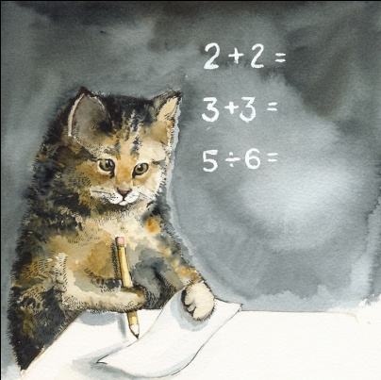

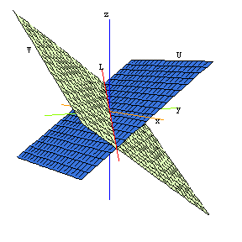
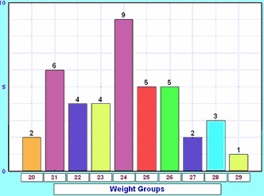
MATH TOPICS IMPORTANT TO ECONOMICS

Slide 3

LINEAR ALGEBRA!
Input Output Matrices
Demonstrate how goods from one industry are consumed in other industries.
Rows of the matrix represent producing sector of the economy
Columns of the matrix represent consuming sector of the economy
One vector of the matrix represents the internal demand
Models what would happen if a producer increases or decreases the price of a good

Slide 4
EXAMPLE OF INPUT
OUTPUT MATRIX
( )
S₁
S₂
.
.
.
S_{n}
S₁ S_{2 . . .} S_{n}
a₁₁ a₁₂ . . . a_{1n}
a₂₁ a₂₂ . . . a_{2n}
. . .
. . .
. . .
a_{n1} a_{n2} . . . a_{nn}
The entry a_{ij} represents the percent total production value of
sector j is spent on products of sector i

Slide 5
CALCULATING AMOUNT OF A GOOD PRODUCED
[ ] = [ ] + [ ]
Amount
produced
Internal
demand
Final
demand

Slide 6


Slide 7
DUALITY
Refers to connections between quantities and prices that arise as a consequence of the hypotheses of optimization and convexity
Derives convex functions involving mappings and vectors to determine cost, profit, and production
Finds an equilibrium of the market and optimal values of supply and demand
Involves proofs of several lemmas (Hotelling’s lemma and Shephard’s lemma to name a few!)

Slide 8
FOUNDATIONS STYLE PROOF!!!
Hotelling’s Lemma
Result of duality
Asserts the net supply function of good i as the derivative of the profit
function with respect to the price of good i
If (x, y) ∈ nm(p, w) = ndF∗(p, w), then (p, w) ∈ ndF∗∗(x, y) = ndF(x, y).
Then dF(x, y) + (p, w) · ((x′, y′) − (x, y)) ≤ dF(x′, y′) for all (x′, y′).
This implies that x ∈ F and furthermore that (p, w) · ((x′, y′) − (x, y)) ≤ 0 for all (x, y) ∈ F, in other words, that (x, y) is profit-maximizing at prices (p, w). Conversely, suppose that (x, y) is profit maximizing at prices (p, w).
Then (p, w) satisfies the subgradient inequality of dF at (x, y), and so (p, w) ∈ ndF.
Consequently, (x, y) ∈ ndF∗(p, w) ≡ nm(p, w).

Slide 9


Slide 10
GAME THEORY
The Science of Strategy
Started by Princeton mathematician John Von Neumann
Mathematically & logically determines the actions that “players” should take for best personal outcomes in a wide array of “games”
Mathematically analyzes interdependence of player strategy to optimize gains
Interdependent strategies can be sequences or simultaneous functions

Slide 11
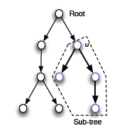
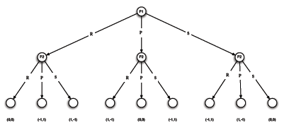
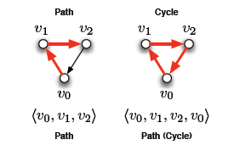
MATHEMATICAL CONCEPTS IN GAME THEORY
Linear Algebra
Example: Saddle Points and Zero-Sum Games
In zero-sum games, the winner’s gains are equal to the loser’s loss, resulting in a “zero-sum”.
Game choices can be represented by matrices whose vectors are manipulated to calculate saddle points: equilibrium strategy pairs (x, y).
Theorems and their Proofs
Some prominent theorems proved in Game Theory include:
Bayes Rule
Expected Utility Theorem
Zermelo’s Theorem
Minimax Theorem
Brouwer Fixed Point Theorem
Nash Equilibrium Theorem
All of these involve a foundations style proof!!!
(See resource guide for links to proofs!)
Probability
Example: Die Rolling Game
You put up your own money; even rolls lose $10 * the roll, odd rolls win $12 * the roll. Should you play?
This specific example involves random variables, mean, and calculation of the expectation.
Other aspects of game theory, however, include power sets, conditional probability, union and intersection of probability, Bayes Rule, and more!
Set Theory
Example: Utility Theory
Utility theory mainly involves Lotteries:
L = {{A₁, A₂, …, A_{n}}, p}
A lottery is a set containing all possibilities of outcomes and their respective probabilities.
Unions, intersections, difference, Cartesian products, and power sets are all used to calculate the optimal choices for players in a given game.
Trees and Graphs
Used to map possible choices and their resulting outcomes.
Examples include:
Probability
Set Theory
Trees and Graphs
Linear Algebra
Theorems and their Proofs

