Slide 1


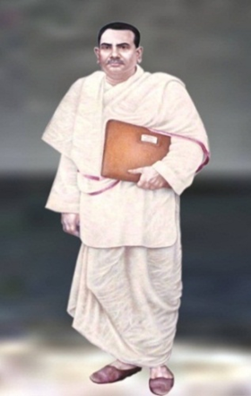


Slide 2
HEALTH CARE DELIVERY SYSTEM IN INDIA
Introduction
Health Care Delivery System in India
Definition
Health Care Delivery System
At the Central
Union Ministry Health and Family Welfare
The Directorate General of Health Services
Organization
Functions
The Central Council of Health and Family welfare
Functions
At State Level
1)State Level
2)State health director
Sub Centre Level
3.Primary Health Care Level
4. Community Health Care Level
5.National Health Programmers
Community Nursing Services
Conclusion

Slide 3
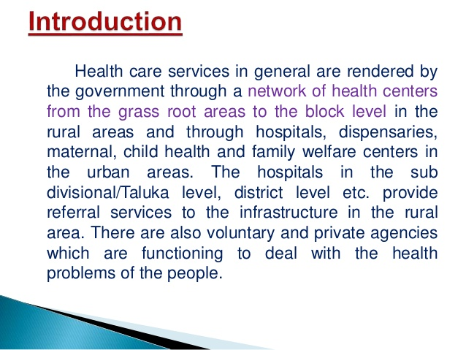

Slide 4
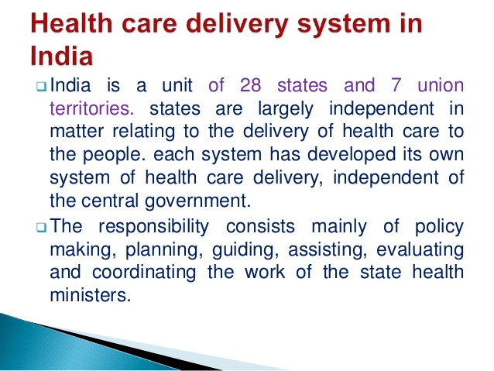

Slide 5
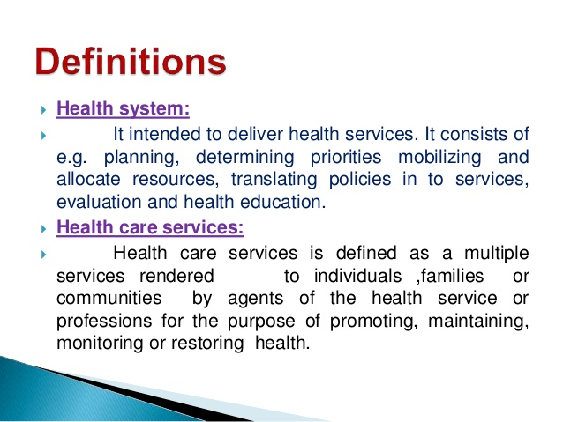

Slide 6
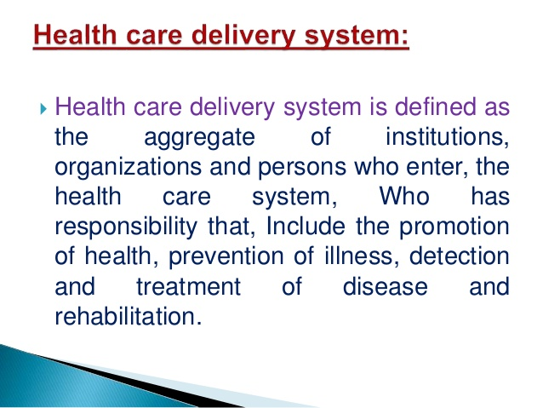

Slide 7
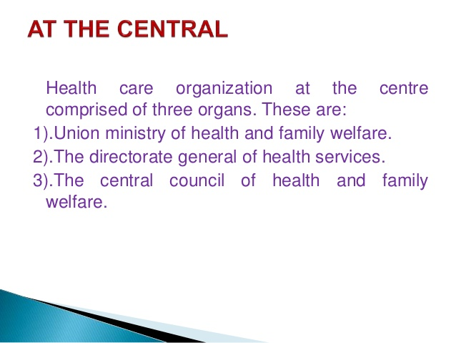

Slide 8
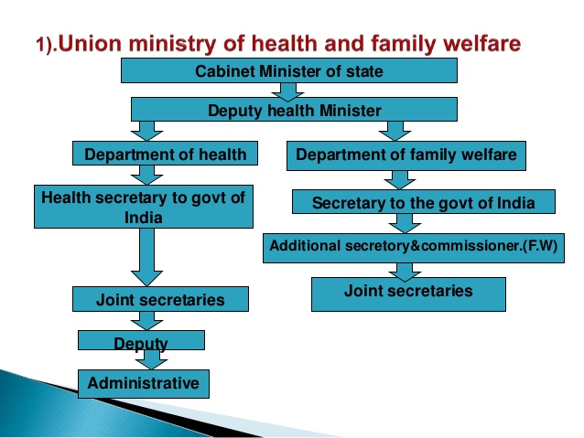

Slide 9
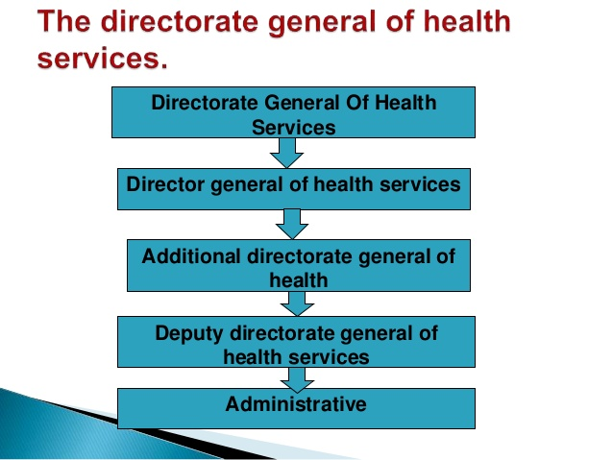

Slide 10
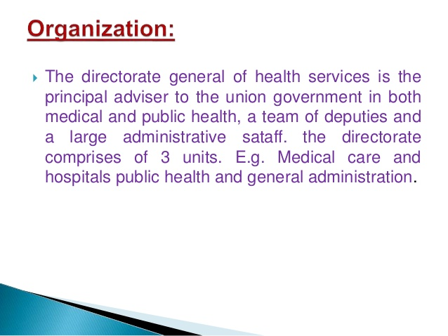

Slide 11
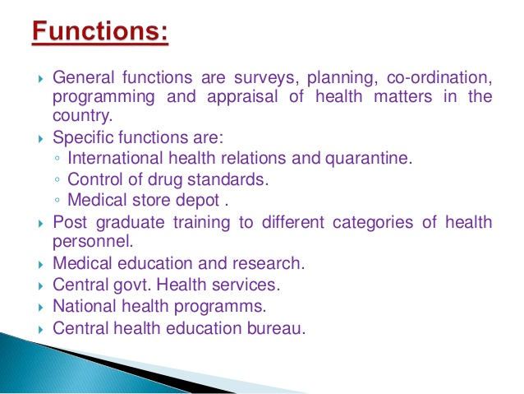

Slide 12
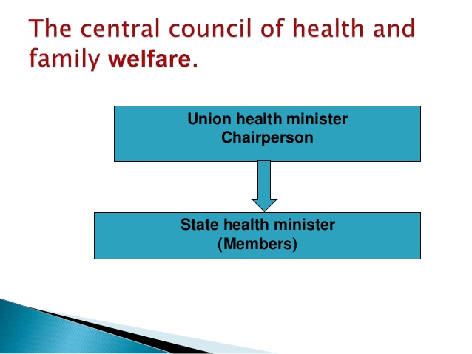

Slide 13
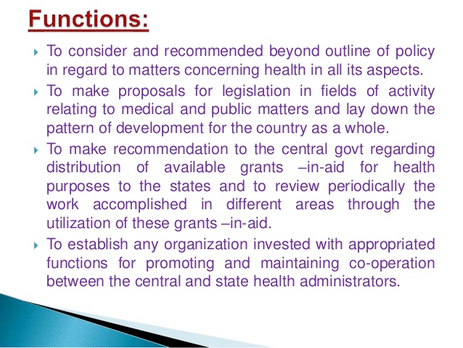

Slide 14
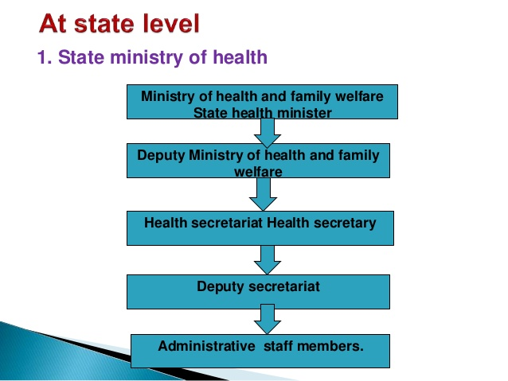

Slide 15
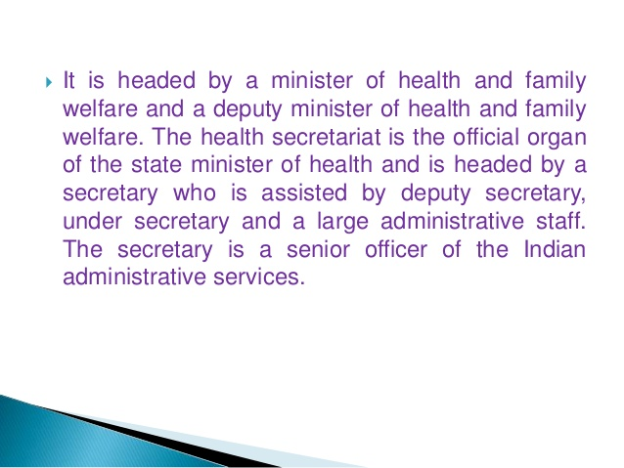

Slide 16


Slide 17
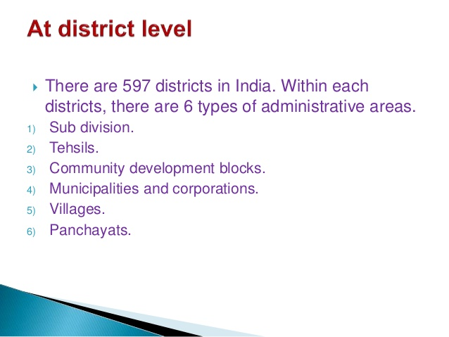

Slide 18
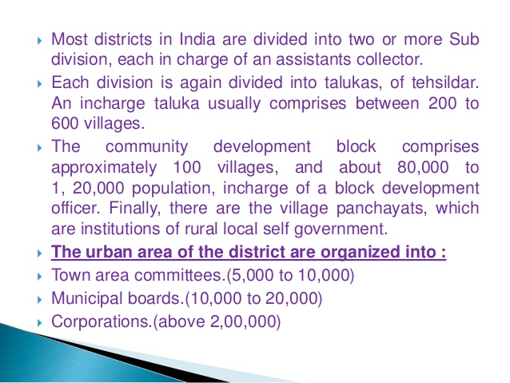

Slide 19
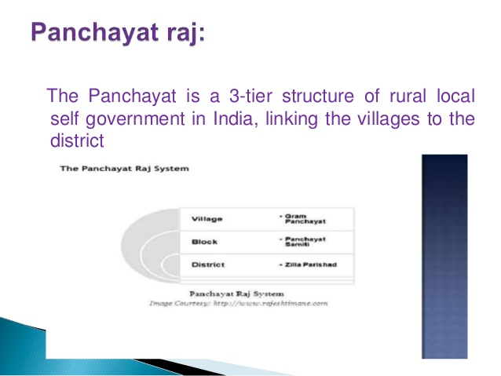

Slide 20
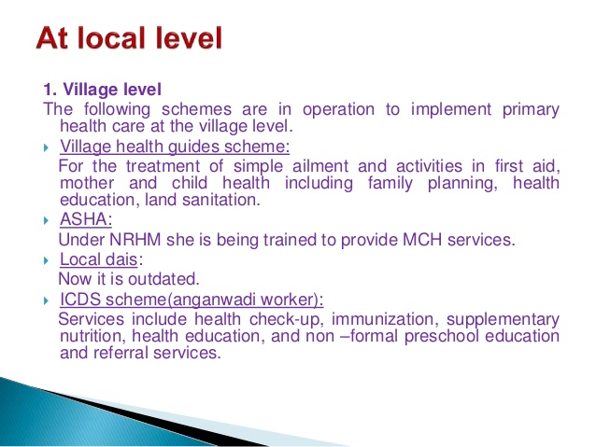

Slide 21
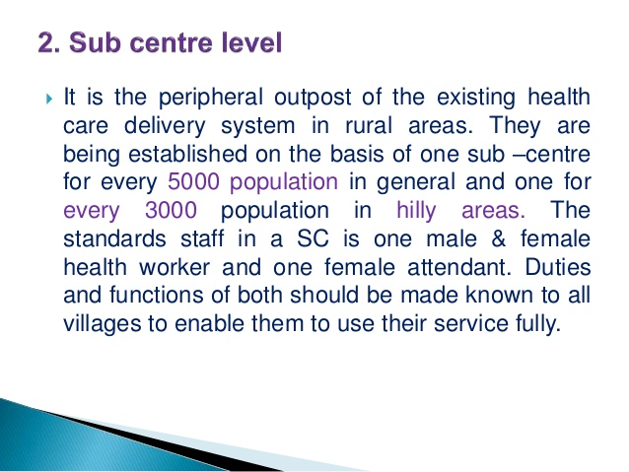

Slide 22
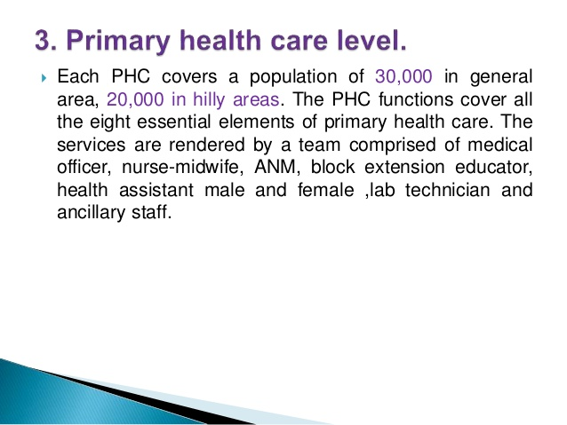

Slide 23
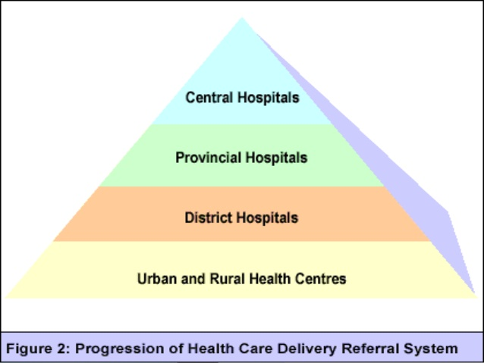

Slide 24
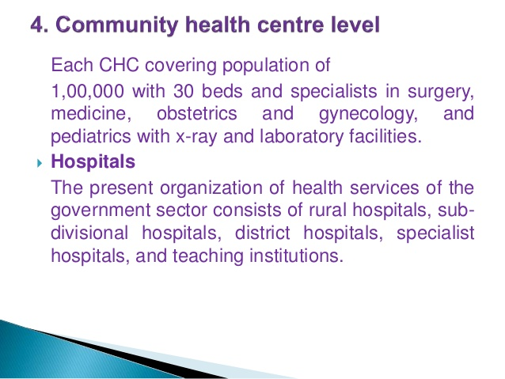

Slide 25
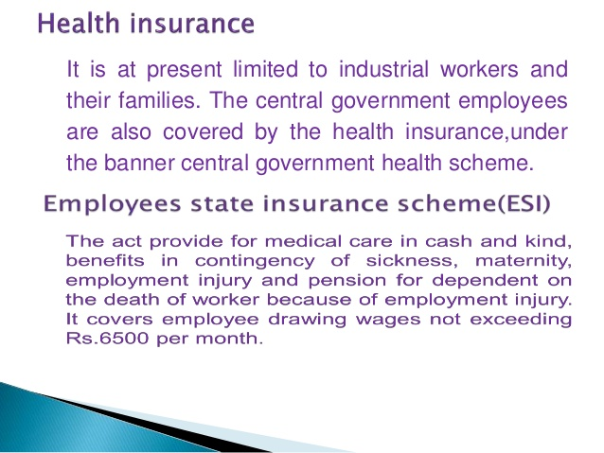

Slide 26
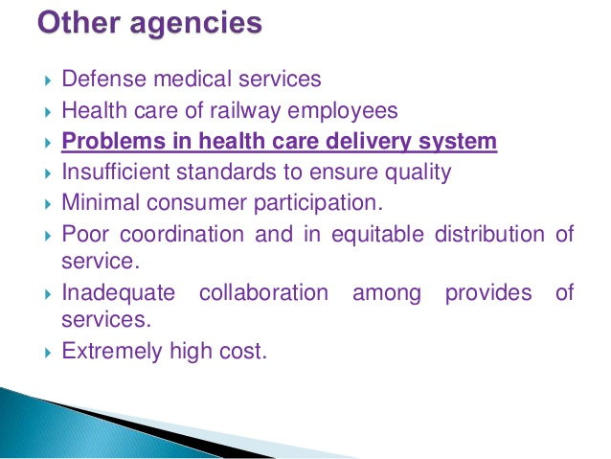

Slide 27
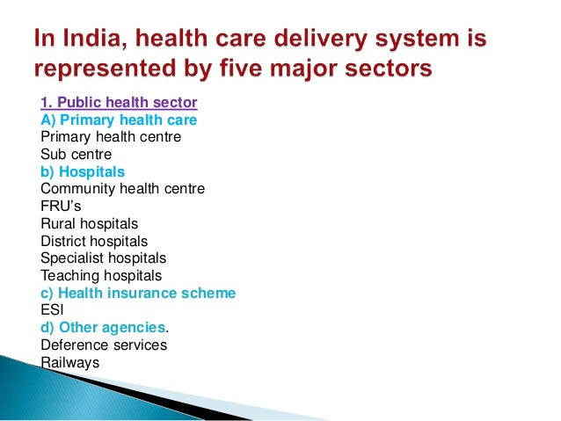

Slide 28
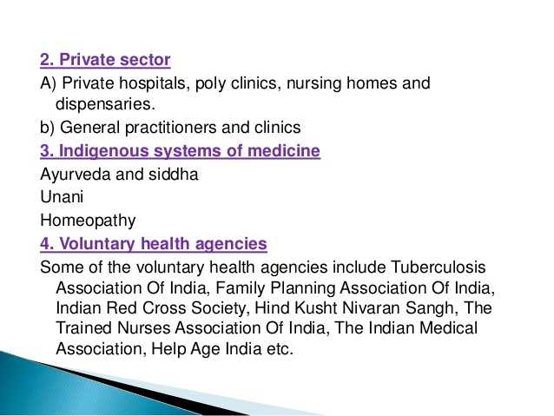

Slide 29
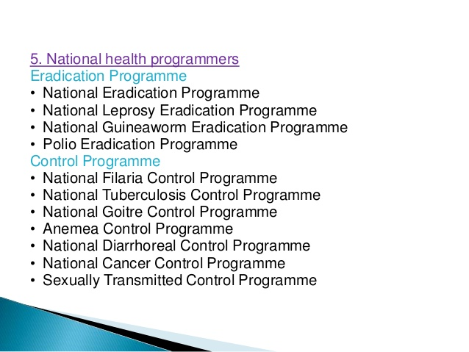

Slide 30
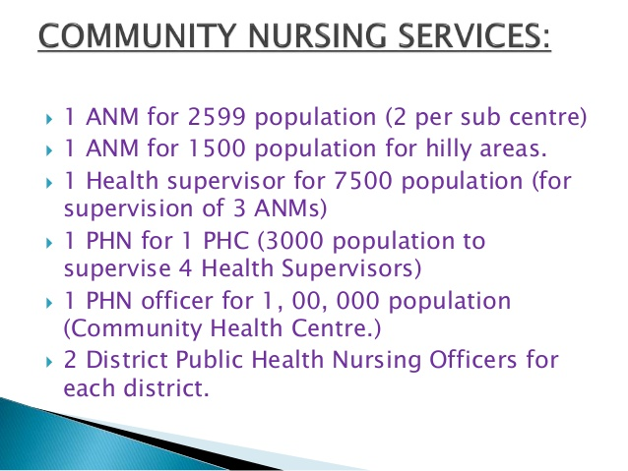

Slide 31
CONCLUSION:
India has been focussing on providing comprehensive care to mother and child. It has framed policies that allow the design and implementation of programs on new-born care in an inclusive manner. However, looking at the pace of achievements of the targets so far and future targets, it needs to focus more on framing of the policies in terms of building capacity of existing human resources, enhancing further allocation of ﬁnances dedicated toward new born care, identifying areas through operational research, which can enhance quantity and quality of care for new born care in India. The path is set and we need to operationalize and move forward

Slide 32
Thank You

