Slide 1

M104- TOPOLOGY
METRIC SPACES
K. C. TAMMI RAJU, M. Sc;
HOD, Dept. of mathematics;
PG COURSES

Slide 2
CONTENT
Definition and Examples of Metric Spaces
Discrete Metric Space – Examples
Pseudo – metric
Norm
Subspace

Slide 3




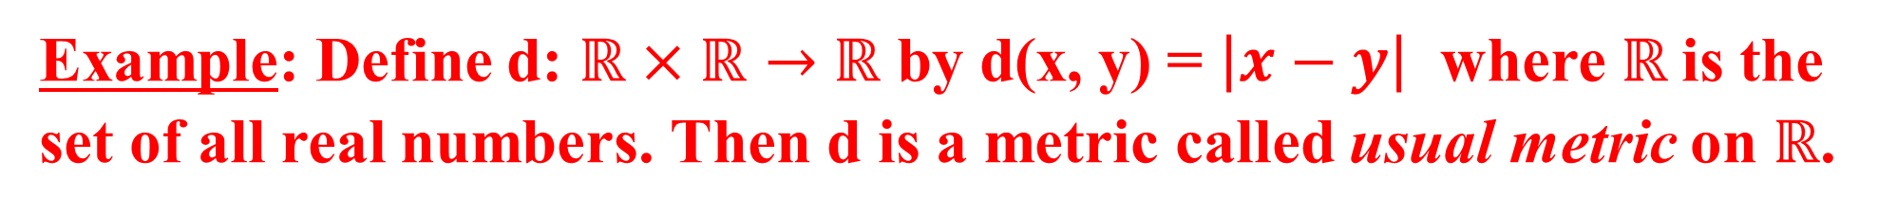
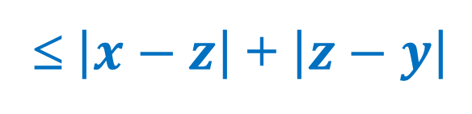
Definition: Let X be a nonempty set and d: X × X → $ℝ$ be a function.
d is said to be a metric on X if
(i) d(x, y) ≥ 0 ∀ x, y ∈ X and d(x, y) = 0 iff x = y. (Non negativity)
(ii) d(x, y) = d(y, x) ∀ x, y ∈ X. (symmetry)
(iii) d(x, y) ≤ d(x, z) + d(z, y) ∀ x, y, z ∈ X (Triangle in equality).
If d is a metric on X then (X, d) is called a metric space.
d(x, y) is called the distance between x and y.
Example: Define d: $ℝ×ℝ→$ $ℝ$ by d(x, y) = $\left|x−y\right|$ where $ℝ$is the set of all real numbers. Then d is a metric called usual metric on $ℝ$.
Solution: (i) d(x, y) = $\left|x−y\right|$ ≥ 0. d(x, y) = 0 iff $\left|x−y\right|$ = 0 iff x = y.
(ii) d(x, y) = $\left|x−y\right|$ = $\left|y−x\right|$ = d(y, x)
(iii) d(x, y) = $\left|x−y\right|$
$=$ $\left|x−z+z−y\right|$
≤ $\left|x−z\right|$ + $\left|z−y\right|$
Hence d is a metric on $ℝ$.
= d(x, z) + d(z, y).

Slide 4


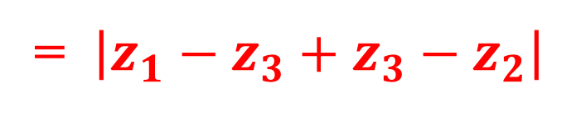

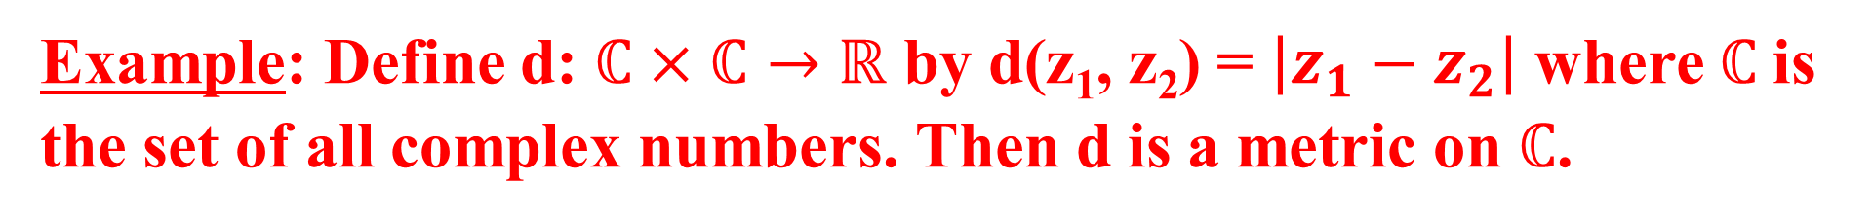

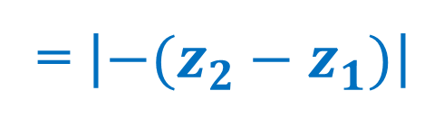

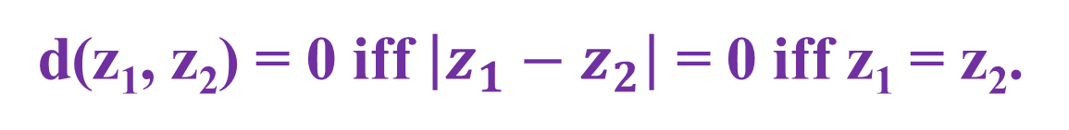

Example: Define d: $ℂ×ℂ→$ $ℝ$ by d(z₁, z₂) = $\left|z_{1}−z_{2}\right|$ where $ℂ$is the set of all complex numbers. Then d is a metric on $ℂ$.
Solution: Let $z_{1}, z_{2}, z_{3}$ ∈ $ℂ.$
(i) d(z₁, z₂) = $\left|z_{1}−z_{2}\right|$ ≥ 0 and
d(z₁, z₂) = 0 iff $\left|z_{1}−z_{2}\right|$ = 0 iff z₁ = z₂.
(ii) d(z₁, z₂) = $\left|z_{1}−z_{2}\right|$
= $\left|−(z_{2}−z_{1})\right|$
= $\left|z_{2}−z_{1}\right|$
= d(z₂, z₁).
(iii) d(z₁, z₂) = $\left|z_{1}−z_{2}\right|$
= $\left|z_{1}−z_{3}+z_{3}−z_{2}\right|$
≤ $\left|z_{1}−z_{3}\right|$ + $\left|z_{3}−z_{2}\right|$
= d(z₁, z₃) + d(z₃, z₂).
∴ d is a metric called usual metric on $ℂ$.

Slide 5
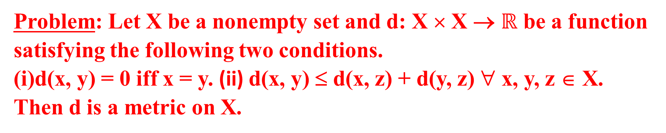
Problem: Let X be a nonempty set and d: X × X → $ℝ$ be a function satisfying the following two conditions.
d(x, y) = 0 iff x = y. (ii) d(x, y) ≤ d(x, z) + d(y, z) ∀ x, y, z ∈ X.
Then d is a metric on X.
Solution: Interchange y and z in (ii).
Then d(x, z) ≤ d(x, y) + d(z, y) ∀ x, z, y ∈X
Replace z by x. Then d(x, x) ≤ d(x, y) + d(x, y)
⇒ 0 ≤ 2 d(x, y) ∀x, y ∈X
⇒ d(x, y) ≥ 0 ∀x, y ∈X.
(ii) Replace z by x in (ii). Then d(x, y) ≤ d(x, x) + d(y, x)
⇒ d(x, y) ≤ 0 + d(y, x).
⇒ d(x, y) ≤ d(y, x) ∀ x, y ∈ X.
Similarly d(y, x) ≤ d(x, y).
Hence d(x, y) = d(y, x) ∀ x, y ∈ X.
(iii) By (ii) d(x, y) ≤ d(x, z) + d(y, z)
= d(x, z) + d(z, y) since d(y, z) = d(z, y)
∴ d(x, y) ≤ d(x, z) + d(z, y) ∀ x, y, z ∈ X.
Hence d is a metric on X.

Slide 6
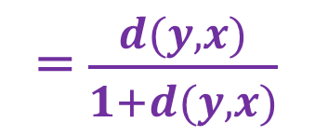
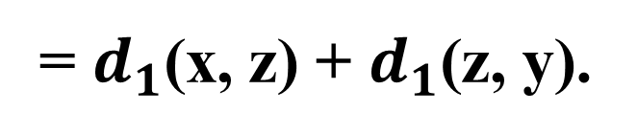
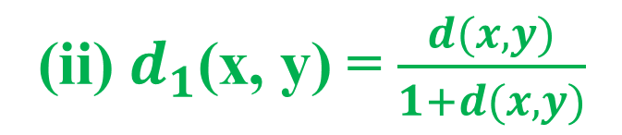
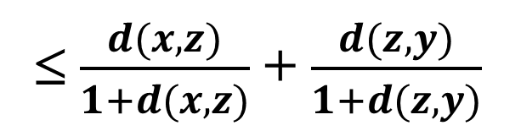

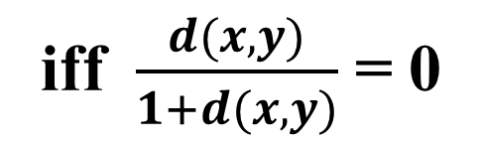
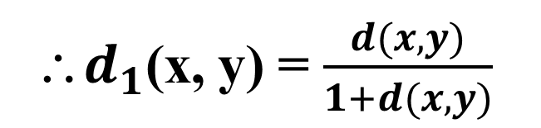
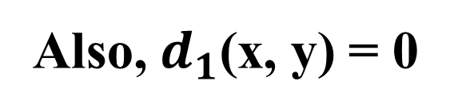
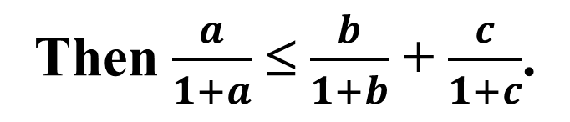

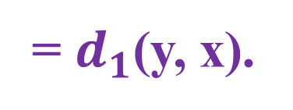
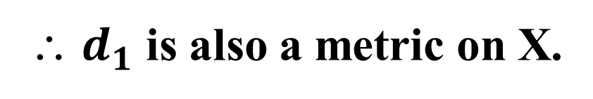
Problem: Let X be a metric space with metric d. Then show that
(i) d₁ defined by $d_{1}$(x, y) = $\frac{d(x,y)}{1+d(x,y)}$ is a metric on X,
(ii) X is bounded set in (X, $d_{1}$).
Solution: (i) Let x, y, z ∈ X.
Since d is metric, we have d(x, y) ≥ 0
∴ $d_{1}$(x, y) = $\frac{d(x,y)}{1+d(x,y)}$ ≥ 0.
iff $\frac{d(x,y)}{1+d(x,y)}$ = 0
Also, $d_{1}$(x, y) = 0
iff d(x, y) = 0
iff x = y since d is a metric.
(ii) $d_{1}$(x, y) = $\frac{d(x,y)}{1+d(x,y)}$
= $\frac{d(y,x)}{1+d(y,x)}$
= $d_{1}$(y, x).
(iii) Put a = d(x, y), b = d(x, z), c = d(z, y).
⸪d is a metric, a ≤ b + c.
Then $\frac{a}{1+a}$ ≤ $\frac{b}{1+b}$ + $\frac{c}{1+c}$.
∴$d_{1}$(x, y) = $\frac{d(x,y)}{1+d(x,y)}$
≤ $\frac{d(x,z)}{1+d(x,z)}$ + $\frac{d(z,y)}{1+d(z,y)}$
= $d_{1}$(x, z) + $d_{1}$(z, y).
∴ $d_{1}$ is also a metric on X.

Slide 7
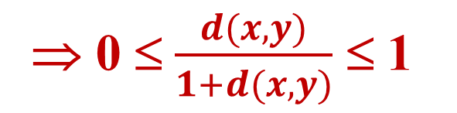

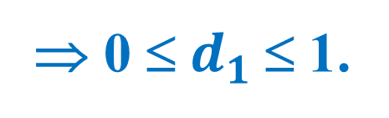
For any x, y ∈ X, 0 ≤ d(x, y) ≤ 1 + d(x, y)
⇒ 0 ≤ $\frac{d(x,y)}{1+d(x,y)}$ ≤ 1
⇒ 0 ≤ $d_{1}$≤ 1.
∴ d(X) = sup {$d_{1}\left(x,y\right):$ x, y ∈ X} ≤ 1.
This shows that X is bounded in the metric space (X, $d_{1}$).

Slide 8
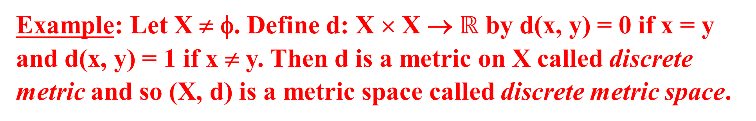
Example: Let X ≠ φ. Define d: X × X → $ℝ$ by d(x, y) = 0 if x = y and d(x, y) = 1 if x ≠ y. Then d is a metric on X called discrete metric and so (X, d) is a metric space called discrete metric space.
Solution: (i) Clearly d(x, y) ≥ 0 and d(x, y) = 0 iff x = y.
(ii) If x = y then d(x, y) = 0 = d(y, x).
If x ≠ y, d(x, y) = 1 = d(y, x).
Thus, d(x, y) = d(y, x).
(iii) Suppose x = y = z, then d(x, y) = 0 = 0 + 0 = d(x, z) + d(z, y).
Suppose x = y ≠ z.
Then d(x, y) = 0 ≤ 1 + 1 = d(x, z) + d(z, y).
Similar is the case when x = z ≠ y, and y = z ≠ x
Suppose no two are equal. Then d(x, y) = 1 ≤ 1 + 1 = d(x, z) + d(z, y).
Thus, in all the cases d(x, y) ≤ d(x, z) + d(z, y).
Hence d is a metric on X.

Slide 9

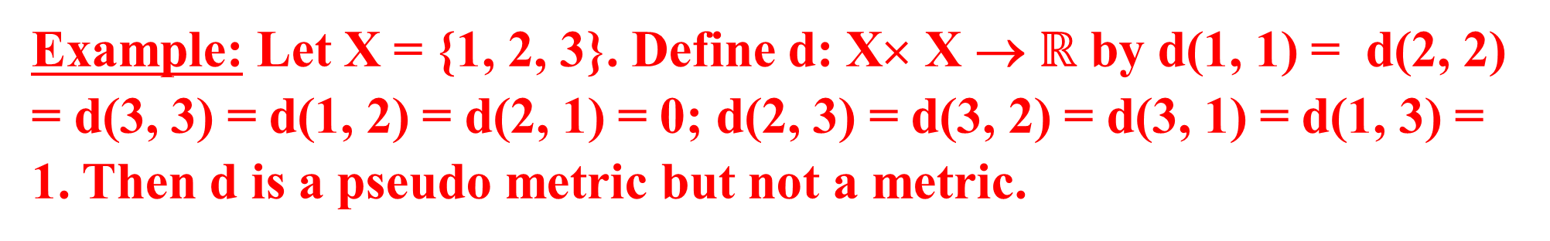
Definition: Let X be a ≠ φ set and d: X × X → $ℝ$ be a function ∋
d(x, y) ≥ 0 ∀ x, y ∈ X and x = y ⇒ d(x, y) = 0.
(ii) d(x, y) = d(y, x) ∀ x, y ∈ X.
(iii) d(x, y) ≤ d(x, z) + d(z, y) ∀ x, y, z ∈ X.
Then d is said to be a pseudo – metric on X.
Note: Every metric is a pseudo – metric. But converse is not true.
Example: Let X be a set with $\left|X\right|$ ≥ 2.
Define d(a, b) = 0 ∀ a, b ∈ X.
Then d is a pseudo metric but not a metric.
Solution: Clearly d is a pseudo metric.
Let a ≠ b.
Then also d(a, b) = 0.
∴ d is not a metric.
Example: Let X = {1, 2, 3}. Define d: X× X → $ℝ$ by d(1, 1) = d(2, 2) = d(3, 3) = d(1, 2) = d(2, 1) = 0; d(2, 3) = d(3, 2) = d(3, 1) = d(1, 3) = 1. Then d is a pseudo metric but not a metric.
Solution: Clearly d is a pseudo metric.
1 ≠ 2 but d(1, 2) = 0.
So, d is not a metric.

Slide 10
Problem: Let d be a Pseudo metric on X and define ‘~’ on X by x ~ y ⇔ d(x, y) = 0. (i) Show that ‘~’ is an equivalence relation (ii) Define a metric on the set of all equivalence classes.
Solution: (i) ~ is reflexive: For, x ~ x ∀ x ∈ X since d(x, x) = 0.
~ is symmetric: For, suppose x ~ y.
⇒ d(x, y) = 0
⇒d(y, x) = 0⇒y ~ x.
~ is transitive: Suppose x ~ y, y ~ z
⇒ d(x, y) = 0 and d(y, z) = 0.
Now d(x, z) ≤ d(x, y) + d(y, z) = 0 + 0 = 0.
⇒ d(x, z) = 0 ⇒ x ~ z.
Hence ~ is an equivalence relation.
Define d*([x], [y]) = d(x, y).
Then d*([x], [y]) = d(x, y) ≥ 0.
d*([x], [y]) = 0
iff d(x, y) = 0
iff x ~ y iff [x] = [y].
d*([x], [y]) = d(x, y)
= d(y, x)
= d*([y], [x]).
d*([x], [y]) = d(x, y)
≤ d(x, z) + d(z, y)
= d*([x], [z]) + d*([z], [y]).
Hence d* is a metric on the set of all equivalence classes {[x] : x ∈ X}.

Slide 11
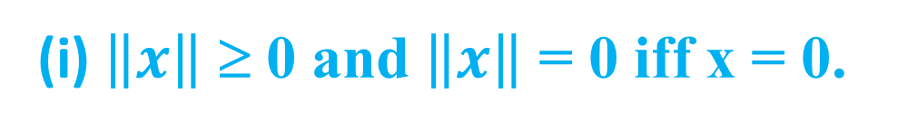
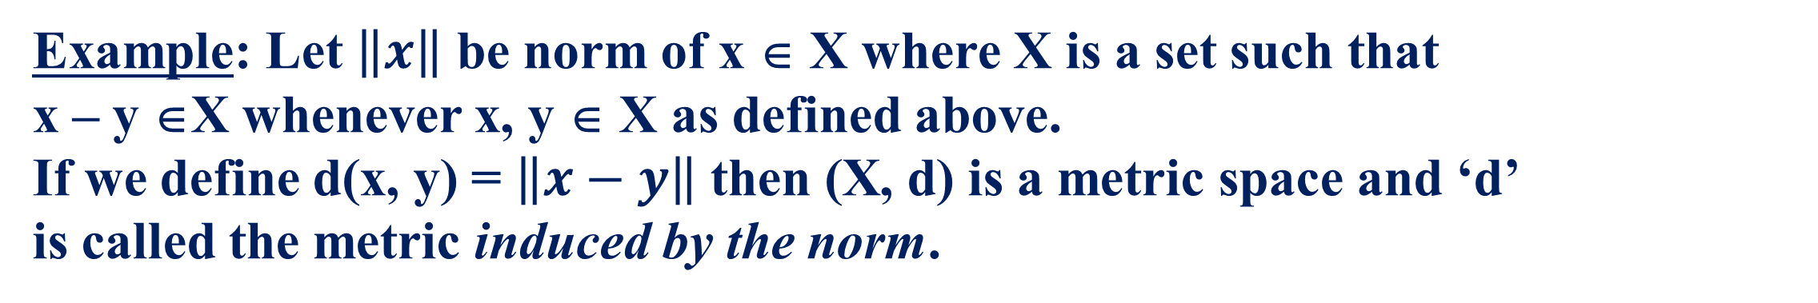
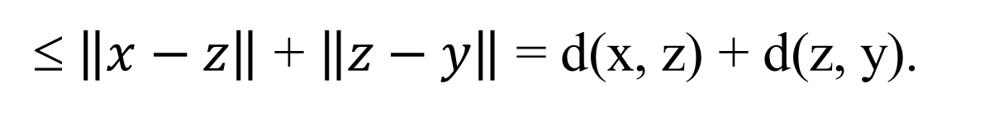



Definition: Let X be a nonempty set.
If for each x ∈ X, ∃ a real number $\left\|x\right\|,$ satisfying the conditions
(i) $\left\|x\right\|$ ≥ 0 and $\left\|x\right\|$ = 0 iff x = 0.
(ii) $\left\|−x\right\|$= $\left\|x\right\|$ ∀ x ∈ X.
(iii) $\left\|x+y\right\|≤ \left\|x\right\|+\left\|y\right\|$ ∀ x, y ∈ X,
then $\left\|x\right\|$ is called norm of x.
Example: Let $\left\|x\right\|$ be norm of x ∈ X where X is a set such that x – y ∈X whenever x, y ∈ X as defined above. If we define d(x, y) = $\left\|x−y\right\|$ then (X, d) is a metric space and ‘d’ is called the metric induced by the norm.
Proof: Let x, y ∈ X. (i) Then d(x, y) = $\left\|x−y\right\|$ ≥ 0.
Now d(x, y) = 0 iff $\left\|x−y\right\|$ = 0 iff x – y = 0 iff x = y.
(ii)d(x, y) = $\left\|x−y\right\| = \left\|−(y−x)\right\|=\left\|y−x\right\|$ = d(y, x)
(iii)Let x, y, z ∈ X. Then d(x, y) = $\left\|x−y\right\|$ = $\left\|x−z+z−y\right\|$
≤ $\left\|x−z\right\|$ + $\left\|z−y\right\|$ = d(x, z) + d(z, y).
∴(X, d) is a metric space.

Slide 12
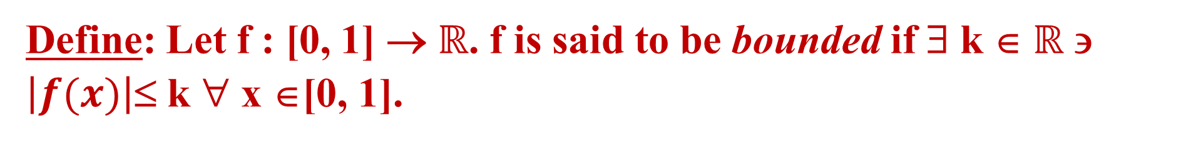
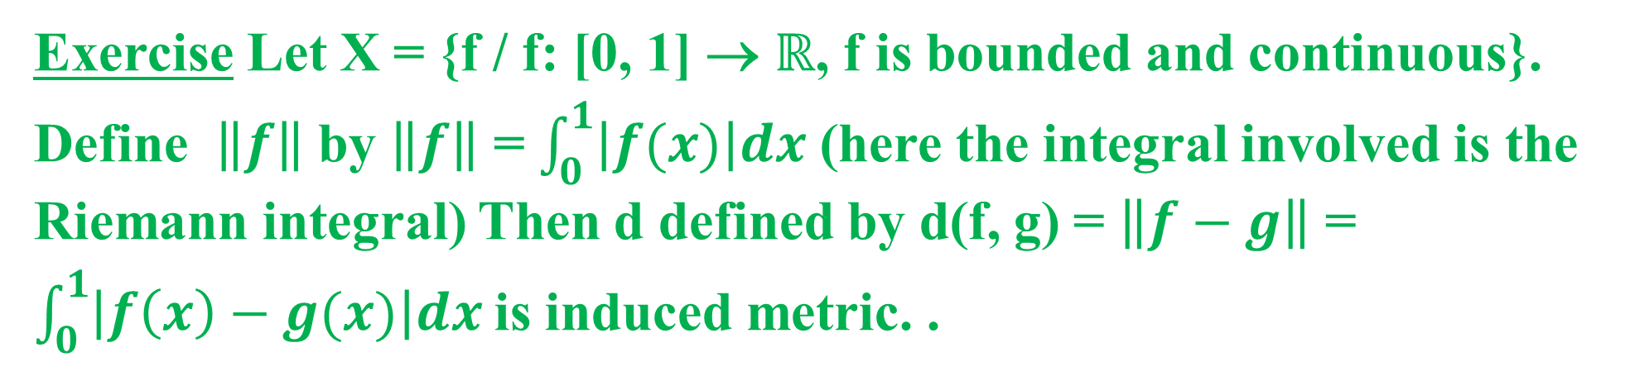
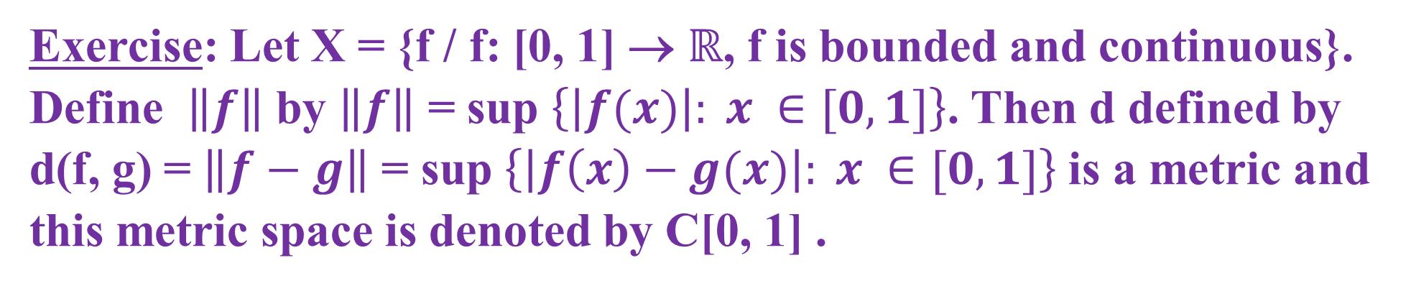
Define: Let f : [0, 1] → $ℝ$. f is said to be bounded if ∃ k ∈$ℝ$ ∋ $\left|f(x)\right|$≤ k ∀ x ∈[0, 1].
Exercise Let X = {f / f: [0, 1] → $ℝ$, f is bounded and continuous}. Define $\left\|f\right\|$ by $\left\|f\right\|$ = $\int_{0}^{1}{\left|f(x)\right|dx}$ (here the integral involved is the Riemann integral) Then d defined by d(f, g) = $\left\|f−g\right\|$ = $\int_{0}^{1}{\left|f\left(x\right)−g(x)\right|dx}$is induced metric. .
Exercise: Let X = {f / f: [0, 1] → $ℝ$, f is bounded and continuous}. Define $\left\|f\right\|$ by $\left\|f\right\|$ = sup $\left\{\left|f(x)\right|: x ∈[0, 1]\right\}$. Then d defined by d(f, g) = $\left\|f−g\right\|$ = sup $\left\{\left|f\left(x\right)−g(x)\right|: x ∈[0, 1]\right\}$is a metric and this metric space is denoted by C[0, 1] .

Slide 13
Definition: Let (X, d) be a metric space and Y ⊆ X. With the
restrictions of ‘d’ to Y, (Y, d) is a metric space and (Y, d) is called
subspace of (X, d).
Definition: Let (X, d) be a metric space and A ⊆ X.
(i) If x∈X then the distance from x to A, d(x, A) = inf {d(x, a) / a ∈ A}.
(ii) The diameter of the set A, d(A) = sup {d(x, y) / x, y ∈ A}.
(iii) If d(A) = ± ∞ then A is said to have infinite diameter, otherwise, it is said to have finite diameter.
Note that if A = φ then d(φ) = sup {d(x, y) / x, y ∈ φ} = sup φ = - ∞
and so φ has infinite diameter.
A is said to be bounded if d(A) is finite. A mapping f: Y → X
where Y ≠ φ and (X, d) is a metric space is said to be bounded if
the set f(Y) is bounded in (X, d).
Example: Let $ℝ^{k}$ be the Euclidean space.
Define d(x, y) = $\left|x−y\right|$ ∀ x, y ∈ $ℝ^{k}.$ Then d is a metric on $ℝ^{k}.$

Slide 14

Important questions covered
1. Definition Metric Space and give examples
2. Definition pseudo metric and give two examples of pseudo metric spaces which are not metric spaces.
3. Let X be a metric space with metric d. Then show that
(i) d₁ defined by $d_{1}$(x, y) = $\frac{d(x,y)}{1+d(x,y)}$ is a metric on X,
(ii) X is bounded set in (X, $d_{1}$).

