Slide 1
M403-GRAPH THEORY INTRODUCTION - 2
K. C. TAMMI RAJU, M. Sc;
HOD, Dept. of mathematics;
PG COURSES

Slide 2
CONTENTS
BASIC DEFINITIONS:
Finite and Infinite graphs
Incidence and Degree
The sum of the degrees of all vertices in a graph G is twice the number of edges in G.
The number of vertices of odd degree in a graph is always even.
Regular graph
Isolated vertex
pendant vertex
a brief history of graph theory

Slide 3
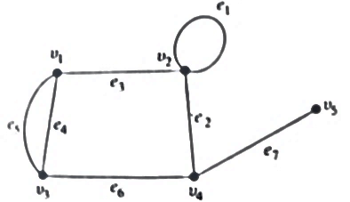
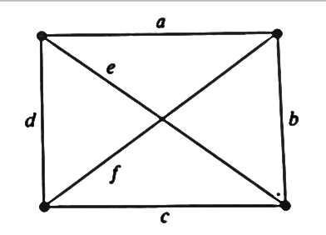
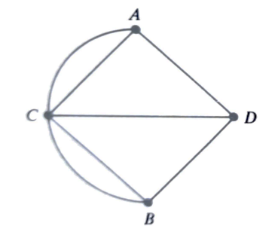
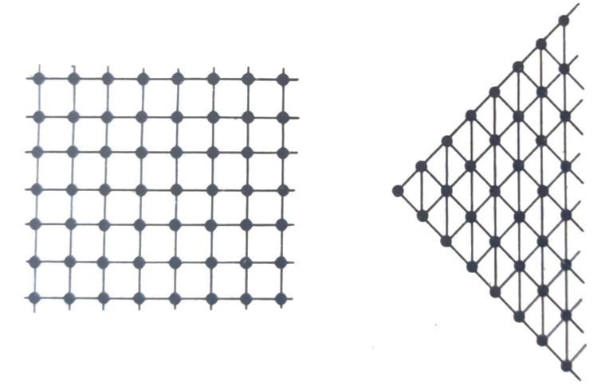
1-3, FINITE AND INFINITE GRAPHS
Although in our definition of a graph neither the vertex set V nor the edge set E need be finite, in most of the theory and almost all applications these sets are finite.
A graph with a finite number of vertices as well as a finite number of the edges is called a finite graph; otherwise, it is an infinite graph.
The graphs in figs. 1-1, 1-2, 1- 5, 1-7, and 1-8 are all examples of finite graphs. Portions of two infinite graphs are shown in fig 1-10.

Slide 4
1-4. INCIDENCE AND DEGREE
Definition: When a vertex v_{i}, is an end vertex of some edge e_{j}, v_{i} and e_{j} are said to be incident with (on or to) each other.
Example: edges e₂, e₆, and e₇ are incident with vertex v₄.
Definition: Two nonparallel edges are said to be adjacent if they are incident on a common vertex. Similarly, two vertices are said to be adjacent if they are the end vertices of the same edge.
Example: e₂ and e₇ in Fig. 1-1 are adjacent.
Example: In Fig. 1-1, v₄ and v₅, are adjacent, but v₁ and v₄ are not.

Slide 5
Definition: The number of edges incident on a vertex v_{i}, with self-loops counted twice, is called the degree, d(v_{i}), of vertex v_{i}.
Example: d(v₁) = d(v₃) = d(v₄) = 3, d(v₂) = 4, and d(v₅) = 1.
∴$d($v₁) + d(v₂) + d(v₃) + d(v₄) + d(v₅)
= 3 + 4 + 3 + 3 + 1
= 14
= 2×7
= twice the number of edges.
Result: The sum of the degrees of all vertices in a graph G is twice the number of edges in G.
Proof: Consider a graph G with e edges and n vertices v₁, v₂, ... , v_{n}.
⸪ each edge contributes 2 degrees, sum of the degrees of all vertices in G is twice the number of edges in G.
That is, $\sum_{i=1}^{n}{d\left(v_{i}\right)=2e}$ ♦

Slide 6
Theorem 1 - 1: The number of vertices of odd degree in a graph is always even.
Proof: Let G be a graph in which v₁, v₂, …, v_{n} be n vertices and e be
the number of edges.
Then $\sum_{i=1}^{n}{d\left(v_{i}\right)=2e}…$ (1-1)
If we consider the vertices with odd and even degrees separately, the quantity in the left side of Eq. (1-1) can be expressed as the sum of two sums, each taken over vertices of even and odd degrees, respectively, as follows:
$\sum_{i=1}^{n}{d\left(v_{i}\right)=\sum_{even}{d(v_{j})}+\sum_{odd}{d(v_{k})}}$…(1-2)
Since the LHS of eq 1-2 is even and the first expression on RHS is even, the second expression must be even.
Ie. $\sum_{odd}{d(v_{k})}=$ an even number … 1-3
Because in Eq 1-3 each d(v_{k}) is odd, the total number of terms in the sum must be even to make the sum an even number.
Hence the theorem.

Slide 7
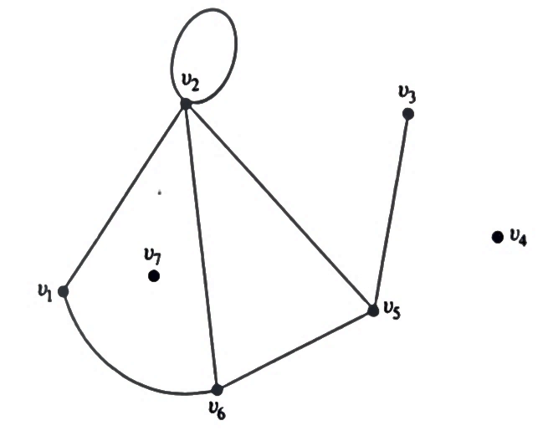
Definition: A graph in which all vertices are of equal degree is called a regular graph (or simply a regular). The graph of three utilities shown in Fig. 1-7 is a regular of degree three.
Definition: A vertex having no incident edge is called an isolated vertex. In other words, isolated vertices are vertices with zero degree.
Example: Vertices v₄ and v₇ in Fig. 1-11 are isolated vertices.
Definition: A vertex of degree one is called a pendant vertex or an end vertex.
Example: Vertex v₃ in Fig. 1-11 is a pendant vertex.
Definition: Two adjacent edges are said to be in series if their common vertex is of degree two.
Example: In Fig. 1-11, the two edges incident on v₁ are in series.

Slide 8
Definition: In the definition of a graph G = (V, E), it is possible for the edge set E to be empty. Such a graph, without any edges, is called a null graph.
In other words, every vertex in a null graph is an isolated vertex.
Example: A null graph of six vertices is shown in Fig. 1-12. Although the edge set E may be empty, the vertex set V must not be empty; otherwise, there is no graph.
Note: A graph must have at least one vertex.
• v₁
•v₂ •v₃ •v₄ •v₅
•v₆ Fig. 1-12 Null graph of six vertices.

Slide 9
[1-6. A BRIEF HISTORY OF GRAPH THEORY As mentioned before, graph theory was born in 1736 with Euler's paper in which he solved the Konigsberg bridge problem [1-4]. For the next 100 years nothing more was done in the field.
In 1847, G. R. Kirchhoff (1824-1887) developed the theory of trees for their applications in electrical networks [1-6]. Ten years later, A. Cayley (1821-1895) discovered trees while he was trying to enumerate the isomers of saturated hydrocarbons C_{n}H_{2n+2} [1-3].
About the time of Kirchhoff and Cayley, two other milestones in graph theory were laid.

Slide 10
One was the four-color conjecture, which states that four colors are sufficient for coloring any atlas (a map on a plane) such that the countries with common boundaries have different colors.
It is believed that A. F. Mobius (1790-1868) first presented the four-color problem in one of his lectures in 1840.
About 10 years later, A. De Morgan (1806-1871) discussed this problem with his fellow mathematicians in London.
De Morgan’s letter is the first authenticated reference to the four-color problem.

Slide 11
The problem became well known after Cayley published it in 1879 in the first volume of the Proceedings of the Royal Geographic Society.
To this day, the four-color conjecture is by far the most famous unsolved problem in graph theory; it has stimulated an enormous amount of research in the field (1-11).
The other milestone is due to Sir W. R. Hamilton (1805-1865).
In the year 1859 he invented a puzzle and sold it for 25 guineas to a game manufacturer in Dublin.

Slide 12
The puzzle consisted of a wooden, regular dodecahedron (a polyhedron with 12 faces and 20 corners, each face being a regular pentagon and three edges meeting at each corner; see Fig. 2-21).
The corners were marked with the names of 20 important cities: London, New York, Delhi, Paris, and so on.
The object in the puzzle was to find a route along the edges of the dodecahedron, passing through each of the 20 cities exactly once [1-12].

Slide 13
Although the solution of this specific problem is easy to obtain (as we shall see in Chapter 2), to date no one has found a necessary and sufficient condition for the existence of such a route (called Hamiltonian circuit) in an arbitrary graph.
This fertile period was followed by half a century of relative inactivity.
Then a resurgence of interest in graphs started during the 1920s.
One of the pioneers in this period was D. K6nig.
He organized the work of other mathematicians and his own and wrote the first book on the subject, which was published in 1936 [1-7].

Slide 14
The past 30 years has been a period of intense activity in graph theory both pure and applied.
A great deal of research has been done and is being done in this area.
Thousands of papers have been published and more than a dozen books written during the past decade.
Among the current leaders in the field are Claude Berge, Oystein Ore (recently deceased), Paul Erdés, William Tutte, and Frank Harary.]

Slide 15
IMPORTANT QUESTIONS COVERED
Prove that the sum of the degrees of all vertices in a graph G is twice the number of edges in G.
Prove that the number of vertices of odd degree in a graph is always even.
Write A brief history of graph theory

