Slide 1

M 301- FUNCTIONAL ANALYSIS
HILBERT SPACES
K. C. TAMMI RAJU, M. Sc;
HOD, Dept. of mathematics;
PG COURSES

Slide 2
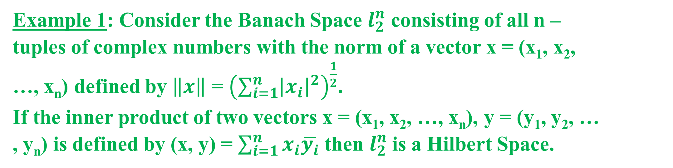
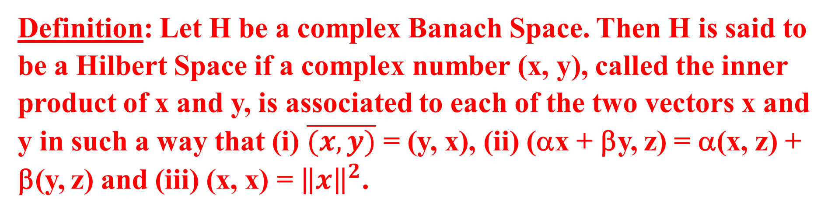
Definition: Let H be a complex Banach Space. Then H is said to be a Hilbert Space if a complex number (x, y), called the inner product of x and y, is associated to each of the two vectors x and y in such a way that (i) $\overline{(x,y)}$ = (y, x), (ii) (αx + βy, z) = α(x, z) + β(y, z) and (iii) (x, x) = ${\left\|x\right\|}^{2}$.
Example 1: Consider the Banach Space $l_{2}^{n}$ consisting of all n – tuples of complex numbers with the norm of a vector x = (x₁, x₂, …, x_{n}) defined by $\left\|x\right\|$ = ${\left(\sum_{i=1}^{n}{{\left|x_{i}\right|}^{2}}\right)}^{\frac{1}{2}}$. If the inner product of two vectors x = (x₁, x₂, …, x_{n}), y = (y₁, y₂, … , y_{n}) is defined by (x, y) = $\sum_{i=1}^{n}{x_{i}\overline{y_{i}}}$ then $l_{2}^{n}$is a Hilbert Space.

Slide 3
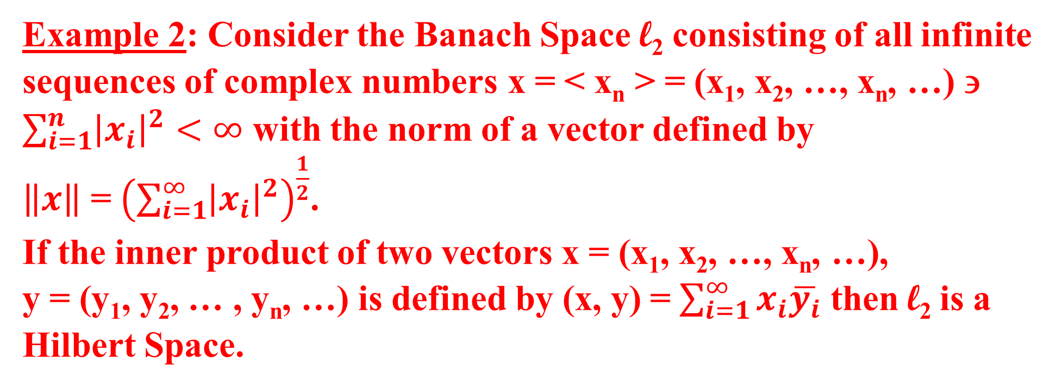
Example 2: Consider the Banach Space l₂ consisting of all infinite sequences of complex numbers x = < x_{n} > = (x₁, x₂, …, x_{n}, …) ∋ $\sum_{i=1}^{n}{{\left|x_{i}\right|}^{2}}<∞$ with the norm of a vector defined by $\left\|x\right\|$ = ${\left(\sum_{i=1}^{∞}{{\left|x_{i}\right|}^{2}}\right)}^{\frac{1}{2}}$. If the inner product of two vectors x = (x₁, x₂, …, x_{n}, …), y = (y₁, y₂, … , y_{n}, …) is defined by (x, y) = $\sum_{i=1}^{∞}{x_{i}\overline{y_{i}}}$ then l₂ is a Hilbert Space.

Slide 4
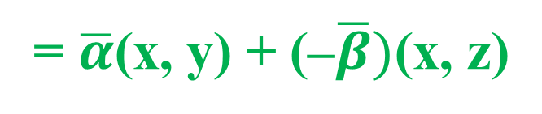



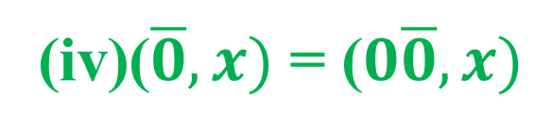
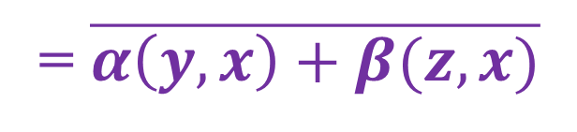

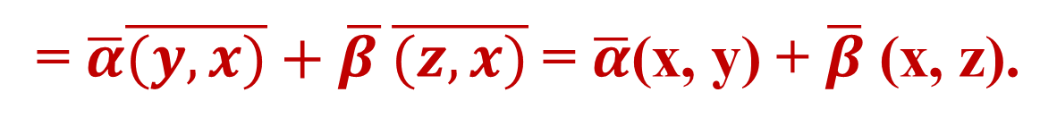


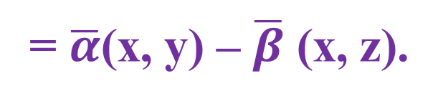
Theorem: In a Hilbert Space H prove that (i) (αx – βy, z) = α(x, z) – β(y, z).
(ii) (x, αy + βz) = $\overline{α}$(x, y) + $\overline{β}$ (x, z). (iii) (x, αy – βz) = $\overline{α}$(x, y) – $\overline{β}$ (x, z). (iv) (x, $\overline{0}$) = 0 ∀ x ∈ H and ($\overline{0},x)$ = 0 ∀ x ∈ H.
Proof: In what follows let α, β ∈ K and x, y, and z ∈ H.
(αx – βy, z) = (αx + {–β}y, z) = α(x, z) + (–β)(y, z) = α(x, z) – β(y, z).
(ii)(x, αy + βz) = $\overline{(αy+βz,x)}$
= $\overline{α\left(y,x\right)+β(z,x)}$
$$=\overline{α\left(y,x\right)}+\overline{β(z,x)}$$
= $\overline{α}\overline{(y,x)}+\overline{β }\overline{(z,x)}$ = $\overline{α}$(x, y) + $\overline{β}$ (x, z).
(iii)(x, αy – βz) = (x, αy +{–β}z)
= $\overline{α}$(x, y) + (–$\overline{β})$(x, z)
= $\overline{α}$(x, y) – $\overline{β}$ (x, z).
(iv)($\overline{0},x)$ = ($0\overline{0},x)$
= 0($\overline{0},x)$ = 0 ∀ x ∈ H
and (x, $\overline{0}$) = $\overline{(\overline{0},x)}$
= $\overline{0}$ = 0 ∀ x ∈ H.

Slide 5



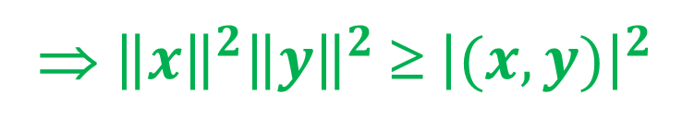

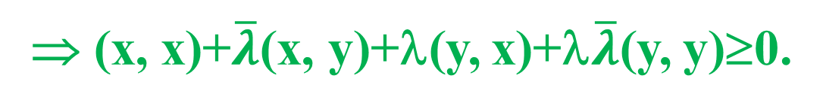


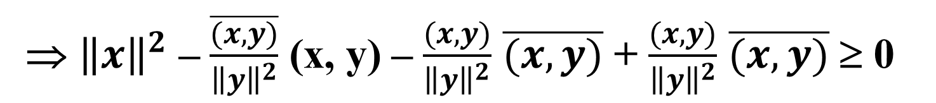

Schwartz Inequality: 4*: If x and y are any two vectors in a Hilbert Space H then $\left|(x, y)\right|$ ≤ $\left\|x\right\|\left\|y\right\|$
Proof: If y = $\overline{0}$, then $\left\|y\right\|$ = 0 and (x, y) = (x, $\overline{0})$ = 0 so that both sides vanish and the equality holds.
Now let y ≠ $\overline{0}$.
For any scalar λ, (x + λy, x + λy) ≥ 0
⇒ (x, x + λy) + λ(y, x + λy) ≥ 0
⇒ (x, x)+$\overline{λ}$(x, y)+λ(y, x)+λ$\overline{λ}$(y, y)≥0.
⇒ ${\left\|x\right\|}^{2}$ + $\overline{λ}$(x, y) + λ(y, x) + λ$\overline{λ}$ ${\left\|y\right\|}^{2}$ ≥ 0… (1)
Since y ≠ $\overline{0}$, $\left\|y\right\|$ ≠ 0. ∴Put λ = $\frac{−(x,y)}{{\left\|y\right\|}^{2}}$.
⇒ ${\left\|x\right\|}^{2}$ – $\frac{\overline{(x,y)}}{{\left\|y\right\|}^{2}}$ (x, y) – $\frac{(x,y)}{{\left\|y\right\|}^{2}}$ (y, x) + $\frac{(x,y)}{{\left\|y\right\|}^{2}}\frac{\overline{(x,y)}}{{\left\|y\right\|}^{2}}$ ${\left\|y\right\|}^{2}$ ≥ 0
⇒ ${\left\|x\right\|}^{2}$ – $\frac{\overline{(x,y)}}{{\left\|y\right\|}^{2}}$ (x, y) – $\frac{(x,y)}{{\left\|y\right\|}^{2}}$ $\overline{(x,y)}$ + $\frac{(x,y)}{{\left\|y\right\|}^{2}}$ $\overline{(x,y)}$ ≥ 0
⇒ ${\left\|x\right\|}^{2}$– $\frac{{\left|(x,y)\right|}^{2}}{{\left\|y\right\|}^{2}}$ ≥ 0.
⇒ ${\left\|x\right\|}^{2}{\left\|y\right\|}^{2}$≥ ${\left|(x,y)\right|}^{2}$
⇒ $\left|(x, y)\right|$ ≤ $\left\|x\right\|\left\|y\right\|$

Slide 6

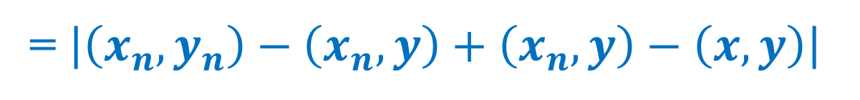


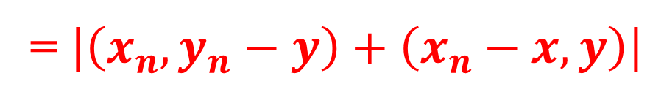
Theorem: In a Hilbert space the inner product is jointly continuous i.e., x_{n} → x, y_{n} → y ⇒ (x_{n}, y_{n}) → (x, y).
Proof: Let x_{n} → x, y_{n} → y.
Now $\left|\left(x_{n},y_{n}\right)−(x,y)\right|$
= $\left|\left(x_{n},y_{n}\right)−\left(x_{n},y\right)+\left(x_{n},y\right)−\left(x,y\right)\right|$
= $\left|\left(x_{n},y_{n}−y\right)+\left(x_{n}−x,y\right)\right|$
≤ $\left|\left(x_{n},y_{n}−y\right)\right|$ + $\left|\left(x_{n}−x,y\right)\right|$
≤ $\left\|x_{n}\right\|\left\|y_{n}−y\right\|$ + $\left\|x_{n}−x\right\|\left\|y\right\|$ by Schwartz inequality,
But $\left\|y_{n}−y\right\|$ → 0 and $\left\|x_{n}−x\right\|$ → 0 as n → ∞ (∵ x_{n} → x, y_{n} → y)
∴ $\left|\left(x_{n},y_{n}\right)−(x,y)\right|$→ 0 as n → ∞.
Hence (x_{n}, y_{n}) → (x, y).

Slide 7
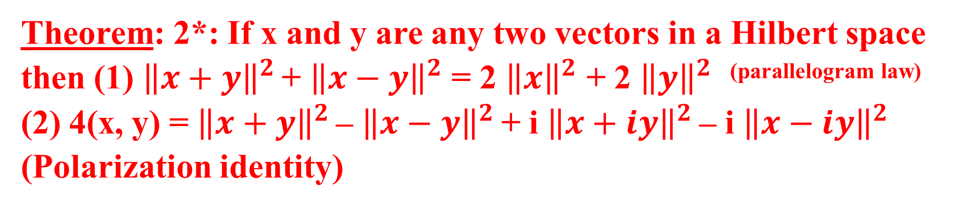

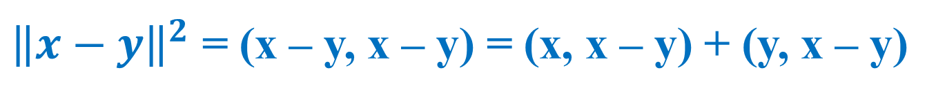
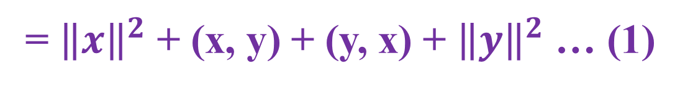
Theorem: 2*: If x and y are any two vectors in a Hilbert space then (1) ${\left\|x+y\right\|}^{2}$ + ${\left\|x−y\right\|}^{2}$ = 2 ${\left\|x\right\|}^{2}$ + 2 ${\left\|y\right\|}^{2}$ ^{(parallelogram law)}
(2) 4(x, y) = ${\left\|x+y\right\|}^{2}$ – ${\left\|x−y\right\|}^{2}$ + i ${\left\|x+iy\right\|}^{2}$ – i ${\left\|x−iy\right\|}^{2}$ (Polarization identity)
Proof (i) ${\left\|x+y\right\|}^{2}$ = (x + y, x + y) = (x, x + y) + (y, x + y)
= (x, x) + (x, y) + (y, x) + (y, y)
= ${\left\|x\right\|}^{2}$ + (x, y) + (y, x) + ${\left\|y\right\|}^{2}$ … (1)
${\left\|x−y\right\|}^{2}$ = (x – y, x – y) = (x, x – y) + (y, x – y)
= (x, x) – (x, y) – (y, x) + (y, y)
= ${\left\|x\right\|}^{2}$ – (x, y) – (y, x) + ${\left\|y\right\|}^{2}$… (2)
Adding (1) and (2), ${\left\|x+y\right\|}^{2}$ + ${\left\|x−y\right\|}^{2}$ = 2 ${\left\|x\right\|}^{2}$ + 2 ${\left\|y\right\|}^{2}$

Slide 8
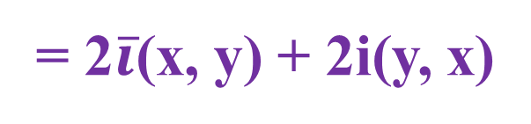
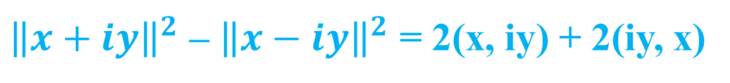
(ii) Subtract (2) from (1). ${\left\|x+y\right\|}^{2}$ – ${\left\|x−y\right\|}^{2}$ = 2(x, y) + 2(y, x) … (3)
Replacing y by iy in (3),
${\left\|x+iy\right\|}^{2}$ – ${\left\|x−iy\right\|}^{2}$ = 2(x, iy) + 2(iy, x)
= 2$\overline{i}$(x, y) + 2i(y, x)
= – 2i(x, y) + 2i(y, x) … (4)
Multiplying both sides of (4) by i we get,
i${\left\|x+iy\right\|}^{2}$ – i${\left\|x−iy\right\|}^{2}$ = 2(x, y) – 2(y, x) … (5)
Adding (3) and (5),
${\left\|x+y\right\|}^{2}$ – ${\left\|x−y\right\|}^{2}$ + i${\left\|x+iy\right\|}^{2}$ – i${\left\|x−iy\right\|}^{2}$ = 4(x, y)

Slide 9
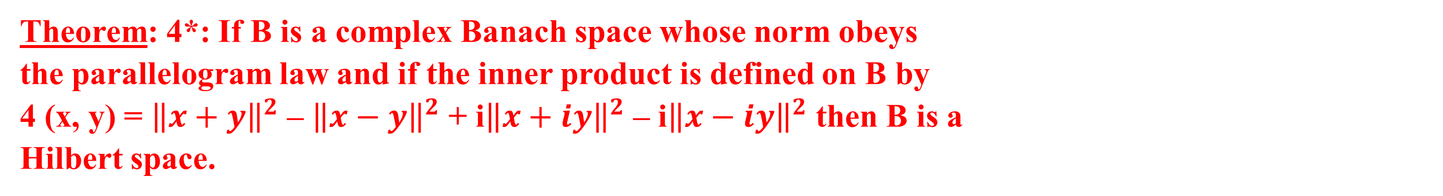
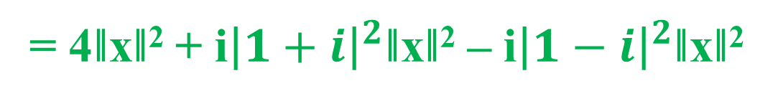
Theorem: 4*: If B is a complex Banach space whose norm obeys the parallelogram law and if the inner product is defined on B by 4 (x, y) = ${\left\|x+y\right\|}^{2}$ – ${\left\|x−y\right\|}^{2}$ + i${\left\|x+iy\right\|}^{2}$ – i${\left\|x−iy\right\|}^{2}$ then B is a Hilbert space.
Proof: The norm in B is given by
‖x + y‖² + ‖x – y‖² = 2 ‖x‖² + 2 ‖y‖² … (1)
And inner product, 4(x, y) = ‖x+y‖² – ‖x–y‖² + i ‖x + iy‖² – i‖x – iy‖² … (2)
Claim: (x, x) = ‖x‖²
Replace, y by x in (2)
4(x, x) = ‖x + x‖² – ‖$\overline{0}$‖² + i ‖(1 + i)x‖² – i ‖(1 – i)x‖²
= 4‖x‖² + i${\left|1+i\right|}^{2}$‖x‖² – i${\left|1−i\right|}^{2}$‖x‖²
= 4‖x‖² + 2i‖x‖² – 2i‖x‖² ∵${\left|1+i\right|}^{2}$ = ${\left|1−i\right|}^{2}$= 1 + 1 = 2
= 4‖x‖²
Thus, (x, x) = ‖x‖²

Slide 10

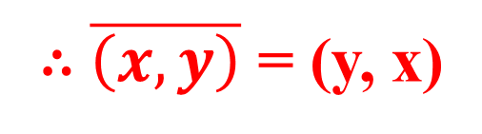
Claim: $\overline{\left(x,y\right)}$ = (y, x)
4 (x, y) = ${\left\|x+y\right\|}^{2}$ – ${\left\|x−y\right\|}^{2}$ + i${\left\|x+iy\right\|}^{2}$ – i${\left\|x−iy\right\|}^{2}$
Taking the complex conjugate on both sides of (2),
4$\overline{(x,y)}$ = ‖x + y‖² – ‖x – y‖² – i ‖x + iy‖² + i ‖x – iy‖²
= ‖y + x‖² – ‖ – (y – x)‖² – i ‖i(y – ix)‖² + i ‖ – i(y + ix)‖²
= ${\left\|y+x\right\|}^{2}−{\left\|y−x\right\|}^{2}−i{\left|i\right|}^{2}{\left\|y−ix\right\|}^{2}+i{\left|−i\right|}^{2}{\left\|y+ix\right\|}^{2}$
= ‖y + x‖² – ‖y – x‖² – i ‖(y – ix)‖² + i ‖y + ix‖²
= 4(y, x)
∴ $\overline{\left(x,y\right)}$ = (y, x)
Claim: (x + y, z) = (x, z) + (y, z)
Replacing x by x + y and y by z in (2)
4(x + y, z) = ‖x + y + z‖² – ‖x + y – z‖² + i ‖x + y + iz‖² – i‖x + y – iz‖² … (3)
Replacing x by x + z in (1),
‖x + z + y‖² + ‖x + z – y‖² = 2‖x + z‖² + 2‖ y ‖²
(or) ‖x + y + z‖² = 2‖x + z‖² + 2 ‖ y ‖² – ‖x + z – y‖² … (4)
Again ‖x + z – y‖² = ‖ z – y + x‖² = 2‖ z – y‖² + 2‖ x ‖² – ‖ z – y – x‖^{2 by (1)}
= 2‖ y – z‖² + 2‖x‖² – ‖x + y – z‖² … (5)
Substituting the value of ‖x + z – y‖² from (5) in (4)

Slide 11
‖x + y + z‖² = 2‖x + z‖² + 2‖y‖² – {2‖y – z‖² + 2‖x‖² – ‖x + y – z‖²}
(or) ‖x + y + z‖² – ‖x + y – z‖² = 2‖x + z‖² + 2‖ y ‖² – 2‖y – z‖² – 2‖ x ‖² … (6)
Interchanging x and y in (6) we get,
‖x + y + z‖² – ‖x + y – z‖² = 2‖y + z‖² + 2‖ x ‖² – 2‖x – z‖² – 2‖ y ‖²… (7)
Adding (6) and (7) we get,
‖x + y + z‖² – ‖x + y – z‖² = ‖x + z‖² – ‖x – z‖² + ‖y + z‖² – ‖y – z‖²… (8)
Replacing z by iz in (8) and multiplying both sides by I,
i‖x+ y+iz‖² – i‖x+y–iz‖² = i‖x+iz‖² – i‖x–iz‖² + i‖y+iz‖² – i‖y–iz‖²… (9)
Adding (8) and (9)
‖x + y + z‖² – ‖x + y – z‖² + i ‖x + y + iz‖² – i ‖x + y – iz‖² = ‖x + z‖² – ‖x – z‖² + i‖x + iz‖² – i‖x – iz‖² + {‖y + z‖² – ‖y – z‖² + i‖y + iz‖² – i‖y – iz‖²}…(10)
By (3) and (10) we get 4(x + y, z) = 4(x, z) + 4(y, z)
i.e., (x + y, z) = (x, z) + (y, z)…(11)

Slide 12
Claim: (αx, y) = α(x, y)
(a) Let α be a positive integer
Then (x + x, y) = (x, y) + (x, y)
⇒ (2x, y) = 2(x, y) so that result is true for n = 2
Assume the result is true for n i.e., (nx, y) = n(x, y)…(12)
Then ({n +1}x, y)
= (nx + x, y)
= (nx, y) + (x, y)
= n(x, y) + (x, y)
= (n + 1)(x, y).
∴ Result is true for n + 1 if it were true for n
∴ By induction result is true for all positive integral values of α
Claim:(–x, y) = – (x, y)
Replacing x by – x in (2) we get,
4(– x, y) = ‖–x + y‖² – ‖–x – y‖² + i ‖–x + iy‖² – i‖–x – iy‖²
= ‖x – y‖² – ‖x + y‖² + i ‖x – iy‖² – i‖x + iy‖² ( ∵ ‖ –x ‖ = ‖ x ‖)
= – 4(x, y)
∴ (–x, y) = – (x, y) … (13)
Let α be negative integers
Then ∃ a positive integer β ∋ α = – β.
∴ (αx, y) = (–βx, y) = (–(βx), y) = – (βx, y) = –β(x, y) = α(x, y)

Slide 13
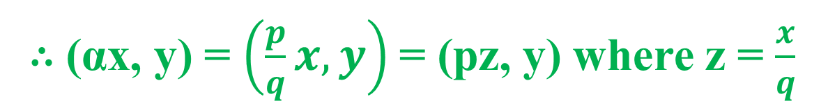


(c) Let α be rational say α = $\frac{p}{q}$ where p, q are integers and q ≠ 0
∴ (αx, y) = $\left(\frac{p}{q}x,y\right)$= (pz, y) where z = $\frac{x}{q}$
= p(z, y) … (14)
∴ (z, y) = $\frac{1}{q}$ (qz, y) … (15)
Also (qz, y) = q(z, y)
Substituting (z, y) from (15) in (14),(αx, y) = $\frac{p}{q}$ (qz, y) = α(x, y)
Similarly, we can prove the result if α is any real number.
(d) Let α be a complex number.
Replacing x by ix in (2),
4(ix, y) = ‖ix + y‖² – ‖ix – y‖² + i‖ix + iy‖² – i‖ix – iy‖²
= ׀i׀²‖x – iy‖² – ׀i׀²‖x + iy‖² + i׀i׀² ‖x + y‖² – i׀i׀²‖x – y‖²
= ‖x – iy‖² – ‖x + iy‖² + i‖x + y‖² – i‖x – y‖²
= –i²‖x – iy‖² + i²‖x + iy‖² + i‖x + y‖² – i‖x – y‖²
= i{‖x + y‖² – ‖x – y‖² + i‖x + iy‖² – i‖x – iy‖²} = i4(x, y)
∴ (ix, y) = i(x, y)
Let α = a + ib where a, b ∈ $ℝ.$
Then(αx, y) = ({a + ib}x, y)
= (ax, y) + i(bx, y)
= a(x, y) + ib(x, y) = (a + ib)(x, y) = α(x, y)
Ie. (αx, y) = α(x, y) when α ∈₵
Hence B is a Hilbert space.

Slide 14

Convex Set: Let L be a Real or Complex Linear Space. A non-empty subset S of L is said to be convex if x, y ∈ S ⇒ (1 – α)x + αy ∈ S where α is any real number ∋ 0 ≤ α ≤ 1.
Note: Taking α = $\frac{1}{2}$ we see that if S is a convex subset of a linear space L, then x, y ∈ S ⇒ $\frac{x+y}{2}$ ∈ S.

Slide 15




Theorem: 8*: A closed convex subset C of a Hilbert Space H contains a unique vector of smallest norm.
Proof: Let d = inf {$\left\|x\right\|$: x ∈ C}.
Then ∃ a sequence {x_{n}} of vectors in C ∋ $\left\|x_{n}\right\|$ → d
Consider two vectors x_{m} and x_{n} belonging to sequence {x_{n}}
Since C is a convex subset of H and x_{m}, x_{n} ∈ C, $\frac{x_{m}+x_{n}}{2}$ ∈ C.
∴ By the definition of d, $\left\|\frac{x_{m}+x_{n}}{2}\right\|≥d$ so that $\left\|x_{m}+x_{n}\right\|≥2d$…(1).
By parallelogram law,
${\left\|x_{m}+x_{n}\right\|}^{2}+{\left\|x_{m}−x_{n}\right\|}^{2}$ =2${\left\|x_{m}\right\|}^{2}$+2${\left\|x_{n}\right\|}^{2}$
⇒ ${\left\|x_{m}−x_{n}\right\|}^{2}$ = 2${\left\|x_{m}\right\|}^{2}$+ 2${\left\|x_{n}\right\|}^{2}−{\left\|x_{m}+x_{n}\right\|}^{2}$
≤ 2${\left\|x_{m}\right\|}^{2}$+ 2${\left\|x_{n}\right\|}^{2}−4d^{2}$… (2).
2${\left\|x_{m}\right\|}^{2}$+ 2${\left\|x_{n}\right\|}^{2}−4d^{2}$→ $2d^{2}+2d^{2}−4d^{2}$ = 0 ⸪ $\left\|x_{m}\right\|\&\left\|x_{n}\right\|$→ d
⸫$\left\|x_{m}−x_{n}\right\|→0$
∴ {x_{n}} is a Cauchy sequence in C.

Slide 16
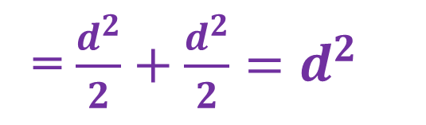
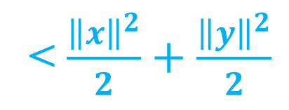
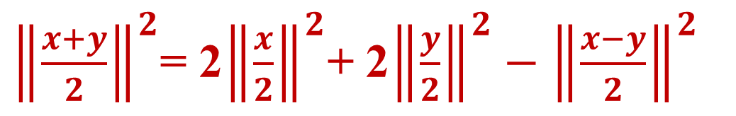
C is also complete, since H is complete and C is closed
Hence {x_{n}} converges in C.
∴ ∃ x in C ∋ x_{n} → x.
Now $\left\|x\right\|$ = $\left\|lt x_{n}\right\|$ = lt $\left\|x_{n}\right\|$⸪ norm is a continuous mapping
= d.
∴ x is vector in C with smallest norm.
Uniqueness of x:
If possible, suppose y is another vector in C ∋ $\left\|y\right\|=d$.
Then $\frac{x+y}{2}$ ∈ C and again by parallelogram law,
${\left\|\frac{x+y}{2}\right\|}^{2}$= 2${\left\|\frac{x}{2}\right\|}^{2}$+ 2${\left\|\frac{y}{2}\right\|}^{2}−{\left\|\frac{x−y}{2}\right\|}^{2}$
< $\frac{{\left\|x\right\|}^{2}}{2}+\frac{{\left\|y\right\|}^{2}}{2}$
= $\frac{d^{2}}{2}+\frac{d^{2}}{2}=d^{2}$
which contradicts the definition of d.
∴ A closed convex subset C of a Hilbert Space H contains a unique vector of smallest norm.

Slide 17



Theorem: 3*: Let M be a closed linear subspace of a Hilbert space H, x be a vector not in M and d be the distance of M from x. Then ∃ a unique vector y₀ in M ∋ $\left\|x−y_{0}\right\|$ = d.
Proof: Let d(x, M) = d = inf {$\left\|x−z\right\|$: z ∈ M} by definition.
∴ ∃ a sequence {y_{n}} of vectors in M ∋ $\left\|x−y_{n}\right\|$ → d
Consider two vectors y_{m} and y_{n} belonging to sequence {y_{n}}.
Since M is a linear subspace of H, $\frac{y_{m}+y_{n}}{2}$ ∈ M.
∴$\left\|x−\frac{y_{m}+y_{n}}{2}\right\|≥d$ ⇒ $\left\|2x−(y_{m}+y_{n})\right\|≥2d$ … (1).
Appling parallelogram for the vectors x – y_{m} and x – y_{n} we get
${\left\|x−y_{m}−(x−y_{n})\right\|}^{2}$ = 2${\left\|x−y_{m}\right\|}^{2}$ + 2${\left\|x−y_{n}\right\|}^{2}−{\left\|x−y_{m}+x−y_{n}\right\|}^{2}$
⇒ ${\left\|y_{n}−y_{m}\right\|}^{2}$ = 2${\left\|x−y_{m}\right\|}^{2}$+ 2${\left\|x−y_{n}\right\|}^{2}−{\left\|2x−(y_{m}+y_{n})\right\|}^{2}$
≤ 2${\left\|x−y_{m}\right\|}^{2}$+ 2${\left\|x−y_{n}\right\|}^{2}−4d^{2}$
Since $\left\|x−y_{m}\right\|$→ d and $\left\|x−y_{n}\right\|$→ d we have
${\left\|y_{n}−y_{m}\right\|}^{2}$ ≤ 2${\left\|x−y_{m}\right\|}^{2}$+ 2${\left\|x−y_{n}\right\|}^{2}−4d^{2}$→ $2d^{2}+2d^{2}−4d^{2}$ = 0

Slide 18
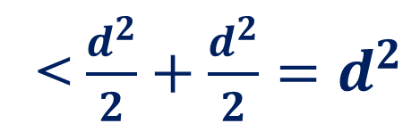
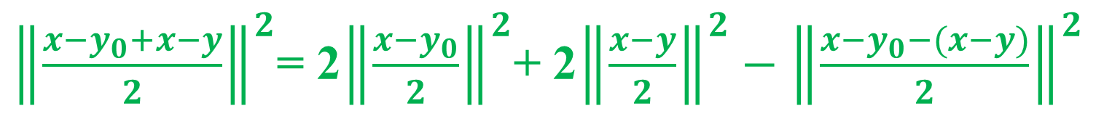

∴ {y_{n}} is a Cauchy sequence in M.
∴ ∃ y₀ ∈ M ∋ y_{n} → y₀ ∵ M is closed subspace of complete space.
Now $\left\|x−y_{0}\right\|$ = $\left\|x−lt y_{n}\right\|$ = $\left\|lt(x −y_{n})\right\|$ = lt $\left\|x−y_{n}\right\|$= d
∴ y₀ is vector in M ∋ $\left\|x−y_{0}\right\|$ = d
Uniqueness of y₀:
If possible, suppose y is another vector in M ∋ $\left\|x−y\right\|=d$
Then $\frac{y_{0}+y}{2}$ ∈ M and again by parallelogram law
${\left\|\frac{x−y_{0}+x−y}{2}\right\|}^{2}$= 2${\left\|\frac{x−y_{0}}{2}\right\|}^{2}$+ 2${\left\|\frac{x−y}{2}\right\|}^{2}−{\left\|\frac{x−y_{0}−(x−y)}{2}\right\|}^{2}$
< $\frac{d^{2}}{2}+\frac{d^{2}}{2}=d^{2}$
⇒ $\left\|2x−{(y}_{0}+y)\right\|$ < 2d which is a contradiction to (1).
Hence y₀ is unique.

