Slide 1
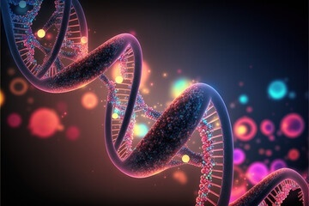
CHEMICAL MUTAGENIC AGENTS
B.SITA KALYANI
DEPARTMENT OF MICROBIOLOGY
DNR COLLEGE

Slide 2
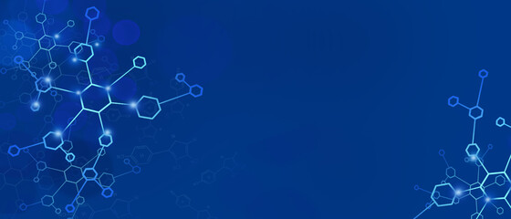
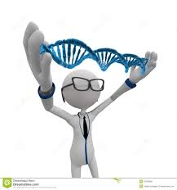
CONTENTS:-
Chemical mutagens
Types
Base analogues
Intercalating agents
Alkylating agents
Metal ions
Uses

Slide 3

CHEMICAL MUTAGENS
A mutagen is any substance or agent that can cause a mutation , or change in the sequence or structure of DNA.
Chemicals are actually dangerous for the entire world.
The first mutagenic effect of the nitrogen mustard was reported by Charlotte Aurebach in 1942.
Nitrogen mustard is a gas used during world war 1 and 2.

Slide 4
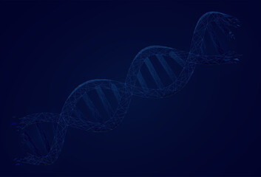
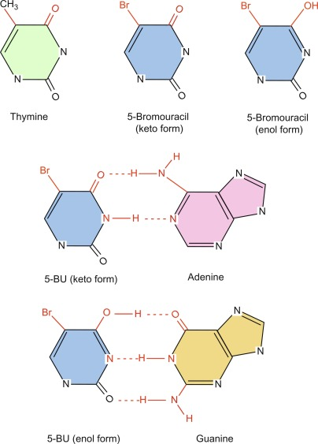
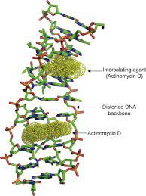
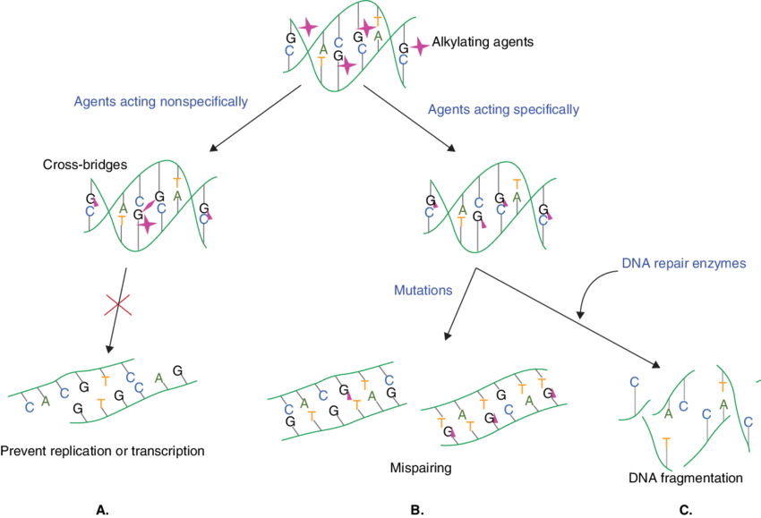
Types of chemical mutagens:-
1.BASE ANALOGUES
2.INTERCALATING AGENTS
3.ALKYLATING AGENTS

Slide 5
BASE ANALOGUES
These are the chemicals similar to the bases of DNA purine and pyramidines or structurally resemble the DNA bases.
Bromouracil and aminopurine are 2 common base anlogues incorporated into DNA instead of normal bases, during the process of replication.
The 5-bromouracil are artificially synthesized molecules –a base analog utilized in the genetic research which is incorporated in DNA in place of the thymine.
Instead of the methyl group of the thymine, in the bromouracil contains Bromine group-highly resemble to the thymine.
It pairs with the adenine as like the thymine and produces the mutation.

Slide 6
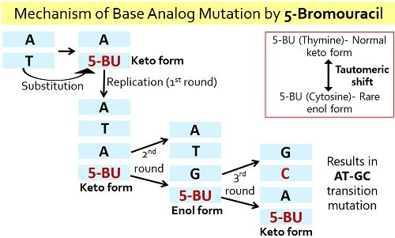
Thus the TA basepair is replaced by GC basepair at the end of the replication and this happens because of the tautomeric shift of 5-BU from ‘enol’ to ‘keto’ form.

Slide 7
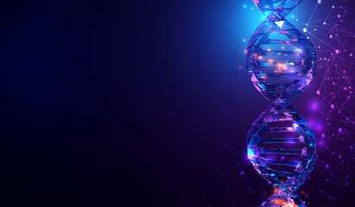
INTERCALATING AGENTS
EtBr-Ethidium Bromide is an example.
Other intercalating agents like proflavin,acridine orange operated by the same mechanism a like the EtBR.
The molecules intercalate between the bases of DNA and disrupt its structure.
If it is incorporated during the replication,it can cause frameshift mutation and also blocks transcription.

Slide 8
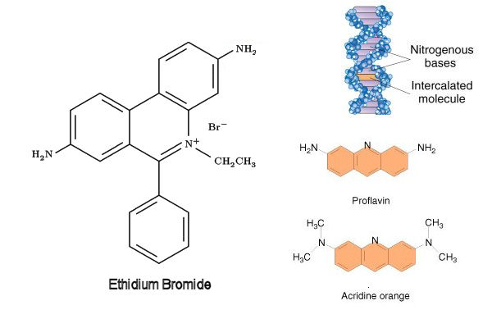

Slide 9
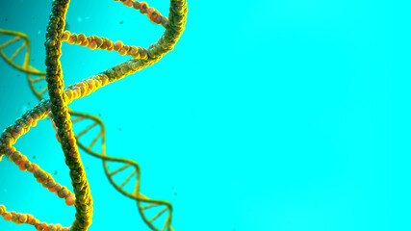
ALKYLATING AGENTS
Ethylnitrosourea, mustard gas and vinyl chloride arecommon alkylating agents that add alkyl group to the DNA and damages it.
The agents induce base-pairing errors by increasing ionization and produces gaps in the DNA strand.
The alkylated purine bases are removed by the phenomenon is called depurination,although depurination is not mutagenic and can be repaired by the DNA-repair pathway.

Slide 10
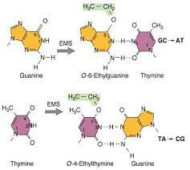
Common Alkylating Agents
Methylhydrazine.
Temozololide
Decarbazine
Busulfan
Iomustin
“When nitrites are added to smoked meat , It forms nitrosamine like mutagen that can break DNA or creates DNA crosslinking”.

Slide 11
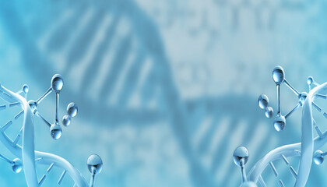
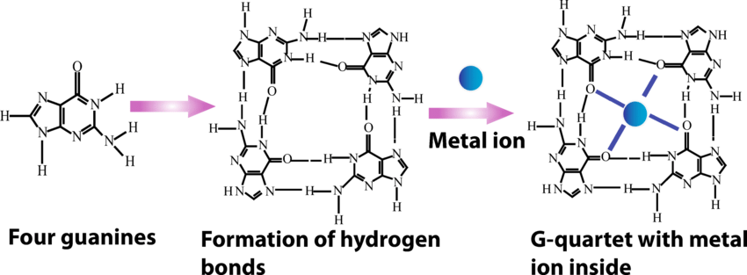
METAL IONS
Nickel,chromium,cobalt,cadmium,arsenic,iron are some examples.
The metal ion work by the priducing ROS(reactive oxygen species)hindering the DNA repair pathway,cause DNA hypermethylation or may directly damages the DNA.

Slide 12
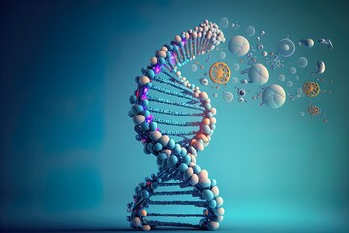
USES
IN MICROBIOLOGY
Use of Chemical Mutagenesis to induce mutation in a variety of microorganisms used for production of antibiotics or enzymes.
For isolation of overproducing Mutants of food grade enzymes.
For the production of more competent and high yield producing strains
IN BIOTECHNOLOGY
Use in plant breeding e.g.rice,bean, mulberry, to improve crops.
Used to increase genetic variation e.g. increased seedling, stress tolerance ,high yield.

Slide 13
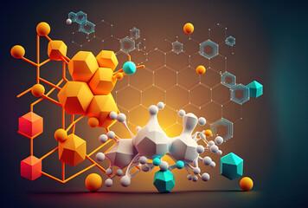
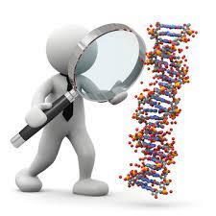
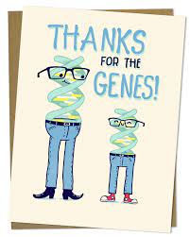
ANY QUESTIONS?

Slide 14
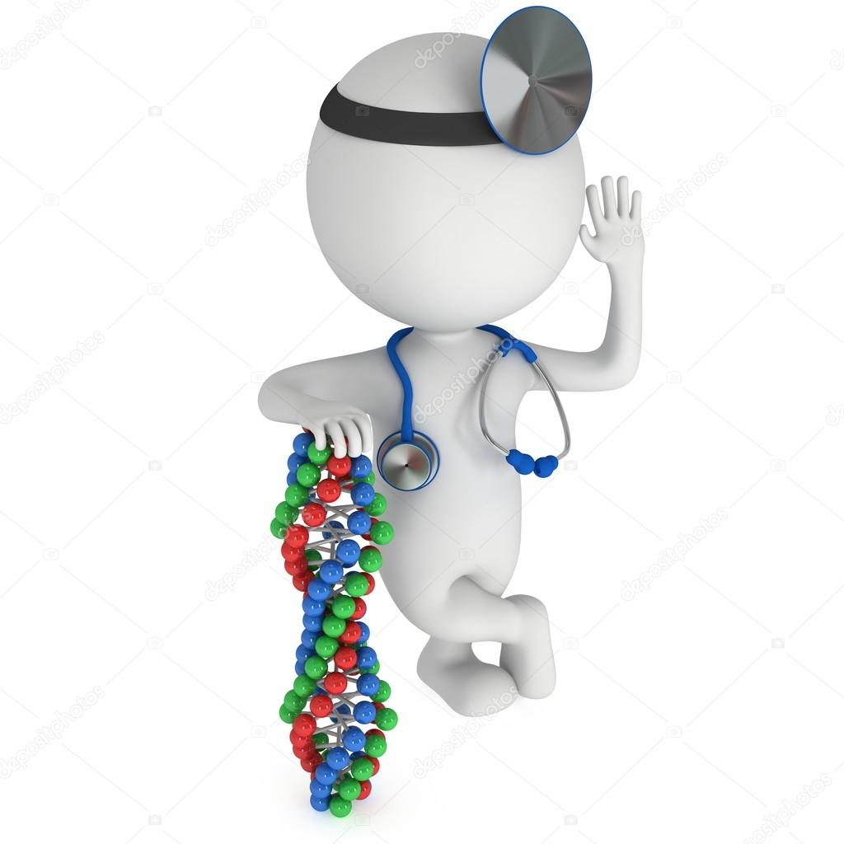
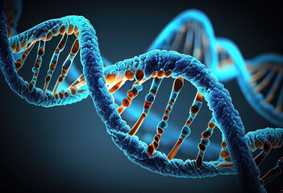
Thank you

