Slide 1
CHLOROPLAST S.YAMINI DEPARTMENT OF MICROBIOLOGY DNR COLLEGE

Slide 2
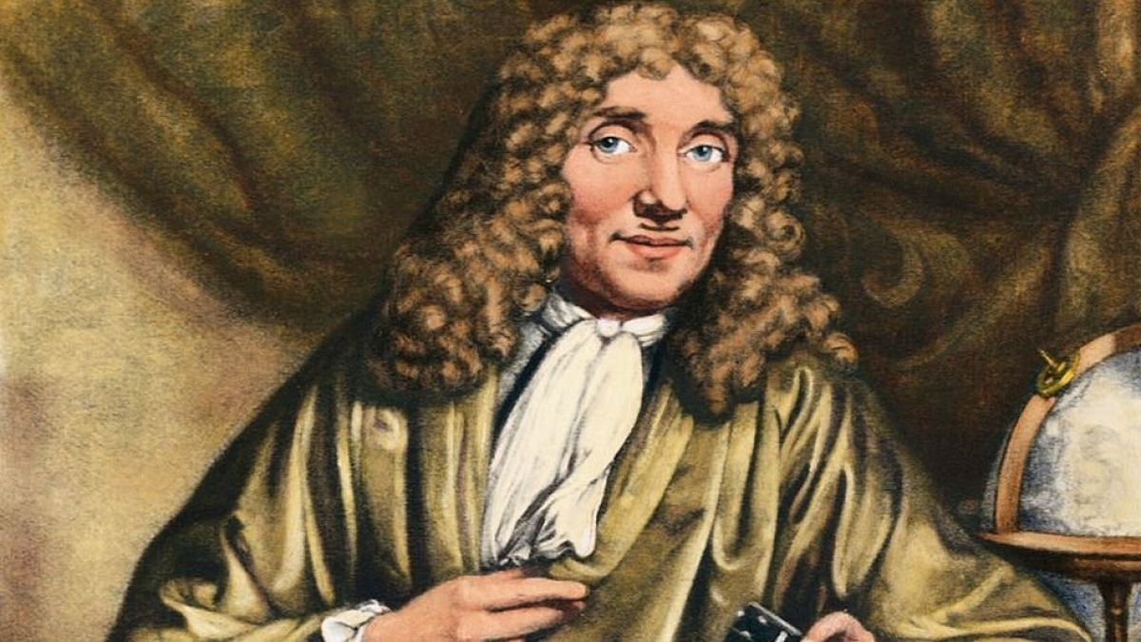

Slide 3
DISCOVERY The chloroplast was first observed by the Dutch microscopic Antoine Van Leeuwenhoek in the 17th century, but it was not until the 19th century that its role in photosynthesis was discovered. The French biologist Henri Dutrochet was the first to suggest that chloroplasts might be involved in photosynthesis in the early 19th century, and this idea was later supported by the work of other scientists, including Julius von Sachs and Theodor Engelmann. The German botanist Andreas Franz Wilhelm Schimper is credited with coining the term ‘’chloroplast’’ in 1883.

Slide 4
DEFINATION ; Chloroplasts are organelles found in plant cells that are responsible for photosynthesis. They contain chlorophyll and other pigments that absorb light energy, Which is then used to synthesize sugars and other organic molecules. EX; Red Algae , Diatoms

Slide 6
STRUCTURE OF CHLOROPLAST
Chloroplast are complex organelles that contain several different structures. Here are some of the main parts of a chloroplast;
1.Outer membrane; This is the outermost layer of the chloroplast, which is permeable to small molecules and ions.
2.Inner membrane; This is the second layer of the chloroplast, Which is less permeable than the outer membrane and contains transport proteins that regulate the movement of molecules in and out of the chloroplast.

Slide 7
3.Intermembrane space; This is the space between the outer and inner membranes of the chloroplast. 4.Thylakoids; These are flattened, membrane-bound sacs that are arranged in stacks called grana. They contain the pigments and proteins that are involved in the light-dependent reactions of photosynthesis. 5.Stroma; This is the fluid-filled space surrounding the thylakoids , which contains enzymes and other structures that are involved in the light- independent reactions of photosynthesis. 6.Chlorophyll; These are pigments that absorbing light energy during photosynthesis.

Slide 8
7.Carotenoids;These are pigment that absorb light energy in different parts of the spectrum than chlorophyll. 8.Ribosomes;These are small structures that are involved in the synthesis of proteins. 9.DNA; Chloroplasts contain their own DNA, which is involved in the synthesis of some of the proteins that are needed for photosynthesis.

Slide 9
TYPES OF CHLOROPLAST;
There are three types of chloroplasts; grana, stroma, and intermembrane space
Grana chloroplast; Grana chloroplast are the structures within chloroplast where photosynthesis takes place.
Stroma; Stroma chloroplast are the fluid –filled spaces within chloroplasts that surround the thylakoid membranes.
Intermembrane; The intermembrane space is the space between the inner and outer membranes of the chloroplast.

Slide 10
FUNCTIONS OF CHLOROPLAST; The main function of chloroplasts is to carry out photosynthesis, the process by which plants convert light energy into chemical energy that can be used by cells. Chloroplasts also play a role in the synthesis of amino acids, lipids and pigments.

