Slide 1
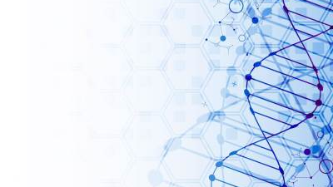
MEOSIS
G.VANDANA
DEPARTMENTOF MICROBILOGY
DNR COLLEGE
.

Slide 2
MEIOSIS
Meiosis is a process where a single cell divides twice to produce four cells containing half the original amount of genetic information. These cells are our sex cells – sperm in males, eggs in females. ... These four daughter cells only have half the number of chromosomes? of the parent cell – they are haploid.

Slide 3
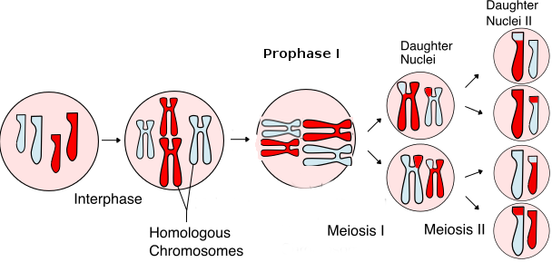

Slide 4
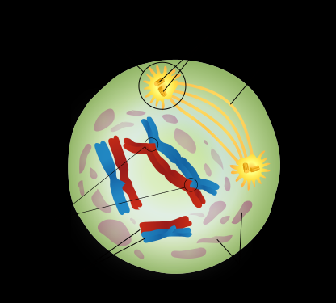
Meiosis I
In meiosis I, homologous chromosomes are separated into two cells such that there is one chromosome (consisting of two chromatids) per chromosome pair in each daughter cell.
Prophase I
Prior to prophase, chromosomes replicate to form sister chromatids. There are initially four chromatids (c) and two chromosomes (n) for each of the 23 chromosome pairs (4c, 2n). The nuclear envelope disintegrates and the chromosomes begin to condense. Spindle fibres appear which will be important for successful division of the chromosomes.
To further increase the genetic diversity, homologous chromosomes exchange parts of themselves such that one chromosome contains both maternal and paternal DNA. This process is known as crossing over, and the points at which this occurs on a chromosome are referred to as chiasmata.
Prometaphase I
Now the spindle fibres attach to the chromosomes at a points along the chromosomes called centromeres. While this is happening the chromosomes continue to condense.

Slide 5
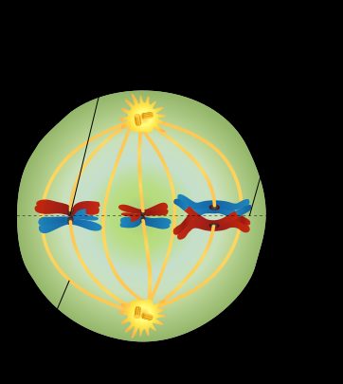
Metaphase I
Next, maternal and paternal versions of the same chromosome align along the equator of the cell. These are the homologous chromosome process called independent assortment occurs – this is when maternal and paternal chromosomes line up randomly align themselves on either side of the equator. This is turn determines to which gamete chromosomes are allocated to, which leads to genetic diversity among offspring.

Slide 6
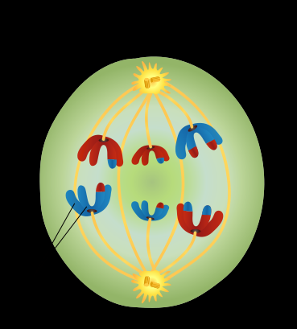
Anaphase I
Here each of the homologous chromosomes get pulled towards opposite poles of the cell as the spindle fibres retract to divide the DNA between the two cells which will be formed

Slide 7
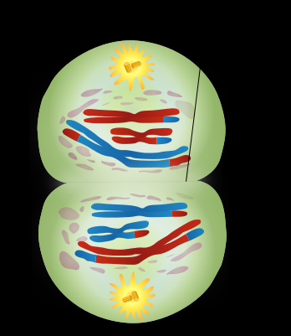
Telophase I and Cytokinesis I
During telophase I, the nuclear envelope reforms and spindle fibres disappear. In Cytokinesis I, the cytoplasm and cell divides resulting in two cells that are technically haploid – there is one chromosome and two chromatids for each chromosome (2c, n).

Slide 8
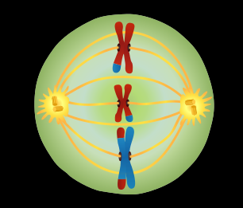
Meiosis II
Prophase II and Prometaphase II
These stages are identical to their counterparts in meiosis I.
Metaphase II
Now chromosomes line up in single file along the equator of the cell. This is in contrast to Metaphase I where chromosomes lined up in homologous pairs.

Slide 9
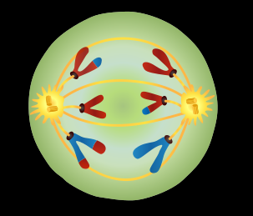
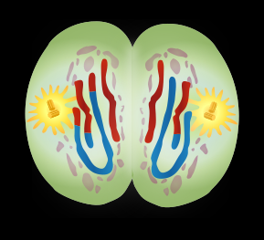
Anaphase II
Next, sister chromatids are pulled to opposite poles of the equator.
Telophase II
This is the same as Telophase I.
Cytokinesis II
Again, the cytoplasm and cell divides producing 2 non-identical haploid daughter cells, but as this is happening in both cells produced by meiosis I, the net product is 4 non-identical haploid daughter cells, each comprising one chromosome consisting of one chromatid (1c, 1n). These are gametes.
Adapted from work by Ali Zifan [CC BY-SA 4.0 (https://creativecommons.org/licenses/by-sa/4.0)], via Wikimedia Commons

