Slide 1
DNA SEQUENCING
S.YAMINI
DEPARTMENT OF MICROBIOLOGY
DNR COLLEGE

Slide 2

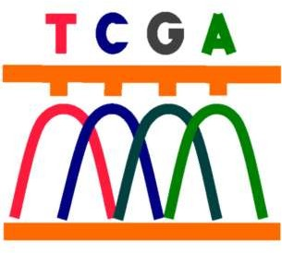
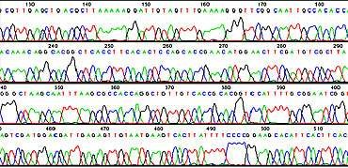
What is DNA Sequencing ?

Slide 3
The process of determining the order of nucleotides adenine (A), thymine (T), cytosine (C), and guanine (G) along a DNA strand.
We need to know the order of nucleotide bases in a strand of DNA for sequencing.
All the information required for the growth and development of an organism is encoded in the DNA of its genome.
So, DNA sequencing is fundamental to genome analysis and understanding the biological processes in general.

Slide 4
Historical Timeline
1870 – Friedrich Miescher discovers DNA
1940 - Avery: Proposes DNA as ‘Genetic Material’
1953 – Watson & Crick “double helical structure” 1970 - Wu: Sequences λ Cohesive End DNA
1977 – Sanger: Dideoxy Chain Termination 1977 – Gilbert: Chemical Degradation 1986 – Partial Automation
1990 – Cycle Sequencing, Improved Sequencing Enzymes,
Improved fluorescent detection schemes 2002 – NGS: 454 Pyrosequencing

Slide 5
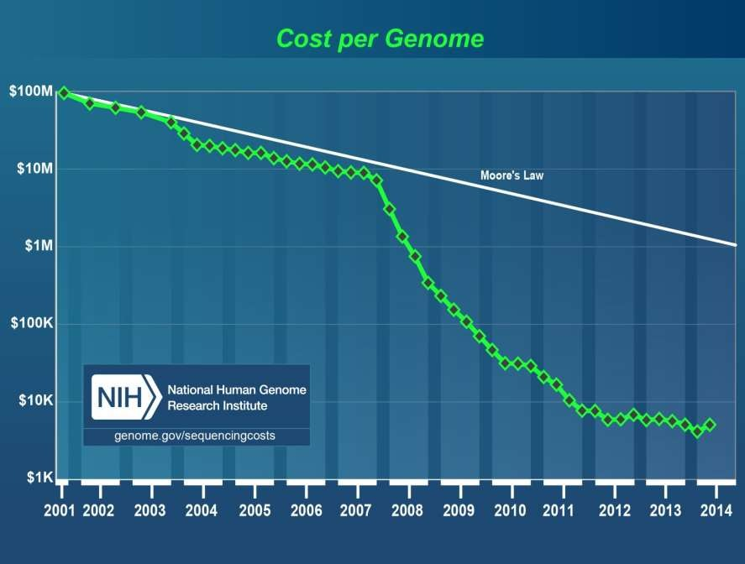

Slide 6

To determine the order of the nucleotide bases adenine, guanine, cytosine, and thymine in a molecule of DNA two methods
were used
Sanger; Chain Termination Sequencing method
Maxam and Gilbert; Chemical Sequencing method
These two methods are most popular conventional methods
Robotics and automated sequencing are based on these methods

Slide 7
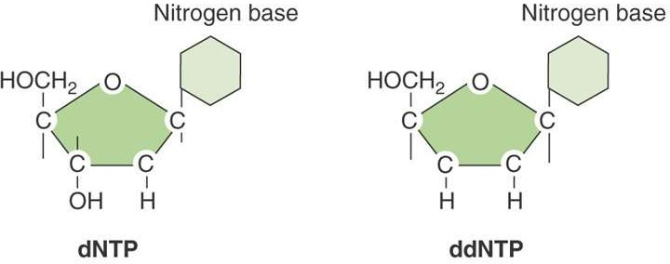
Sanger’s- Chain Termination Sequencing
It is PCR based method
A modified DNA replication reaction
Growing chains are terminated by dideoxynucleotides

Slide 8
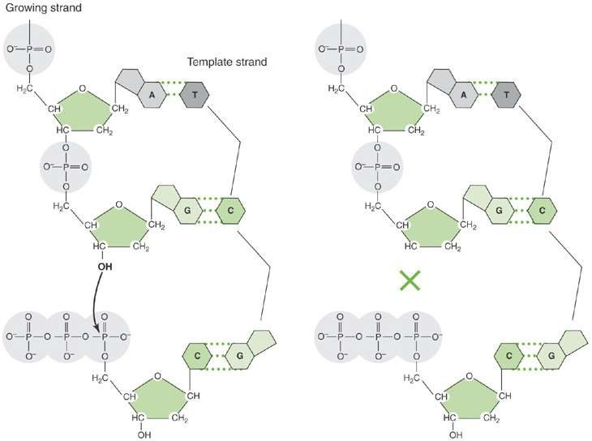
The 3′-OH group necessary for formation of the phosphodiester bond is missing in ddNTPs.

Slide 9
Sanger Sequencing: Process
Get enough quantity of DNA (Run PCR)
Aliqot DNA into four different tubes
Prepare PCR reaction mix as below:
Primer, Taq polymerase, template(ssDNA), dNTPS (All) and ddNTPs(ddATP, ddGTP,ddCTP & ddTTP respectively)
Run PCR
Perform Gel Electrophoresis
Interpret results

Slide 10


A sequencing reaction mix includes labeled primer and template.
Primer
5′OP-
-3′ OH
TCGACGGGC…
Template
Template area to be sequenced
Dideoxynucleotides are added separately to each of the four tubes.

Slide 11
With addition of enzyme (DNA polymerase), the primer is extended until a ddNTP is encountered.
The chain will end with the incorporation of the ddNTP.
With the proper dNTP:ddNTP ratio, the chain will terminate throughout the length of the template.
All terminated chains will end in the ddNTP added to that reaction.

Slide 12
The collection of fragments is a sequencing ladder.
The resulting terminated chains are resolved by electrophoresis.
Fragments from each of the four tubes are placed in four separate gel lanes.

Slide 13
Sanger Sequencing: An Example
5’-TACACGATCGA-3’
3’-ATGTGCTAGCT-5’
Denature the sequence
Use only forward primer i.e. use 3’-5’ strand of DNA

Slide 14
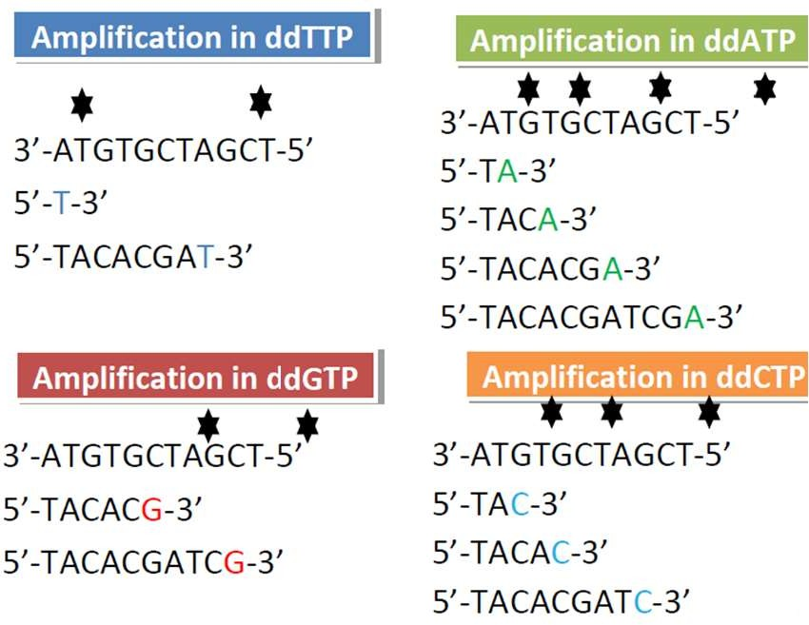

Slide 15
Maxam–Gilbert sequencing method

Slide 16
Maxam–Gilbert sequencing is a method of DNA sequencing developed by Allan Maxam and Walter Gilbert in 1976–1977.
This method is based on nucleobase-specific partial chemical modification of DNA and subsequent cleavage of the DNA backbone at sites adjacent to the modified nucleotides.

Slide 17
Maxam Gilbert Sequencing: Process Summarized
Label 5’- end of DNA
Aliquot DNA sample in 4 tubes
Perform base modification reaction
Perform Cleavage reaction
Perform Gel Electrophoresis
Perform Autoradiography
Interpret results

Slide 18
I. Chemical Modification of DNA; radioactive labeling at one 5' end of the DNA (typically by a kinase reaction using gamma-³²P ATP)
Purification of the DNA fragment to be sequenced
Chemical treatment generates breaks in DNA
Run on the gel

Slide 19
Chemical Modification and Cleavage
Poly nucleotide Kinase radioactive label at one 5' end of the DNA using gamma-³²P
5′ G A C G T G C A A C G A A 3′
³²P 5′ G A C G T G C A A C G A A 3′

Slide 20
Chemical Modification and Cleavage
Base Modification using Dimethyl sulphate
Purine
  Adenine
  Guanine
Only DMS------- G
DMS+ Formic acid-------G+A
Cleavage of Sugar Phosphate backbone using Piperidine

Slide 21
Base modification using Hydrazine
Pyrimidine
  Cytosine
  Thymine
Hydrazine----- C+T
Hydrazine + NaCl--------C
Cleavage of Sugar Phosphate backbone using Piperidine

Slide 22
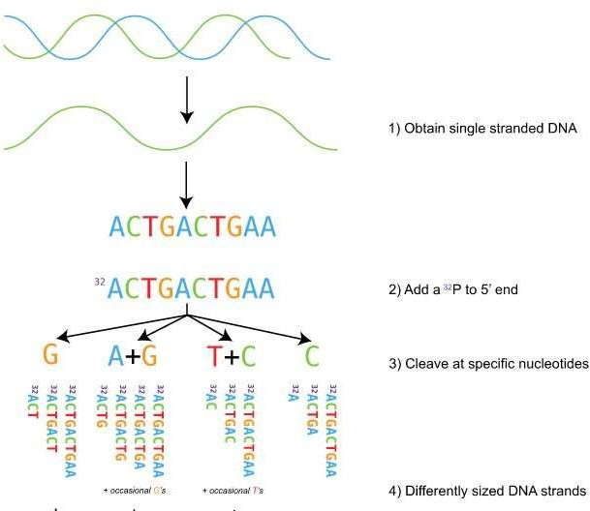

Slide 23
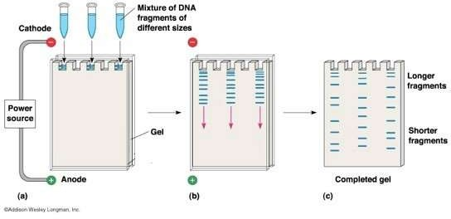

Slide 24
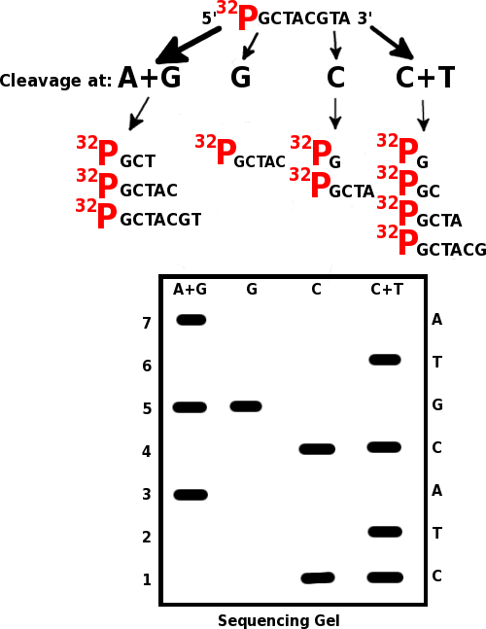
An Example for Maxam-Gilbert Sequencing

