Slide 1
LIBRARY CONSTRUCTION AND SCREENING
S. YAMINI
DEPARTMENT OF MICROBIOLOGY
DNR COLLEGE

Slide 2
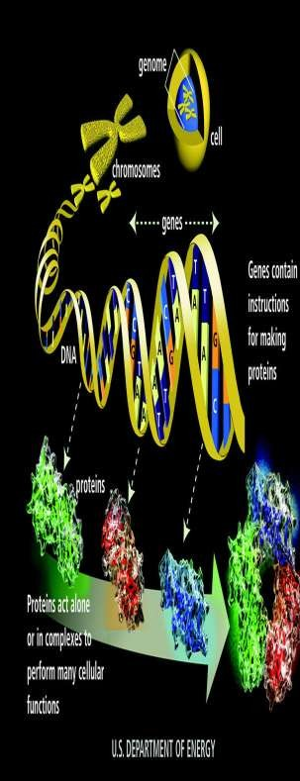
A gene library is a collection of different DNA sequences from an organism,
which has beenAlso called genomic libraries or gene banks.
cloned into a vector for ease of purification, storage and analysis.

Slide 3
Uses of gene libraries
To obtain the sequences of genes for analysis, amplification, cloning, and expression.
Once the sequence is known probes, primers, etc. can be synthesized for further
diagnostic work using, for example, hybridization reactions, blots and PCR.
Knowledge of a gene sequence also offers the possibility of gene therapy.
Also, gene expression can be used to synthesize a product in particular host cells, e.g. synthesis of human gene products in prokaryotic cells.

Slide 4
Two Types Of Gene Library
Depending upon the source of the DNA used.
1.Genomic library.
2.cDNA library

Slide 5
Types of GENE library:
genomic library contains DNA fragments representing the entire genome of an organism.
cDNA library contains only complementary DNA molecules synthesized from mRNA molecules in a cell.

Slide 6
Genomic Library :
Made from nuclear DNA of an organism or species.
DNA is cut into clonable size pieces as randomly possible using restriction endonuclease
Genomic libraries contain whole genomic fragments including gene exons and introns, gene promoters, intragenic DNA,origins of replication, etc

Slide 7
Construction of Genomic Libraries
Isolation of genomic DNA and vector.
Cleavage of Genomic DNA and vector by Restriction Endonucleases.
Ligation of fragmented DNA with the vector.
Transformation of r-DNA in the bacterial cell.
Amplification of the r-DNA in bacterial cells.

Slide 8
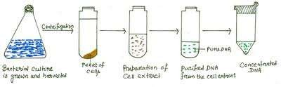
Step1:- Extraction of genomic DNA

Slide 9
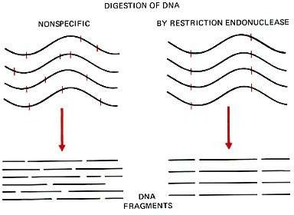
Step2:- Cut with a restriction endonuclease enzyme

Slide 10
Physical shearing (agitation or sonication )
endonuclease enzymes (2 or more can be used)

Slide 11
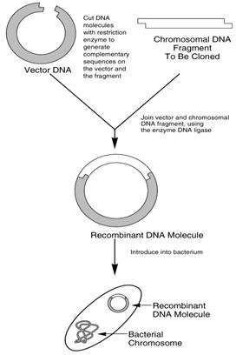
Step3:-Ligate the gene with the vector which cleaves by same enzyme

Slide 12
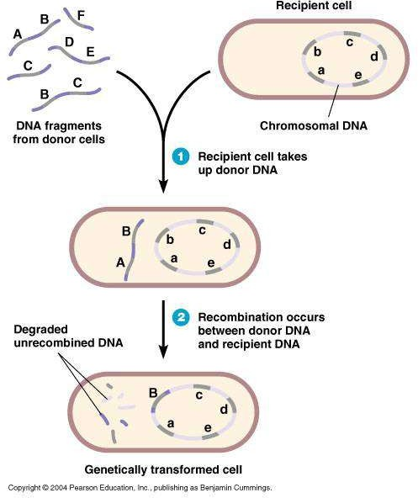
Step4:-Transformatiom
Transfer (transform) into bacteria Cells which are able to undergo this treatment are termed as competent cells
CaCl 2 causes DNA to precipitate on the outside walls of bacterial cells.

Slide 13
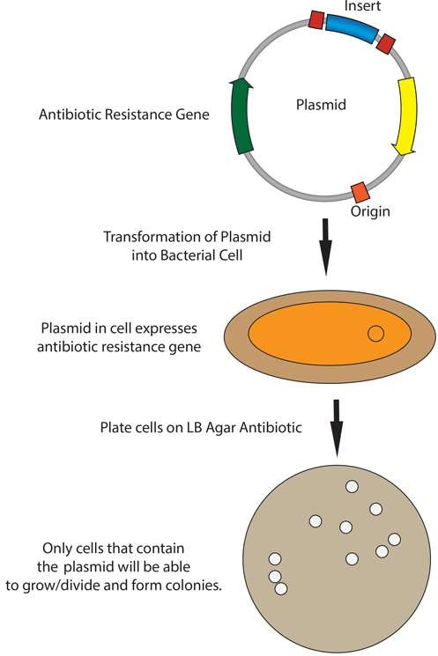
Step5:- Amplification
E.coli cells are grown in an agar medium containing ampicillin or tetracyclin at 37°C.

Slide 14
Screening of genomic library
Once the genomic library has been created, it is screened to identify the genes of interest. One of the most common library screening technique is called colony hybridization.
In the process of library construction, phage vectors are used then the process of identification of genes of interest involved is the plaques hybridization

Slide 15
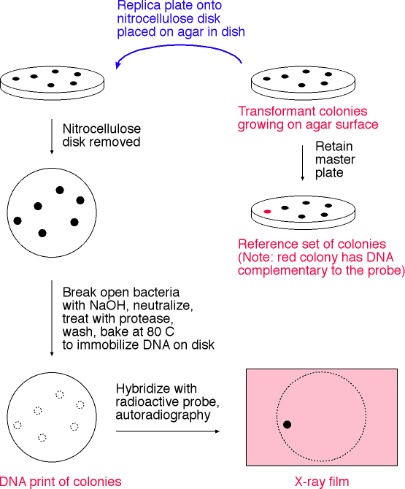
Colony Hybridization
Colony Hybridization is the screening of ibrary with a labeled probe (radioactive, etc.) to identify a specific sequence of DNA, RNA, enzyme, protein, or antibody.

Slide 16
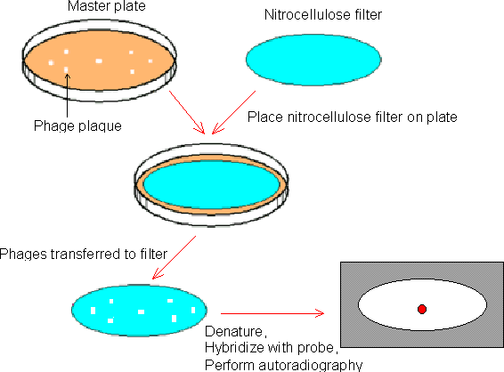
Plaque hybridization :
The plaques are screened by a technique ,based on the hybridization of oligonucleotide probe to target DNA.
DNA is transferred directly from the Petri dish to the filter, which is then incubated with labeled probes.

Slide 17
Applications of Genomic Library
1. Genomic library construction is the first step in any DNA sequencing projects.
2. Genomic library helps in identification of the novel pharmaceutically important genes.
3. Genomic library helps in identification of new genes which were silent in the host.
4. It helps us in understanding the complexity of genomes.
5. Serving as a source of genomic sequence for generation of transgenic animals through genetic engineering .
6. Study of the function of regulatory sequences in vitro.
7. Study of genetic mutations in cancer tissues.

Slide 18
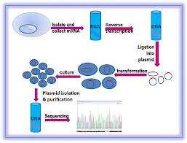
cDNA library -
Complementary DNA molecules synthesized from mRNA molecules in a cell. ,

Slide 19
constitute some portion of the transcriptome of the organism.
cDNA is produced from fully transcribed mRNA found in the nucleus
therefore contains only the expressed genes of an organism.
So ,tissue specific cDNA libraries can be produced.

Slide 20
cDNA is created from a mature mRNA from a eukaryotic cell with the use of an enzyme known as reverse transcriptase.
In eukaryotes, apoly-(A) tail distinguishes mRNA from tRNA and rRNA and can therefore be used as a primer site for reverse transcription

Slide 21
Steps
1. mRNA extraction
2 methods
trizol extraction
column purification.
by using oligomeric dT nucleotide coated resins where only the mRNA having the poly-A tail will bind.
The rest of the RNAs are eluted out
The mRNA is eluted by using eluting buffer and some heat to separate the mRNA strands from oligo-dT.

Slide 22
Once mRNA is purified,
oligo-dT is tagged as a complementary primer which binds to the poly-A tail providing a free 3'-OH end that can be extended by reverse transcriptase to create the complementary DNA strand.
Now, the mRNA is removed by using a RNAse enzyme leaving a single stranded cDNA (sscDNA).
This sscDNA is converted into a double stranded DNA with the help of DNA polymerase
However, for DNA polymerase to synthesize a complementary strand a free 3'-OH end is needed

Slide 23
This is provided by the sscDNA itself by generating a
hairpin loop at the 3' end by coiling on itself.
polymerase extends the 3'-OH end and later the loop at 3' end is opened by the scissoring action of S₁ nuclease.
Restriction endonucleases and DNA ligase are then used to clone the sequences into bacterial plasmids.
The cloned bacteria are then selected, commonly through the use of antibiotic selection.
Once selected, stocks of the bacteria are created which can later be grown and sequenced to compile the cDNA library

Slide 24
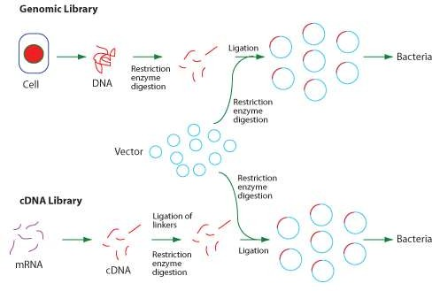

Slide 25
cDNA Library uses
cDNA libraries are commonly used when reproducing eukaryotic genomes, as the amount of information is reduced to remove the large numbers of non-coding regions from the library.
cDNA libraries are used to express eukaryotic genes in prokaryotes.
cDNA libraries are most useful in reverse genetics where the additional genomic information is of less use.
Also, it is useful for subsequently isolating the gene that codes for that mRNA.

Slide 26
cDNA Library vs. Genomic DNA Library
cDNA library lacks the non-coding and regulatory elements found in genomic DNA.
Genomic DNA libraries provide more detailed information about the organism, but are more resource-intensive to generate and maintain.

Slide 27


