Slide 1

PRODUCTION OF ETHYL ALCOHOL
M.SATYA SUMANJALI
DEPARTMENT OF MICROBIOLOGY
DNR COLLEGE

Slide 2
INDUSTRIAL PRODUCTION OF ETHYL ALCOHOL
One of the most important and best known industrial fermentation is that in which ethyl alcohol is produced from sugar by yeast under anaerobic condition.
The production of alcohol became commercially feasible on large scale shortly after the 1906 when industrial alcohol act was passed. This act allowed the sale of tax-free alcohol, if it was first denatured to prevent its use as alcoholic beverage.
The unit of measurement commonly used in reporting the ethyl alcohol is the proof.
Proof is twice the percent in the volume of ethyl alcohol. For example 95 % ethyl alcohol by volume is 190 proof.

Slide 3
INDUSTRIAL PRODUCTION OF ETHYL ALCOHOL FROM MOLASSES
In India molasses (obtained from sugar factories) is the most important raw material used for alcohol production.
The alcohol manufacturing process involves following steps.
1) Microorganism
2) Preparation of inoculum
3) Preparation of fermentation medium
4) Fermentation conditions
5) Recovery

Slide 4
1. MICROORGANISM–
Yeasts are the important organisms involved in alcohol production.
Certain types of yeast possessing following properties are used
A)Able to produce high concentration of alcohol.
B)Having high alcohol tolerance
C)Having uniform and stable biochemical characteristics.
D)Capable of growing rapidly and vigorously in fermentation medium
Selected strains of Saccharomyces cerevisiae are most commonly used. However, other yeast like Schizosaccharomyces pombe, Saccharomyces anamensis, Candida yeast may also be used under certain conditions.

Slide 5
2. PREPARATION OF INOCULUM (YEAST CULTURE)
Large amount of yeast culture is required in industrial production of ethyl alcohol. The average amount of inoculum used for inoculation of fermentation medium is 4 % volume-by-volume.
The medium used for inoculum preparation is same as that of actual fermentation medium.
Aeration is of benefit in preparing the inoculum, as the purpose is to obtain large no. of yeast cells.
Steps involved in building up of inoculum are
A)10 ml of sterile medium in a test tube is inoculated with pure culture of yeast and tube incubated at 28 to 30 ⁰C for a suitable period.

Slide 6
B)The tube culture is transferred to a flask containing 200 ml of sterile medium. Flask is incubated at 28 to 30 ⁰C to obtain sufficient cell mass.
C)The flask culture is transferred to a suitable glass container containing about 4 lit of sterile medium and incubated at 28 to 30⁰C.
D)Finally this culture is used to inoculate a small tank containing about 10-40 gallons of sterile medium.
After incubation, the inoculum is used to inoculate the fermentation medium in fermenter.

Slide 7
3) PREPARATION OF FERMENTATION MEDIUM-
Black strap molasses is the principal source of alcohol. This is the syrup that is left after the recovery of crystalline sugar from the concentrated juice of sugar cane. It usually contains 48 to 55 % sugar, mainly sucrose.
To prepare fermentation medium molasses are diluted to a sugar concentration 10 to 18 % (usually 12 %)by adding required quantity of water.
Higher sugar concentration adversely reacts on yeast and alcohol produced may inhibit the action of yeast with consequences that fermentation time is prolonged. The use of low concentration of sugar is uneconomic.

Slide 8
Molasses generally contain most of the nutrient substances for yeast but ammonium sulphate or phosphates may be added to the fermentation medium to supply deficiencies of nitrogen and phosphorus.
The pH of the fermentation medium is adjusted to 4.8 to 5.5 by using H₂SO₄ or lactic acid. Lactic acid bacteria can also be grown for pH adjustment.
Due to acidic pH, medium usually does not get contaminated by bacteria. Therefore, usually fermentation medium is not sterilized but however, pasteurization of fermentation medium may be practiced.

Slide 9
4) FERMENTATION CONDITIONS -
Following fermentation conditions are carefully controlled to obtain maximum yield.
Temperature-An optimum temp of 28-30⁰C is maintained. Temp increases due to heat generation during fermentation. This is controlled by circulating the water through cooling coils. At a temp above 30⁰C alcohol evaporates rapidly and also favors the growth of bacterial contaminants.
pH–Fermentation proceeds satisfactorily at pH 4.0 to 4.5. This pH favors the growth of yeast and inhibits the growth of bacteria.
Higher pH values increases the chances of contamination while lower pH values inhibits alcohol production.

Slide 10
H₂SO₄ is commonly used to adjust the pH of mash. Lactic acid is also satisfactory.
Lactic acid favors the growth of yeast but inhibits the growth of butyric acid bacteria, which is harmful to the yeast fermentation.
Agitation and Aeration-Intermittent agitation is required for mixing and cooling the medium.
Aeration is required only in early stages of fermentation for optimum reproduction of yeast cells but it is not required for the production of alcohol.
During fermentation, CO₂ is evolved and anaerobic conditions are maintained.
Fermentation time - Fermentation starts within few hours after the addition of yeast.

Slide 11
RECOVERY –
The fermented mash (also called “beer”) is distilled to separate the ethyl alcohol and Fusel oils from the other constituents of the medium.
During distillation, fractions containing different concentrations of alcohol are separated.
The solids called slops or stillage recovered during distillation process are used as fertilizer constituent as they contain potassium and phosphates.
Other byproducts of fermentation called fusel oil are also separated during distillation process.
The alcohol obtained may be further purified, dehydrated and denatured.

Slide 12
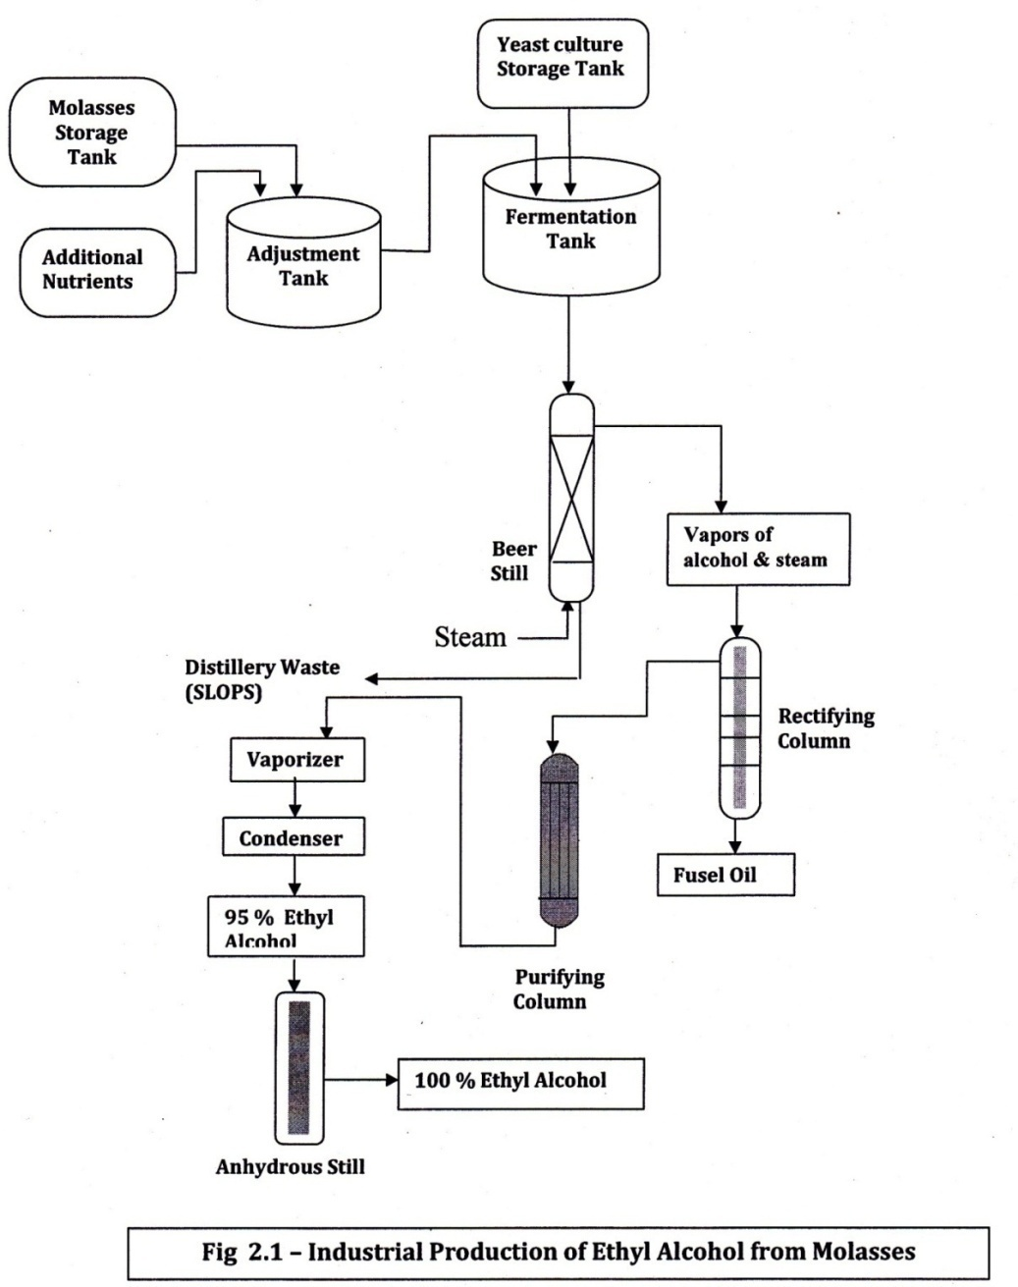
Fig. 2.1 Industrial Production of Ethyl Alcohol from Molasses

Slide 13
BY-PRODUCTS OF ALCOHOLIC FERMENTATION:-
There are four main by-products of alcohol industry.
These are A) CO₂ B) Yeast C) Fusel oils D) Slops or Stillage
CO₂- CO₂ is produced in large quantities during
fermentation. It is collected and purified.
Purified CO₂ can be liquefied or converted into dry ice. Large quantities of liquefied CO₂ are used in the soft drink industry for the manufacture of cold drinks, while dry ice has many commercial applications.
B)Yeast- The yeast separated from fermented medium
can be safely used for feeding the animals (animal
feed). Thus this yeast is the valuable fodder, which is
rich in proteins, vitamins and essential trace elements.

Slide 14
C) Fusel oils –
During fermentation, some quantities of higher alcohols mainly isoamyl alcohol and butyl alcohol is formed.
This fraction of higher alcohols is collectively known as fusel oils.
After refining they are used in the manufacture of perfumes and potable liquors.
However the bulk amount of this fraction is converted into various acetates by esterification. Esters of these higher alcohols are used in paint industry and lacquer industry.

Slide 15
D) Slops- During distillation process slops are separated. The slops are usually discarded but may be used in no. of ways.
The slops may be used as substitute for some of the water in diluting molasses for a new mash. The solids from the slops may be concentrated and sold as a fertilizer constituent as they contain potassium and phosphates.
MECHANISM OF ALCOHOL FERMENTATION
Alcohol fermentation is an anaerobic fermentation taking place in the absence of air or oxygen .The raw materials like molasses and waste sulphite liquor serves as the energy and carbon source for ethanol producing micro-organisms.

Slide 16
Monosaccharides (e.g.,Glucose) are directly fermented to alcohol while disaccharides are first hydrolysed to monosaccharides and are then fermented to form alcohol and CO₂ as shown in the following reaction.
Disaccharide -----C₆H₁₂O₆ ------- 2 CH₃CH₂OH + 2CO₂ Monosaccharide Ethyl alcohol Monosaccharide (e.g. Glucose) is converted into pyruvic acid via glycolysis or EMP pathway.
Pyruvic acid then acted upon by pyruvate decarboxylase and is converted into acetaldehyde and carbon dioxide.
Acetaldehyde is then converted into ethyl alcohol by the enzyme alcohol dehydrogenase as shown below.

Slide 17
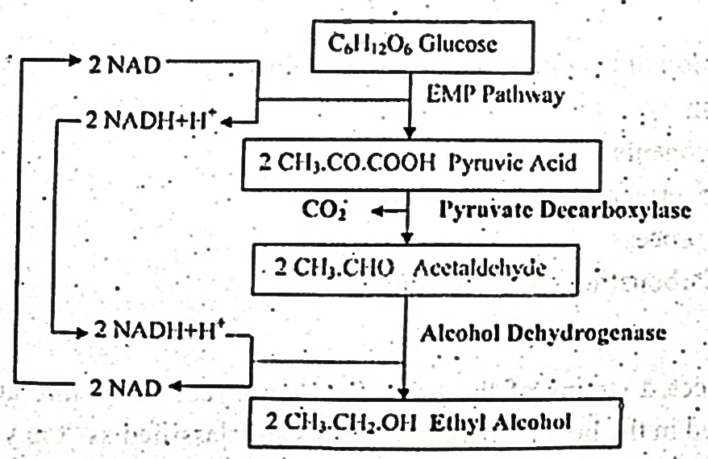

Slide 18
INDUSTRIAL PRODUCTION OF ETHYL ALCOHOL FROM WASTE SULPHITE LIQUOR
Sulphite liquor is produced as a waste product in the manufacture of pulp from wood and is described separately in unit no.1
Fermentation process involves following steps.
1. MICROORGANISM --
Sulphite liquor fermentation utilizes yeast Candida pseudotrophicalis because of the ability of this organism to ferment pentose sugars.
Although the Saccharomyces cerevisiae can also be used, but in this case the pentose sugars of the sulphite liquor are not fermented.

Slide 19
2. RAW MATERIAL–
Sulphite liquor, the waste product of paper pulping industry is the fundamental raw material in this process.
3. PREPARATION OF FERMENTATION MEDIUM –
Waste sulphite liquor obtained during pulping process cannot be used directly for fermentation as it contains SO₂, which is toxic to the growth of yeast.
Therefore, it is necessary first to remove SO₂, acetic acid and formic acid that are present in liquor.
Sulphite liquor is pumped into a column known as stripper where it flows top to bottom.
Simultaneously, steam is introduced at the bottom of column and flows upward. This removes sulphur dioxide (SO₂) and other volatile materials. This process is called conditioning of liquor.

Slide 20
The hot sulphite liquor is cooled to 30^{O}C. A slurry (solution) of lime is added to adjust the pH to 4.5. Urea is also added to liquor as a source of nitrogen.
4 . FERMENTATION CONDITIONS–
The conditioned sulphite liquor is pumped into the fermentation tank.
It is inoculated with yeast culture and following fermentation conditions are maintained to obtain maximum yield.
pH- Fermentation is carried out at an optimum pH 4.5.
Temp- Fermentation is carried out at an optimum temp of 30^{O}C.
Agitation & Aeration- The medium is intermittently agitated. No aeration is required as alcohol production takes place under anaerobic conditions .

Slide 21
Time- Fermentation process usually completes within 20 hrs.
Yield – The yield is about 22 gallons of alcohol per ton of pulp.
5. RECOVERY –
The alcohol is recovered from fermented mash as that of alcohol from molasses.

Slide 22
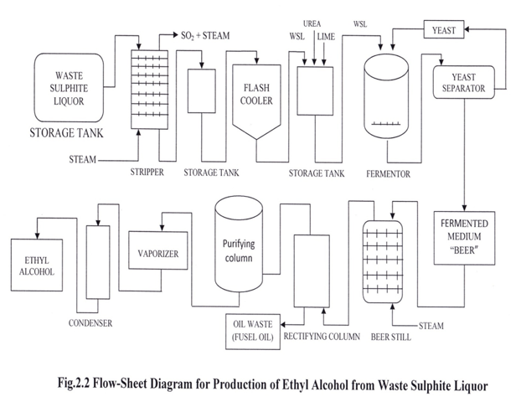

Slide 23
Water
Adjustment Fermentor
Tank/ diluter Temp.70-80⁰F
Sugar content – 10 –18% pH 4.0 – 4.5
pH – 4.0 – 4.5 F. Time-50 hrs
Inoculom preparation
Steam
Purifying Rectifying
column column
Molasses
Storage tank
CO₂
H₂SO₄
Additional
Nutrients
Vapours of alcohol & steam
Beer
Still
DistilleryWaste (Slops)
Vaporizer
Condenser
Oil
Waste
Alcohol
Fusel oil

