Slide 1
FOOD PRESERVATION
R.SAKUNTALA
DEPARTMENT OF MICROBIOLOGY
DNR COLLEGE

Slide 2




Food Preservation
Food Preservation is a process in which
Food and vegetables are prevented from getting spoiled
The color, texture, and nutritive values of food is also preserved
Food products lasts for a long period of time: Shelf life of food product is increased

Slide 3

So, we can defined Food Preservation as:
Retaining food over a period of time without being contaminated by pathogenic organisms or chemicals and without losing its colour, texture, flavour and nutritious value.
Food Preservation usually involves preventing the growth of bacteria, fungi and other microorganisms, as well as retarding the oxidation of fats which causes rancidity.

Slide 4

Types of foods
Food Types
Perishable
Semi Perishable
Non perishable
Fruits
Milk
Cheese, Some
ready foods
Grains

Slide 5

Food types
Perishable
  Lasts for less time 2 days to 1 week
  Example: Fruits, milk, vegetables, meat
Semi perishable
  Lasts for around 2 months and are processed
  Example: Ice-cream, cheese, bread, cake, pastries
Non perishable
  Has longer shelf Life more than 6 months
  Example: Food grains

Slide 6

Why to preserve food?
If we are able to preserve foods, we enjoy any kind of foods in any season
We eat food even it is not available in our areas
We can store our food easily and without worries

Slide 7

Principles of Food Preservation
1. Inhibit the growth and activity of Microorganisms
-Removal of microorganisms
-Stopping the growth and activity of microorganisms (low temperatures, drying or chemicals)
- Destruction of MO(heating or radiation)
2. Protecting against self decomposition of food
-Inhibit the activity of Endogenous Enzyme
Protection from invasion and spoilage by insects and rodents
Protection against losses by mechanical causes

Slide 8

Importance of Food Preservation:
Increases the shelf life of food
Retain the quality of food – colour, texture, flavour & nutritional value
Increases food supply
Decreases wastage of food
Make foods available throughout the year

Slide 9

Common food preservation methods
Bottling and canning
Pickling
Drying
Salting
Vacuum packing
Cooling and freezing
Waxing
Pasteurization
Boiling
Smoking

Slide 10

Bottling andcanning
Bottling and canning are processes of preserving food by heating and then sealing it in an airtight container.
The food is boiled to kill microorganisms and then sealed to prevent other microorganisms from getting in.

Slide 11

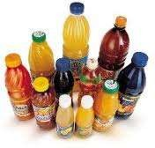
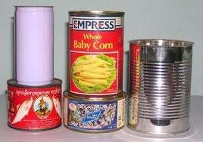
Canning
Bottling

Slide 12

PICKLING
Pickling food in vinegar or other acids, makes it difficult for microorganisms to live.
Sugar can also be used in pickling fruits such as mangoes and cherries.
The concentrated sugar solution used draws water from the fruit thus preventing the growth of microorganisms.

Slide 13

Drying
A lot of food is preserved by drying under the sun.
Drying removes most water from food. Most bacteria die or become inactive when the food is dried.

Slide 14

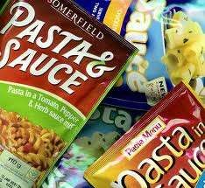
A lot of fruits such as raisins, guavas and papayas can be eaten dried.

Slide 15

Salting
Salting is an age-old way of preserving food. The salt draws out moisture and prevents microorganisms from growing. In this process, food such as fresh fish are gutted, washed and coarse salt is rubbed into it.

Slide 16

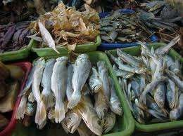
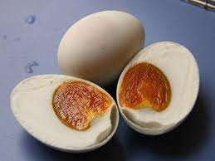
A lot of our local foods are preserved by salting process.

Slide 17

Vacuum Packing
Vacuum packing keeps food by sucking air out from its packaging.
Food is thus prevented from spoiling because there is no air.

Slide 18

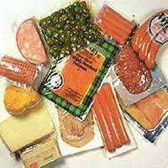
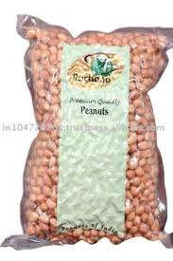
Vacuum packing is commonly used for storing nuts, sliced fish, pickled and dried fruit.

Slide 19

Cooling and Freezing
Cooling slows down the action of microorganisms, thus it takes longer to spoil. It allows fruit from different parts of the world to appear on our supermarket shelves.(0 to -4⁰ C)
At freezing temperature, microorganisms become inactive, thus food cannot spoil when it is frozen. (-18 ⁰ C)

Slide 20

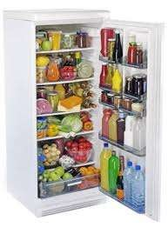
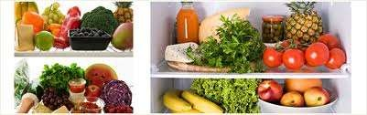
Food like meat, fruit and vegetables are kept in the refrigerator.

Slide 21

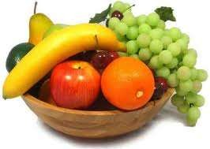
Waxing
Waxing of fruit and vegetables is also common. Apples, oranges, and tomatoes are dipped into liqiud wax to prevent growth of fungi and loss of moisture.
Waxed fruit need to be washed thoroughly or peeled before eating.

Slide 22

Pasteurization
Pasteurization means heating food to a certain temperature for some time followed by rapid cooling. Heating at such high enough temperature kills most bacteria. However, it does not affect the taste and nutritional value of the food.

Slide 23

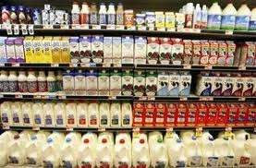
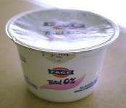
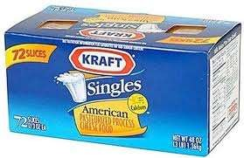
Fresh milk, yoghurt drink and juices are pasteurized to make them last longer.

Slide 24

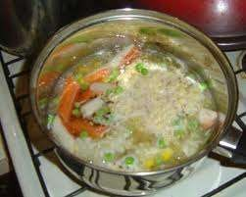
Boiling
As food is heated and cooked, the heat kills the
microorganisms,
Boiling kills most bacteria. However, those not affected by heat will grow when the conditions are suitable.
Boiling kills bacteria

Slide 25

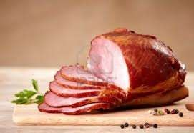
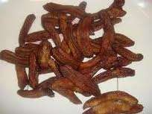
Smoking
Smoking is the process of drying food with smoke for a long period of time. This method is mainly used for fish, meat and fruit such as banana.
The drying effects of smoke and the chemicals produced from the smoke help to preserve the food.
Smoked banana
smoked meat

Slide 26

Irradiation
 Ionising radiation takes the form of Gama-rays from isotopes or, commercially to a lesser extent, from X-rays and electrons. It is permitted in 38 countries to preserve foods by destruction of micro-organisms or inhibition of biochemical changes.

Slide 27

The main advantages of irradiation are as follows:
there is little or no heating of the food and therefore negligible change to sensory characteristics
packaged and frozen foods may be treated
fresh foods may be preserved in a single operation, and without the use of chemical preservatives
energy requirements are very low
changes in nutritional value of foods are comparable with other methods of food preservation

Slide 28
Chemical methods of preservation
are substances which, under certain conditions, either delay the growth of microorganisms without necessarily destroying them or prevent deterioration of quality during manufacture and distribution.
Can be naturally occurring or synthetic substance that is added to products such as foods, pharmaceuticals, paints, biological samples, wood, etc. to prevent decomposition by microbial growth or by undesirable chemical changes.
these substances are added in very low quantities (up to 0.2%) which do not alter the and physico- chemical properties of the foods at or only very little.

Slide 29
Chemical Preservatives
The purpose of using a chemical agent as a preservative is to retard food spoilage caused by microorganisms.
The use of chemical preservatives will prolong the shelf life of the food even further
They may be incorporated into the foods,or only on their surface.

Slide 30
Chemical Preservatives
Benzoic acid and benzoate
Scorbic acid
Lactic,acetic,propionic acid
Sodium chloride
Sulphurous acids and sulphites
Sulphur dioxide
Nitrates and Nitrites
Antibiotics

Slide 31
Benzoic acid and benzoate are used for the preservation of vegetables
Sodium benzoate is a common preservative in acid or acidified foods such as fruit juices, syrups, jams and jellies, pickles, preserves, fruit cocktails, etc.
Scorbic acid is recommended for foods susceptible for fungi e.g it inhibits mould growth in bread
Sodium chloride causes dehydration of food as well as microorganisms

Slide 32
Sulphurous acids and sulphites are added to wines as preservatives.
Sulphurous acid is used in preservation of dry fruites
Sulphur dioxide suppresses the growth of yeast and moulds
Nitrates and Nitrites are used together in meat and fish preservation and for retension of red colour of the meat.
Aureomycin is the most commonly used antibiotic for the preservation of animal products under chilling conditions

Slide 33
THANK YOU

