Slide 1
CPU MCA I Semester
P. Mounika
MCA Department

Slide 2
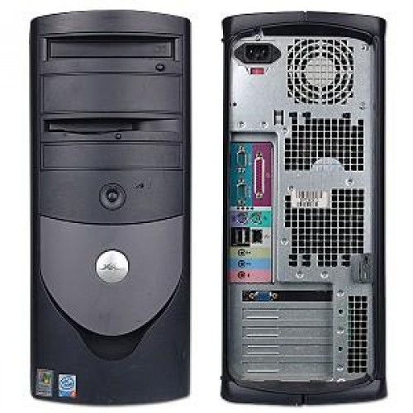
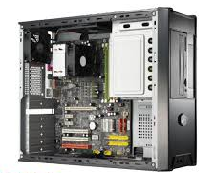
What is CPU?
CPU is the heart and brain of a computer.
It receives data as input.
The Central Processing Unit (CPU) is simply the central processor or the processor where most calculation takes places.

Slide 3
History of Central Processing Unit

Slide 4
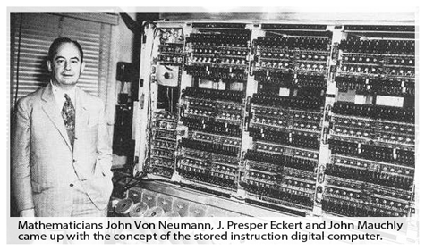
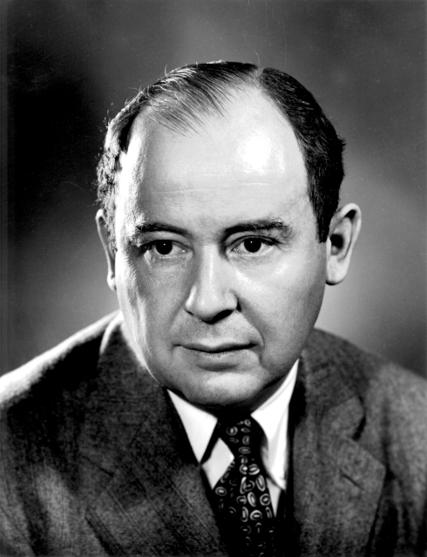
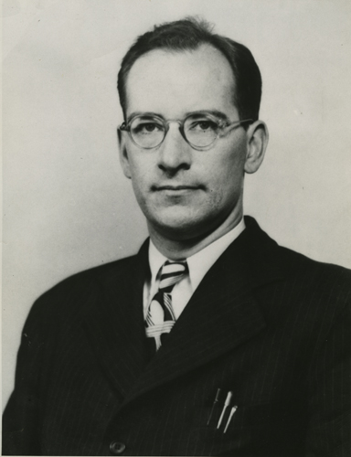
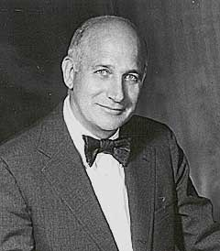
In the 1940, mathematicians:
John Von Neumann
J. Presper Eckert
John Mauchly
Came up with the concept of the stored instruction digital computer.

Slide 5
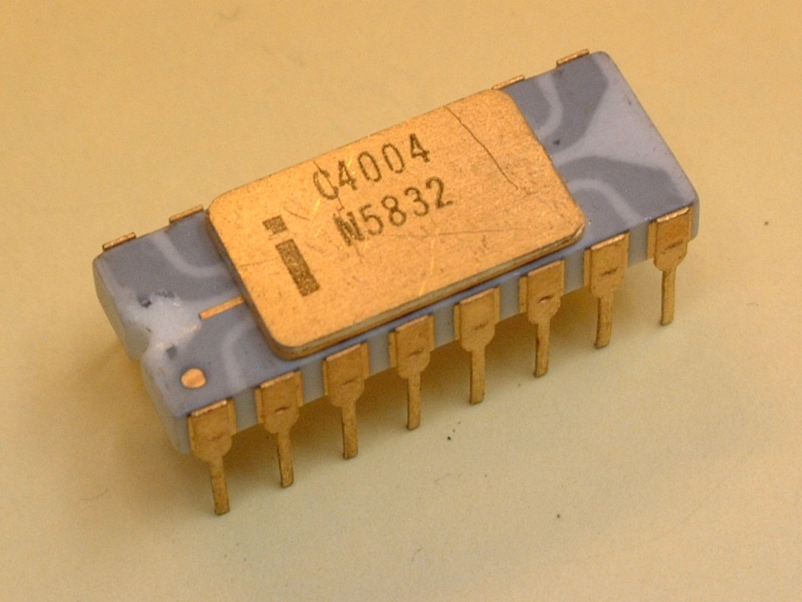

On 1970’s a component of mainframe computer known as CPU is a steel cabinet bigger than a refrigerator full of circuit boards crowded with transistors.
In 1971 the first microprocessor invented. The 4004 microprocessor .

Slide 6
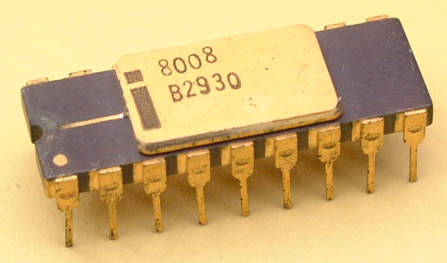
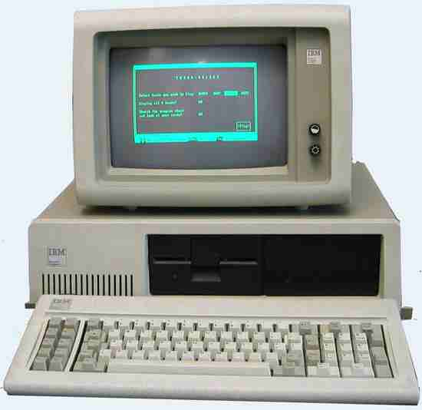





In 1972 The 8008 was the first of many 8- bit microprocessors to fuel the home computer revolution.
In 1979, Intel delivered the
8088 and IBM engineers used it for the first PC . From 8086.

Slide 7
Parts of System Units:
Motherboard
Memory
Bus
Expansion Slot
Ports and Connector
Bays
Power Supply
Sound Components

Slide 8
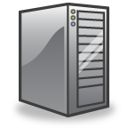
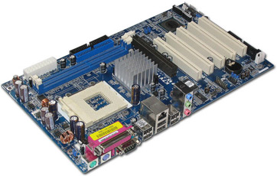
Motherboard:
The motherboard is the main circuit board of a microcomputer. It is also known as the mainboard or system board.
Memory:
Memory is the part of the computer that temporarily stores applications, documents, and stem operating information.

Slide 9
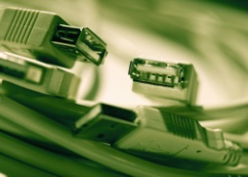
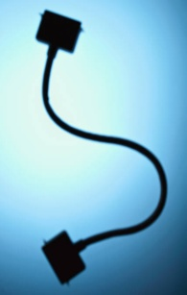
Bus:
A bus is an electronic line that allows 1s and 0s to move from one place to another.
Expansion Slots:
Expansions slots appear on the motherboard. They are sockets into which adapters are connected.
Ports and Connectors:
A port is a connector located on the motherboard or on a separate adapter.

Slide 10
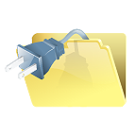

Bays:
A bay is a space inside the computer case where a hard drive, floppy drive or CD-ROM drive sits
Power Supply:
A power supply changes normal household electricity into electricity that a computer can use.
Sound Components :
A sound card lets a computer play and record high quality sound.

Slide 11
Components of CPU:
Control Unit
Arithmetic Logic Unit
Memory Unit/Register

Slide 12
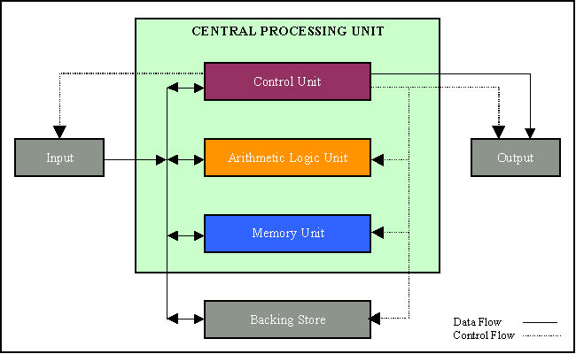
Arrangement of Components:

Slide 13
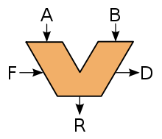
ALU(Arithmetic Logic Unit):
It performs two types of operations
1. Arithmetic Operations.
2. Logical Operations.

Slide 14
Arithmetic Operations:
Operation : Symbol
Addition : +
Subtraction : -
Multiplication : *
Division : /

Slide 15
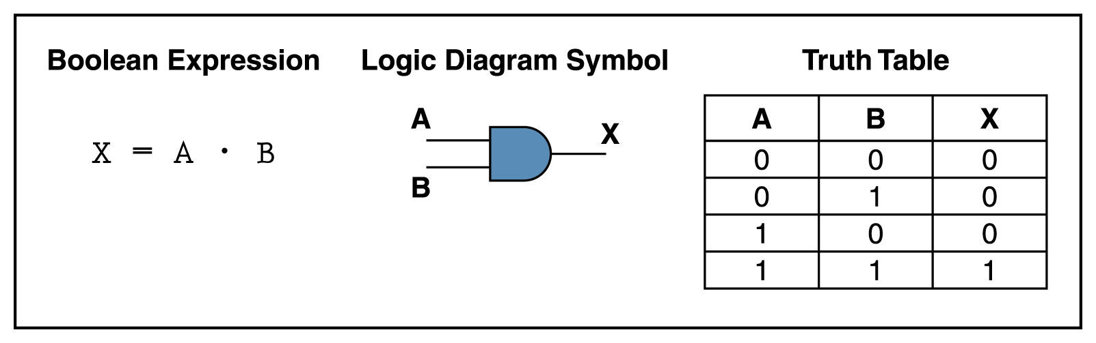
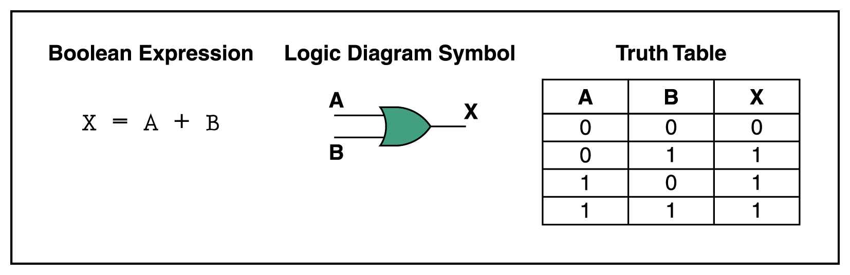
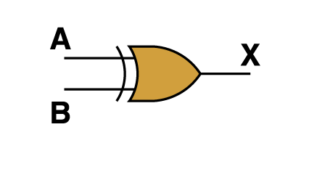
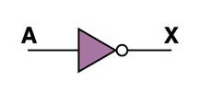
Logical Operations:
Logical AND
Logical OR
Logical NOT
Logical EXCLUSIVE OR

Slide 16
CU (Control Unit):
It reads and instructions from memory and transforms them into a series of signals to activate other parts of the computer.
Controls the operations that takes place in various parts of a computer by sending electronic signals.

Slide 17
MU/Register(Memory Unit):
Is the part of the computer that holds data and instructions for processing.

Slide 18
Functions of the CPU

Slide 19
FETCH
DECODE
EXECUTE
STORE

Slide 20
Fetch:
Taking the instruction from the memory. Decode:
Translating and decoding Assembly code binary instructions which are understandable to your CPU. Execute:
Execute calculation, move data and jump to different address. Store:
CPU dive some data after executing the instruction and store data being instructed.

Slide 21


