Slide 1
Types of Networking Devices
MCA II Semester
                K.SUPARNA
                MCA Department

Slide 2
Networking Devices:
Networking devices are components used to connect computers or other electronic devices
Together so that they can share files or resources like printers or fax machines.
These are also called communicating devices.
The following are the various networking devices.
Repeater
Hub
Bridge
Switch
Router
Gateway
Brouter
Modem
Network Interface Card (NIC)

Slide 3
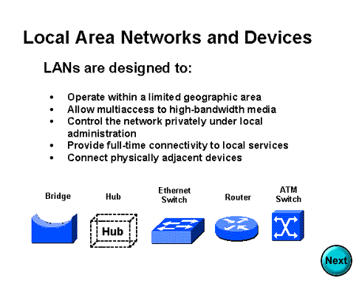

Slide 4
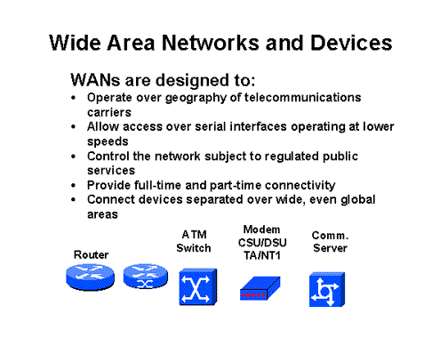

Slide 5
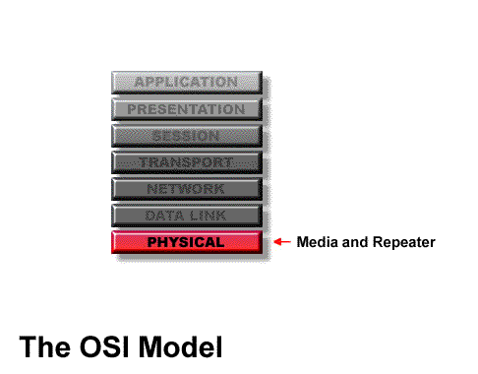
Repeater :
A repeater operates at the physical layer. Its task is to regenerate the signal over the same network before the signal becomes too weak or corrupted.
A repeater is a regenerator, not an amplifier.
When the signal becomes weak, they copy the signal bit by bit and regenerate it at the original strength.
It is 2 port device.

Slide 6
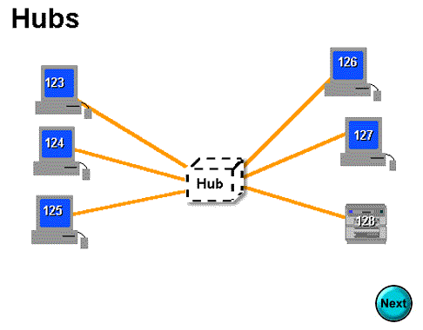
Hub :
A hub is device used to connect several computers together.
Hubs cannot filter data, so data packets are sent to all connected devices.
Also, they do not have intelligence to find out best path for data packets which leads to inefficiencies and wastage.
Types of Hub
Active Hub :- Active hubs use electronics to amplify and clean up the signal before it is broadcast to the other ports.
Passive Hub :- Passive hubs simply connect all ports together electrically and they are not powered.
3.Bridge:
A bridge operates at data link layer.
A bridge is a repeater, with add on functionality of filtering content by reading the MAC addresses of source and destination.
It is also used for interconnecting two LANs working on the same protocol.
Bridges can filter out noise.

Slide 7
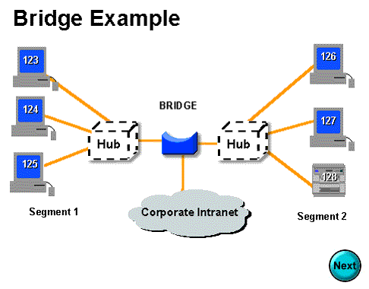
4. Switch:
A network switch is a computer networking device that connects network segments.
Switch is data link layer device.
Switch can perform error checking before forwarding data, that makes it very efficient as it does not forward packets that have errors and forward good packets selectively to correct port only.
5. Routers:
A router is a device like a switch that routes data packets based on their IP addresses.
Router is mainly a Network Layer device.
Routers normally connect LANs and WANs together and have a dynamically updating routing table based on which they make decisions on routing the data packets.

Slide 8
6. Gateway :
A gateway is a passage to connect two networks together that may work upon different networking models.
They basically work as the messenger agents that take data from one system, interpret it, and transfer it to another system.
Gateways are also called protocol converters and can operate at any network layer.
7. Brouter:
It is also known as bridging router is a device which combines features of both bridge and router.
It can work either at data link layer or at network layer.
Working as router, it is capable of routing packets across networks; working as bridge, it is capable of filtering local area network traffic.

Slide 9
8. Modem :
Modem means Modulator- Demodulator.
Modulation : digital information to analog signals.
Demodulation: Analog signal back into digital information.
9. Network Interface Card (NIC):
NIC provides physical interface between computer and cabling.
NIC prepares data, sends data, and controls the flow of data.
It can also receive and translate data into bytes for the CPU to understand.
It has specific MAC address.

Slide 10
References:
Data Communications and Networking , Fourth Edition, Behrouz A.Forouzan
2. Networking Devices, Geeksforgeeks.org
3.Networking Device, Slidesharenet

Slide 11
Thank You

