Slide 1


Introduction to Asynchronous Data Transfer
Asynchronous data transfer refers to the exchange of information between systems or devices without the need for real-time synchronization. This allows for more efficient and flexible communication, as data can be sent and received at different times.
Presented by
K.Venkatesh
Mca department

Slide 2
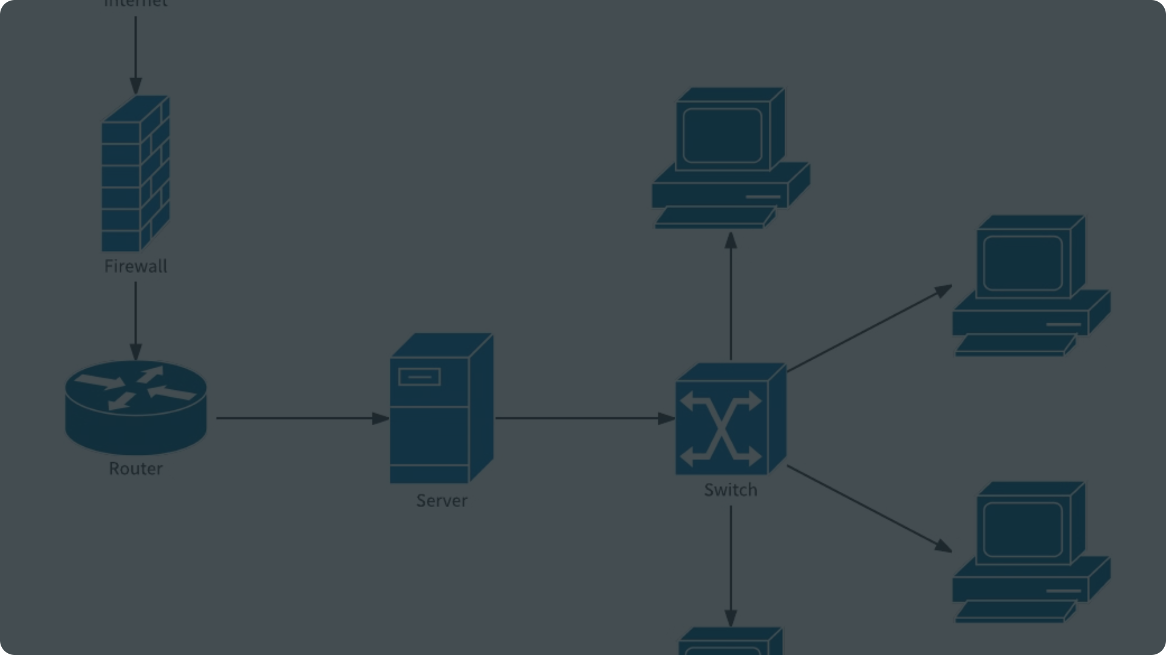
Advantages of Asynchronous Communication
1
Scalability
2
Reliability
3
Flexibility
Asynchronous systems can handle high volumes of data and concurrent requests without getting overwhelmed.
Asynchronous communication is less prone to failures, as messages can be queued and retried if necessary.
Asynchronous systems allow for more flexibility in terms of when and how data is exchanged.

Slide 3
Protocols for Asynchronous Data Transfer
MQTT
WebSockets
RabbitMQ
A lightweight publish-subscribe protocol designed for IoT and machine-to-machine communication.
A bidirectional, real-time communication protocol that enables asynchronous data exchange.
A message broker that supports various asynchronous messaging protocols like AMQP and MQTT.

Slide 4
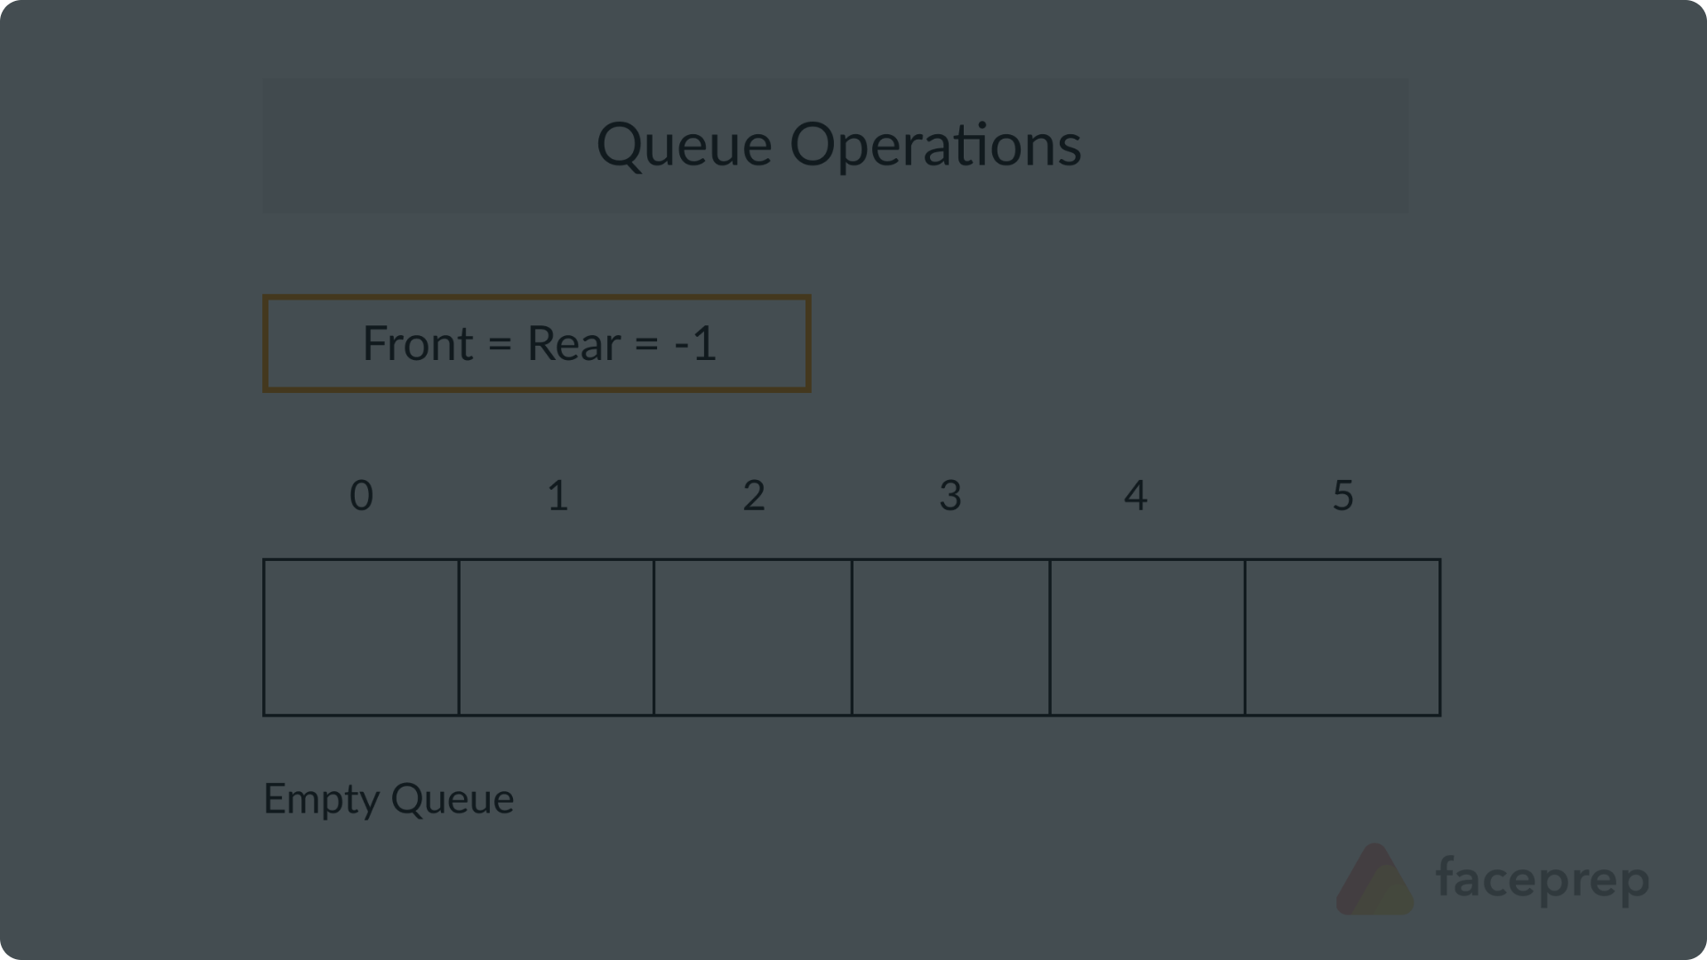
Asynchronous Data Queues and Buffers
1
Data Queues
Queues store and sequence messages, ensuring they are processed in the order they were received.
2
Data Buffers
Buffers temporarily hold data to smooth out differences in data production and consumption rates.
3
Message Brokers
Broker services like RabbitMQ manage queues and buffers to facilitate asynchronous data transfer.

Slide 5
Asynchronous API Design Patterns
Webhooks
Server-Sent Events
Webhooks allow services to send real-time information to other applications over the internet.
SSE is a standard that allows a server to push data to a client as an event stream.
Pub-Sub
Message Queues
The publish-subscribe pattern decouples message producers and consumers for asynchronous messaging.
Message queues buffer and sequence messages, enabling asynchronous and reliable data transfer.

Slide 6



Handling Failures in Asynchronous Systems
Retries
Dead-Letter Queues
Compensating Actions
Automatically retrying failed requests can improve reliability and fault tolerance.
Capturing and analyzing failed messages in a separate queue can aid debugging.
Implementing compensating actions can help undo the effects of failed asynchronous operations.

Slide 7




Monitoring and Observability in Async Environments
Metrics
Tracing
Logging
Alerting
Monitor key performance indicators like message throughput, latency, and error rates.
Trace asynchronous requests and messages to understand end-to-end workflow performance.
Logging critical events and errors can help diagnose issues in asynchronous systems.
Set up alerts to proactively notify teams of potential problems in the system.

Slide 8
Best Practices for Asynchronous Data Transfer
Use reliable protocols
Leverage protocols like MQTT, WebSockets, and message queues that are designed for asynchronous communication.
Optimize for performance
Implement strategies like batching, compression, and caching to improve the efficiency of data transfer.
Ensure data integrity
Implement mechanisms like idempotency, message deduplication, and retries to guarantee data consistency.
Monitor and observe
Establish comprehensive monitoring and observability to quickly identify and resolve issues.

