Slide 1

Introduction to Digital Computers
Digital computers are electronic devices that process data using binary digits (0s and 1s). They have revolutionized how we live, work, and communicate in the modern world. These powerful machines can perform complex calculations, store vast amounts of information, and automate a wide range of tasks.
Presented by
K.VENKATESH
MCA DEPARTMENT

Slide 2
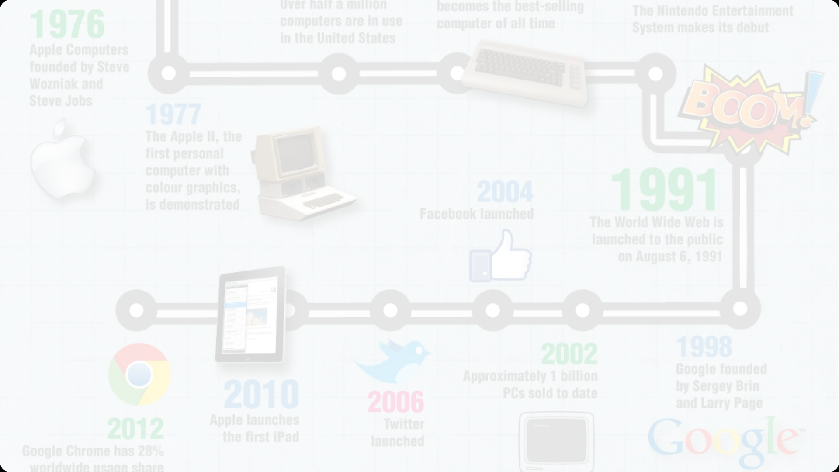
History of Digital Computers
1
Early Pioneers
The foundations of digital computing were laid by visionaries like Charles Babbage, Ada Lovelace, and Alan Turing in the 19th and early 20th centuries.
2
ENIAC and Mainframes
The first general-purpose electronic computer, ENIAC, was built in 1946, ushering in the era of mainframe computers.
3
Personal Computers
In the 1970s and 80s, the invention of the microprocessor led to the development of affordable personal computers, revolutionizing home and office computing.

Slide 3
Components of a Digital Computer
Input Devices
Central Processing Unit (CPU)
Memory and Storage
Keyboards, mice, scanners, and cameras allow users to enter data and interact with the computer.
RAM, ROM, and various storage devices like hard drives and solid-state drives (SSDs) store data and programs.
The "brain" of the computer, responsible for executing instructions and performing calculations.

Slide 4
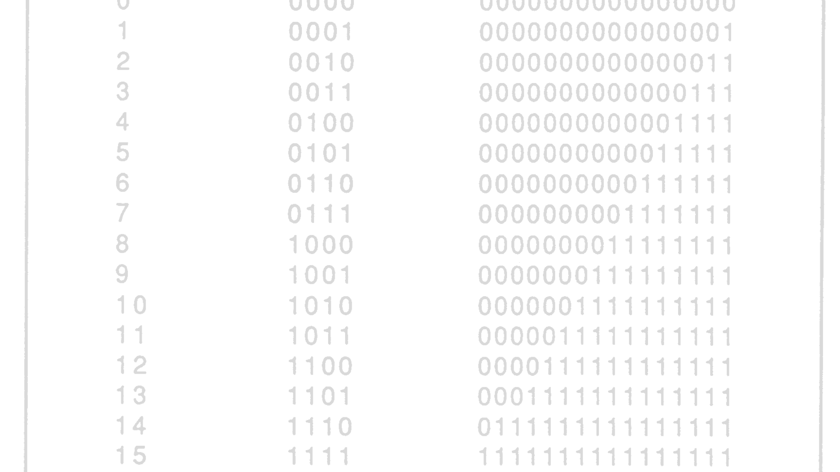
Binary Number System
1
Fundamental Building Block
2
Representing Information
3
Logical Operations
Binary digits allow for simple yet powerful logical operations, such as AND, OR, and NOT, which are the foundation of digital logic.
Digital computers use the binary number system, which consists of only two digits: 0 and 1.
Binary digits, or "bits," can be used to represent all types of data, including numbers, text, images, and audio.

Slide 5




Digital Logic Gates
AND Gate
OR Gate
NOT Gate
XOR Gate
Outputs a 1 if all inputs are 1.
Outputs a 1 if any input is 1.
Outputs the opposite of the input.
Outputs a 1 if only one input is 1.

Slide 6
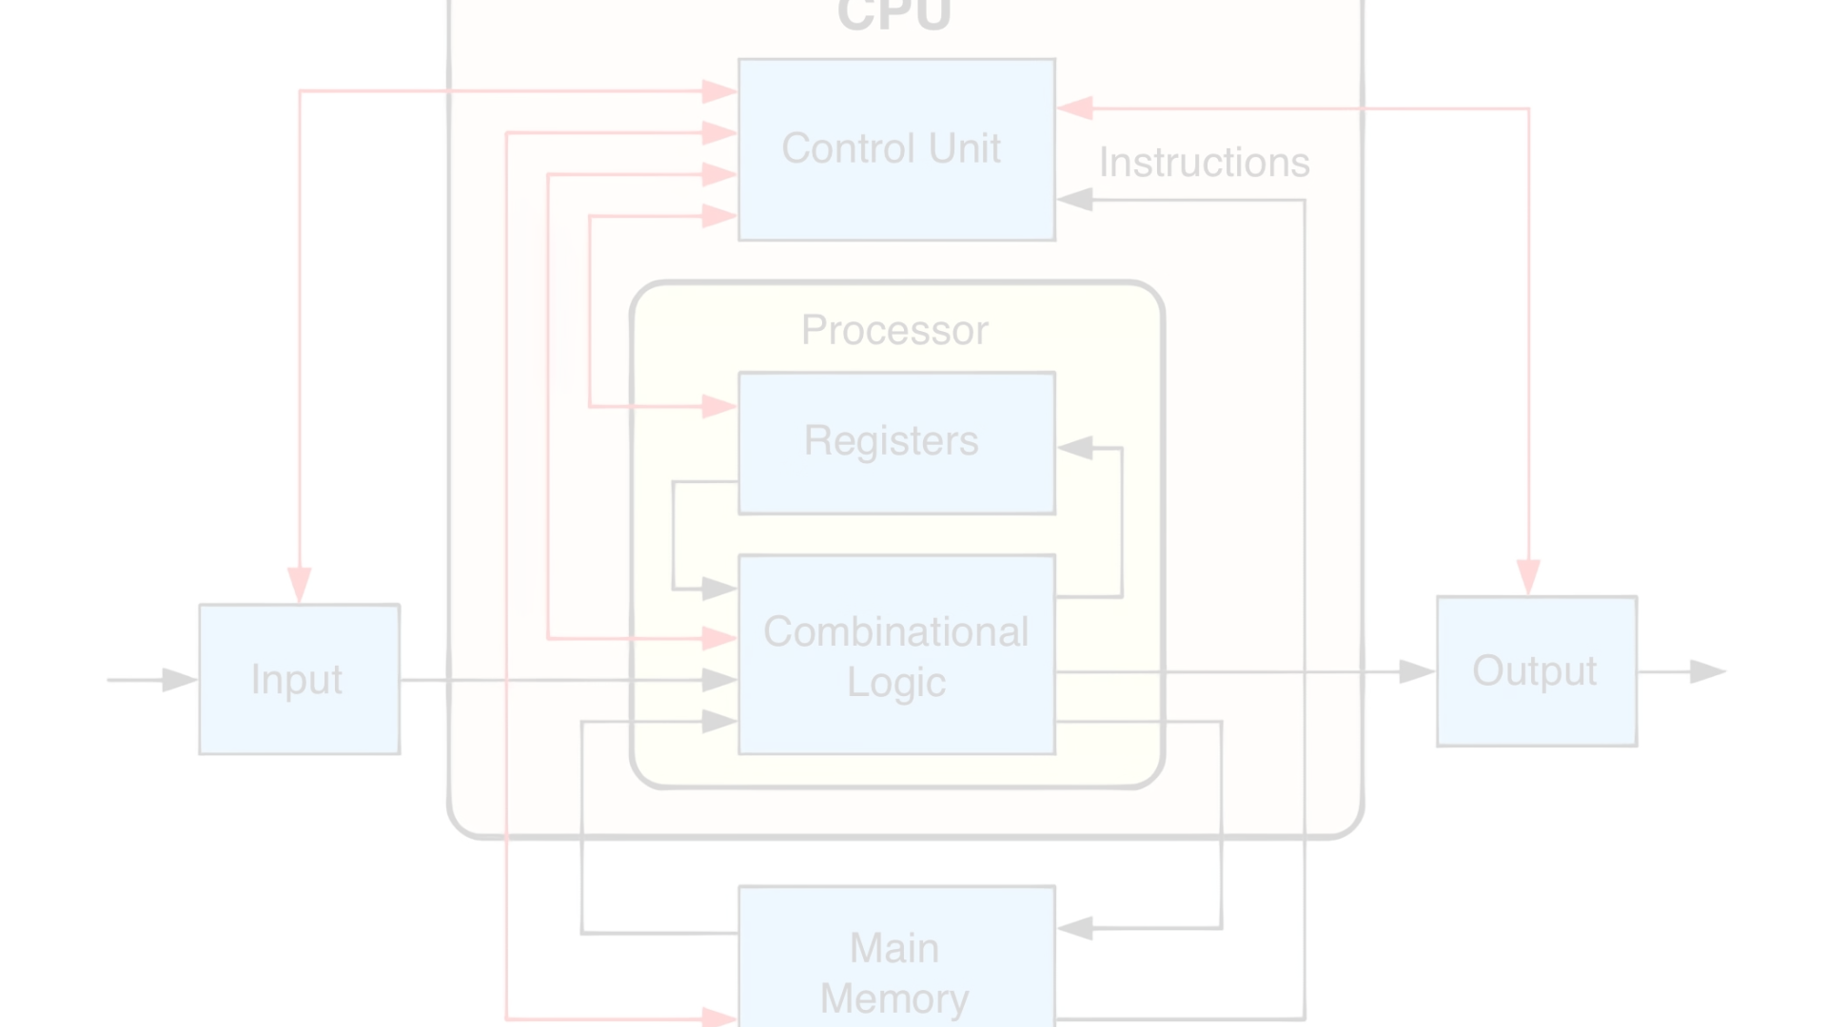



Central Processing Unit (CPU)
Fetch
Decode
Execute
The CPU fetches instructions from memory.
The CPU decodes the instructions to determine what operations to perform.
The CPU executes the instructions, performing calculations and manipulating data.

Slide 7
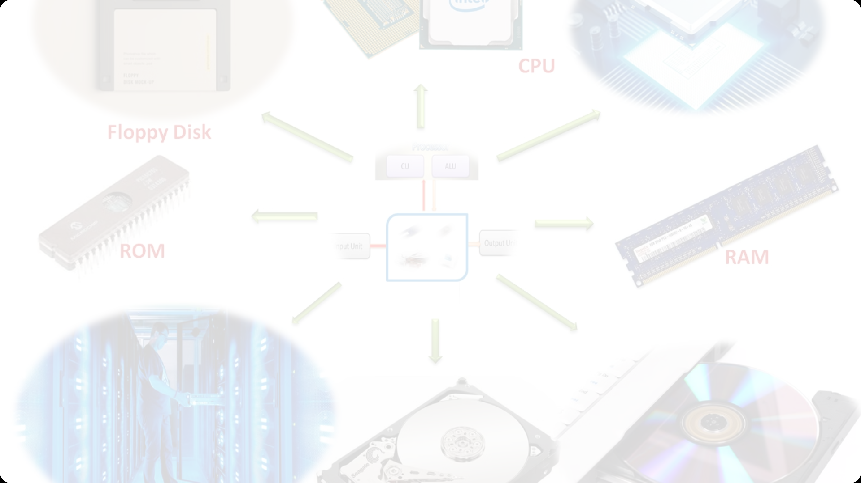
Memory and Storage
Random Access Memory (RAM)
Read-Only Memory (ROM)
Storage Devices
Hard disk drives, solid-state drives, and optical discs provide long-term storage for files, programs, and data.
Volatile memory that stores data and instructions for immediate use by the CPU.
Non-volatile memory that stores the computer's basic input/output system (BIOS) and firmware.

Slide 8
Applications of Digital Computers
Entertainment
Gaming, media playback, and streaming
Communication
Email, video conferencing, and social media
Productivity
Word processing, spreadsheets, and presentation software
Scientific Research
Data analysis, simulations, and complex calculations

