Slide 1

Introduction to Fixed-point Representation
Fixed-point representation is a way to store and manipulate numerical values in digital systems using a finite number of bits. It provides a balance between precision and memory usage, making it useful in embedded systems and digital signal processing applications.
Presented by
K.VENKATESH
MCA DEPARTMENT

Slide 2
Advantages and Disadvantages of Fixed-point
Advantages
Disadvantages
Efficient memory usage, simple arithmetic operations, and deterministic behavior.
Limited dynamic range and potential for overflow/underflow errors.

Slide 3
Representation of Integers in Fixed-point
Signed Integers
Unsigned Integers
Use two's complement representation to store positive and negative integers.
Represent only non-negative integers using a simple binary encoding.

Slide 4
Representation of Fractions in Fixed-point
1
Fractional Part
2
Scaling
Represent the decimal portion using a fixed number of bits after the binary point.
Adjust the binary point position to control the range and precision of fractional values.

Slide 5
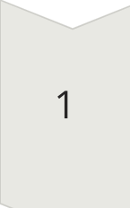

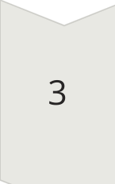
Arithmetic Operations in Fixed-point
Addition/Subtraction
Align the binary points before performing the operation.
Multiplication
Shift the binary point position to maintain the correct scale.
Division
Shift the binary point position to achieve the desired result.

Slide 6


Scaling and Normalization in Fixed-point
Scaling
Normalization
Adjust the binary point position to control the range and precision.
Shift the binary point to maintain the most significant bits.

Slide 7
Applications of Fixed-point Representation
Digital Signal Processing
Embedded Systems
Image and Video Processing
Motor Control
Financial Calculations
Scientific Computing

Slide 8

Conclusion and Future Considerations
Fixed-point representation remains an important tool in modern computing, balancing efficiency and precision. As computational demands continue to grow, advancements in fixed-point algorithms and hardware can further expand its applications in emerging technologies.

