Slide 1
DNR COLLEGE, PG COURSES
BHIMAVARAM
DESIGN AND ANALYSYS OF ALGORITHMS
Class : MCA I-Semester
Faculty: V.SARALA

Slide 2
UNIT-II

Slide 3
Divide and Conquer
In divide and conquer approach, a problem is divided into smaller problems, then the smaller problems are solved independently, and finally the solutions of smaller problems are combined into a solution for the large problem.
Generally, divide-and-conquer algorithms have three parts −
1. Divide the problem into a number of sub-problems that
are smaller instances of the same problem.
2. Conquer the sub-problems by solving them recursively.
If they are small enough, solve the sub-problems as base cases.
3. Combine the solutions to the sub-problems into the solution for
the original problem.

Slide 4
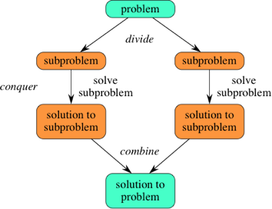
Fig: Divide and Conquer

Slide 5
Merge Sort
Merge sort is a divide-and-conquer algorithm based on the idea of breaking down a list into several sub-lists until each sublist consists of a single element and merging those sublists in a manner that results into a sorted list.
Idea:
Divide the unsorted list into N sublists, each containing element.
Take adjacent pairs of two singleton lists and merge them to form a list of 2 elements. N will now convert into N/2 lists of size 2.
Repeat the process till a single sorted list of obtained.
Time Complexity is O(n log n).

Slide 6
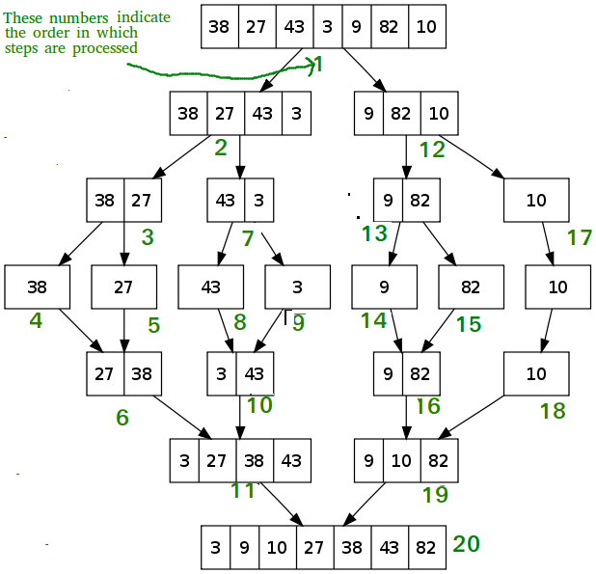
An example array {38, 27, 43, 3, 9, 82, 10}

Slide 7
In this algorithm, the numbers are stored in an array numbers[]. Here, p and q represents the start and end index of a sub-array.
Algorithm:
Merge-Sort (numbers[], p, r)
if p < r then
q = ⌊(p + r) / 2⌋
Merge-Sort (numbers[], p, q)
Merge-Sort (numbers[], q + 1, r)
Merge (numbers[], p, q, r)

Slide 8
Function:
Merge (numbers[], p, q, r)
n1 = q – p + 1
n2 = r – q
declare leftnums[1…n1 + 1] and rightnums[1…n2 + 1] temporary arrays
for i = 1 to n1
leftnums[i] = numbers[p + i - 1]
for j = 1 to n2
rightnums[j] = numbers[q+ j]
leftnums[n1 + 1] = ∞
rightnums[n2 + 1] = ∞
i = 1
j = 1
for k = p to r
if leftnums[i] ≤ rightnums[j]
numbers[k] = leftnums[i]
i = i + 1
else
numbers[k] = rightnums[j]
j = j + 1

Slide 9
Quick Sort
The quick sort uses divide and conquer to gain the same advantages as the merge sort. Quicksort is the opposite: all the real work happens in the divide step. In fact, the combine step in quicksort does absolutely nothing.
Quicksort has a couple of other differences from merge sort. Quicksort works in place. And its worst-case running time is as bad as selection sort's and insertion sort's: Θ(n²). But its average-case running time is as good as merge sort's: Θ(n log₂ n).

Slide 10
Quick sort works by partitioning a given array A[p ... r] into two non-empty sub array A[p ... q] and A[q+1 ... r] such that every key in A[p ... q] is less than or equal to every key in A[q+1 ... r].
Algorithm:
Quick-Sort (A, p, r)
if p < r then
q Partition (A, p, r)
Quick-Sort (A, p, q)
Quick-Sort (A, q + r, r)

Slide 11
Partitioning procedure rearranges the sub-arrays in-place.
Function: Partition (A, p, r)
x ← A[p]
i ← p-1
j ← r+1
while TRUE do
Repeat j ← j - 1
until A[j] ≤ x
Repeat i← i+1
until A[i] ≥ x
if i < j then
exchange A[i] ↔ A[j]
else
return j

Slide 12
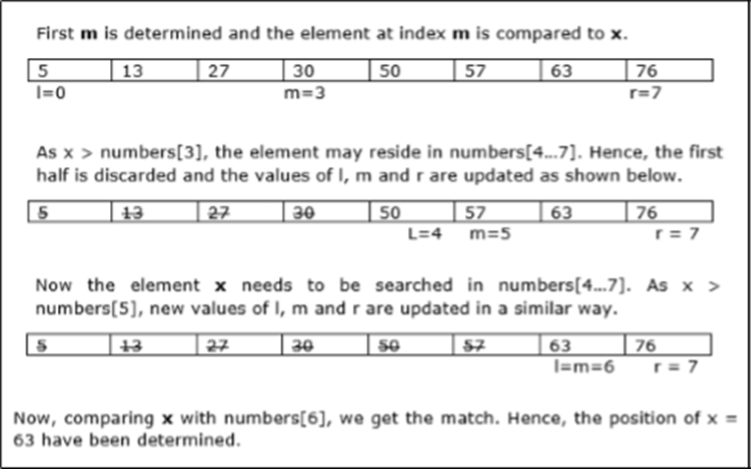
Binary Search
Binary search can be performed on a sorted array. In this approach, the index of an element x is determined if the element belongs to the list of elements. Binary search uses O(log n) time.
In this example, we are going to search element 63.

Slide 13
In this algorithm, we want to find whether element x belongs to a set of numbers stored in an array numbers[]. Where l and r represent the left and right index of a sub-array in which searching operation should be performed.
Algorithm: Binary-Search(numbers[], x, l, r)
if l = r then
return l
else
m := ⌊(l + r) / 2⌋
if x ≤ numbers[m] then
return Binary-Search(numbers[], x, l, m)
else
return Binary-Search(numbers[], x, m+1, r)

Slide 14
Binary Tree Traversals
Traversal is a process to visit all the nodes of a tree and may print their values too. Because, all nodes are connected via edges (links) we always start from the root (head) node. That is, we cannot randomly access a node in a tree. There are three ways which we use to traverse a tree −
In-order Traversal
Pre-order Traversal
Post-order Traversal

Slide 15
In-order Traversal
In this traversal method, the left subtree is visited first, then the root and later the right sub-tree. We should always remember that every node may represent a subtree itself.
If a binary tree is traversed in-order, the output will produce sorted key values in an ascending order.
Algorithm
Until all nodes are traversed −
Step 1 − Recursively traverse left subtree.
Step 2 − Visit root node.
Step 3 − Recursively traverse right subtree.

Slide 16
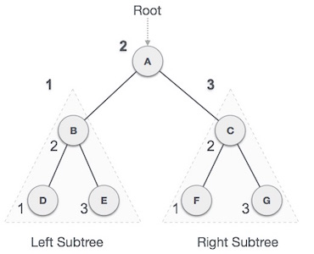
We start from A, and following in-order traversal, we move to its left subtree B. B is also traversed in-order. The process goes on until all the nodes are visited. The output of inorder traversal of this tree will be −
D → B → E → A → F → C → G

Slide 17
Pre-order Traversal
In this traversal method, the root node is visited first, then the left subtree and finally the right subtree.
Algorithm
Until all nodes are traversed −
Step 1 − Visit root node.
Step 2 − Recursively traverse left subtree.
Step 3 − Recursively traverse right subtree.

Slide 18
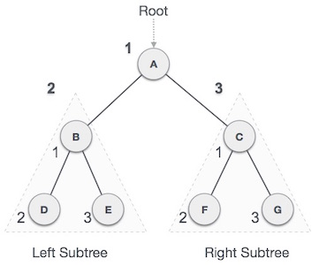
We start from A, and following pre-order traversal, we first visit A itself and then move to its left subtree B. B is also traversed pre-order. The process goes on until all the nodes are visited. The output of pre-order traversal of this tree will be −
A → B → D → E → C → F → G

Slide 19
Post-order Traversal
In this traversal method, the root node is visited last, hence the name. First we traverse the left subtree, then the right subtree and finally the root node.
Algorithm
Until all nodes are traversed −
Step 1 − Recursively traverse left subtree.
Step 2 − Recursively traverse right subtree.
Step 3 − Visit root node.

Slide 20
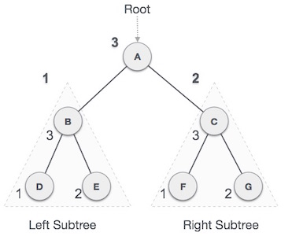
We start from A, and following Post-order traversal, we first visit the left subtree B. B is also traversed post-order. The process goes on until all the nodes are visited. The output of post-order traversal of this tree will be −
D → E → B → F → G → C → A

Slide 21
Decrease and Conquer
Decrease and Conquer algorithm make the problem smaller by reducing problem at each step. They can reduce the problem by
constant amount
constant factor
variable factor
Insertion Sort
Insertion sort is a decrease by 1 algorithm. Because it only decreases by one, we should not expect it to be more efficient than linear.
We scan the array from the sorted part of the array, going from right to left, until we find the element smaller or equal to A[i] and insert A[i] right after that element.

Slide 22
Algorithm InsertionSort(A[0...n-1])
for i ← to n-1 do // move the unsorted portion
v ← A[i] // value to sort
j ← i-1 // end of the sorted array
while j ≥ 0 and A[j] > v do // scan the sorted part of the array
for the insertion point
A[j+1] ← A[j] // shift the sort array to make room for the
insertion
j--
A[j+1] ← v // insert

Slide 23
Depth-First Search
The algorithm recursively visit adjacent vertices as deep as possible until it cannot find a new vertex to visit and then back ups.
An algorithm for a graph that might not be connected and number the vertices.
Algorithm DFS(G)
count ← 0
for each vertex v in V do
if v is marked 0 do
dfs(v)
Algorithm dfs(v)
count++
for each vertex w adjacent to v do
if w adjacent to v is marked 0 then dfs(w) // not visited yet

Slide 24
Breath-First Search
Breadth-first search visit the adjacent vertices before going one level deeper.
Algorithm BFS(G)
count ← 0
for each vertex v in V do
if v is marked 0 do
bfs(v)
Algorithm bfs(v)
count++
mark v with count
add v to queue
while queue is not empty do
for each vertex w adjacent to front of queue do
if w is marked 0 then // not visited
count++
add w to queue
remove front from queue

Slide 25
Topological Sort
Topological sort is an ordering of the vertices that is not contrary to the dependencies. In other words, if you were to perform one job at a time, a topological sort is one order that you could perform the jobs.
There must be a source vertex, the vertex with no dependencies, i.e. in-degree is zero.
The algorithm uses an incounter initially equal to the in-degree of the vertices. When incounter goes to zero for a vertex it is placed on the list for the topological sort and all dependent adjacent vertices' incounter is reduced by one.
Basically, the algorithm reduces the size of the graph by one each time a source is removed.

Slide 26
Algorithm TopoSource(G(V, E))
make empty Container of vertices, C
make empty List of vertices, S
for each vertex v in V do
incounter(v) ← in-deg(v)
if incounter(v) == 0 then C.add(v)
while C is not empty do
u ← C.remove()
S.add(u)
for each edge (u, w) do // edge is out from u to w
incounter(w) ← incounter(w)-1
if incounter(w) == 0 then C.add(w)
if L.size() == V.size() then return S
else return "G has a cycle"

Slide 27
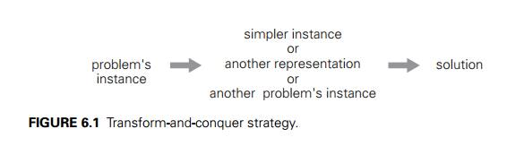
Transform and Conquer
Transform-and-conquer because these methods work as two-stage procedures. First, in the transformation stage, the problem’s instance is modified to be, for one reason or another, more amenable to solution. Then, in the second or conquering stage, it is solved. There are three major variations of this idea that differ by what we transform a given instance to (Figure 6.1):

Slide 28
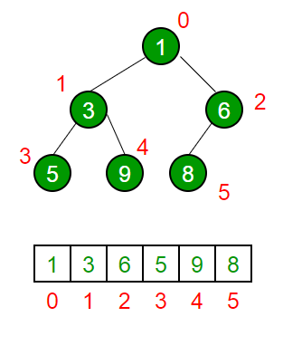
Heaps and Heap Sort
Heap
A heap is a binary tree of T that satisfies two properties:
– Global shape property: it is a complete binary tree
– Local ordering property: the label in each node is “smaller
than or equal to” the label in each of its child nodes

Slide 29
Heap Sort
Heaps can be used in sorting an array. In max-heaps, maximum element will always be at the root. Heap Sort uses this property of heap to sort the array.
Consider an array which is to be sorted using Heap Sort.
Initially build a max heap of elements in Arr .
The root element, that is Arr[1] , will contain maximum element of Arr. After that, swap this element with the last element of Arr and heapify the max heap excluding the last element which is already in its correct position and then decrease the length of heap by one.
Repeat the step 2, until all the elements are in their correct position.

Slide 30
void heap_sort(int Arr[ ])
{
int heap_size = N;
build_maxheap(Arr);
for(int i = N; i >= 2 ; i-- )
{
swap|(Arr[ 1 ], Arr[ i ]);
heap_size = heap_size - 1;
max_heapify(Arr, 1, heap_size);
}
}
Complexity:
max_heapify has complexity O(log N), build_maxheap has complexity O(N) and we run max_heapify N-1 times in heap_sort function, therefore complexity of heap_sort function is O(N log N).

Slide 31
Problem Reduction
Problem Reduction: Definition
To solve an instance of problem A:
1. Transform the instance of problem A into an instance of
problem B
2. Solve the instance of problem B
3. Transform the solution to problem B into a solution of
problem A
We say that problem A reduces to problem B

Slide 32
Example
Finding the Least Common Multiple (LCM) of 2 integers
Example: LCM(24, 36) = 72
Solution technique: reduce LCM to Greatest Common Divisor (GCD):
Instance of Problem A: LCM(24, 36)
Instance of Problem B: GCD(24, 36)
Solution of B: GCD(24, 36) = 12 (by Euclid's algorithm)
Transform solution of B into solution of A:
LCM(24, 36) = 24*36 / GCD(24, 36) = 24*36 / 12 = 72

Slide 33
Thank You

