Slide 1
DNR COLLEGE, PG COURSES
BHIMAVARAM
DESIGN AND ANALYSYS OF ALGORITHMS
Class : MCA I-Semester
Faculty: V.SARALA

Slide 2
UNIT-III

Slide 3
Space and Time Tradeoffs
Sorting by Counting
Counting Sort Algorithm is an efficient sorting algorithm that can be used for sorting elements within a specific range. This sorting technique is based on the frequency/count of each element to be sorted and works using the following algorithm-
Input: Unsorted array A[] of n elements
Output: Sorted arrayB[]
Step 1: Consider an input array A having n elements in the range of 0 to k, where n and k are positive integer numbers. These n elements have to be sorted in ascending order using the counting sort technique. Also note that A[] can have distinct or duplicate elements
Step 2: The count/frequency of each distinct element in A is computed and stored in another array, say count, of size k+1. Let u be an element in A such that its frequency is stored at count[u].

Slide 4
Step 3: Update the count array so that element at each index, say i, is equal to –
count[i]= ∑ count[u] where 0<=u<=i
Step 4: The updated count array gives the index of each element of array A in the sorted sequence. Assume that the sorted sequence is stored in an output array, say B, of size n.
Step 5: Add each element from input array A to B as follows:
a. Set i=0 and t = A[i]
b. Add t to B[v] such that v = (count[t]-1).
c. Decrement count[t] by 1
d. Increment i by 1
Repeat steps (a) to (d) till i = n-1
Step 6: Display B since this is the sorted array

Slide 5
Time Complexity Analysis
For scanning the input array elements, the loop iterates n times, thus taking O(n) running time. The sorted array B[] also gets computed in n iterations, thus requiring O(n) running time. The count array also uses k iterations, thus has a running time of O(k). Thus the total running time for counting sort algorithm is O(n+k).

Slide 6
Key Points:
The above implementation of Counting Sort can also be extended to sort negative input numbers
Since counting sort is suitable for sorting numbers that belong to a well-defined, finite and small range, it can be used asa subprogram in other sorting algorithms like radix sort which can be used for sorting numbers having a large range
Counting Sort algorithm is efficient if the range of input data (k) is not much greater than the number of elements in the input array (n). It will not work if we have 5 elements to sort in the range of 0 to 10,000

Slide 7
Advantages of Counting Sort:
It is quite fast
It is a stable algorithm
Disadvantages of Counting Sort:
It is not suitable for sorting large data sets
It is not suitable for sorting string values

Slide 8
Hashing
Hashing is the process of mapping large amount of data item to smaller table with the help of hashing function.
Hashing is also known as Hashing Algorithm or Message Digest Function.
It is a technique to convert a range of key values into a range of indexes of an array.
It is used to facilitate the next level searching method when compared with the linear or binary search.
Hashing allows to update and retrieve any data entry in a constant time O(1).
Constant time O(1) means the operation does not depend on the size of the data.
Hashing is used with a database to enable items to be retrieved more quickly.
It is used in the encryption and decryption of digital signatures.

Slide 9
Hash Function
A fixed process converts a key to a hash key is known as a Hash Function.
This function takes a key and maps it to a value of a certain length which is called a Hash value or Hash.
Hash value represents the original string of characters, but it is normally smaller than the original.
It transfers the digital signature and then both hash value and signature are sent to the receiver. Receiver uses the same hash function to generate the hash value and then compares it to that received with the message.
If the hash values are same, the message is transmitted without errors.

Slide 10
Hash Table
Hash table or hash map is a data structure used to store key-value pairs.
It is a collection of items stored to make it easy to find them later.
It uses a hash function to compute an index into an array of buckets or slots from which the desired value can be found.
It is an array of list where each list is known as bucket.
It contains value based on the key.
Hash table is used to implement the map interface and extends Dictionary class.
Hash table is synchronized and contains only unique elements.
As we know the mapping between an item and the slot where item belongs in the hash table is called the hash function.

Slide 11
B-Trees
B-tree is a self-balancing tree data structure that maintains sorted data and allows searches, sequential access, insertions, and deletions in logarithmic time. The B-tree generalizes the binary search tree, allowing for nodes with more than two children. Unlike other self-balancing binary search trees, the B-tree is well suited for storage systems that read and write relatively large blocks of data, such as discs.
B-trees differ significantly from red-black trees in that B-tree nodes may have many children, from a handful to thousands. B-trees are similar to red-black trees in that every n-node B-tree has height O(lg n), although the height of a B-tree can be considerably less than that of a red-black tree because its branching factor can be much larger. Therefore, B-trees can also be used to implement many dynamic-set operations in time O(lg n).

Slide 12
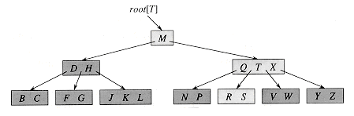
Figure: A B-tree whose keys are the consonants of English. An internal node x containing n[x] keys has n[x] + 1 children. All leaves are at the same depth in the tree. The lightly shaded nodes are examined in a search for the letter R.

Slide 13
Dynamic Programming
Warshall’s and Floyd’s Algorithm
Floyd-Warshall Algorithm is an algorithm for finding the shortest path between all the pairs of vertices in a weighted graph. This algorithm works for both the directed and undirected weighted graphs. But, it does not work for the graphs with negative cycles (where the sum of the edges in a cycle is negative).
Floyd-Warhshall algorithm is also called as Floyd's algorithm, Roy-Floyd algorithm, Roy-Warshall algorithm, or WFI algorithm.
This algorithm follows the dynamic programming approach to find the shortest paths.

Slide 14
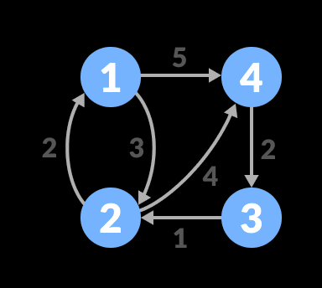
Floyd-Warshall Algorithm
n = no of vertices
A = matrix of dimension n*n
for k = 1 to n
for i = 1 to n
for j = 1 to n A^{k}[i, j] = min (A^{k-1}[i, j], A^{k-1}[i, k] + A^{k-1}[k, j]) return A
Let the given graph be:

Slide 15
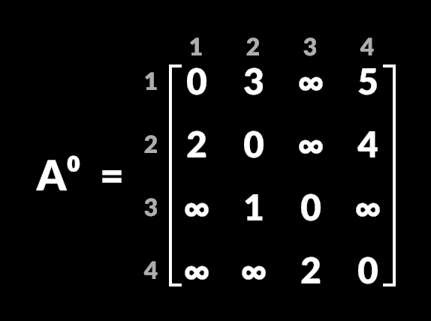
Follow the steps below to find the shortest path between all the pairs of vertices.
Create a matrix A¹ of dimension n*n where n is the number of vertices. The row and the column are indexed as i and j respectively. i and j are the vertices of the graph.
Each cell A[i][j] is filled with the distance from the i^{th} vertex to the j^{th} vertex. If there is no path from i^{th} vertex to j^{th} vertex, the cell is left as infinity.

Slide 16
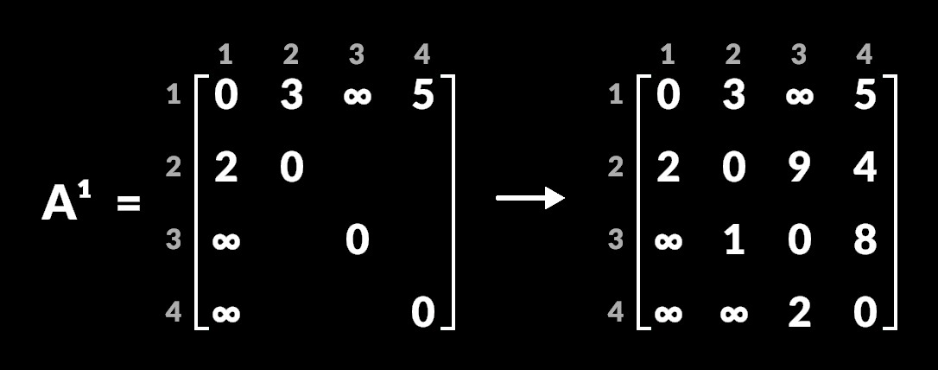
2. Now, create a matrix A¹ using matrix A⁰. The elements in the first column and the first row are left as they are. The remaining cells are filled in the following way.
Let k be the intermediate vertex in the shortest path from source to destination. In this step, k is the first vertex. A[i][j] is filled with (A[i][k] + A[k][j]) if (A[i][j] > A[i][k] + A[k][j]).
That is, if the direct distance from the source to the destination is greater than the path through the vertex k, then the cell is filled with A[i][k] + A[k][j].
In this step, k is vertex 1. We calculate the distance from source vertex to destination vertex through this vertex k.

Slide 17
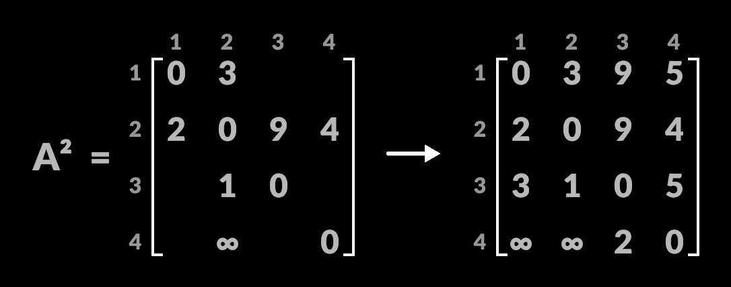
3. Similarly, A² is created using A³. The elements in the second column and the second row are left as they are.
In this step, k is the second vertex (i.e. vertex 2). The remaining steps are the same as in step 2.

Slide 18
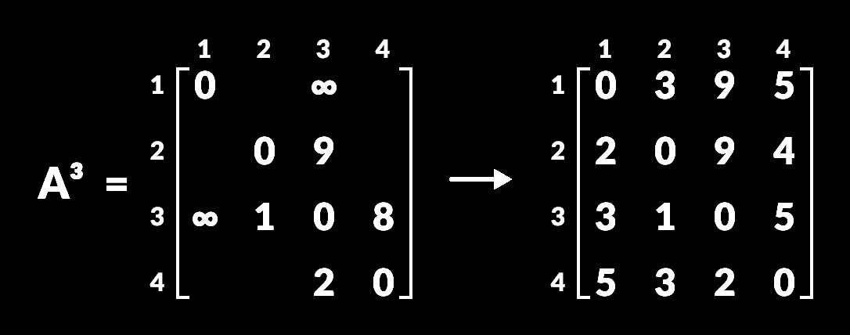
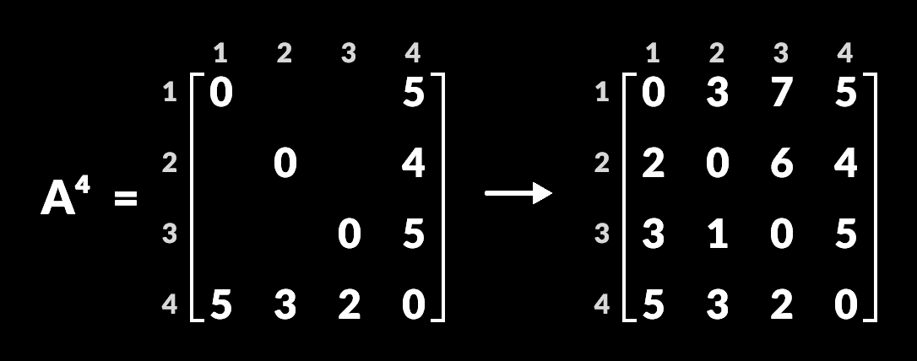
Similarly, A³ and A⁴ is also created.
A⁴ gives the shortest path between each pair of vertices.

Slide 19
Optimal Binary Search Trees
An optimal binary search tree (Optimal BST), sometimes called a weight-balanced binary tree, is a binary search tree which provides the smallest possible search time (or expected search time) for a given sequence of accesses (or access probabilities). Optimal BSTs are generally divided into two types: static and dynamic.
In the static optimality problem, the tree cannot be modified after it has been constructed. In this case, there exists some particular layout of the nodes of the tree which provides the smallest expected search time for the given access probabilities. Various algorithms exist to construct or approximate the statically optimal tree given the information on the access probabilities of the elements.

Slide 20
In the dynamic optimality problem, the tree can be modified at any time, typically by permitting tree rotations. The tree is considered to have a cursor starting at the root which it can move or use to perform modifications. In this case, there exists some minimal-cost sequence of these operations which causes the cursor to visit every node in the target access sequence in order. The splay tree is conjectured to have a constant competitive ratio compared to the dynamically optimal tree in all cases, though this has not yet been proven.

Slide 21
A binary search tree is a tree with data (keys) at internal nodes with the following property :
The key at any internal node is greater than all keys in the left hand subtree and less than all keys in the right hand subtree.
Example Tree 1 (where A<B<C<D<E<F<G<H) :
For a given set of keys (and ordering) we can find many possible binary search trees.
Example Tree 2 (where A<B<C<D<E<F<G<H) :
Example Tree 3 (where A<B<C<D<E<F<G<H) :
To search for a given key in a tree, we can use the following useful search technique:
datatype INTREE = EMPTY
| Node of (INTREE * int * INTREE)
fun IsInTree (k,Empty) = false
| IsInTree (k,Node(left,entry,right)) =
(k=entry) orelse
if (k<entry) then
IsInTree (k,left)
else (* k>entry *)

Slide 22
The Knapsack Problem and Memory Functions
Dynamic programming algorithm for the knapsack problem: given n items of known weights w₁, . . . , w_{n} and values v₁, . . . , v_{n} and a knapsack of capacity W , find the most valuable subset of the items that fit into the knapsack. We assume here that all the weights and the knapsack capacity are positive integers; the item values do not have to be integers.
To design a dynamic programming algorithm, we need to derive a recurrence relation that expresses a solution to an instance of the knapsack problem in terms of solutions to its smaller subinstances. Let us consider an instance defined by the first i items, 1 ≤ i ≤ n, with weights w₁, . . . , w_{i}, values v₁, . . . , v_{i}, and knapsack capacity j, 1 ≤ j ≤ W. Let F (i, j ) be the value of an optimal solution to this instance, i.e., the value of the most valuable subset of the first i items that fit into the knapsack of capacity j. We can divide all the subsets of the first i items that fit the knapsack of capacity j into two categories: those that do not include the ith item and those that do. Note the following:

Slide 23
Among the subsets that do not include the ith item, the value of an optimal subset is, by definition, F (i − 1, j ).
Among the subsets that do include the ith item (hence, j − w_{i} ≥ 0), an optimal subset is made up of this item and an optimal subset of the first i − 1 items that fits into the knapsack of capacity j − w_{i}. The value of such an optimal subset is v_{i} + F (i − 1, j − w_{i}).
Thus, the value of an optimal solution among all feasible subsets of the first i items is the maximum of these two values. Of course, if the ith item does not fit into the knapsack, the value of an optimal subset selected from the first i items is the same as the value of an optimal subset selected from the first i − 1 items. These observations lead to the following recurrence:
F(i,j)= {max{F(i-1,j),vi+F(i-1,j-wi)} if j-wi>=0,
{F(i-1,j) if j-wi<0.
Our goal is to find F (n, W ), the maximal value of a subset of the n given items that fit into the knapsack of capacity W, and an optimal subset itself.

Slide 24
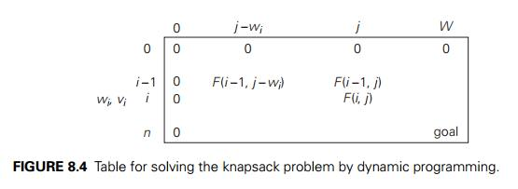
For i, j > 0, to compute the entry in the ith row and the j th column, F (i, j ), we compute the maximum of the entry in the previous row and the same column and the sum of v_{i} and the entry in the previous row and w_{i} columns to the left. The table can be filled either row by row or column by column.

Slide 25
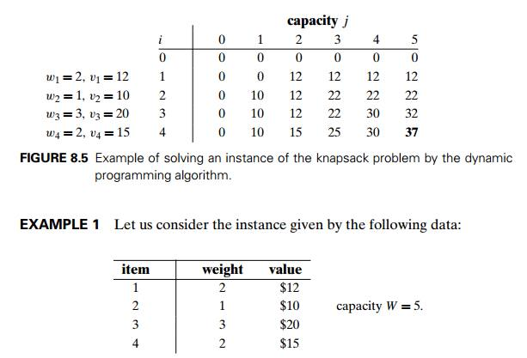

Slide 26
Thus, the maximal value is F (4, 5) = $37. We can find the composition of an optimal subset by backtracing the computations of this entry in the table. Since F (4, 5) > F (3, 5), item 4 has to be included in an optimal solution along with an optimal subset for filling 5 − 2 = 3 remaining units of the knapsack capacity. The value of the latter is F (3, 3). Since F (3, 3) = F (2, 3), item 3 need not be in an optimal subset. Since F (2, 3) > F (1, 3), item 2 is a part of an optimal selection, which leaves element F (1, 3 − 1) to specify its remaining composition. Similarly, since F (1, 2) > F (0, 2), item 1 is the final part of the optimal solution {item 1, item 2, item 4}.
The time efficiency and space efficiency of this algorithm are both in (nW ). The time needed to find the composition of an optimal solution is in O(n). You are asked to prove these assertions in the exercises.

Slide 27
Greedy Technique
Prim’s Algorithm
Prim's algorithm to find minimum cost spanning tree (as Kruskal's algorithm) uses the greedy approach. Prim's algorithm shares a similarity with the shortest path first algorithms.
Prim's algorithm, in contrast with Kruskal's algorithm, treats the nodes as a single tree and keeps on adding new nodes to the spanning tree from the given graph.
To contrast with Kruskal's algorithm and to understand Prim's algorithm better, we shall use the same example −

Slide 28
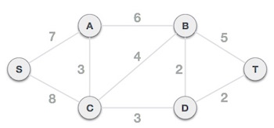
Step 1 - Choose any arbitrary node as root node
In this case, we choose S node as the root node of Prim's spanning tree. This node is arbitrarily chosen, so any node can be the root node. One may wonder why any video can be a root node. So the answer is, in the spanning tree all the nodes of a graph are included and because it is connected then there must be at least one edge, which will join it to the rest of the tree.

Slide 29
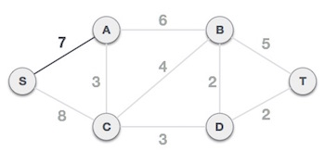
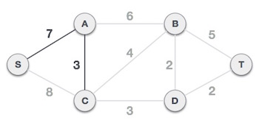
Step 2 - Check outgoing edges and select the one with less cost
After choosing the root node S, we see that S,A and S,C are two edges with weight 7 and 8, respectively. We choose the edge S,A as it is lesser than the other.
Now, the tree S-7-A is treated as one node and we check for all edges going out from it. We select the one which has the lowest cost and include it in the tree.

Slide 30
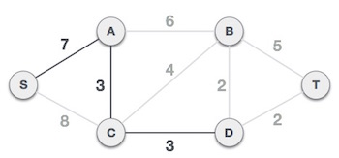
After this step, S-7-A-3-C tree is formed. Now we'll again treat it as a node and will check all the edges again. However, we will choose only the least cost edge. In this case, C-3-D is the new edge, which is less than other edges' cost 8, 6, 4, etc.
After adding node D to the spanning tree, we now have two edges going out of it having the same cost, i.e. D-2-T and D-2-B. Thus, we can add either one. But the next step will again yield edge 2 as the least cost. Hence, we are showing a spanning tree with both edges included.

Slide 31
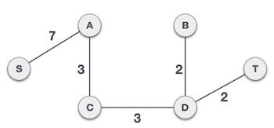
We may find that the output spanning tree of the same graph using two different algorithms is same.
A spanning tree is a subset of Graph G, which has all the vertices covered with minimum possible number of edges. Hence, a spanning tree does not have cycles and it cannot be disconnected..

Slide 32
Kruskal’s Algorithm
Kruskal's algorithm to find the minimum cost spanning tree uses the greedy approach. This algorithm treats the graph as a forest and every node it has as an individual tree. A tree connects to another only and only if, it has the least cost among all available options and does not violate MST properties.
To understand Kruskal's algorithm let us consider the following example −

Slide 33

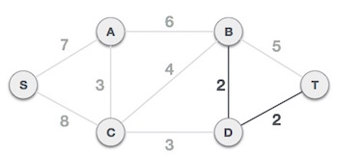
Step 1 - Arrange all edges in their increasing order of weight
The next step is to create a set of edges and weight, and arrange them in an ascending order of weightage (cost).
Step 2 - Add the edge which has the least weightage
Now we start adding edges to the graph beginning from the one which has the least weight. Throughout, we shall keep checking that the spanning properties remain intact. In case, by adding one edge, the spanning tree property does not hold then we shall consider not to include the edge in the graph.

Slide 34
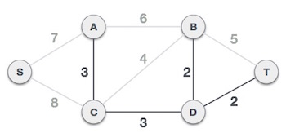
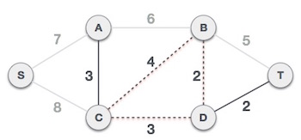
The least cost is 2 and edges involved are B,D and D,T. We add them. Adding them does not violate spanning tree properties, so we continue to our next edge selection.
Next cost is 3, and associated edges are A,C and C,D. We add them again −
Next cost in the table is 4, and we observe that adding it will create a circuit in the graph. −

Slide 35
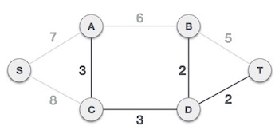
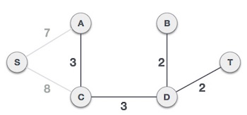
We ignore it. In the process we shall ignore/avoid all edges that create a circuit.
We observe that edges with cost 5 and 6 also create circuits. We ignore them and move on.

Slide 36
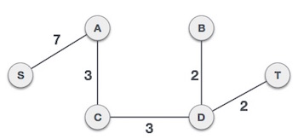
Now we are left with only one node to be added. Between the two least cost edges available 7 and 8, we shall add the edge with cost 7.
By adding edge S,A we have included all the nodes of the graph and we now have minimum cost spanning tree.

Slide 37
Huffman Trees
Definition
Huffman coding provides codes to characters such that the length of the code depends on the relative frequency or weight of the corresponding character. Huffman codes are of variable-length, and without any prefix (that means no code is a prefix of any other). Any prefix-free binary code can be displayed or visualized as a binary tree with the encoded characters stored at the leaves.
Huffman tree or Huffman coding tree defines as a full binary tree in which each leaf of the tree corresponds to a letter in the given alphabet.
The Huffman tree is treated as the binary tree associated with minimum external path weight that means, the one associated with the minimum sum of weighted path lengths for the given set of leaves. So the goal is to construct a tree with the minimum external path weight.

Slide 38
An example is given below-
Letter frequency table
Letter z k m c u d l e
Frequency 2 7 24 32 37 42 42 120
Huffman code
Letter Freq Code Bits
e 120 0 1
d 42 101 3
l 42 110 3
u 37 100 3
c 32 1110 4
m 24 11111 5
k 7 111101 6
z 2 111100 6

Slide 39
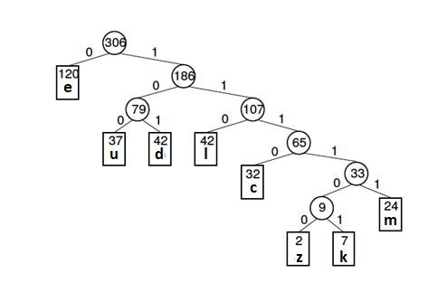
The Huffman tree (for the above example) is given below -

Slide 40
End of UNIT-III
Thank You

