Slide 1
DNR COLLEGE, PG COURSES
BHIMAVARAM
DESIGN AND ANALYSYS OF ALGORITHMS
Class : MCA I-Semester
Faculty: V.SARALA

Slide 2
UNIT-IV

Slide 3
Limitations of Algorithm Power
Lower-Bound Arguments
Lower Bounds
We will first look at lower bounds, which estimate the minimum amount of work needed to solve a given problem. Once we have established a lower bound, we know that no algorithm can exist without performing work equivalent to at least that of the upper bound.
Some examples:
• the number of comparisons needed to find the largest element in a set of n numbers
• number of comparisons needed to sort an array of size n
• number of comparisons necessary for searching in a sorted array of n numbers
• the number of comparisons needed to determine if all elements of an array of n elements are unique
• number of multiplications needed to multiply two n × n matrices

Slide 4
Some lower bound examples:
• sorting: lower bound Ω(n log n), tight
• searching in a sorted array: lower bound Ω(log n), tight
• determine element uniqueness: lower bound Ω(n log n), tight
• n-digit integer multiplication: lower bound Ω(n), tightness unknown
• multiplication of n × n matrices: lower bound Ω(n 2 ), tightness unknown
There are a number of methods that can be used to establish lower bounds:
• trivial lower bounds
• information-theoretic arguments (decision trees)
• adversary arguments
• problem reduction

Slide 5
Trivial Lower Bounds
Trivial lower bounds are based on counting the number of items that must be processed in input and generated as output to solve a problem.
Information-Theoretic Arguments
Rather than the number of inputs or outputs to process, an information-theoretic lower bound is based on the amount of information an algorithm needs to produce to achieve its solution.
Adversary Arguments
The adversary argument. This method depends on a “adversary” that makes the algorithm work the hardest by adjusting the input.
Problem Reduction
A key idea in the analysis of algorithms is problem reduction. If we can come up with a way to convert a problem we wish to solve to an instance of a different problem to which we already have a solution, this produces a solution to the original problem.

Slide 6
Decision Trees
Decision Tree : Decision tree is the most powerful and popular tool for classification and prediction. A Decision tree is a flowchart like tree structure, where each internal node denotes a test on an attribute, each branch represents an outcome of the test, and each leaf node (terminal node) holds a class label.
Decision Tree Representation :
Decision trees classify instances by sorting them down the tree from the root to some leaf node, which provides the classification of the instance. An instance is classified by starting at the root node of the tree, testing the attribute specified by this node, then moving down the tree branch corresponding to the value of the attribute as shown in the figure. This process is then repeated for the subtree rooted at the new node.

Slide 7
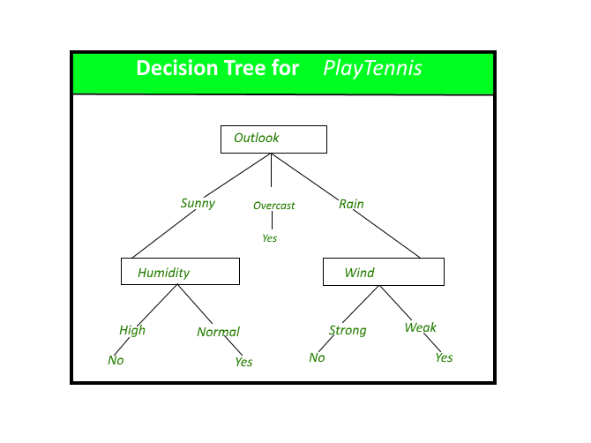

Slide 8
The decision tree in above figure classifies a particular morning according to whether it is suitable for playing tennis and returning the classification associated with the particular leaf.(in this case Yes or No).
For example,the instance
(Outlook = Rain, Temperature = Hot, Humidity = High,
Wind = Strong )
would be sorted down the leftmost branch of this decision tree and would therefore be classified as a negative instance.
In other words we can say that decision tree represent a disjunction of conjunctions of constraints on the attribute values of instances.
(Outlook = Sunny ^ Humidity = Normal) v (Outllok =
Overcast) v (Outlook = Rain ^ Wind = Weak)

Slide 9
The strengths of decision tree methods are:
Decision trees are able to generate understandable rules.
Decision trees perform classification without requiring much computation.
Decision trees are able to handle both continuous and categorical variables.
Decision trees provide a clear indication of which fields are most important for prediction or classification.
The weaknesses of decision tree methods :
Decision trees are less appropriate for estimation tasks where the goal is to predict the value of a continuous attribute.
Decision trees are prone to errors in classification problems with many class and relatively small number of training examples.
Decision tree can be computationally expensive to train. The process of growing a decision tree is computationally expensive.

Slide 10
P, NP and NP-complete problems
P (Polynomial) problems
P problems refer to problems where an algorithm would take a polynomial amount of time to solve, or where Big-O is a polynomial (i.e. O(1), O(n), O(n²), etc). These are problems that would be considered ‘easy’ to solve, and thus do not generally have immense run times.
NP (Non-deterministic Polynomial) Problems
NP problems were a little harder for me to understand, but I think this is what they are. In terms of solving a NP problem, the run-time would not be polynomial. It would be something like O(n!) or something much larger. However, this class of problems can be given a specific solution, and checking the solution would have a polynomial run-time.

Slide 11
NP-Hard Problems
A problem is classified as NP-Hard when an algorithm for solving it can be translated to solve any NP problem. Then we can say, this problem is at least as hard as any NP problem, but it could be much harder or more complex.
NP-Complete Problems
NP-Complete problems are problems that live in both the NP and NP-Hard classes. This means that NP-Complete problems can be verified in polynomial time and that any NP problem can be reduced to this problem in polynomial time.

Slide 12
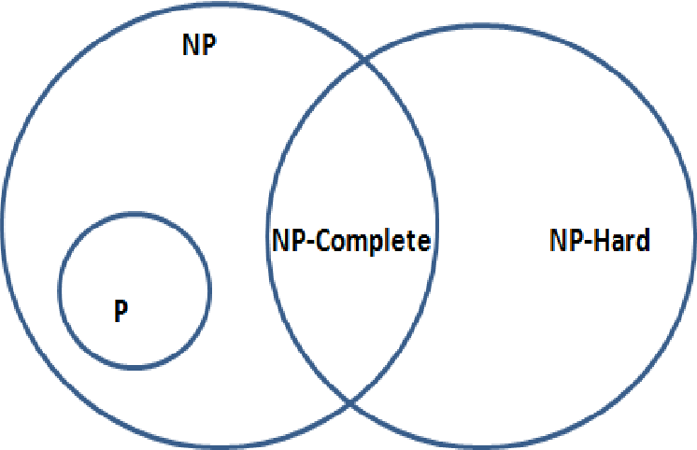
Below is a venn diagram of the different class spaces.

Slide 13
Coping with the Limitations of Algorithms Power
Backtracking
Backtracking is a technique based on algorithm to solve problem. It uses recursive calling to find the solution by building a solution step by step increasing values with time. It removes the solutions that doesn't give rise to the solution of the problem based on the constraints given to solve the problem.
Backtracking algorithm is applied to some specific types of problems,
Decision problem used to find a feasible solution of the problem.
Optimisation problem used to find the best solution that can be applied.
Enumeration problem used to find the set of all feasible solutions of the problem.

Slide 14
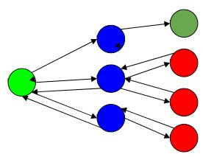
Example,
Here,
Green is the start point, blue is the intermediate point, red are points with no feasible solution, dark green is end solution.
Here, when the algorithm propagates to an end to check if it is a solution or not, if it is then returns the solution otherwise backtracks to the point one step behind it to find track to the next point to find solution.

Slide 15
ALGORITHM
Step 1 − if current_position is goal, return success
Step 2 − else,
Step 3− if current_position is an end point, return failed.
Step 4− else, if current_position is not end point, explore and repeat above steps.
Let’s use this backtracking problem to find the solution to N-Queen Problem.
In N-Queen problem, we are given an NxN chessboard and we have to place n queens on the board in such a way that no two queens attack each other. A queen will attack another queen if it is placed in horizontal, vertical or diagonal points in its way. Here, we will do 4-Queen problem.

Slide 16
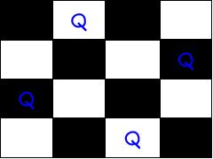
Here, the solution is −
Here, the binary output for n queen problem with 1’s as queens to the positions are placed.
{0 , 1 , 0 , 0} {0 , 0 , 0 , 1} {1 , 0 , 0 , 0} {0 , 0 , 1 , 0}
For solving n queens problem, we will try placing queen into different positions of one row. And checks if it clashes with other queens. If current positioning of queens if there are any two queens attacking each other. If they are attacking, we will backtrack to previous location of the queen and change its positions. And check clash of queen again.

Slide 17
ALGORITHM
Step 1 − Start from 1st position in the array.
Step 2 − Place queens in the board and check. Do,
  After placing the queen, mark the position as a part of the solution and then recursively check if this will lead to a solution.
  Now, if placing the queen doesn’t lead to a solution and trackback and go to step (a) and place queens to other rows.
  If placing queen returns a lead to solution return TRUE.
Step 3 − If all queens are placed return TRUE.
Step 4 − If all rows are tried and no solution is found, return FALSE.

Slide 18
Branch-and-Bound
Branch and bound is an algorithm design paradigm which is generally used for solving combinatorial optimization problems. These problems are typically exponential in terms of time complexity and may require exploring all possible permutations in worst case. The Branch and Bound Algorithm technique solves these problems relatively quickly.
Let us consider the 0/1 Knapsack problem to understand Branch and Bound.

Slide 19
Let’s see the Branch and Bound Approach to solve the 0/1 Knapsack problem: The Backtracking Solution can be optimized if we know a bound on best possible solution subtree rooted with every node. If the best in subtree is worse than current best, we can simply ignore this node and its subtrees. So we compute bound (best solution) for every node and compare the bound with current best solution before exploring the node.
Example bounds used in below diagram are, A down can give $315, B down can $275, C down can $225, D down can $125 and E down can $30.

Slide 20
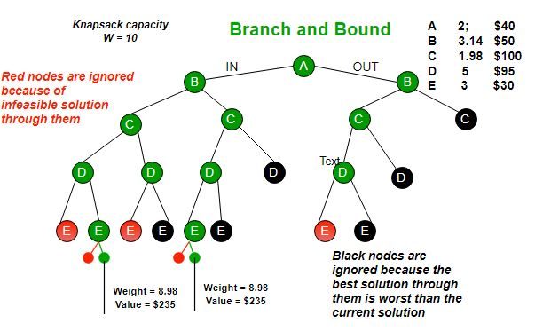

Slide 21
Approximation Algorithms for
NP-hard Problems
We discuss a different approach to handling difficult problems of combinatorial optimization, such as the traveling salesman problem and the knapsack problem. Their optimization versions fall in the class of NP-hard problems—problems that are at least as hard as NP-complete problems. Hence, there are no known polynomial-time algorithms for these problems, and there are serious theoretical reasons to believe that such algorithms do not exist.
There is a radically different way of dealing with difficult optimization prob-lems: solve them approximately by a fast algorithm. This approach is particularly appealing for applications where a good but not necessarily optimal solution will suffice. Besides, in real-life applications, we often have to operate with inaccurate data to begin with. Under such circumstances, going for an approximate solution can be a particularly sensible choice.

Slide 22
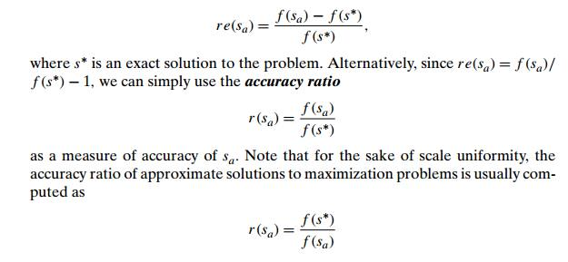
Of course, if we use an algorithm whose output is just an approximation of the actual optimal solution, we would like to know how accurate this approximation is. We can quantify the accuracy of an approximate solution s_{a} to a problem of minimizing some function f by the size of the relative error of this approximation,

Slide 23
THANK YOU

