Slide 1
The Accounting Cycle
MCA I Semester
A.DURGA DEVI
MCA DEPARTMENT

Slide 2
List The Steps In The Accounting Cycle
Analyze source documents & record business transactions in a journal
Post journal entries to the ledger accounts
Prepare a trial balance
Gather adjustment data and record adjustments in the work sheet
Complete the work sheet
Create financial reports from data in work sheet
Journalize and post the adjusting entries
Journalize and post the closing entries
Prepare the post-closing trial balance
Chapter 3
Chapter 4
Chapter 5

Slide 3
Steps in the Accounting Process
Journalize business transaction:
  Use source document to record journal entry in general journal
    Decide on accounts that are affected
    Enter Date
    Don’t indent debit
    Indent credit
    Write description
    DR = CR
Post all journal entries to ledger accounts in general ledger
  Transfer date
  Transfer amount
  Record both cross references
Transfer all totals to trial balance

Slide 4
What Is a General Journal?
The book in which a person enters the original record of a business transaction
  Commonly referred to as a book of original entry
Chronological listing of all the business transactions for the company
  Each listing records the debits and credits associated with that business transaction
A book or a location on a hard drive where all business transactions are listed
  Like a diary

Slide 5
What’s in a Journal Entry?
Date
At least one debit entry
  Debit account, use exact account title, do not indent titles
At least one credit entry
  Credit account, use exact account title, indent titles
An explanation of the transaction:
  Check number
  Invoice number
  Accounts receivable customer name
  Many other elements…
  Remember: the accountant must leave a good audit trail so that users of accounting information can understand what occurred with each transaction
DR=CR

Slide 6
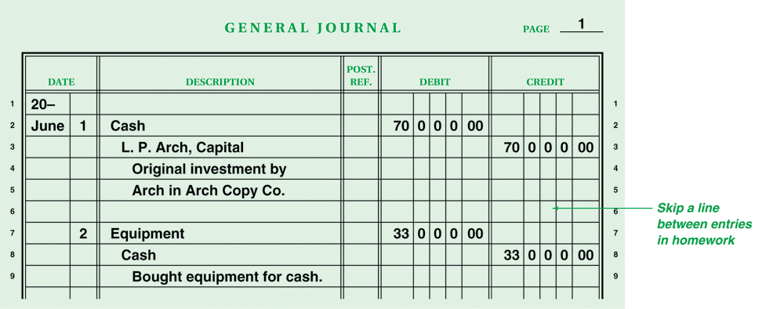
Example of Business Transaction Recorded in the General Journal
Create a journal entry for each transaction.

Slide 7
Definitions:
Ledger Account
  Complete listing of business transactions for an individual account
  Where you look if you want to find the balance of any given account
General Ledger
  A loose-leaf book or computer file containing all the Ledger Accounts
    Each account from the chart of accounts has its own ledger account in the general ledger
Posting
  The process of transferring figures from the journal to the ledger accounts

Slide 8
Four-Step Posting Process
Transfer transaction date to account’s date column
Transfer the debit/credit amount and calculate the new balance
Write journal page number in posting reference column of ledger as a cross-reference
Go back to journal and write account number in posting reference column of journal as a cross-reference
  Cross-reference
    The ledger account number in the Post. Ref. column of the journal and the journal page number in the Post. Ref. column of the ledger account

Slide 9
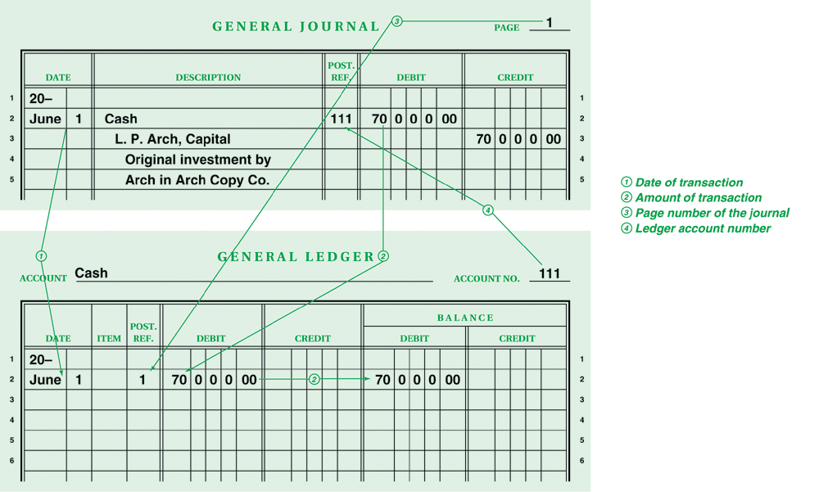
Posting Transaction (a): Arch deposited $70,000 in bank account in name of business

Slide 10
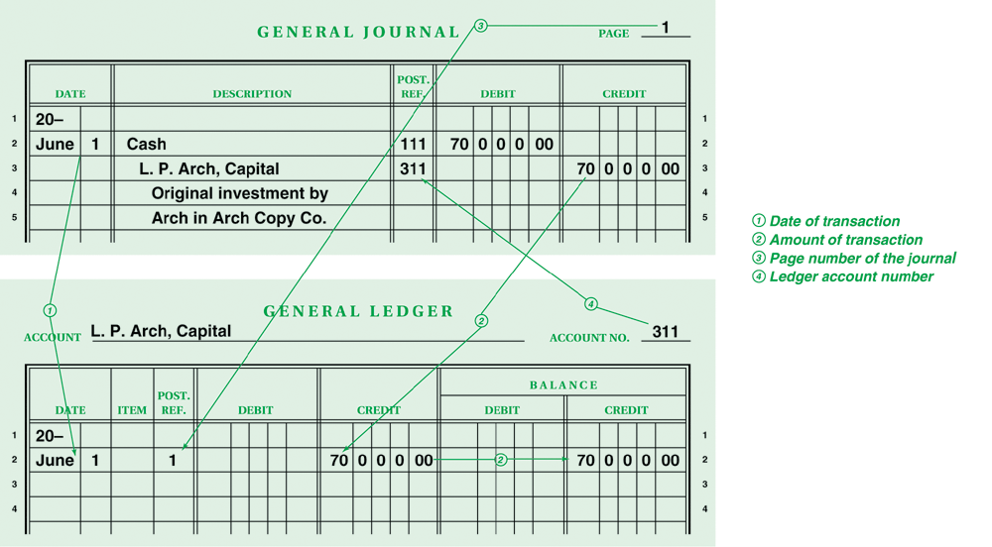
Posting Transaction (a): Arch deposited $70,000 in bank account in name of business

Slide 11
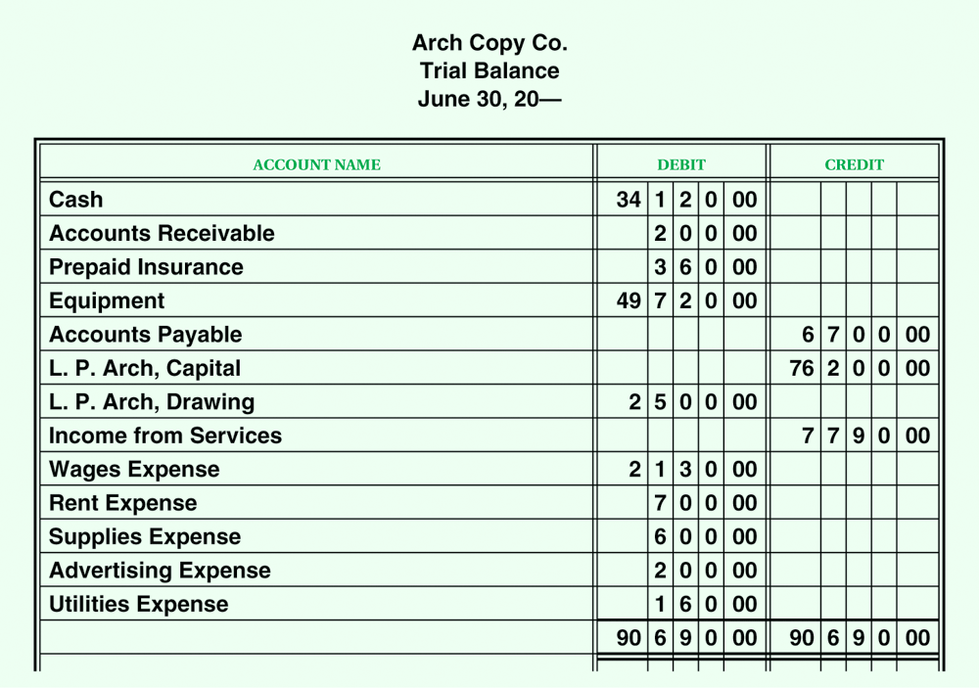
Preparing a Trial Balance
List the ledger account balances in two columns on the trial balance
  Left column = Debits
  Right column = Credits
Trial balance proves DR = CR

Slide 12
THANK YOU

