Slide 1
BUDGETING, PLANNING and CONTROL MCA I Semester
A.DURGA DEVI
MCA DEPARTMENT

Slide 2
BUDGETING, PLANNING and CONTROL

Slide 3
1) Appreciate the importance of budgets. 2) Understand the different kinds of budgeting procedures 3) Understand the components of a budget 4) Understand the various steps in creating a master-budget 5) Create a Sales budget 6) Create a Production budget 7) Create a Raw Material Purchase budget 8) Create a Labor cost budget 9) Prepare a Cash Receipt and Disbursement budget 10) Prepare a projected Income and Balance Sheet statement
Upon completion of this session, participants will be able to:

Slide 4
Use of Budgets in Planning and Control
The entire planning and control process of many companies is built around budgets.

Slide 5
Planning
Budgets are useful because they enhance:
Communication.
Coordination.
The process of developing a budget forces managers to consider:
Goals.
Objectives.
Specify means of achieving them.

Slide 6
Control
Budgets are useful because they provide a basis for evaluating performance.
Performance evaluation is carried out by comparing actual performance with planned or budgeted performance.
Significant deviations from planned performance are associated with three potential causes.

Slide 7
Control: Significant Deviations From Planned Performance Are Associated With
Poorly conceived budgets.
Business conditions may have changed.
Managers that have done a particularly good or bad job managing operations.

Slide 8
Developing the Budget
Budgets are prepared for
Departments.
Divisions.
Company as a whole.
The Budget Committee is responsible for approval of the budget:
Senior managers
President
CFO
Various vice-presidents
Controller.

Slide 9
Developing the Budget (Continued)
Top-down approach is where goals are pushed down from top management.
Bottom-up approach is where lower-level managers are the primary source of information used in setting the budget.

Slide 10
Budget Time Period
Budgets range from months to several years or more.
Key point is that there is an inverse relationship between”
Length of the budget period.
Detail contained within the budget.

Slide 11
Zero Base Budgeting
Zero Base Budgeting (ZBB) is a method of budget preparation which begins each period with a clean slate.
Managers must start from zero and justify budgets every period.
Used in government budgeting.
Not commonly used in business.

Slide 12
The Master Budget
Master Budget (comprehensive) Includes:
Sales budget.
Production budget.
Direct materials budget.
Direct labor budget.
Manufacturing overhead budget.
Selling and administrative budget.

Slide 13
The Master Budget
Master Budget Includes:
Capital acquisitions budget.
Cash receipts and disbursements budget.
Budgeted income statement.
Budgeted balance sheet.

Slide 14
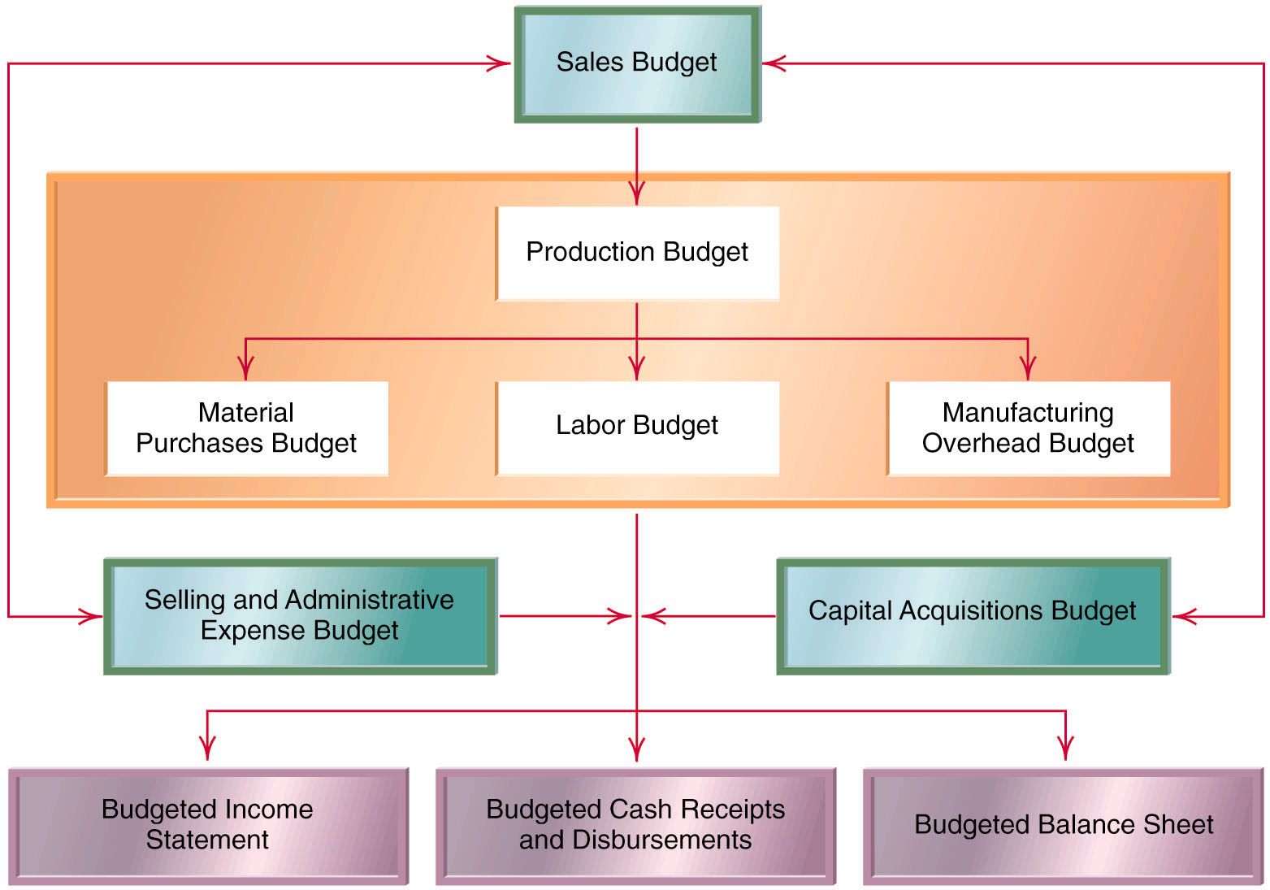
The Master Budget: Graphic

Slide 15
Sales Budget
Sales budget is the first step in the budget process.
It comes first because other budgets cannot be prepared without an estimate of sales.
Example: production estimates are based on forecast sales.

Slide 16
Sales Budget (Continued)
Companies use a variety of methods to estimate sales:
Econometric models.
Previous sales trends.
Trade journals and magazines.
Sales force estimates.

Slide 17
Production Budget
Production forecasts are based on the
following relationships:
Finished units to be produced
=
expected sales in units
+
desired ending inventory of finished units
–
beginning inventory of finished units

Slide 18
Direct Material Purchase Budget
Direct materials budgets depend on:
The amount needed for production
The amount need for ending inventory.

Slide 19
Direct Material Purchase Budget (Continued)
Calculated as follows:
Required purchases of direct materials
=
amount required for production
+
desired ending inventory of direct materials
–
beginning inventory of direct materials

Slide 20
Direct Labor Budget
Direct labor budget calculated by multiplying:
Number of units to be produced
x
Labor hours per unit
x
rate per hour

Slide 21
Manufacturing Overhead Budget
Cost per unit of production of each variable cost item is multiplied by the quantity of units produced.
Fixed costs remain relatively constant.

Slide 22
Selling and Administrative Expense Budget
Selling and administrative expense budgets include:
Salaries.
Advertising.
Office expenses.
Other general expenses.

Slide 23
Budgeted Income Statement
Sales figures come from the sales budget.
Cost of goods sold is based on unit cost of production (and the direct materials budget).
Labor cost information comes from the direct labor budget.
Overhead cost information is provided by the manufacturing overhead budget provides.

Slide 24
Capital Acquisitions Budget
Acquisitions of capital assets such as:
Property.
Plant
Equipment.
Must be carefully planned because they consume substantial cash reserves.
This Topic is separately covered in another Module

Slide 25
Cash Receipts and Disbursements Budget
Managers plan for the
Amount of cash flows and the
Timing of cash flows.
VERY important budget because...
The timing of cash inflows and outflows may diverge substantially from the income statement.

Slide 26
Budgeted Balance Sheet
The last component of the master budget.
A function of all of the other budgets.
Sometimes referred to as a pro-forma balance sheet.
Used to assess the effect of planned decisions on future financial position.

Slide 27
Use of Computers in The Budget Planning Process
Computers are very useful in the preparation of budgets.
Spreadsheets, like Excel, are very effective in modeling budget relationships.
Spreadsheets allow for “what if” analysis:
What if direct labor increases to $14.45
What if fixed factory overhead decreases by 3.5%…

Slide 28
Budgetary Control
In addition to:
Planning
Communicating goals
Coordinating activities
Budgets also facilitate control of operations.

Slide 29
Budgets as A Standard For Evaluation
Budgets facilitate control by providing a standard for evaluation.
The standard is the budgeted amount against which actual results are compared.
Differences between budgeted and actual amounts are called budget variances (Covered separately in another Module)
Material differences between actual and budgeted should be investigated.

Slide 30
Static and Flexible Budgets
A static budget is not adjusted for the actual level of production and is not suited for performance measurement.
A flexible budget is a set of budget relationships that can be adjusted to various activity levels. It is suited for performance measurement.

Slide 31
Conflict in Planning and Control Uses of Budgets
Conflict is inherent in the planning and control uses of budgets.
Result is that managers:
Pad their budgets.
Shift income between accounting periods to increase their compensation.

Slide 32
Why Budget-Based Compensation Can Lead To Budget Padding and Income Shifting
Hurdle bonuses and variable bonuses are commonly used.
Two problems:
Managers have an incentive to “pad” their budgets resulting in “slack” budgets that are easy to achieve.
Managers have an incentive to shift income from one accounting period to another to achieve “hurdle” targets.

Slide 33
Quick Review Question #1
Which of the following items do not requre a cash outflow?
Salaries.
Purchase of raw material.
Advertising.
Depreciation.

Slide 34
Quick Review Answer #1
Which of the following items do not requre a cash outflow?
Salaries.
Purchase of raw material.
Advertising.
Depreciation.

Slide 35
Quick Review Question #2
Which of the following comes last in the budget process.
Sales budget.
Cash receipts/disbursements budget.
Budgeted balance sheet.
Production budget.

Slide 36
Quick Review Answer #2
Which of the following comes last in the budget process.
Sales budget.
Cash receipts/disbursements budget.
Budgeted balance sheet.
Production budget.

Slide 37
Quick Review Question #3
The difference between a budgeted and actual amount is called
An error.
A flexible budget.
A variance.
Fraud.

Slide 38
Quick Review Answer #3
The difference between a budgeted and actual amount is called
An error.
A flexible budget.
A variance.
Fraud.

Slide 39
Quick Review Question #4
Beginning inventory is 3,200 units. Required ending inventory is 3,500 units. Sales are forecasted at 14,500 units. The production budget calls for how many units?
21,200
14,200
14,800
Cannot be determined

Slide 40
Quick Review Answer #4
Beginning inventory is 3,200 units. Required ending inventory is 3,500 units. Sales are forecasted at 14,500 units. The production budget calls for how many units?
21,200
14,200
14,800
Cannot be determined

Slide 41
Sales Budget of Collegiate Apparel
Collegiate Apparel Company is preparing budgets for the year ending December 31, 20x1.
Budgeted sales are: First quarter – 15,000 units Second quarter – 5,000 units Third quarter – 10,000 units Fourth quarter – 20,000 units
The selling price is $12 per unit.
Notes:
The marketing department at Collegiate Apparel Company has provided a sales forecast for each of the four quarters in the year 20x1. Each unit sells for twelve dollars. Using a single selling price makes the budgeting process easier to develop.

Slide 42
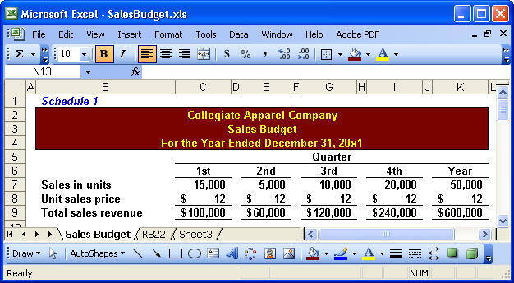
Sales Budget of Collegiate Apparel
Notes:
We are going to use Excel to prepare the various budgets for Collegiate Apparel. We have shown the forecasted unit sales per quarter and the unit selling price. For the year, we expect to sell fifty thousand units and produce revenue of six hundred thousand dollars. We will refer back to this budget as we develop many of the other detail budgets. Notice that we have labeled this budget Schedule One.

Slide 43
Production Budget
Sales
Budget
Production
Budget
Completed
Plan of resources needed to meet current
sales demand and ensure inventory levels
are sufficient for future sales.
Notes:
Once we complete the sales budget we can begin the process of preparing the production budget.

Slide 44
Forecasting Production
Rearrange the basic inventory formula as follows . . .
Units in
beginning
inventory
Required
production
in units
Sales in Units
Units in
ending
inventory
+
–
=
Now, solve for required production . . .
Units to be Produced
Sales in Units
Units in
ending
inventory
Expected
beginning
inventory
=
+
–
Notes:
Part I We know from the periodic inventory system that if we add beginning inventory to units produced and subtract units sold, we calculate the units in ending inventory.
Part II By taking what we know, we can rearrange the equation. The units to be produced during the period is equal to the unit sales plus the units in ending inventory minus the expected units in beginning inventory. Take a few seconds to review these equations. We will use them in preparing several budgets.

Slide 45
The Production Budget
Collegiate Apparel wants units in ending finished goods inventory to be 10% of the next quarter’s expected sales in units.
At the beginning of the year, 1,500 completed units were on hand.
During the first quarter of 20x2, 15,000 units are expected to be sold.
Let’s prepare the production budget.
Notes:
To avoid the problems associated with stocking out of inventory, management at Collegiate Apparel has decided that ending finished goods inventory should be equal to ten percent of the following quarter’s expected unit sales.
At the beginning of the year there were one thousand five hundred units on hand.
The marketing department forecasts first quarter 20x2 units sales at fifteen thousand units.
We have sufficient information to prepare the production budget that we will label Schedule Two.

Slide 46
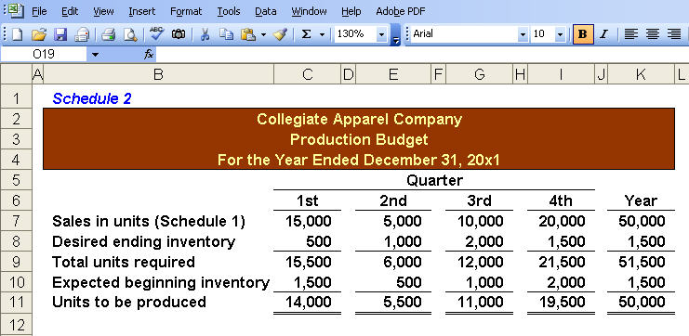
The Production Budget
5,000 × 10% = 500 units
Notes:
Part I We begin the production budget by using the forecasted unit sales from our sales budget. Part II The desired ending inventory is equal to ten percent of the following quarter’s unit sales. In the first quarter the ending inventory is five hundred units. We determine this by multiplying the second quarter’s expected units sales of five thousand units time ten percent. The beginning inventory in the first quarter was given as one thousand five hundred units.
Part III The ending inventory in the first quarter becomes the beginning inventory for the second quarter. It would be a good idea to see if you can calculate the units shown in the third quarter. During the first quarter we expect to sell fifteen thousand units but need to produce only fourteen thousand units. In the third quarter, we expect to sell ten thousand units but must produce eleven thousand units to meet our inventory requirements.

Slide 47
Direct-Materials Budget
Direct materials needed for the budget period can be determined as follows . . .
Required
materials
purchases
Materials
used in
production
Ending
materials
inventory
Beginning
materials
inventory
=
+
–
Notes:
Earlier we determined the number of units to produce using an equation similar to this. We are not ready to prepare our direct-materials budget. Our goal is to make sure we purchase enough direct materials to meet production needs. You can see that the required purchases are equal to the direct materials used in production plus the ending inventory of direct materials less the beginning direct-materials inventory.

Slide 48
Direct-Materials Budget
At Collegiate Apparel 1.5 yards of fabric are required per unit of product.
Management wants fabric on hand at the end of each quarter to be 10% of next quarter’s raw materials required. On January 1st, 2,100 yards of fabric are on-hand. During the first quarter of 20x2, Collegiate expects 21,000 yards of fabric to be required.
Each yard of fabric cost the company $2.
Let’s prepare the direct materials budget.
Notes:
At Collegiate it takes one point five yards of fabric to product one unit of output. Management has established a policy to minimize the likelihood of stocking out of direct materials. Management wants fabric on hand at the end of each quarter to be equal to ten percent of the following quarter’s direct materials required. At the beginning of the year the company had two thousand one hundred yards of fabric on hand. During the first quarter of 20x2, management believes twenty one thousand yards of fabric will be required. Each yard of fabric cost two dollars.

Slide 49
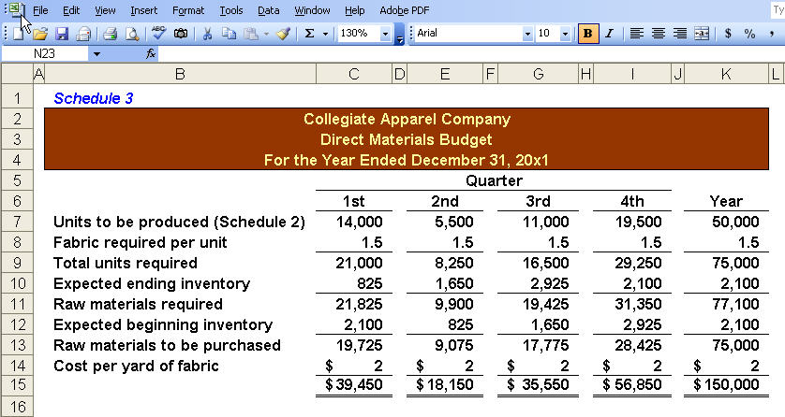
Direct-Materials Budget
8,250 × 10% = 825 units
Notes:
Part I We start with the units to be produced from Schedule Two. The total fabric required is calculated by multiplying the units to be produced by the number of yards of fabric required for each unit, one point five.
Part II The expected ending inventory is ten percent of the direct materials required during the following quarter. You can see the in the second quarter we will need eight thousand two hundred fifty yards of fabric and two percent of this amount is eight hundred twenty-five yards. The number of yards in beginning inventory was given as two thousand one hundred. We will need to purchase nineteen thousand seven hundred and twenty-five yards of fabric during the first quarter. At two dollars per yard, we expect to spend thirty-nine thousand four hundred fifty dollars on direct materials.
Part III The expected ending inventory in the first quarter becomes the expected beginning inventory at the beginning of the following quarter. Make sure you can calculate all the amounts shown for the third quarter.
For the year we expect to spend one hundred fifty thousand dollars on direct materials.

Slide 50
Direct-Labor Budget
At Collegiate Apparel, each unit produced requires 0.20 hour (12 minutes) of direct labor.
Workers earn a wage rate of $10 per hour regardless of the hours worked. Collegiate Apparel can hire workers as needed to meet production.
Let’s prepare the direct labor budget.
Notes:
Let’s turn our attention to the next manufacturing cost; direct-labor. At Collegiate each unit produced required point two hours, or twelve minutes, of direct labor. All direct labor workers are paid ten dollars per hour regardless of the hours worked. We assume Collegiate can hire or layoff as many laborers as needed to meet production. This is a very restrictive assumption, but helps us keep the budgeting process straight-forward.

Slide 51
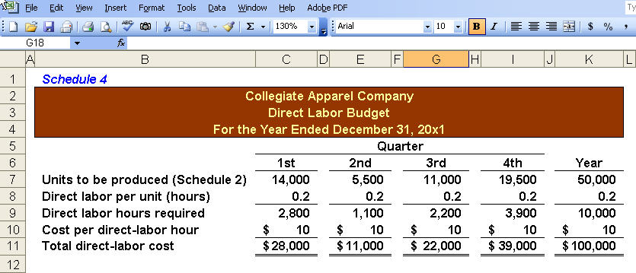
Direct-Labor Budget
Notes:
Once again we begin with the units to be produced from Schedule Two. We multiply the units to be produced by the time required to produce one unit, point two hours. In the first quarter we will need two thousand eight hundred hours of direct labor and, at ten dollars per hour, we expect to pay twenty-eight thousand dollars in gross wages.
For the year, we expect to spend one hundred thousand dollars on direct labor. Let’s look at the manufacturing overhead budget next.

Slide 52
Manufacturing-Overhead Budget
Collegiate Apparel uses activity-based budgeting.
At the unit-level, each unit produced requires $0.25 of indirect materials and $0.15 of electricity.
At the batch-level, the company expects the following production runs:
1st quarter – 28
2nd quarter – 11
3rd quarter – 22
4th quarter – 39
At the product-level, the company expects two new style designs each quarter with each new T-shirt design costing $500.
Details of the facilities-level overhead costs are shown on the manufacturing-overhead budget.
Notes:
Collegiate uses activity-based budgeting. We have listed the unit-level, batch-level, product-level, and facilities-level information for the year. You may want to print this screen or write down most of these numbers to make the preparation of the manufacturing overhead budget easier to understand.

Slide 53
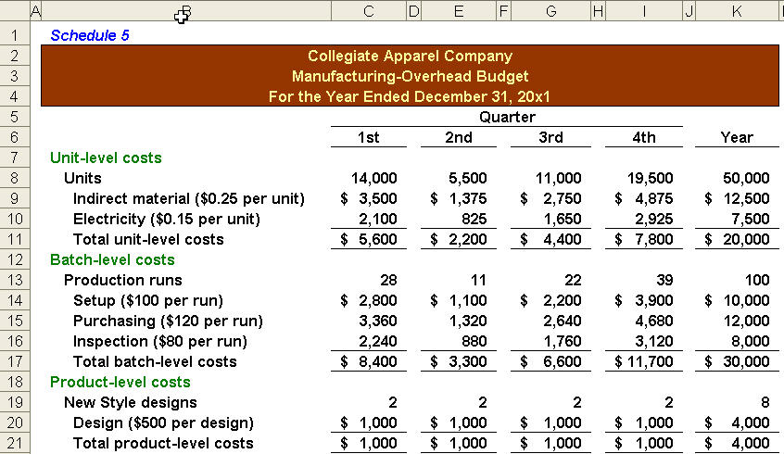
Manufacturing-Overhead Budget
Unit-, Batch-, and Product-level Portions of the Budget
Notes:
For our unit-level costs of indirect materials and electricity, we use the units to be produced from Schedule Two, our production budget. To determine the total indirect material costs for the quarter, multiply the units to be produced by twenty five cents. In the first quarter we get three thousand five hundred dollars for indirect materials.
The batch-level costs are based upon the number of production runs each quarter. In the first quarter we expect twenty-eight production runs at a setup cost of one hundred dollars per run for a total setup cost of two thousand eight hundred dollars.
The product-level costs are based upon the number of new style designs during the quarter. In each quarter we expect two new style designs. During the first quarter the total product-level overhead costs are determined by multiplying the number of new style designs by the cost of five hundred dollars per design.
On the next screen we will complete the manufacturing overhead budget by determining the facilities-level costs and total costs.

Slide 54
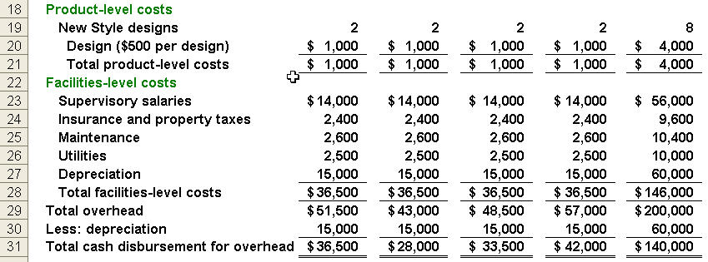
Manufacturing-Overhead Budget
Product-, Facilities-level and Total Overhead Budget
$5,600 + $8,400 + $1,000 + $36,500 = $51,500
Notes:
The facilities-level costs are fixed each quarter and determined by the company. The total facilities-level costs are thirty six thousand five hundred dollars per quarter. You can see the details of this total. The total manufacturing overhead costs for the first quarter are fifty-one thousand five hundred dollars. If we subtract the non-cash expenses, depreciation, included in this total we get expected cash disbursements for overhead in the first quarter of thirty-six thousand five hundred dollars. For the year we expect to incur two hundred thousand dollars in manufacturing overhead costs and spend one hundred forty thousand dollars cash on manufacturing overhead.

Slide 55
SG&A Expense Budget
At Collegiate Apparel, sales commissions and freight-out are unit-level SG&A.
Customer-level SG&A expenses include licensing fees for use of names and logos.
Facilities-level SG&A expense include sales salaries, advertising, and clerical wages.
Let’s prepare the SG&A Expense Budget.
Notes:
All of our expected selling, general, and administrative expenses are detailed on the next screen.

Slide 56
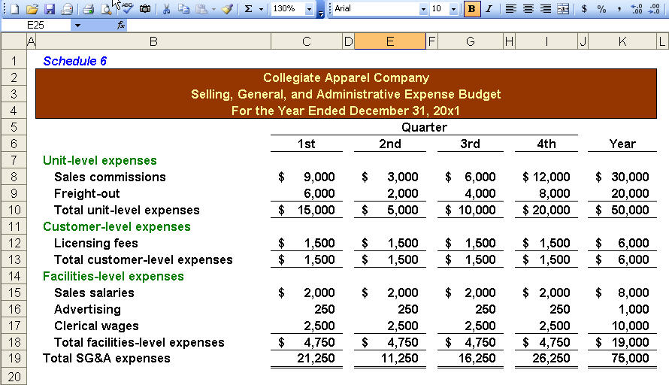
SG&A Expense Budget
$
$
$
$
Notes:
For the year we expect to incur selling, general, and administrative expenses of seventy-five thousand dollars.

Slide 57
Cash Receipts Budget
At Collegiate Apparel all sales are made on account.
The company collects 80% of its billings in the quarter of the sale, 18% in the following quarter. The remaining two percent of each quarter’s sales are expected to be uncollectible.
Sales in the last quarter of 20x0 were $240,000.
Let’s prepare the Cash Receipts Budget.
Notes:
Now we can prepare the cash receipts budget. At Collegiate, eighty percent of the billings in the quarter are collected in that quarter. Eighteen percent of the quarter’s billings are collected in the following quarter, and two percent of all billings are expected to be uncollectible. During the last quarter of 20x0, the previous year, sales and billings were two hundred forty thousand dollars.

Slide 58
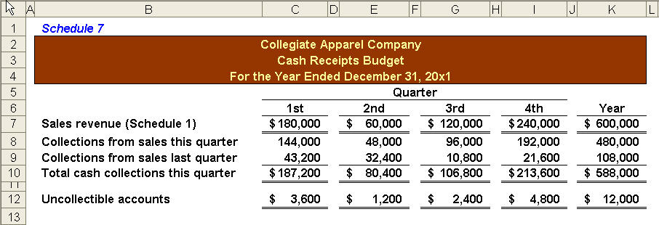
Cash Receipts Budget
$240,000 × 18% = $43,200
$180,000 × 18% = $32,400
$180,000 × 2% = $3,600
Notes:
Part I During the first quarter we expect to collect cash of one hundred eighty-seven thousand two hundred dollars and experience uncollectible accounts of three thousand six hundred dollars. Let’s see how we get these amounts.
Part II Of the sales in the quarter, we expect to collect eighty percent. So, we get our sales from Schedule One of one hundred eighty thousand dollars and multiply by eighty percent to get cash collections of one hundred forty-four thousand dollars. We will collect eighteen percent of the billings for the last quarter of the previous year, or forty-three thousand two hundred dollars.
Part III Our uncollectible accounts expense for the first quarter will be three thousand six hundred dollars, or two percent of quarterly sales of one hundred eighty thousand dollars.
Part IV
In the second quarter we will collect eighteen percent of the first quarter’s sales of one hundred eighty thousand dollars. Make sure you can calculate all the amounts shown in the third quarter.

Slide 59
Cash Payments for Direct-Materials
At Collegiate Apparel all purchases of raw materials are made on account.
The company pays for 60% of its purchases in the quarter of the purchase and the remaining 40% in the following quarter.
Purchases in the last quarter of 20x0 were $56,850.
Let’s prepare the Cash Receipts Budget.
Notes:
All direct materials are purchases on account at Collegiate. The company typically pays sixty percent of the purchases made in the quarter and pays the remaining forty percent in the following quarter.
Purchases for the last quarter of the previous year amounted to fifty-six thousand eight hundred fifty dollars.

Slide 60
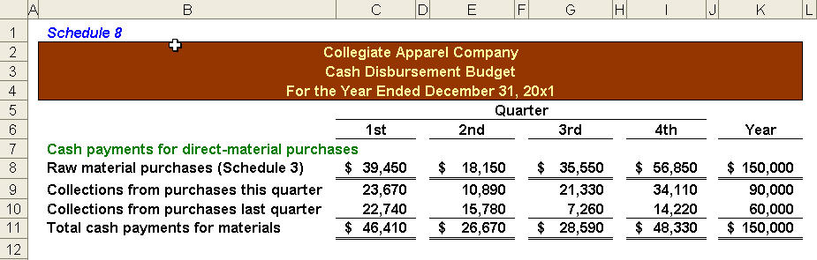
Cash Payments for Direct-Materials
$18,150 × 60% = $10,890
$39,450 × 40% = $15,780
Notes:
Part I We begin the cash disbursement for direct materials budget by getting the raw material purchases from Schedule Three. Instead of looking at the first quarter, let’s go to the second quarter amounts where the purchases of direct material is expected to be eighteen thousand one hundred fifty dollars.
Part II We will pay sixty percent of this amount in the second quarter or ten thousand eight hundred ninety dollars. Part III In addition, we will pay for forty percent of the first quarter’s expected purchases of direct materials, or fifteen thousand seven hundred eighty dollars. Our total expected payments for direct materials during the second quarter will be twenty-six thousand six hundred seventy dollars. See if you can go back to the first quarter and determine the total cash payments.

Slide 61
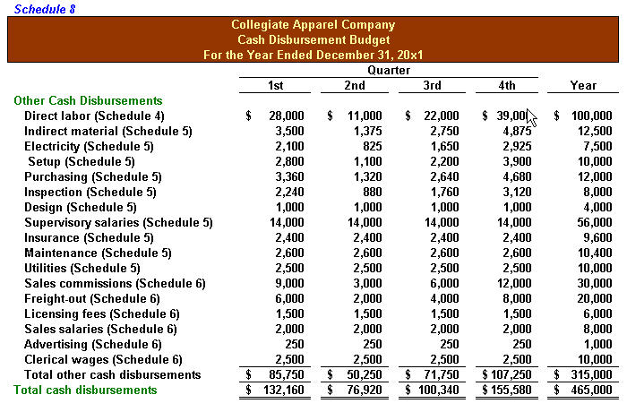
Other Cash Disbursements
Notes:
This screen shows all the other cash disbursements by quarter and in total for the year. In addition to a description and amount, we have also provided the appropriate schedule reference so you can go back and see where we got these amounts. The total cash disbursements for the manufacturing and S G & A expenses for the year amount to four hundred sixty-five thousand dollars.
Now that we have completed the cash receipts and disbursements budgets, we can prepare the cash budget.

Slide 62
Cash Budget
Collegiate Apparel started the year with a cash balance of $10,000, and borrows $100,000 at the beginning of 20x1 to finance plant expansion.
The loan is repaid in the amount of $25,000 at the end of each quarter with interest on the unpaid balance at 10%.
Payments for the plant expansion were:
1st quarter = $45,000
2nd quarter = $15,000
3rd quarter = $5,000
4th quarter = $35,000
Let’s prepare the Cash Budget.
Notes:
Collegiate started the year with a cash balance of ten thousand dollars and borrowed one hundred thousand dollars at the beginning of the year to finance a plant expansion. The loan will be repaid during the year and the payment to the contractor for the plant expansion are shown. Let’s start on the cash budget.

Slide 63
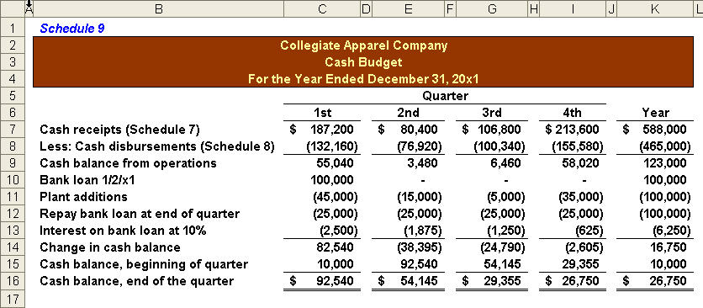
Cash Budget
$100,000 × 10% × ¼ = $2,500
Notes:
Part I We begin by subtracting cash disbursements from Schedule Six from cash receipts on Schedule Seven to get our cash balance from operations. Next, we show the increase in cash from the bank loan and the decrease when amounts are spent on the plant expansion, repayment of the loan and related interest expense.
Part II We calculate interest for the first quarter by multiplying the outstanding balance for the period times ten percent and taking one forth of the total amount. In the first quarter we have two thousand five hundred dollars in interest. The company started the year with a cash balance of ten thousand dollars and ended the first quarter with a cash balance of ninety-two thousand five hundred forty dollars. The ending balance in the first quarter becomes the beginning balance in the second quarter.

Slide 64
THANK YOU

