Slide 1
UNIT-III
Graphs and Trees
Graphs: A graph is determined as a mathematical structure that represents a particular function by connecting a set of points. It is used to create a pairwise relationship between objects.The graph is made up of vertices (nodes) that are connected by the edges (lines).
Graph Theory is the study of points and lines. In Mathematics, it is a sub-field that deals with the study of graphs. It is a pictorial representation that represents the Mathematical truth. Graph theory is the study of relationship between the vertices (nodes) and edges (lines).Formally, a graph is denoted as a pair G(V, E).Where V represents the finite set vertices and E represents the finite set edges.Therefore, we can say a graph includes non-empty set of vertices V and set of edges E.

Slide 2
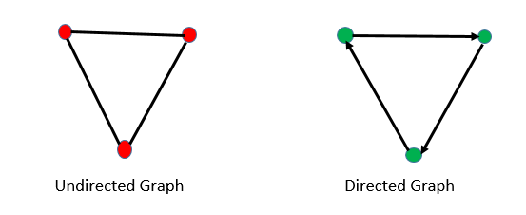
Types of Graphs
The graphs are basically of two types, directed and undirected. It is best understood by the figure given below. The arrow in the figure indicates the direction.

Slide 3
Directed Graph
In graph theory, a directed graph is a graph made up of a set of vertices connected by edges, in which the edges have a direction associated with them.
Undirected Graph
The undirected graph is defined as a graph where the set of nodes are connected together, in which all the edges are bidirectional. Sometimes, this type of graph is known as the undirected network.

Slide 4
Properties of Graph
The starting point of the network is known as root.
When the same types of nodes are connected to one another, then the graph is known as an assortative graph, else it is called a disassortative graph.
A cycle graph is said to be a graph that has a single cycle.
When all the pairs of nodes are connected by a single edge it forms a complete graph.
A graph is said to be in symmetry when each pair of vertices or nodes are connected in the same direction or in the reverse direction.
When a graph has a single graph, it is a path graph.

Slide 5
Trees: A tree in a graph is the connection between undirected networks which are having only one path between any two vertices. It was introduced by British mathematician Arthur Cayley in 1857. The graph trees have only straight lines between the nodes in any specific direction but do not have any cycles or loops. Therefore trees are the directed graph.
A tree or general trees is defined as a non-empty finite set of elements called vertices or nodes having the property that each node can have minimum degree 1 and maximum degree n. It can be partitioned into n+1 disjoint subsets such that the first subset contains the root of the tree and remaining n subsets includes the elements of the n subtree.

Slide 6
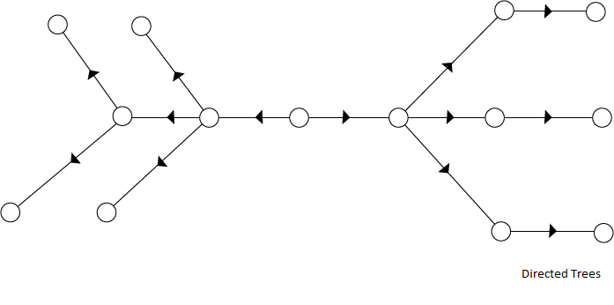
Directed Trees:
A directed tree is an acyclic directed graph. It has one node with indegree 1, while all other nodes have indegree 1 as shown in fig:

Slide 7
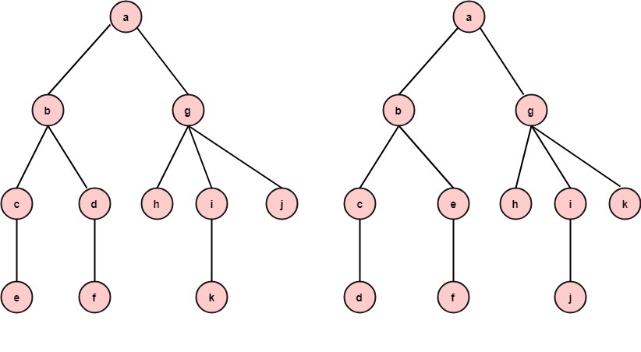
Ordered Trees:
If in a tree at each level, an ordering is defined, then such a tree is called an ordered tree.
Example: The trees shown in the figures represent the same tree but have different orders.

Slide 8
Properties of Trees:
There is only one path between each pair of vertices of a tree.
If a graph G there is one and only one path between each pair of vertices G is a tree.
A tree T with n vertices has n-1 edges.
A graph is a tree if and only if it a minimal connected.

Slide 9
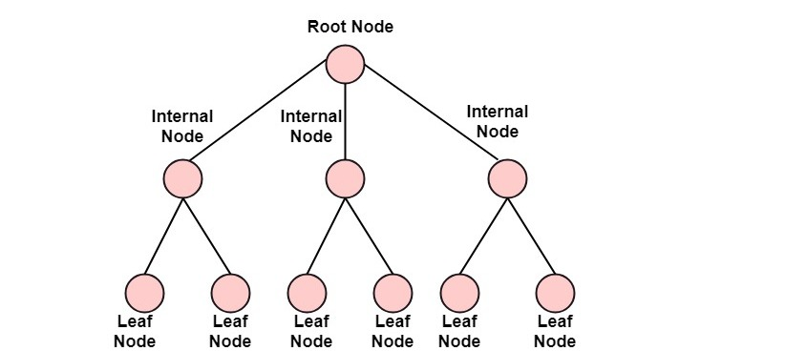
Rooted Trees:
If a directed tree has exactly one node or vertex called root whose incoming degrees is 0 and all other vertices have incoming degree one, then the tree is called rooted tree.

