Slide 1
UNIT IV
Boolean Algebra and Models of Computation
Boolean Functions
Definition: Boolean functions are mathematical expressions that involve Boolean variables and operators (AND, OR, NOT) and return Boolean values (TRUE or FALSE). • Variables: Represented by letters (e.g., A, B, C) and take values 0 (false) or 1 (true). • Operators: • AND (∙): A ∙ B = 1 if both A and B are 1. • OR (+): A + B = 1 if either A or B is 1. • NOT (¬ or '): ¬A or A' = 1 if A is 0.

Slide 2
Representing Boolean Functions
• Truth Tables: List all possible values of input variables and the corresponding output.
• Algebraic Expressions: Use AND, OR, and NOT operators to express the function.
• Canonical Forms:
• Sum of Products (SOP): OR of AND terms (e.g., A∙B + ¬A∙C).
• Product of Sums (POS): AND of OR terms (e.g., (A+B)∙(¬A+C)).

Slide 3
Logic Gates
• AND Gate: Output is 1 if all inputs are 1.
• OR Gate: Output is 1 if at least one input is 1.
• NOT Gate: Output is the complement of the input.
• Derived Gates:
• NAND Gate: Output is the complement of the AND gate (¬(A ∙ B)).
• NOR Gate: Output is the complement of the OR gate (¬(A + B)).
• XOR Gate: Output is 1 if inputs are different (A ⊕ B).
• XNOR Gate: Output is 1 if inputs are the same (¬(A ⊕ B)).

Slide 4
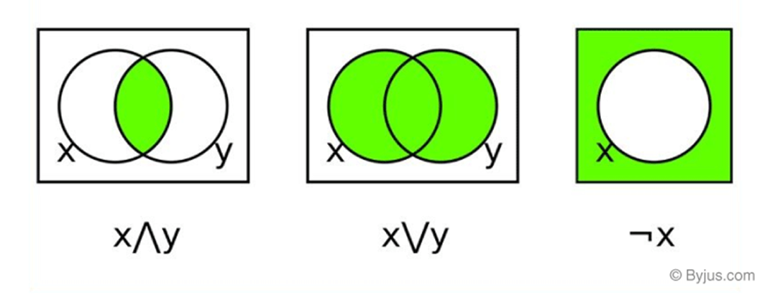
Boolean Algebra Operations The basic operations of Boolean algebra are as follows:
• Conjunction or AND operation
• Disjunction or OR operation
• Negation or Not operation

Slide 5
Below is the table defining the symbols for all three basic operations.
Operator | Symbol | Precedence
NOT | ‘ (or) ¬ | Highest
AND | . (or) ∧ | Middle
OR | + (or) ∨ | Lowest

Slide 6
Boolean Algebra Theorems
The two important theorems which are extremely used in Boolean algebra are De Morgan’s First law and De Morgan’s second law. These two theorems are used to change the Boolean expression. This theorem basically helps to reduce the given Boolean expression in the simplified form. These two De Morgan’s laws are used to change the expression from one form to another form. Now, let us discuss these two theorems in detail.
De Morgan’s First Law:
De Morgan’s First Law states that (A.B)’ = A’+B’. The first law states that the complement of the product of the variables is equal to the sum of their individual complements of a variable

Slide 7
The truth table that shows the verification of De Morgan’s First law is given as follows:
A | B | A’ | B’ | (A.B)’ | A’+B’
0 | 0 | 1 | 1 | 1 | 1
0 | 1 | 1 | 0 | 1 | 1
1 | 0 | 0 | 1 | 1 | 1
1 | 1 | 0 | 0 | 0 | 0

Slide 8
De Morgan’s Second Law:
De Morgan’s Second law states that (A+B)’ = A’. B’.
The second law states that the complement of the sum of variables is equal to the product of
their individual complements of a variable

Slide 9
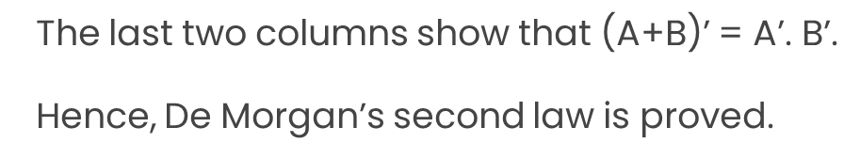
The following truth table shows the proof for De Morgan’s second law
A | B | A’ | B’ | (A+B)’ | A’. B’
0 | 0 | 1 | 1 | 1 | 1
0 | 1 | 1 | 0 | 0 | 0
1 | 0 | 0 | 1 | 0 | 0
1 | 1 | 0 | 0 | 0 | 0

