Slide 1
Mechanics , waves & oscillations
SEMESTER I PAPER – 1
PRESENTED BY:
G. RANGA RAO
Lecturer in Physics
D.N.R College (A), Bhimavaram.

Slide 2
I. MECHANICS OF PARTICLES
(1) Review of Newton’s laws of motion
Newton proposed three laws of motion.
First law: Every body continuous in its state of rest or of uniform motion in a straight line unless it is compelled by same external force to change that state.
Second law: The rate of change of linear momentum of a body is directly proportional to the applied force and the change takes place in the direction of applied force.
Third law: To every action, there is always an equal and opposite reaction.
Limitations:
1) The second law (F = ma) is not applicable when the mass 'm' is variable. E.g. In Rocket motion.
2) When the particles move with relativity velocities, second law is not applicable.
3) The third law is not applicable for particles of atomic size. Because the action and reaction cannot be measured simultaneously when the particles are of atomic size.

Slide 3
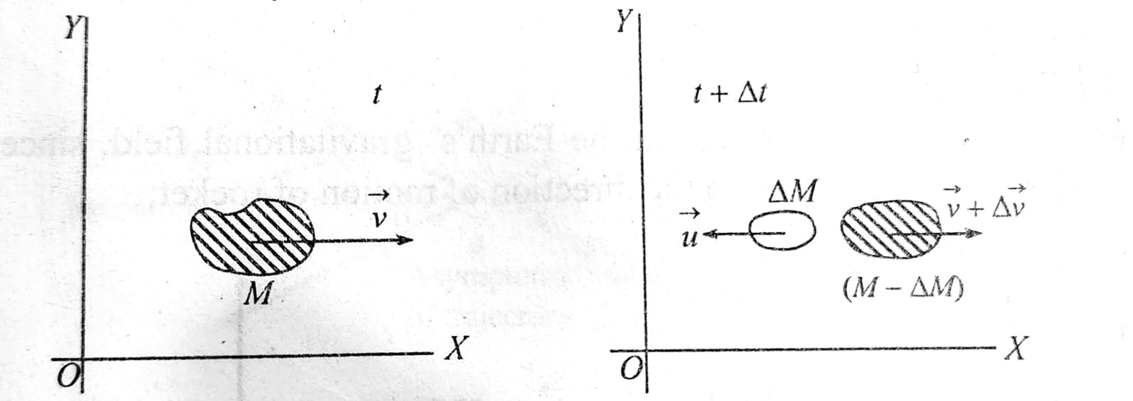
(2) Motion of variable mass system
system of variable mass (motion of a rocket)
1) rocket is a mass varying system. at an instant let $M$ be the mass of the rocket and $\vec{v}$, its velocity relative to the earth.
2) in a small interval of time $Δ$t, let $Δ$m be the mass of the gases burnt which eject out of the rocket with a velocity, say $\vec{u}$relative to the earth and $Δ$ $\vec{v}$ be the increase in the velocity of the rocket.
3) in this small time interval, total initial momentum of the system, $\vec{P_{1}}=M\vec{v}$
total final momentum of the system, $\vec{P}=\left(m−ΔM\right)$
4) considering both parts of masses am and m - am are forming from the same system. we can write external force m on rocket is, p2-p r

Slide 4
(3) Motion of a Rocket
The rocket motion is based on the principle of conservation of linear momentum
it consists of a fuel chamber in which the fuel may be in the form of liquid (or) solid is stored.
liquid hydrogen (or) liquid paraffin with solid oxidiser forms the liquid fuel and gun powder mixed with solid oxidiser form the solid fuel.
when the fuel is burnt, the combustion gases are allowed to escape through a narrow nozzle. due to high pressure inside the combustion chamber, the gases escape from it with high exhaust velocities, importing large momentum to the rocket.
therefore, it moves in a direction opposite to the direction of escape of the gases.

Slide 5
(4) Multistage Rocket
the escape velocity on earth $v_{e}$ is 11.2 km/s and the orbital velocity $v_{0}$ is 8 km/s.
to attain the speeds of this order a single stage rocket is not sufficient. to increase the speed of the rocket the expelled gases coming out in the form a a jet must have maximum velocity and the mass of the final stage rocket must be very much less than its mass the beginning.
the maximum attainable velocity of jet of gases in practice is around 2 km/s.
to increase the velocity even further multistage rockets are used.
in first stage when the fuel is completely burnt it detaches from rocket and drops off. the velocity acquired at the end of the first stage becomes the initial velocity of the second stage.
the second stage is then ignited and starts functioning. the rocket gains acceleration and again when the fuel gets exhausted it also gets detached from rocket.
finally in the last stage the rocket gets the required velocity and only pay load remains which is used to conduct experiments.

Slide 6
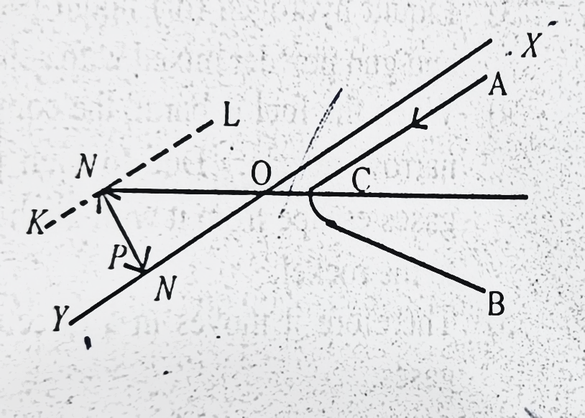
(5) Concept of Impact Parameter & Scattering and Cross – Section
Impact parameter is defined as the closet distance between nucleus and positively charged
particle projected towards it.
i) let $xy$ be the initial direction of motion of a charged alpha particle projected towards the targeted nucleus $N$.
ii) let kl be the line drawn parallel to $xy$ and passing through n.
iii)the perpendicular distance p between the initial direction of the charged particle and the line parallel to this and passing through the target nucleus is called impact parameter p of the collision.
iv) if p=0 the collision becomes head on.

Slide 7
2) Scattering cross section
It is defined as the ratio of number of particles in the solid angle ($dw$) per unit time to the incident intensity
i) when$a$ particles are projected into a thin metal foil, they are scattered in different directions
ii) Let N be the incident intensity. dN be the number of particles scattered per unit into solid angle $dw$
iii) the ratio $\frac{ⅆN}{N}$ is called scattering cross section

Slide 8
(6) Rutherford Scattering – Derivation

Slide 9
(6) Rutherford Scattering – Derivation
Rutherford scattering cross section:
1) let an a-particle moving along ao, approach the stationary nucleus at n. since both are positively charged, there is a force of repulsion between them and this force increases as they approach each other.
2) applying the theory of central orbits, it can be shown, that a particle describes a hyperbola acb, whose one focus is at n and whose asymptotes ao and bo give initial and final directions of motion of the a-particle.
3) let m = mass of the a-particle,
2e = charge on the a-particle
ze = charge on the nucleus, where z is the atomic number
$φ$= angle of scattering,
p = impact of parameter
vo = initial velocity of the a - particle.

Slide 10
5) on account of repulsive force, it will be stopped at a distance 'b' from the nucleus n and made to retrace its path. in such a case, = 180°.
6) electrostatic potential at a distance 'b' from the nucleus = $\frac{Ze}{4πε_{0}b}$
so, p.e of the $a$-particle at distance b = $\frac{Ze.2e}{4πε_{0}b}$
7) since the a-particle is momentarily stopped at a distance b from the nucleus, all its k.e must be completely converted into p.e.
$\frac{2 Ze2}{4π єb 2}$= $\frac{1 }{2}mv2$
8) but in general, the a-particle cannot be directed exactly towards the nucleus, we must consider the case when p# 0. in such a case a-particle will be deflected through an angle which is less than 180° and will travel along the hyperbolic path acb.
9) let v be the velocity of the a-particle at the vertex c of the hyperbola. then applying the law of conservation of energy and law of conservation of angular momentum at a and c.

