Slide 2
MOTION IN A CENTRAL FORCE FIELD
(1) Central force Definition & Examples
1) A force which always acts towards or away from a fixed point on a particle or a body is called "central force".
2) The magnitude of such a force depends only on the distance from the fixed point.
Explanation:
1) Let 'O' be the origin of co-ordinate system. $P$ is a particle described by polar co-ordinates $r$ and $θ$.
2) A force $\vec{F}$ acts on particle $P$. The central force be represented by $\vec{F}=f(r)\hat{r}$ Where $f(r)$ is the magnitude of the force which is a function of $r.$ $\hat{r}$is a unit vector along $\vec{r}$ of the particle with reference to the fixed point.
Examples:
i) The earth moves around the sun under a central force which is always directed towards the sun.
ii) Electrostatic force of attraction or repulsion between two-point charges is a central force.
iii) Elastic force acting on a mass attached to one end of a spring is a central force.

Slide 3
MOTION IN A CENTRAL FORCE FIELD
(2) Characteristics of Centra Forces
The work done by a central force in a closed path is zero.
The work done by a central force in closed path depends only on the positions of body.
The amount of work done by the force is same for all paths when the force is conservative.
The work done by a central force is independent of the path followed by it.
Conservative force is a function of position vector of the particle. i.e., $\vec{F}=f(r)\hat{r}$.

Slide 4
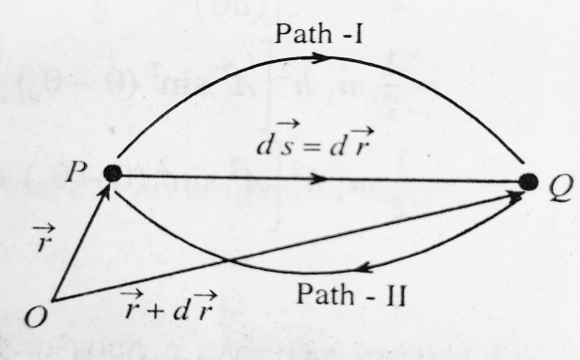
(3) Conservative nature of central forces
1) A force is said to be conservative if the work done by it in moving a particle from one point to another in closed path is zero.
2) F is conservative if work done by it in displacing a body from P to Q depends only on the positions of P and Q and not on the path followed by the body.
3) The amount of work done by the force will be the same for all paths when the force is conservative.
4) The work done by a conservative force along a closed path is zero.
5) Let F ⃗ be a force which is a function of position vector r ⃗ of the particle only.
6) When the particle is displaced from the position vector r ⃗ to r ⃗ + dr. Then.
ds = dr

Slide 5
7) Work done on the particle in the displacement is $dw = F−ds=F dr= F−dr→$(1)
8) The total work done in displacing the particle from P to Q along path-$I = F.dr= W$, say
9) When the particle moves from Q to P, work done along Path-II = W way P
10) Therefore, the total work done along the closed path P→ Q→ P is $W+(− W)=0$ Thus the work done by a conservation force along a closed path is zero.

Slide 6
GPS
Global Positioning System (GPS):
1) It is a system, designed to help navigate on the earth, in the air, and on water.
2) It is made up of satellites, ground stations and receivers.
3) The GPS receiver needs 4 satellites, to work out your position in 3-Dimensions.
4) The GPS is owned and operated by the US department of defence but it is available for general use around the world.
5) 21 GPS satellites and 3 spare satellites are in orbit at 10,600 miles above the earth. Four satellites will be above the horizon.

Slide 7
GPS
Global Positioning System (GPS):
6) Each satellite contains a computer, an atomic clock, and a radio with an understanding of its own orbit and the clock, it continuously broadcasts is changing position and time.
7) GPS receiver contains a computer that "triangulates" its own position by getting bearings from three of the four satellites, the result is provided in the form of a geographic position longitude and latitude, for most receives within 100 meters.
8) The GPS is being used in science to provide data that has never been available before in the quantity and degree of accuracy that the GPS makes possible.
9) The scientists are using the GPS to measure the movement of the arctic ice sheets, the earth's tectonic plates and volcanic activity.
10) A GPS receiver shows where it is. It may also show how fast it is moving, which direction it is going, how high it is, and may be how fast it is going up or down. Many GPS receivers have information about places. The majority are in smart phones.

