Slide 2
RELATIVISTIC MECHANICS

Slide 3
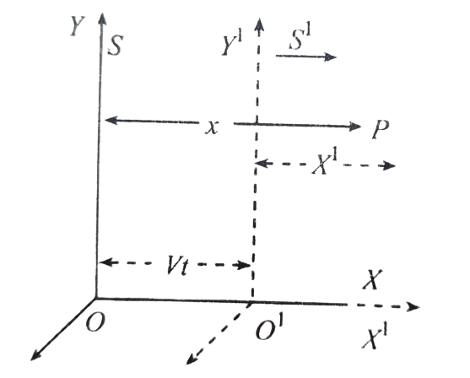
GALILEAN TRANSFORMATIONS
1) Consider the two frames $S$ and $S′$. Let the velocity of $S′$ relative to $S′$ be $V$.
2) Consider an event happening at $P$ at any time.
3) Let the coordinates of $P$with respect to $S$be $x, y, z, t$ and with respect to $S^{′}$ be $x′, y′, z′, t′.$
4) Let $X$ and $X′$ be parallel to $v$. Let $y$' and $Z′$ be parallel to $Y$ and $Z$ respectively.
5) Let us also count the time from the instant at which the origin is $O$ and $O^{′}$coincide.
6) From fig, we have $x = x′ + vt$
∴ $x^{′}=x−vt$ → (1)
7) As there is no relative motion along $y$ and $z$ axis. We have $y^{′}=y$ $→$(2) and $z^{′}=z →\left(3\right)$ and $t^{′}=t→(4)$
8) Equations (1), (2), (3) and (4) are called Galilean transformations.

Slide 4
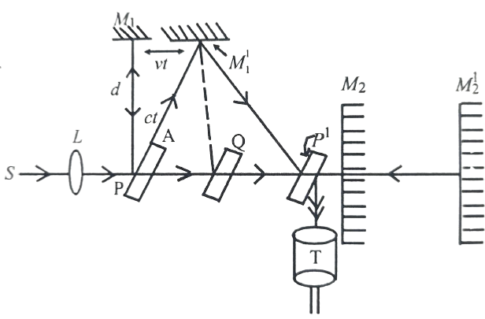
MICHELSON – MORLEY EXPERIMENT
Experiment:
1) The apparatus consists of a monochromatic source of light $S$.
2) Parallel rays from it are incident on a parallel sided plane glass plate $P.$
3) They are partly reflected to $M_{1}$, and partly transmitted to $M_{2}$.
4) The reflected and transmitted parts of the beam are reflected by the plane mirrors$M_{1}$, and $M_{2}$ and send back to $P$ where they produce an interference pattern which is observed through a telescope $T$.
5) The paths of the two beams are made exactly equal by introducing another identical glass plate Q parallel to $P$.
6) Let d = length of optical path of each beam.
$c$ = velocity of light in stationary ether.
$v$= orbital velocity of ether which is also the velocity of the apparatus.

Slide 5
MICHELSON – MORLEY EXPERIMENT
7) Velocity of light from 𝑃 to 𝑀_2 relative to the apparatus is 𝑐−𝑣 and on return from 𝑀_(2 ) 𝑡𝑜 𝑃, it is 𝑐 + 𝑣.
8) If 𝑡_1, is the time taken by light to travel from 𝑃 to 𝑀_2, and 𝑀_2 to P, then
$t_{1}=\frac{d}{c−v}+\frac{d}{c+v}=\frac{2dc}{c^{2}−v^{2}}=\frac{2d}{c(1−v^{2}/c^{2})}=\frac{2d}{c}\left(1−\frac{v^{2}}{c^{2}}\right)=\frac{2d}{c}(1+\frac{v^{2}}{c^{2}})$
Using binomial expansion since $v<< c$.
9) The light in going from $P$ to $M_{1}$, and back, the actual path of light is shown by lines ${PM}_{1}^{1}$, and $M_{1}^{1}P^{′}$ because of the motion of the apparatus through ether.
10) From $∆^{le}$ $PM_{1}, M_{1}^{1}, c^{2}t^{2}=v^{2}t^{2}+d^{2} ⇒ d^{2}=t^{2} (c^{2} − v^{2})$

Slide 6
MICHELSON – MORLEY EXPERIMENT
13). Optical path difference of the two rays$=\frac{dv^{2}}{c^{3}}×c=\frac{dv^{2}}{c^{2}}$[ $∵$optical path difference = Velocity > $∆t$]
14) If λ is the wavelength of light used, path difference in terms of wavelength $=dv^{2}/c^{2}λ$.
15) The apparatus was suddenly rotated through 90° the positions of $M_{1}$ and $M_{2}$ are inter changed. Now the path $PM_{1}$, and $PM_{2}$, are interchanged. Now the path difference is in opposite directions.
i.e., the path difference is $dv^{2}/c^{2}λ$. wavelength
16) The resultant path difference = ($−\frac{dv^{2}}{c^{2}λ}−(\frac{dv^{2}}{c^{2}λ})=dv^{2}/c^{2}λ$wavelength.
17) Thus, the number of fringes shifted due to rotation of the apparatus $n=2dv^{2}/c^{2}λ$

Slide 7
MICHELSON – MORLEY EXPERIMENT
18) In the apparatus used $d$= 10m, $v$ = 3 x $10 m/sec$, $λ$= 5000 Å, c = 3 x $10^{8}$ $m/s$.
$∴$ n$\frac{2×10×(3×{10}^{4})^{2}}{(3×{10}^{8})^{2}×5×{10}^{−7}}=\frac{2×9×{10}^{9}}{9×6×{10}^{9}}=\frac{2}{5}=0.4$fringe
Which is almost 0-4 of a fringe width.
19) Thus, a shift of less than half (0.4 fringe) a fringe was only expected.
Michel- son and Morley could observe a shift of about 0.01 of fringe.
But they could not defect any shift in different seasons on the earth surface. So, it was a null or negative result.
20) This negative or null result suggests that it is impossible to measure the speed of the earth relative to the ether. These observations led Einstein to propose theory of relativity.

