Slide 2
VIBRATING STRINGS

Slide 3
1) Transverse Wave Propagation along a Stretched String
Transverse waves: Waves produced when the particles of the medium are vibrating perpendicular to the direction of propagation of waves are called transverse waves.
Velocity of transverse waves in strings
1) A string AB stretched under tension T is plucked at the middle point and released. T MS
2) When it begins to vibrate, the component of the tension at right angles to the string tends PA e to bring the string back to its original position. 0-80 RMA &
3) PO is a small portion of the string
4) The tension at P acts along the tangent PR while that at acts along the tangent QS.
5) The tangents PR and QS are inclined to the x-axis at an angle 0 and 0- 80 respectively.
6) The angle 60 is very small as the amplitude of the string is very small.

Slide 4
1) Transverse Wave Propagation along a Stretched String
7) Component of tension T acting at P in the horizontal direction is T cos 0 and in vertical direction it is T sin
8) Component of tension T acting at Q in the horizontal direction T cos (0- 80) and in vertical direction it is T sin (0-80)
9) T cos 0 and Tcos (0-80) are nearly equal. Since 80 is very small they cancel each other as they act in opposite directions
10) Resultant force in vertically downward direction = $Tsin 0 − T sin (0− δ0)$
$F+T\{sinθ−\sin\left(θ−δθ\right)\}$
$=T\{sinθ−sinθcosδθ+\cos{sinδθ\}=T Cosθδθ}$
$[sinδθ=δθ and\cos{δθ=1}$

Slide 5
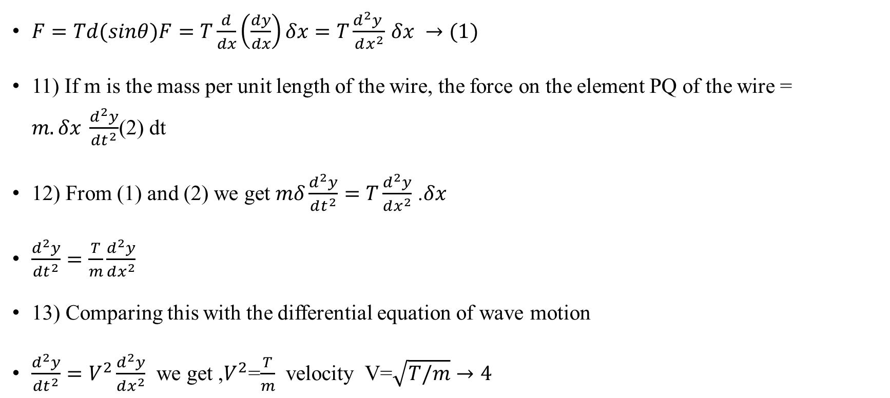
1) Transverse Wave Propagation along a Stretched String
$F=Td(sinθ)F=T\frac{d}{dx}\left(\frac{dy}{dx}\right)δx=T\frac{d^{2}y }{dx^{2}}$ $δx →(1)$
11) If m is the mass per unit length of the wire, the force on the element PQ of the wire = $m.δx \frac{d^{2}y}{dt^{2}}$(2) dt
12) From (1) and (2) we get $mδ\frac{d^{2}y}{dt^{2}}=T\frac{d^{2}y}{dx^{2}}$ .$δx$
$\frac{d^{2}y}{dt^{2}}=\frac{T}{m}\frac{d^{2}y}{dx^{2}}$
13) Comparing this with the differential equation of wave motion
$\frac{d^{2}y}{dt^{2}}=V^{2}\frac{d^{2}y}{dx^{2}}$ we get ,$V^{2}$=$\frac{T}{m}$ velocity V=$\sqrt{T/m}→4$

Slide 6
1) Transverse Wave Propagation along a Stretched String
Laws of Transverse Vibrations:
I law: At a constant tension and constant linear density the frequency of the fundamental note emitted by a string is inversely proportional to its length i.e., $v o 1/l when T and m′$are constants.
II law: When the length and linear density are constant the fundamental note emitted is directly proportional to the square root of Tension$v o VT$ when I and m are constants.
III law: When the length and tension are constant the fundamental note emitted is inversely proportional to the square root of mass per unit length, $u, v o 1/Nm$ when land T are constant.

Slide 7
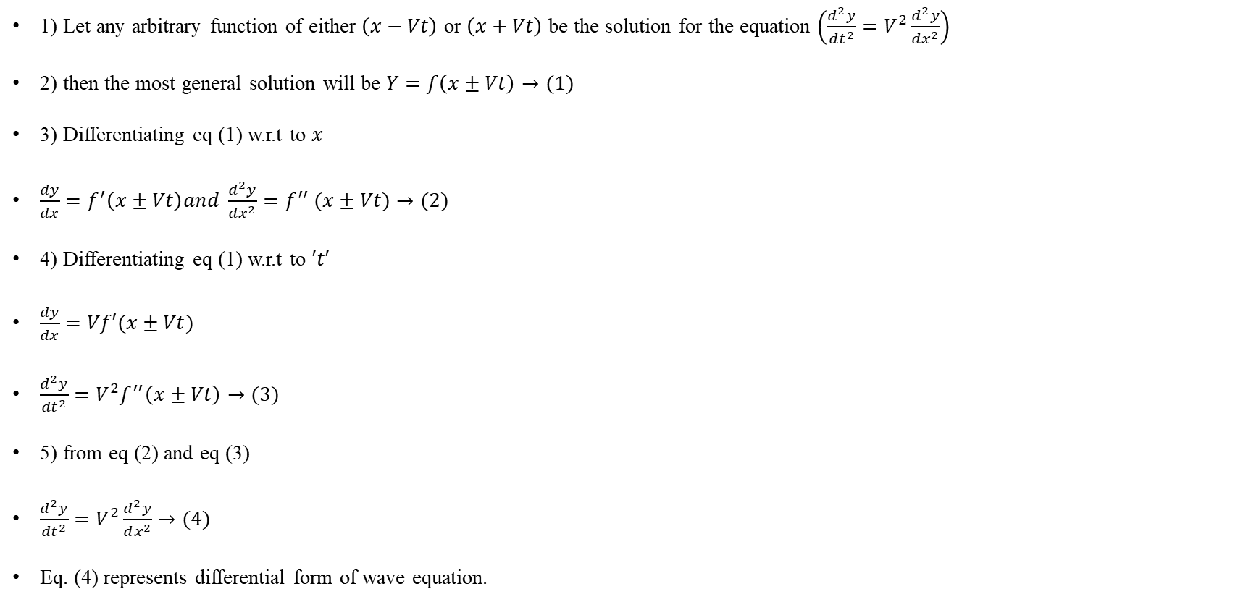
2) General solution of Wave Equation
1) Let any arbitrary function of either $\left(x−Vt\right)$ or $\left(x+Vt\right)$ be the solution for the equation $\left(\frac{d^{2}y}{dt^{2}}=V^{2}\frac{d^{2}y}{dx^{2}}\right)$
2) then the most general solution will be $Y=f\left(x±Vt\right)→(1)$
3) Differentiating eq (1) w.r.t to $x$
$\frac{dy}{dx}=f^{′}\left(x±Vt\right)and \frac{d^{2}y}{dx^{2}}=f^{′′} (x±Vt)→(2)$
4) Differentiating eq (1) w.r.t to $′t′$
$\frac{dy}{dx}=Vf′(x±Vt)$
$\frac{d^{2}y}{dt^{2}}=V^{2}f^{′′}\left(x±Vt\right)→(3)$
5) from eq (2) and eq (3)
$\frac{d^{2}y}{dt^{2}}=V^{2}\frac{d^{2}y}{dx^{2}}→(4)$
Eq. (4) represents differential form of wave equation.

Slide 8
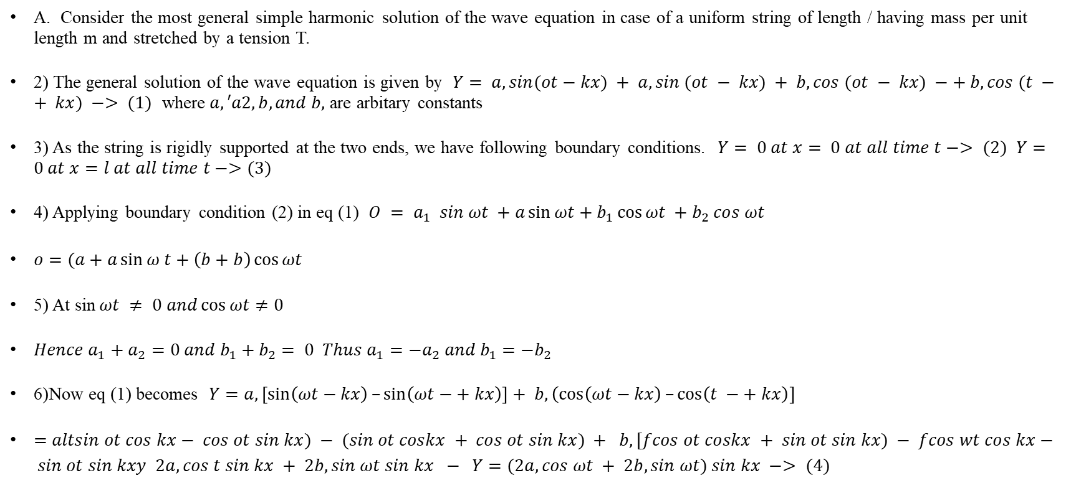
3) Modes of vibration of stretched string damped of both the ends
A. Consider the most general simple harmonic solution of the wave equation in case of a uniform string of length / having mass per unit length m and stretched by a tension T.
2) The general solution of the wave equation is given by $Y= a, sin(ot−kx) + a, sin (ot − kx) + b,cos (ot − kx) −+ b,cos (t −+ kx) −> (1)$ where$a,′a2, b, and b,$ are arbitary constants
3) As the string is rigidly supported at the two ends, we have following boundary conditions. $Y= 0 at x= 0 at all time t−> (2)$ $Y=0 at x=l at all time t−>(3)$
4) Applying boundary condition (2) in eq (1) $O = a_{1} sin ωt +a\sin{ωt}+b_{1}\cos{ωt} +b_{2} cos ωt$
$o=(a+a\sin{ω t+\left(b+b\right)}\cos{ωt}$
5) At sin$ωt ≠ 0 and\cos{ωt}≠0$
$Hence a_{1}+a_{2}=0 and b_{1}+b_{2}= 0 Thus a_{1}=−a_{2} and b_{1}=−b_{2}$
6)Now eq (1) becomes $Y=a, \left[\sin\left(ωt−kx\right)–\sin\left(ωt−+ kx\right)\right]+ b,\left(\cos\left(ωt−kx\right)–\cos\left(t −+ kx\right)\right]$
$=altsin ot cos kx− cos ot sin kx) − (sin ot coskx + cos ot sin kx) + b,[fcos ot coskx + sin ot sin kx) − fcos wt cos kx− sin ot sin kxy 2a, cos t sin kx + 2b, sin ωt sin kx − Y=(2a, cos ωt + 2b,sin ωt) sin kx −> (4)$

