Slide 1
PHYSICS
Dantuluri Narayana Raju College(A)(D.N.R.)
RUTERFORD’S SCATTERING
CROSS SECTION
By
G.SRI LAKSHMI

Slide 2
CONTENTS
HISTORY
INTRODUCTION
RUTHERFORD’S SCATTERING
EQUATION OF SCATTERING CROSS SECTION
IMPORTANCE
CONCLUSION

Slide 3
HISTORY:
Rutherford scattering. ... The initial discovery was made by Hans Geiger and Ernest Marsden in 1909 when they performed the gold foil experiment in collaboration with Rutherford, in which they fired a beam of alpha particles (helium nuclei) at foils of gold leaf only a few atoms thick.

Slide 4
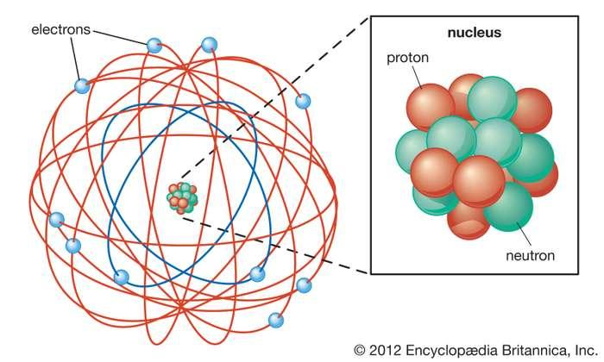
INTRODUCTION
Rutherford model, also called nuclear atom or planetary model of the atom, description of the structure of atoms proposed (1911) by the New Zealand-born physicist Ernest Rutherford. The model described the atom as a tiny, dense, positively charged core called a nucleus, in which nearly all the mass is concentrated, around which the light, negative constituents, called electrons, circulate at some distance, much like planets revolving around the Sun.

Slide 5
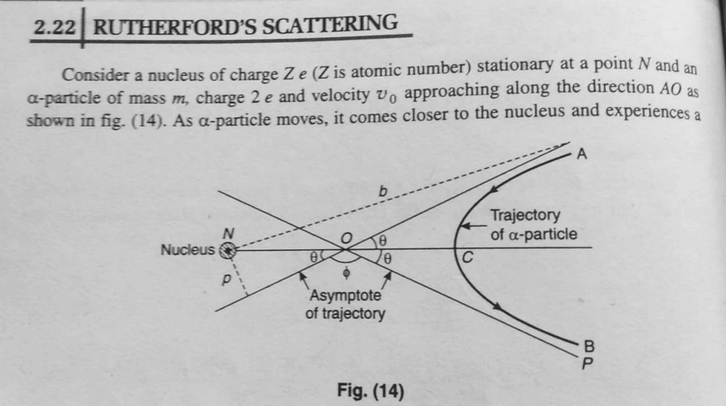

Slide 7
CONCLUSION:
Most of the space inside the atom is empty because most of the α-particles passed through the gold foil without getting deflected. Very few particles were deflected from their path, indicating that the positive charge of the atom occupies very little space.

