Slide 1
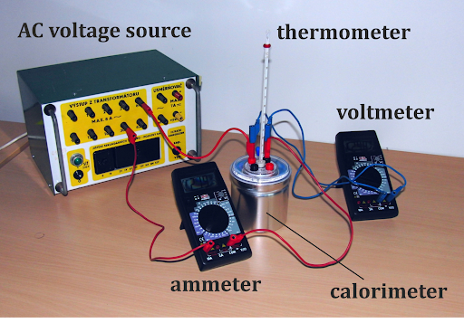
DANTULURI NARAYANA RAJU COLLEGE(A) BHIMAVARAM
DEPARTMENT OF PHYSICS
JOULE’S CALORIMETER
BY
T KRISHNA KUMARI
PHYSICS LAB

Slide 2
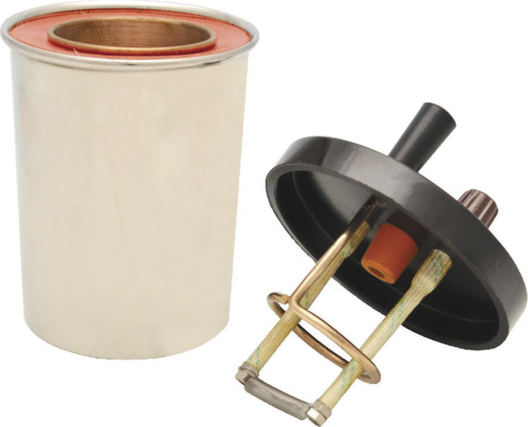
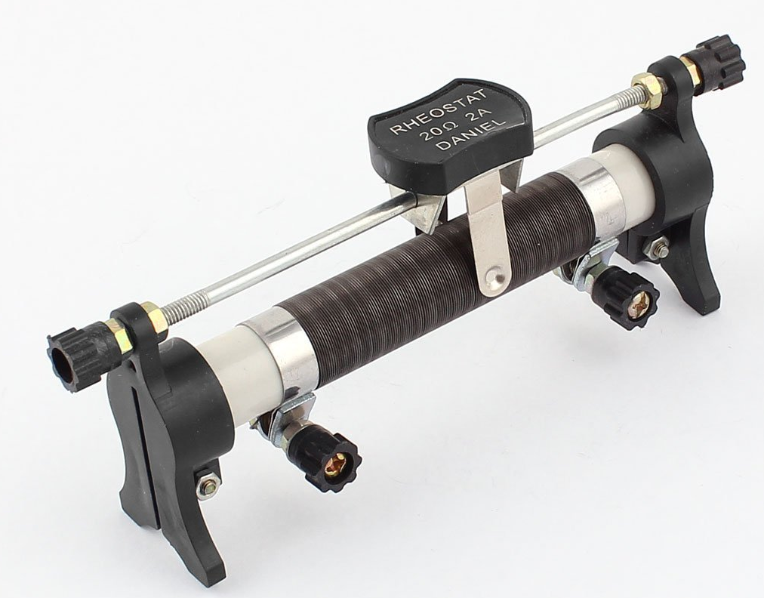
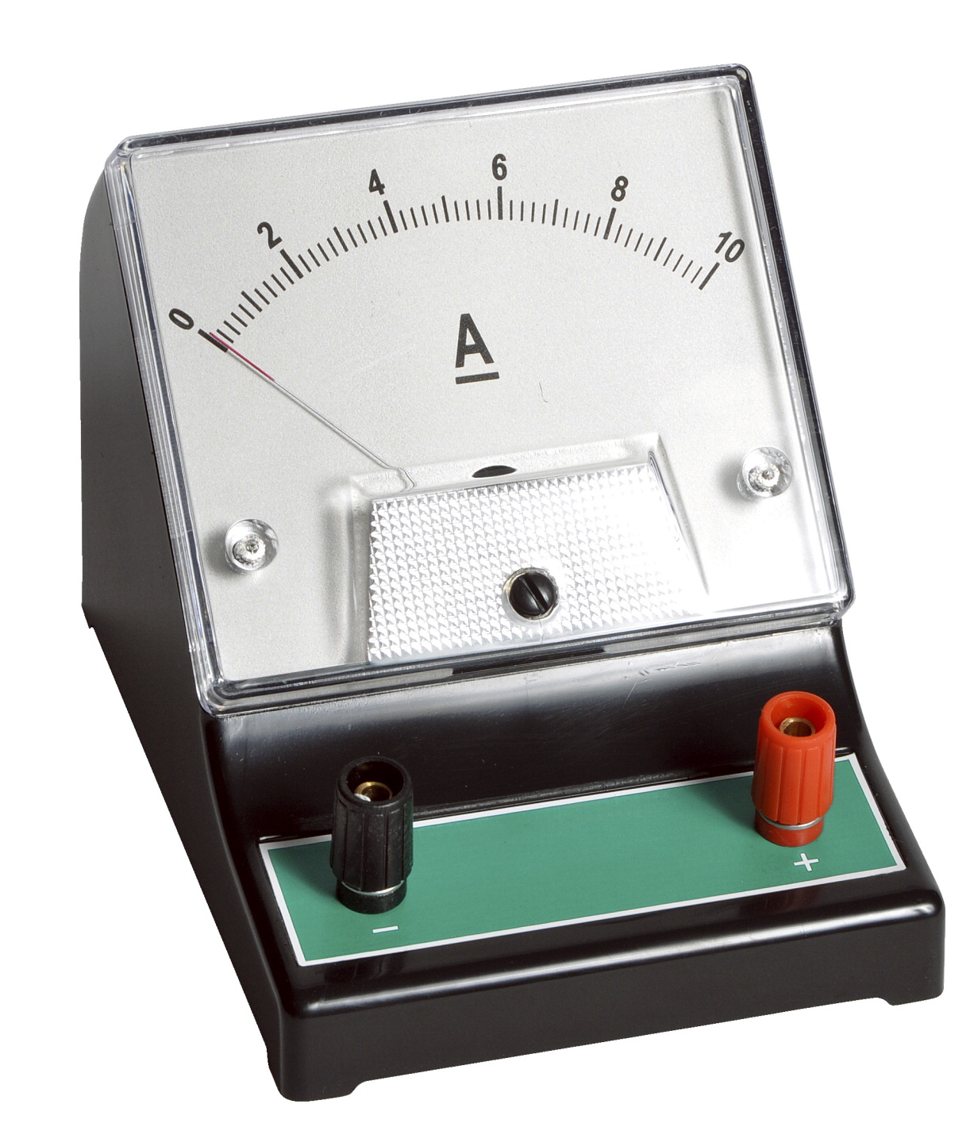
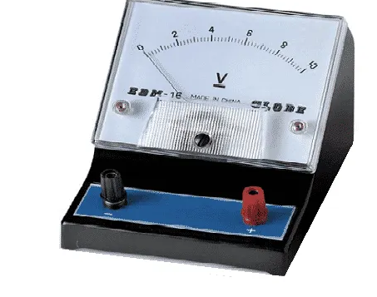
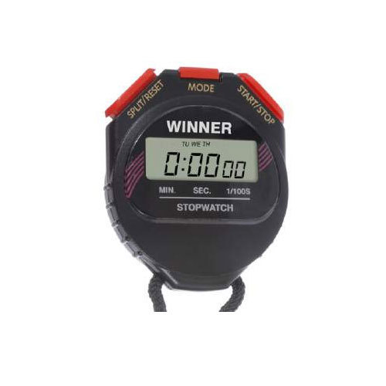
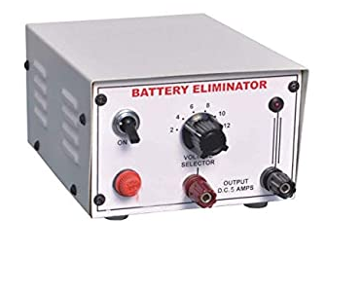
APPARATUS:
Joule’s calorimeter
Ammeter
Voltmeter
Battery
AIM:
To determine the specific heat of liquid by using joule’s calorimeter.
Rheostat
Stop Clock

Slide 3
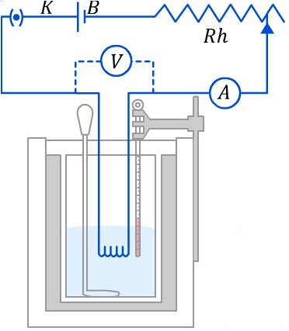
PROCEDURE
The weight of the calorimeter with stirrer W₁ is found. Taking water more than half of the calorimeter and find the weight of the calorimeter with water W₂. The calorimeter is placed in a non conducting enclosure and the heating coil is introduced in the calorimeter.
The battery is connected in series with the joules heating coil, ammeter, rheostat and plug key. The voltmeter is connected parallel to the heating coil. The key is closed and the rheostat is adjusted until the ammeter reads about 2 ampere. The key is removed and the initial temperature T₁ of water in the calorimeter is noted. Then the key is closed and the stop clock is started simultaneously and while passing current the ammeter reading C and voltmeter reading E are noted. The temperature is noted for every 30 seconds until the temperature raises about 5⁰C. Now the current is stopped but the temperature is noted for every 30 seconds until temperature falls about 2⁰C. Time t second during which the current is passed is noted.

Slide 4
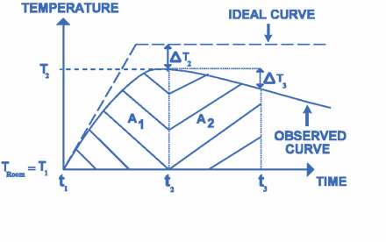
Bartion’s Radiation correction
A graph PQR is plotted taking time along X-axis and temperature along Y- axis .
The radiation correction Δt can be calculated as follows. Lines QK and ML are drawn parallel to Y-axis so that f is greater than 1⁰C . Then areas A and b under the curve are calculated by counting small squares. Then Bartions radiation correction
Δt =( A/B) f
Then corrected final temperature T₂ = ( T₃ + Δt)
The work done due to current in the heater element (ECt) must be equivalent to the heat generated. From the below formula, the specific heat of the liquid can be calculated.

Slide 5
OBSERVATIONS
Weight of the calorimeter + stirrer (W₁ ) = gm
Weight of the calorimeter + stirrer + water (W₂ ) = gm
Initial temperature of water ( T₁ ) = ⁰C
Ammeter reading (C) = amp
Voltmeter reading (E ) = volt
Final temperature of the water ( T₃ ) = ⁰C
Final corrected temperature of the water ( T₃ ) = ⁰C
Time during current is passed (t) = sec
Specific heat of material of the calorimeter ( s₁ ) = cal/gm/ ⁰C
Mechanical equivalent of heat (J) = 4.2 Joules/calorie
Specific heat of liquid (s) = cal/gm/ ⁰C

Slide 6
THANKS!
Any questions?

