Slide 1
Polymorphism in coelenterates
By
Dr. K. Usha Rani
DNR. College

Slide 2
Definition
An organism has more than one types of individuals and each one is specialised to perform a different vital function.

Slide 3
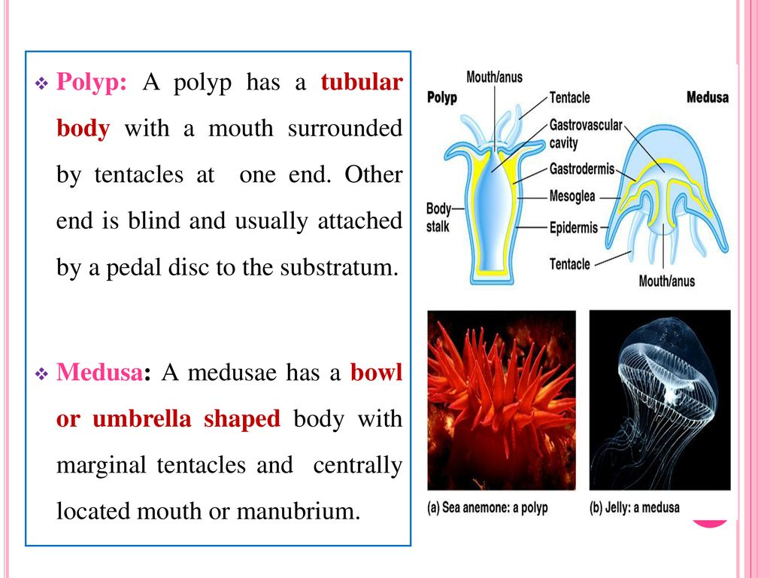
Polyp

Slide 4
Polyp Zooids
Gastrozooids
Gonozooids
Dactyolozooids

Slide 5
Gastrozooids Gonozooids Dactyolozooids
Gastrozooids are responsible for feeding, which they accomplish by capturing and ingesting zooplankton. Gonozooids are reproductive and produce medusae by asexual budding
Gastrozooids look like little flowers and have a circle of stinging tentacles surrounding a mouth, which opens into the coelenteron
Gonozooids may play a role in labour division or in alternation of generations.

Slide 6
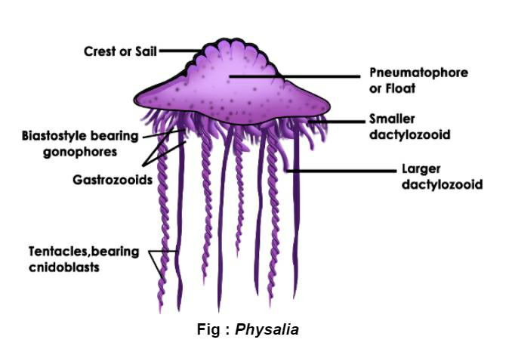

Slide 7


