Slide 1
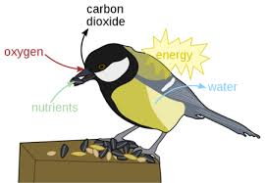
Bird respiratory system
By
Dr. K. Usha Rani
DNR. College

Slide 2
Respiratory system
The avian respiratory system is different from that of other vertebrates
Birds having relatively small lungs plus nine air sacs that play an important role in respiration
The air sacs permit a unidirectional flow of air through the lungs.

Slide 3
Air sacs
Air Sacs. Birds have nine air sacs
Two cervical, an unpaired clavicular, two cranial thoracic, two caudal thoracic, and two abdominal air sacs.
The air sacs are thin-walled structures composed of simple squamous epithelium
Covering a thin layer of connective tissue with very few blood vessels

Slide 5
Mechanism of respiration
The mechanism of breathing involves two main processes: inspiration and expiration.
Inspiration occurs when the diaphragm and the external intercostal muscles contract.
Expiration occurs when the diaphragm and the intercostal muscles relax.

Slide 6
Double respiration
During inspiration, air passes twice through the lungs and get the opportunity to absorb oxygen twice
exhibit this phenomenon which helps them to generate greater amount of energy.

