Slide 1
DENTITION IN MAMMALS
By
G.ADITYA KUMAR
D.N.R.COLLEGE

Slide 2
Introduction
The hard and usually pointed structures connected to the jaw bones in the buccal cavity of vertebrates are known as teeth.
The structure, kind, number and arrangement of teeth are collectively called dentition.

Slide 3
STRUCTURE OF TEETH
Root - It is the basal part embedded in the bony socket of jaw.
Neck - it is the part above the root enclosed by the gum.
Crown - It is the upper part beyond the surface of the gum
I) Pulp cavity: The entire tooth encloses a central pulp cavity surrounded by a layer of odontoblast cells filled with soft pulp. It is made up of connective tissue, blood vessels and nerve fibers.
II) Dentin: A substance chemically similar to bone- dentine forms the major part of the tooth. But the dentine is permeated by numerous thin canaliculi.
III) Enamel: It is present over the de in the crown and neck regions of the tooth. It is hardest and contains only traces of living matter.
IV) Cement: It surrounds the denting of the root portion of the tooth. It is bony in nature.

Slide 4
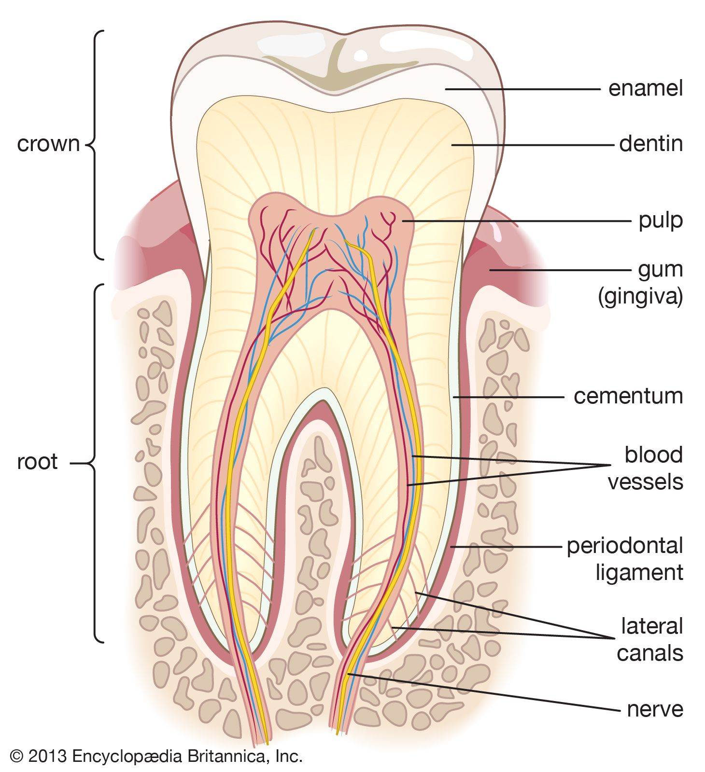

Slide 5
Based on the attachment of teeth in the jaw bone
Acrodont
Thecodont
Pleurodont

Slide 6
Based on the types of teeth
HOMODONT
HETERODONT

Slide 7
Succession of Teeth
Polyphyodont
Diphyodont
Monophyodont

Slide 8
THANK YOU

