Slide 1
Flight adaptations in Bird’s
By
Dr. K.Usha Rani
DNR. College

Slide 2
Anatomical Adaptations
Morphological Adaptations

Slide 3
Anatomical Adaptations
Flight Muscles
Reproductive Organs
Endoskeleton
Sense Organs
Digestive System
Excretory System
Respiratory System
Warmblood
Circulatory System

Slide 4
Morphological Adaptations
Compact Body
Forelimbs Converted to Wings
Feather Covered Body
Bipedal Locomotion
Mobility of Head and Neck
Short Tail
Perching

Slide 5
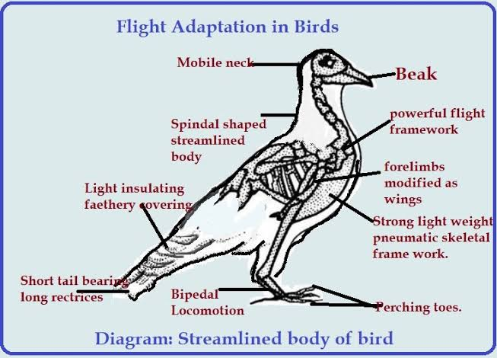

Slide 6


