Slide 1
Scales of Fishes
By
Ramya Sri
DNR. College

Slide 2
Introduction
Exoskeletal covering of body is made of two types of scales- epidermal and dermal. Epidermal scales are cornified derivatives of the Malpighian layer of epidermis. They are well developed in terrestrial vertebrates such as reptiles, birds and mammals. Dermal scales are mesenchymal in origin and especially developed in the fishes.
Scales vary in size and shape in different species.

Slide 3
Types of Scales
Placoid
Cycloid
Ctenoid
Cosmoid
Ganoid

Slide 4
Cosmoid Scales
The cosmoid scales are found in the extinct Crossopterygii and Dipnoi. The external layer of scale is thin and enamel-like and is called the vitrodentine. The middle layer is made up of hard, non-cellular, dentine-like material called the cosmine and contains a number of branching tubules and chambers.

Slide 5
Ganoid scale
These scales are characteristic of the primitive actinopterygians called the ganoid fishes, and are of various forms and structure. These scales are heavy and have an outer layer of hard inorganic, enamel-like material called ganoine.
Scales of this fish have lost the middle cosmine layer, thus, reducing their thickness and rigidity

Slide 6
Placoid Scales
These scales are characteristic of elasmobranch fishes (sharks) only. Each scale has a disc-like basal plate embedded in the dermis and a spine projecting out through the epidermis. In structure, a placoid scale resembles a tooth. The spine has an external covering of enamel-like, hard, transparent material called vitrodentine.
This is followed by a layer of dentine enclosing a pulp cavity from which several branching dentine tubules radiate in different directions. The centre of the basal plate is perforated by an aperture to provide entrance to the blood vessels and nerves from the dermis. The placoid scales are closely set in skin but do not overlap each other and giving a sand paper-like quality to the skin.

Slide 7
Cycloid Scales
The cycloid scales are thin, flexible, transluscent plates, rather circular in outline, thicker in the centre and marked with several concentric lines of growth which can be used for determining the age of the fish. They are found in a large number of teleostean fishes having soft rayed fins, such as Labeo, Catla, Barbus, Cirrhina, etc. The central part of the scale is called the focus and is the first part to develop. In many species, oblique grooves or radii run from the focus towards the margin of the scale.
They form a protective covering over the skin and project diagonally in an imbricating pattern. The part of the scale which is exposed to view in situ condition (posterior area) generally shows less distinct ridges or circuli and chromatophores are also sometimes attached to it. The anterior area lies embedded in the skin.

Slide 8
Ctenoid Scales
The ctenoid scales are also circular and can be distinguished from the cycloid scales by having a more or less serrated free edge
These scales are characteristic of modem higher teleosteans such as perch, sunfish, etc.
They are more firmly attached and their exposed free hind parts which are not overlapped, bear numerous small comb-like teeth or spines. Intermediate types between cycloid and ctenoid scales are also found on different parts of the body. Certain fishes, such as flounders, may bear both types, ctenoid scales dorsally and cycloid scales ventrally.

Slide 9
Uses of Scales
Protective covering of exoskeleton
Useful in separating orders and families
Useful in studying the food habits of piscivorous animals
Cycloid and ctenoid scales are of considerable help in calculating the age of and growth rate of fishes
In some species like Salmo, spawning marks can be seen on the scales, so that it is possible to find how many times a fish has spawned

Slide 10
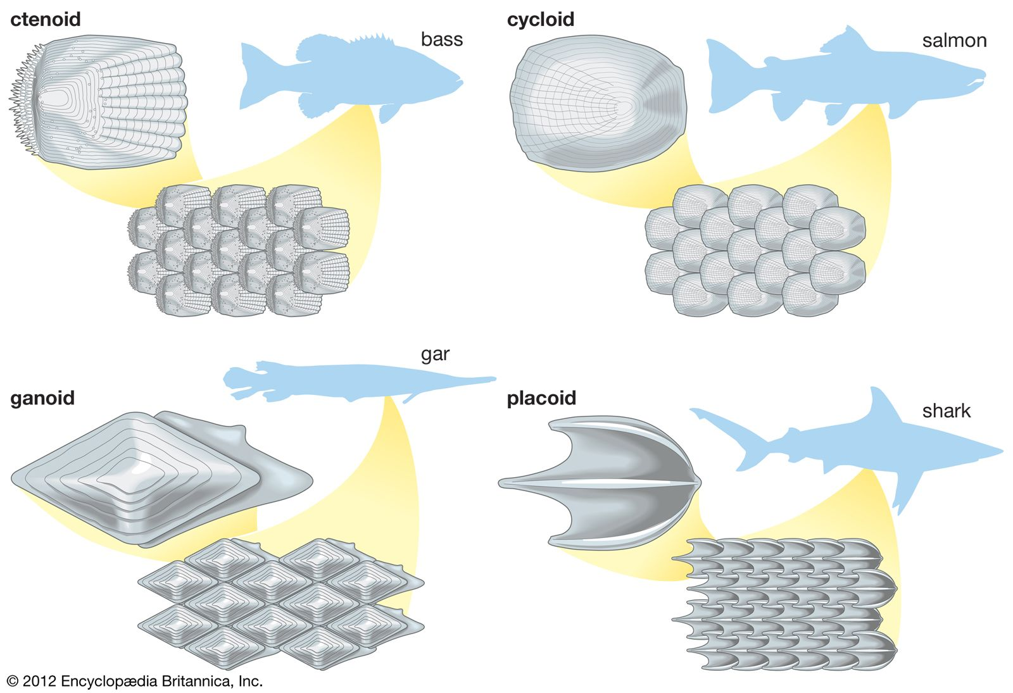

Slide 11


