Slide 1
EPISTASIS
By Dr.B.Padmaja
Assoc. Prof.
D.N.R.College

Slide 2
• Two or more independent genes present on same or different chromosomes interact to produce a new expression.
• Examples are Epistasis, complementary genes, supplementary genes, lethal genes.

Slide 3
Epistasis
• It is a non-allelic interaction.
• One gene’s allele masks the phenotype of the other gene’s alleles.

Slide 4
Types
• Recessive epistasis - The recessive allele of one gene masks the effects of either allele of the second gene.
• Dominant epistasis - The dominant allele of one gene masks the effects of either allele of the second gene.

Slide 5
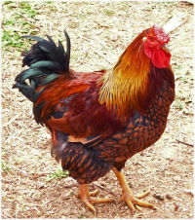
Dominant epistasis
White Leghorn
White Wyandotte

Slide 6
Dominant epistasis

Slide 7
Dominant epistasis

Slide 8
THANK YOU

